Slide 1
A
A
I
B
C
C
J
D
E
E
K
F
G
G
L
H
G
G
L
H
E
E
K
F
C
C
J
D
A
A
I
B
I
B
J
D
K
F
L
H
L
H
K
F
J
D
I
B

Slide 2
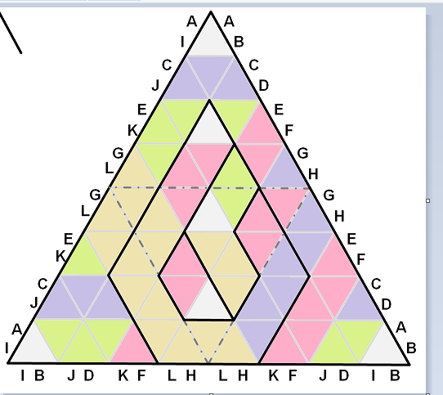
A
A
I
B
C
C
J
D
E
E
K
F
G
G
L
H
G
G
L
H
E
E
K
F
C
C
J
D
A
A
I
B
I
B
J
D
K
F
L
H
L
H
K
F
J
D
I
B

Slide 3
A
A
I
B
C
C
J
D
E
E
K
F
G
G
L
H
G
G
L
H
E
E
K
F
C
C
J
D
A
A
I
B
I
B
J
D
K
F
L
H
L
H
K
F
J
D
I
B

Slide 4
A
A
I
B
C
C
J
D
E
E
K
F
G
G
L
H
G
G
L
H
E
E
K
F
C
C
J
D
A
A
I
B
I
B
J
D
K
F
L
H
L
H
K
F
J
D
I
B

Slide 5
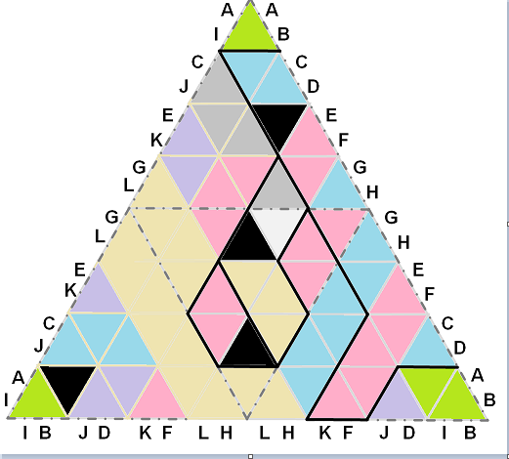
Star Battle in space: tetrahedron 1 ★
Fold the tetrahedron, then place exactly one star per line and region.
There are 4 stars in total. Cells containing stars share no vertices.
A
A
I
B
C
C
J
D
E
E
K
F
G
G
L
H
G
G
L
H
E
E
K
F
C
C
J
D
A
A
I
B
I
B
J
D
K
F
L
H
L
H
K
F
J
D
I
B
#12 by Pedro PSI – 12th of September 2020
pedropsi.github.io/star-battle

