Slide 1
Star Battle in space: cube 2 ★
Fold the cube, then place exactly two stars per line and region.
There are 12 stars in total. Cells containing stars share no vertices.
lines (x)
lines (y)
lines (z)
#13 by Pedro PSI – 04th of October 2020
pedropsi.github.io/star-battle

Slide 2
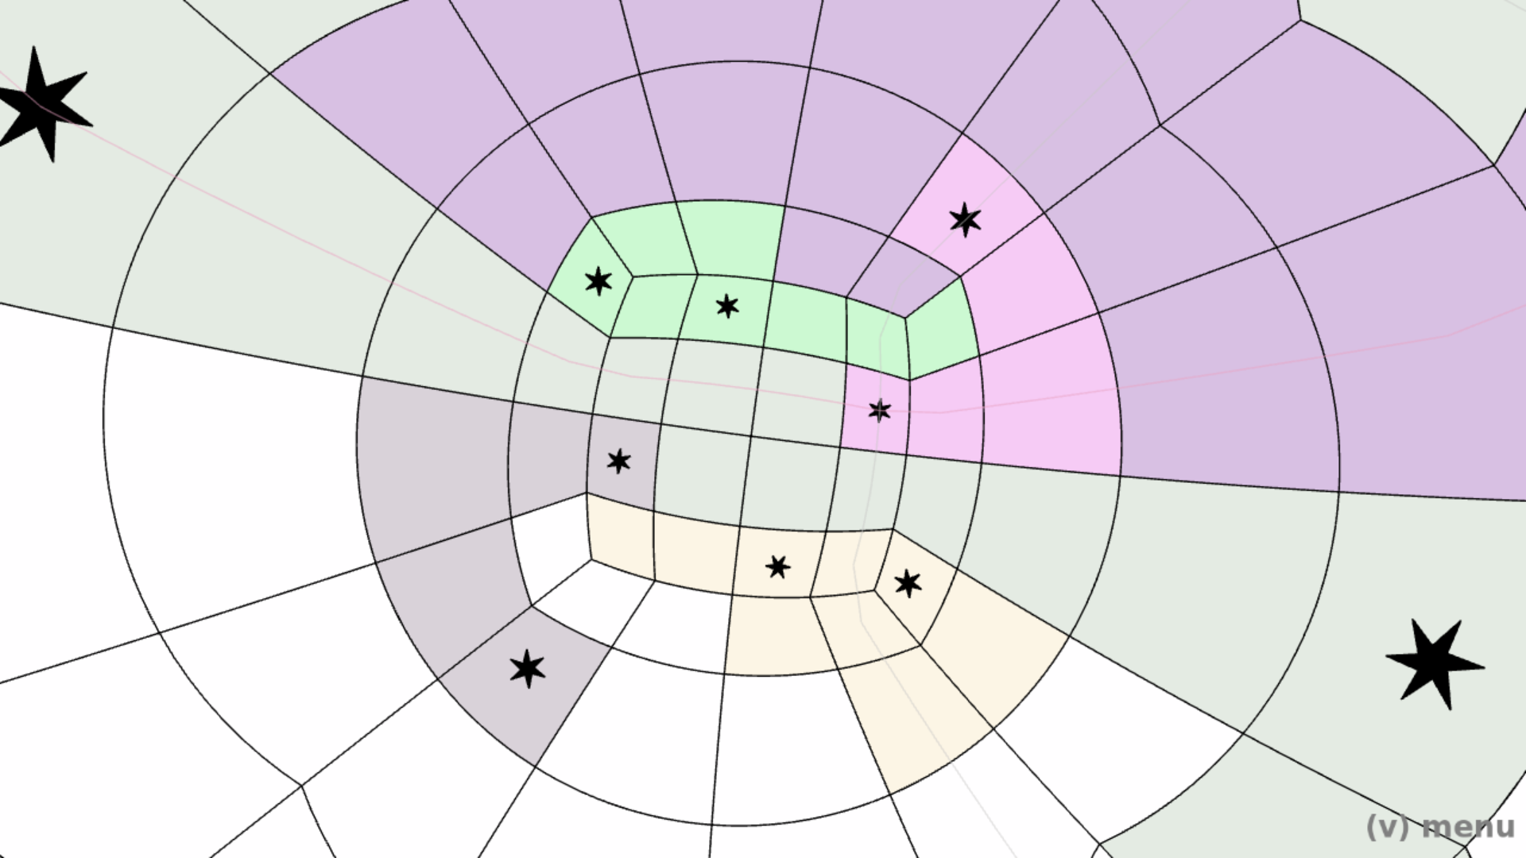

Slide 3
