Slide 1
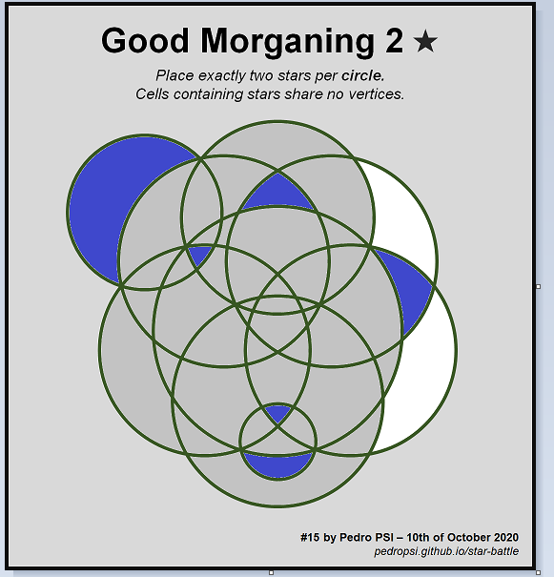
Good Morganing 2 ★
Place exactly two stars per circle.
Cells containing stars share no vertices.
#15 by Pedro PSI – 21st of November 2020
pedropsi.github.io/star-battle

Slide 2
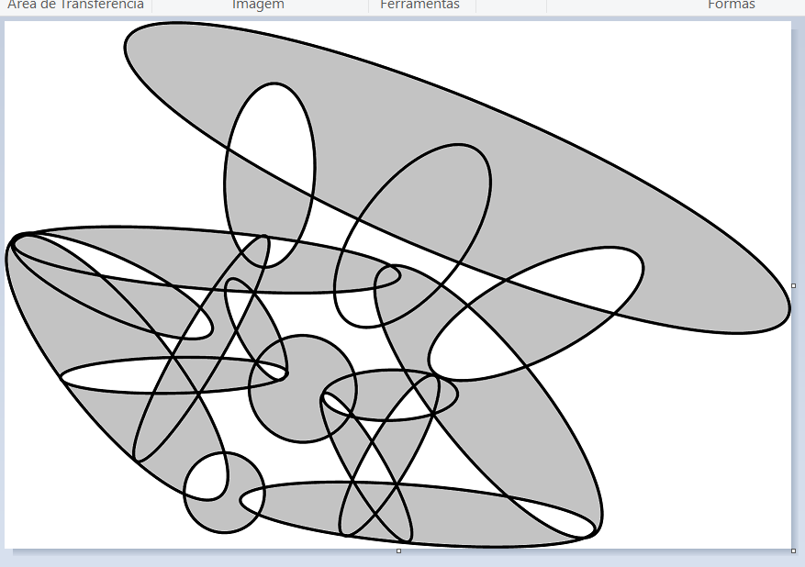

Slide 3
