Slide 1
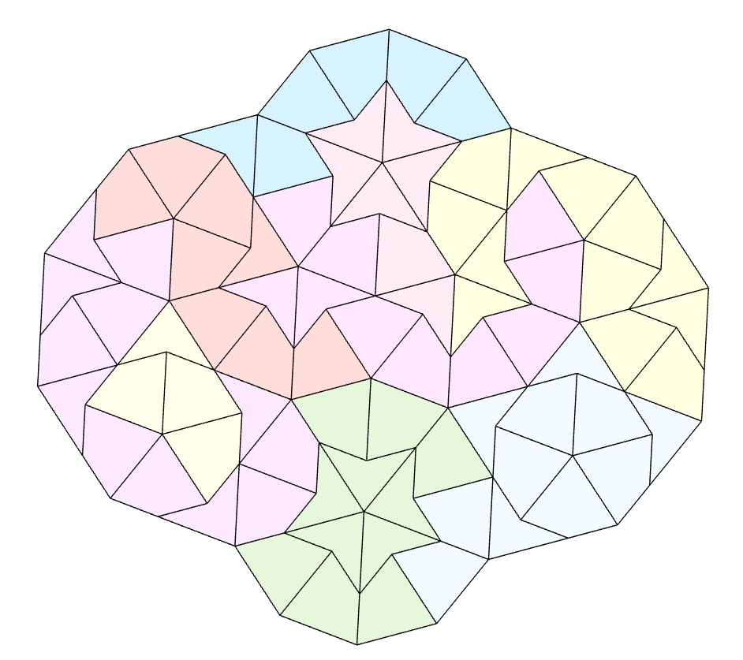
z
Kite and Dart star battle 1 ★
Place exactly one star per region and line.
Cells containing stars share no vertices.
Lines cross cells as follows:
Examples of cells sharing a vertex:
Y
W
X
Z
Z
W
Y
X
O
M
A
B
B
N
C
K
D
L
E
M
A
J
F
R
P
L
E
I
G
C
N
K
D
J
F
H
H
I
G
Q
Interactive version available
Made in ZenoRogue’s adapted HyperRogue engine
#17 by Pedro PSI – 28th of November 2020
pedropsi.github.io/star-battle

Slide 2
Example of cells sharing a vertex:
Lines cross cells as follows:

Slide 3
