Slide 2
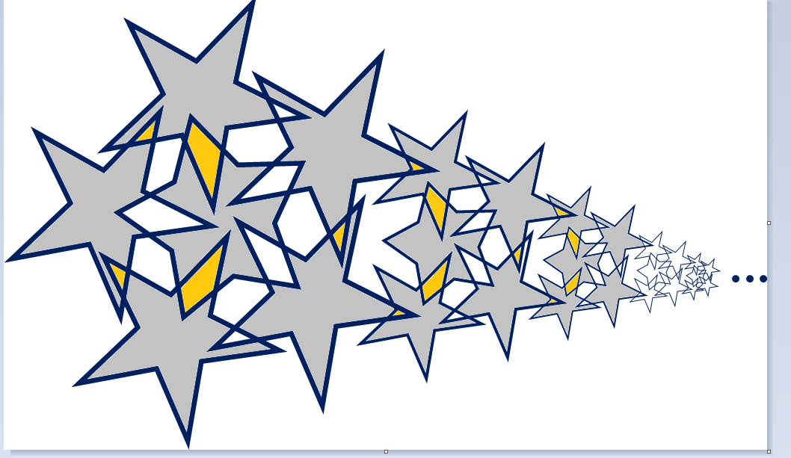

Slide 6
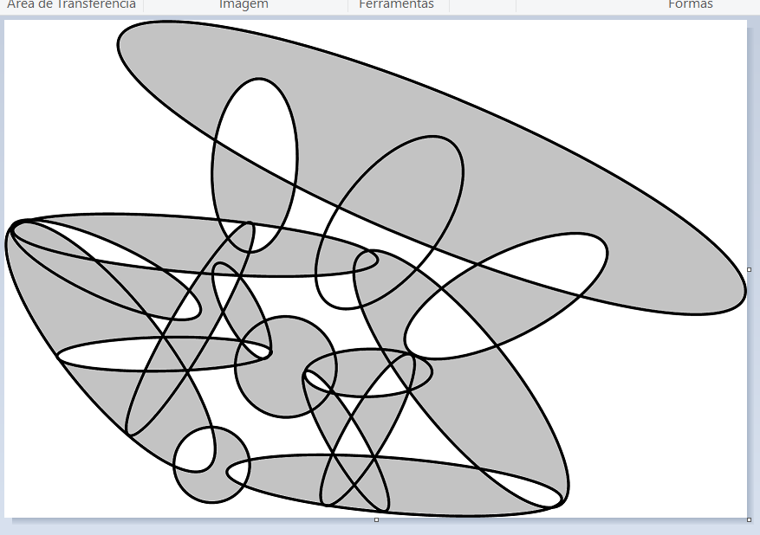

Slide 7
Good Morganing 2 ★
Place exactly two stars per ellipse.
Cells containing stars share no vertices.
#16 by Pedro PSI – 21st of November 2020
pedropsi.github.io/star-battle

