Slide 1
z
Half-hex star battle 1 ★
Place exactly one star per region and line.
Cells containing stars share no vertices.
L
J
I
A
B
C
D
Lines cross cells as follows:
L
E
Y
V
Z
X
W
Z
X
W
Y
V
F
G
H
B
C
J
D
I
K
A
H
G
F
E
Cells sharing vertex examples:
K
#18 by Pedro PSI – 5th of December 2020
pedropsi.github.io/star-battle

Slide 2
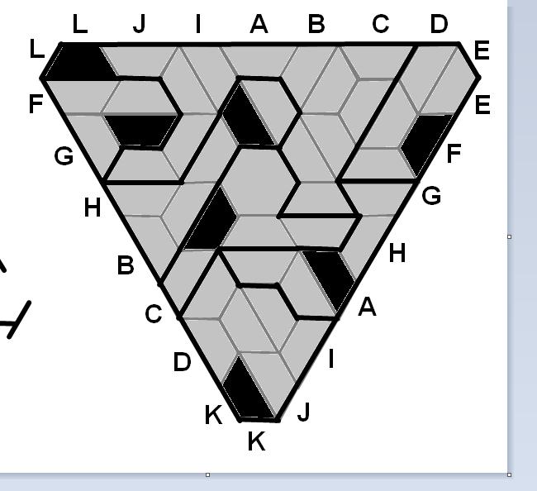
L
J
I
A
B
C
D
L
E
F
G
H
B
C
J
D
I
K
A
H
G
F
E
K

Slide 3
