Slide 1
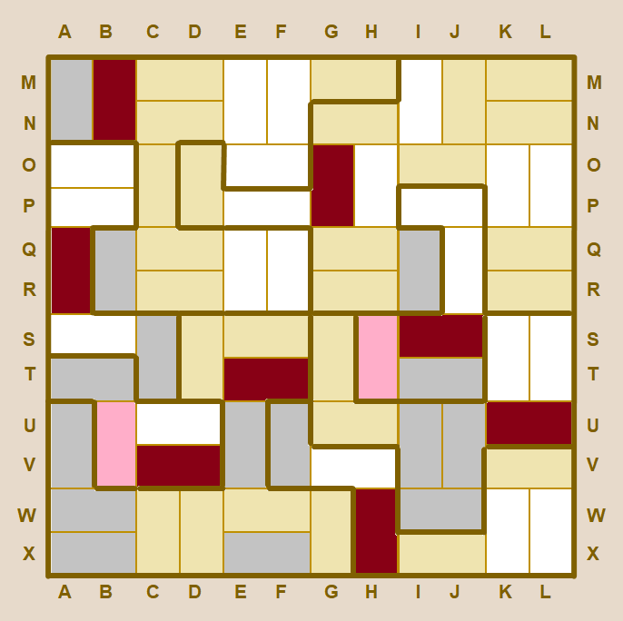
z
Basket Weave star battle 1 ★
Place exactly one star per region and line.
Cells containing stars must not touch.
A
B
C
D
E
F
G
H
I
J
K
L
Lines propagate so:
Y
Z
M
M
N
N
A
A
O
O
Y
Z
P
P
Q
Q
Touching examples:
R
R
S
S
T
T
U
U
V
V
W
W
X
X
A
B
C
D
E
F
G
H
I
J
K
L
#19 by Pedro PSI – 12th of December 2020
pedropsi.github.io/star-battle

Slide 2
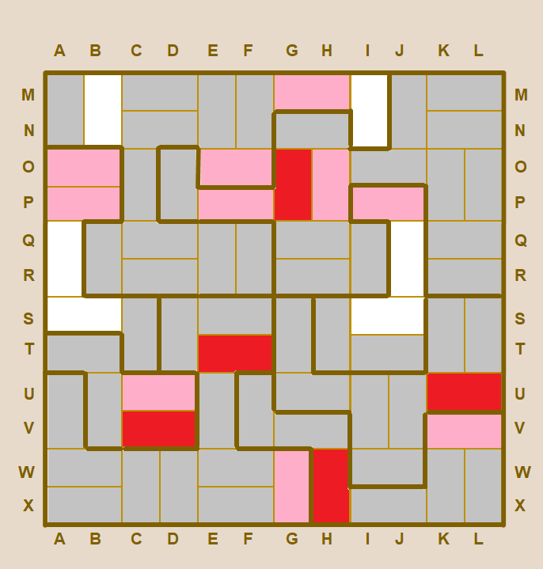
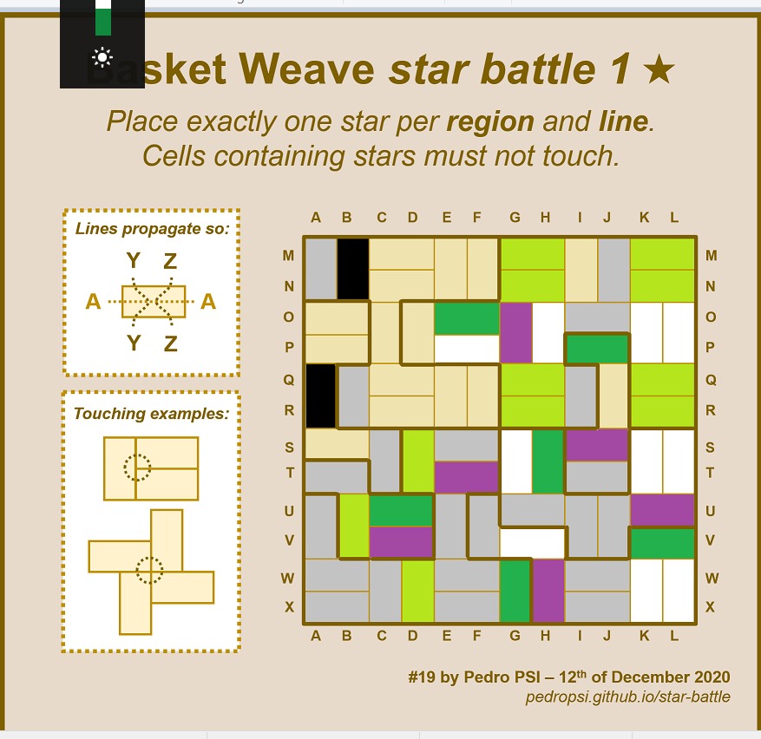
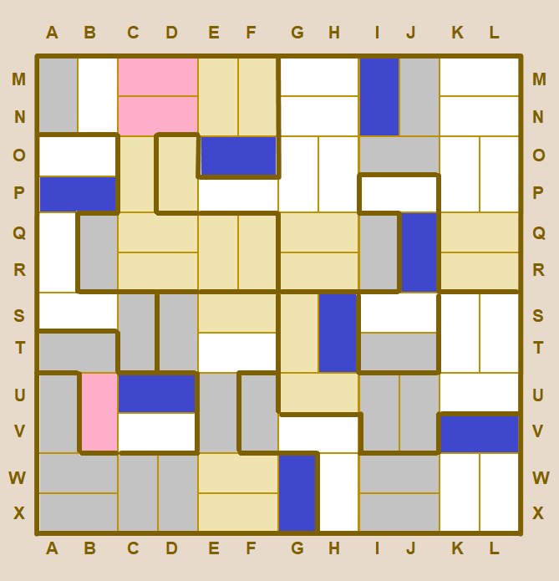

Slide 3
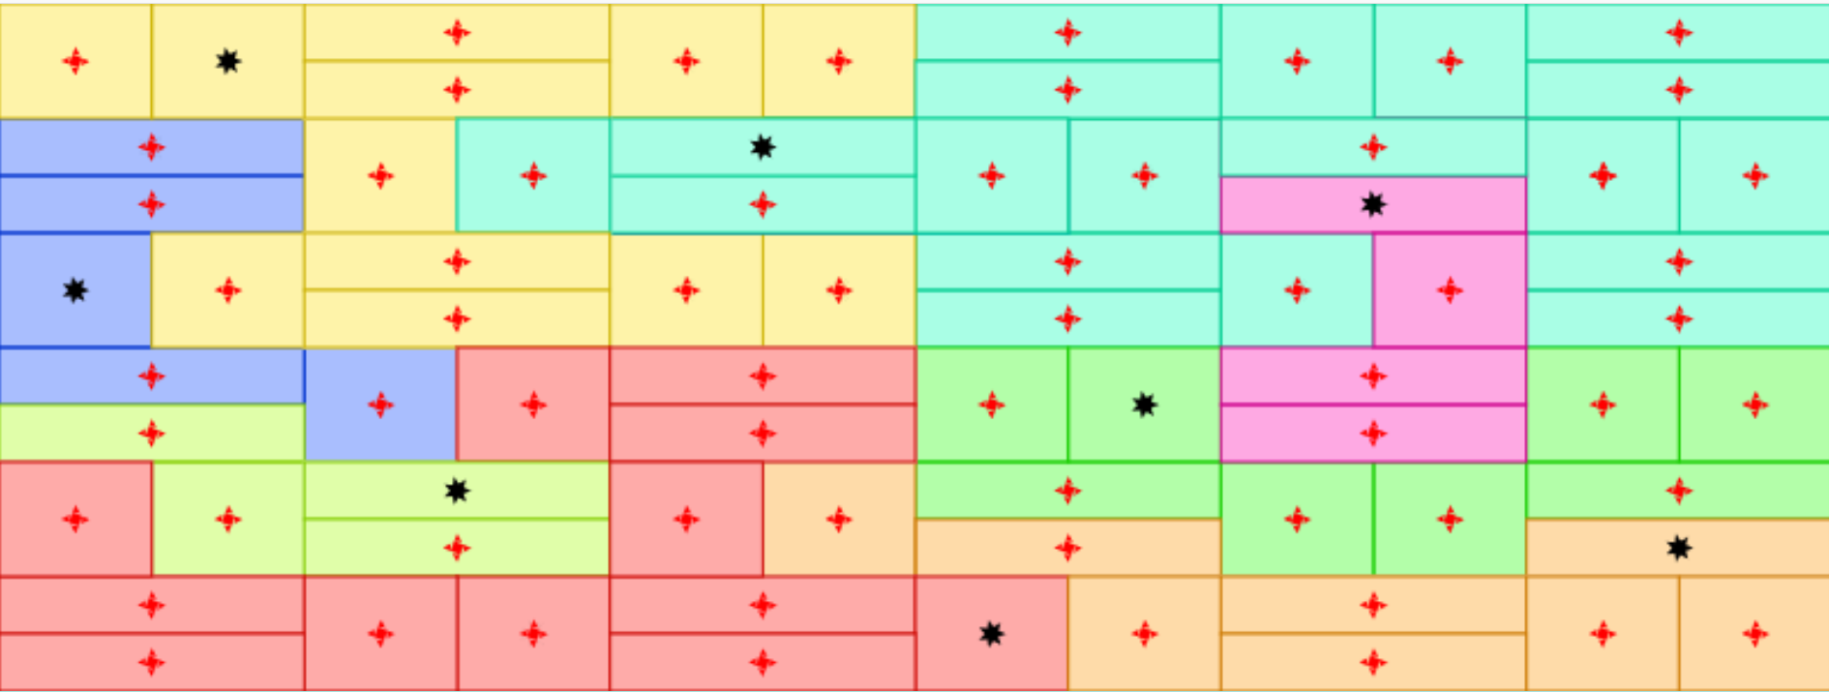
A
B
C
D
E
F
G
H
I
J
K
L
M
M
N
N
O
O
P
P
Q
Q
R
R
S
S
T
T
U
U
W
W
W
W
X
X
A
B
C
D
E
F
G
H
I
J
K
L

