Slide 1
A new idea
Works perfectly!

Slide 2
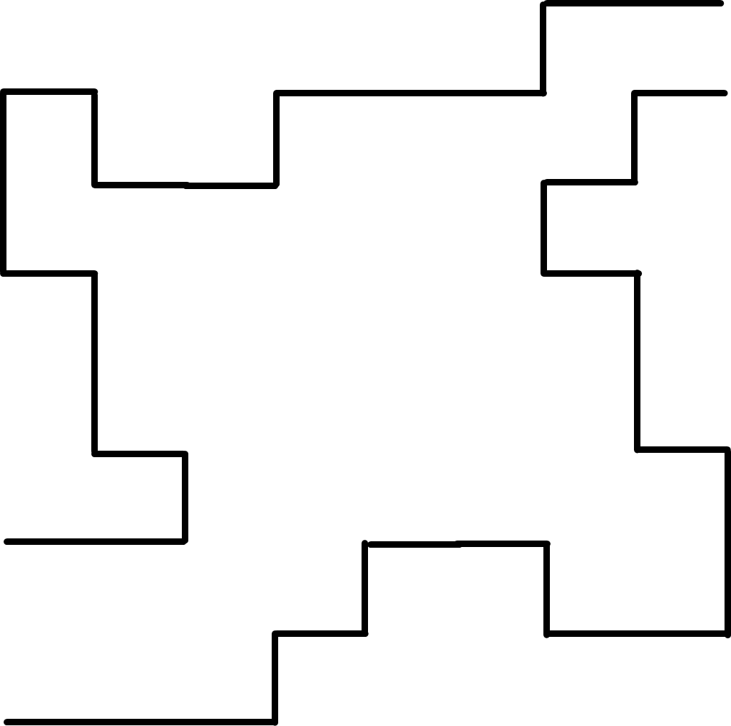
A new idea
Interesting variation
solved

Slide 3
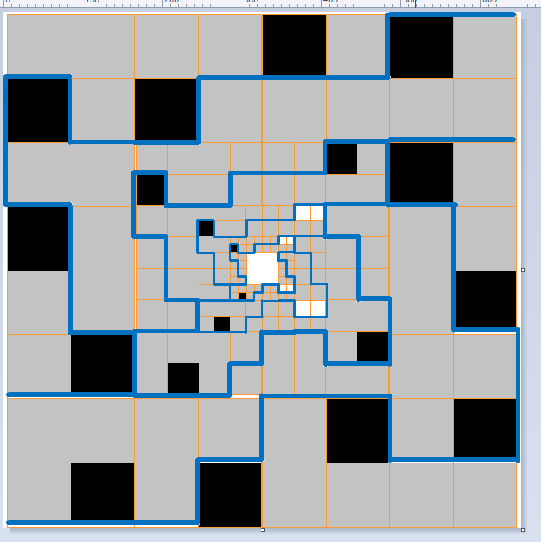
A new idea
Variations grid

Slide 4
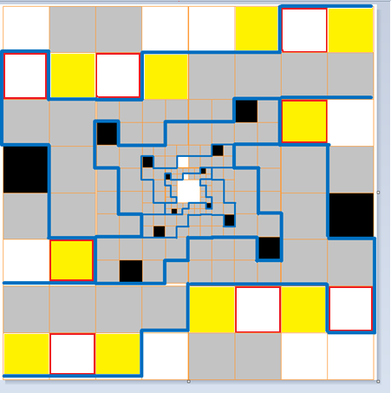
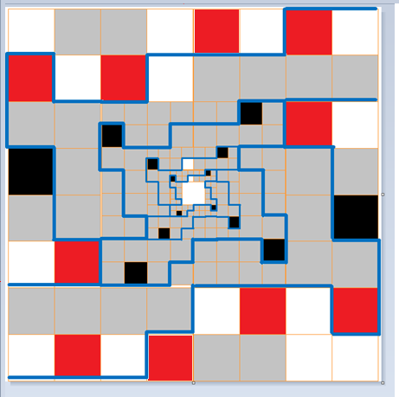
A new idea
Variations grid

Slide 5
A new idea
Variations grid

Slide 6
z
Fractal star battle 2 ★
Place exactly one star per region and line.
Cells containing stars must not touch.
A
B
C
D
E
F
G
H
I
J
K
L
Lines propagate so:
Y
Z
M
M
N
N
A
A
O
O
Y
Z
P
P
Q
Q
Touching examples:
R
R
S
S
T
T
U
U
V
V
W
W
X
X
A
B
C
D
E
F
G
H
I
J
K
L
#20 by Pedro PSI – 19th of December 2020
pedropsi.github.io/star-battle

Slide 7
A
B
C
D
E
…
F
G
H
I
J
K
L
M
N
O
…
…
15
14
13
12
12
11
11
10
10
9
9
8
8
7
7
6
6
5
5
4
4
3
3
2
2
1
1
…
A
B
C
D
E
F
G
H
I
J
K
L

Slide 8
A 3-star tail solution
(good)

Slide 9
A variable 3-star tail solution
(some freedom to alternate)

Slide 10
A 4-star finite solution

Slide 11
A 4-star infinite solution

Slide 12
A finite solution

Slide 13
An infinite solution with a tail of 1 star?

