Slide 1
Fractal star battle 2 ★
Place exactly two stars per region and line.
Cells containing stars share no vertices.
B
A
a
b
D
C
c
d
F
E
…
e
f
J
I
H
G
g
h
i
j
1
2
D
C
c
d
3
3
4
4
F
E
e
f
5
5
6
6
H
G
g
h
7
7
8
8
J
I
i
j
9
9
10
10
…
…
…
…
…
…
-10
…
-9
-10
-9
-8
-8
-7
-7
-6
-6
-5
-5
-4
-4
-3
-3
-2
-1
#25 by Pedro PSI – 21st of December 2020
pedropsi.github.io/star-battle

Slide 2
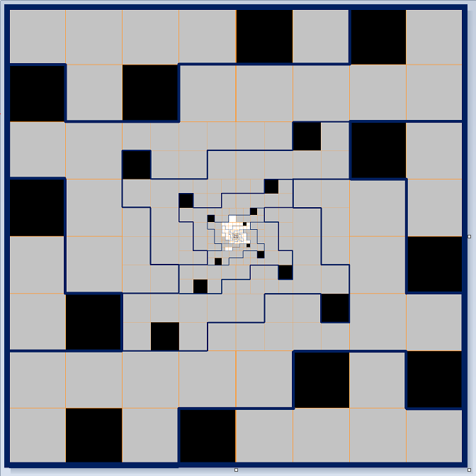
Fractal star battle 2 ★
Place exactly two stars per region and line.
Cells containing stars share no vertices.
B
A
a
b
D
C
c
d
F
E
…
e
f
J
I
H
G
g
h
i
j
A new idea
Variations grid 2
1
2
D
C
c
d
3
3
4
4
F
E
e
f
5
5
6
6
H
G
g
h
7
7
8
8
J
I
i
j
9
9
10
10
…
…
…
…
…
…
-10
…
-9
-10
-9
-8
-8
-7
-7
-6
-6
-5
-5
-4
-4
-3
-3
-2
-1
#25 by Pedro PSI – 21st of December 2020
pedropsi.github.io/star-battle

Slide 3
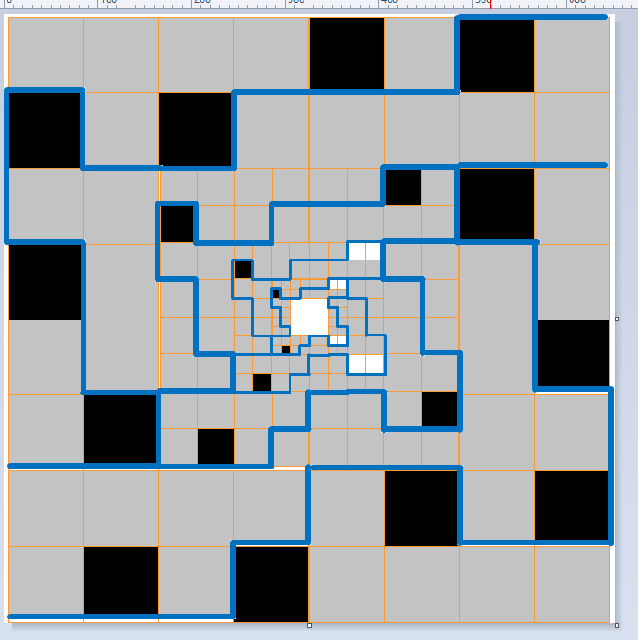
A new idea
Variations grid

Slide 4
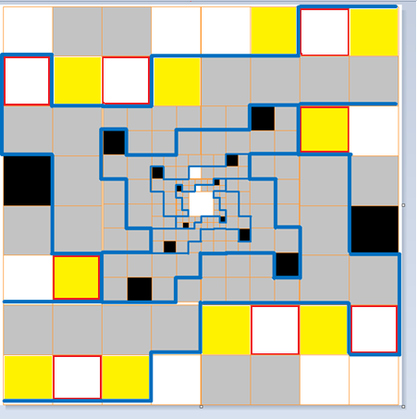
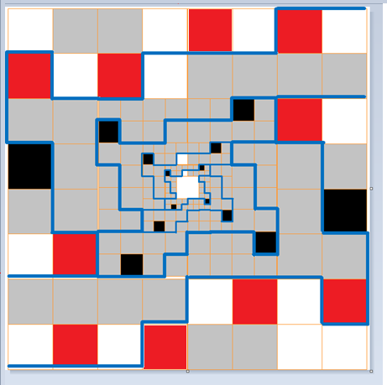
A new idea
Variations grid

Slide 5
A new idea
Works perfectly!

Slide 6
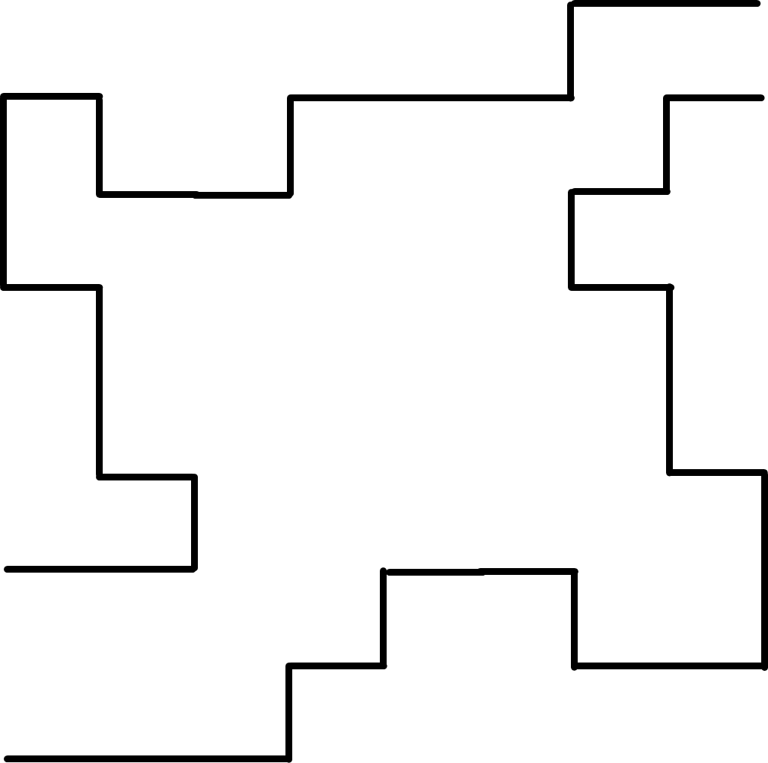
A new idea
Interesting variation
solved

Slide 7
A
B
C
D
E
…
F
G
H
I
J
K
L
M
N
O
…
…
15
14
13
12
12
11
11
10
10
9
9
8
8
7
7
6
6
5
5
4
4
3
3
2
2
1
1
…
A
B
C
D
E
F
G
H
I
J
K
L

Slide 8
A 3-star tail solution
(good)

Slide 9
A variable 3-star tail solution
(some freedom to alternate)

Slide 10
A 4-star finite solution

Slide 11
A 4-star infinite solution

Slide 12
A finite solution

