Slide 1
Cairo star battle 1 ★
Place exactly one star per region and line.
Cells containing stars share no vertices.
g
s
a
O
S
A
B
P
b
c
d
J
t
i
C
D
Stars block five lines so:
Q
T
R
l
E
e
k
F
f
B
A
N
G
E
g
m
H
r
h
t
I
F
o
i
n
J
j
T
K
g
s
k
D
h
L
p
l
q
M
S
m
j
c
C
L
N
n
r
e
O
K
a
b
R
d
o
I
P
M
Q
f
p
q
H
Interactive version in:
ZenoRogue’s adapted HyperRogue engine
#22 by Pedro PSI – 07th of March 2021
pedropsi.github.io/star-battle

Slide 2
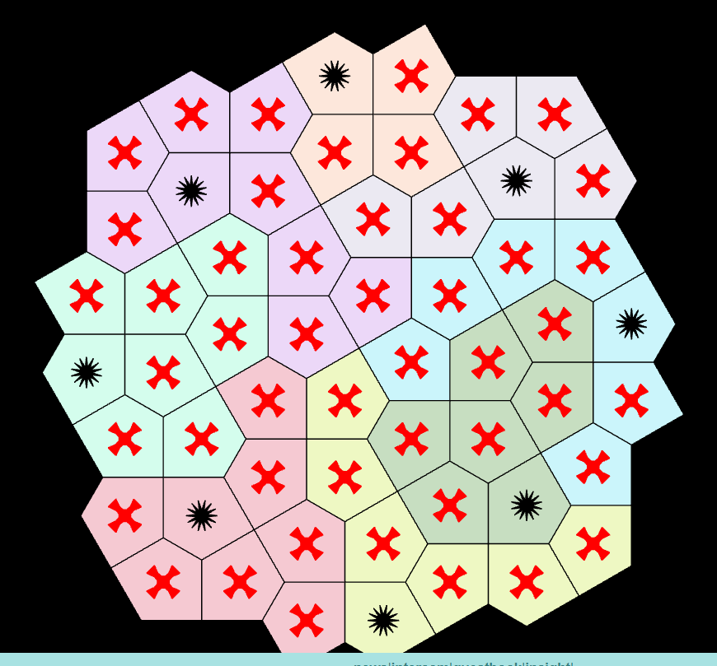

Slide 3
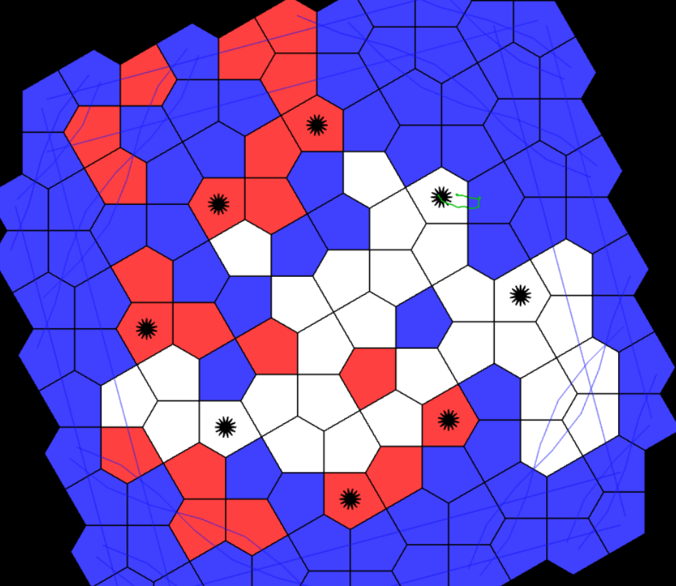

Slide 4
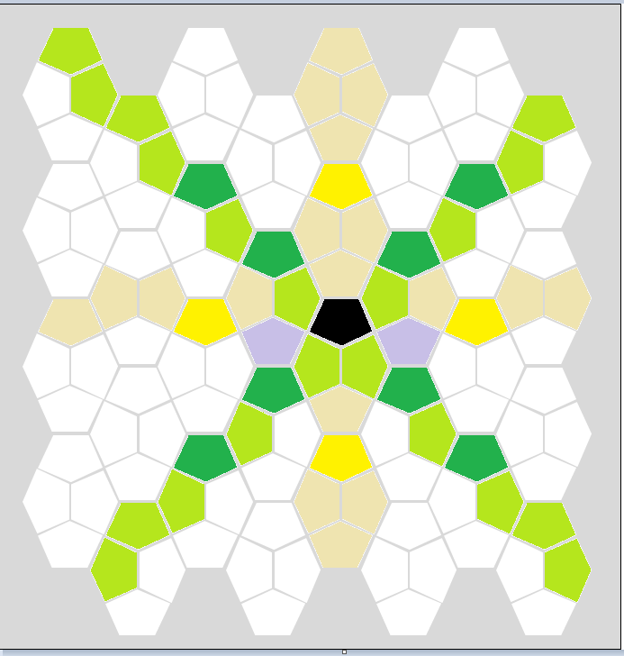
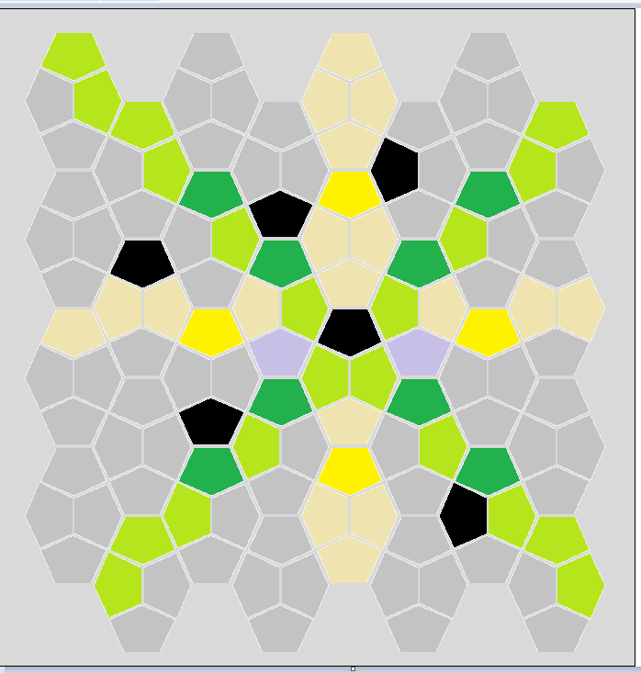
in the list of geometries, find archimedean, filter to Euclidean, and find "(3,3,4,3,4) (0,4)(1)(2,3)", and variation to "dual"

