Slide 1
Types and Programming Languages
Lecture 14
Simon Gay
Department of Computing Science
University of Glasgow
2006/07

Slide 2
Unification
We now need to see how to solve sets of constraints. We use
the unification algorithm, which, given a set of constraints,
checks that there is a solution and if so finds the “best” one
(in the sense that all other solutions can be generated from it).
Unification has more general applications: notably it is the basis
of logic programming as found in languages such as Prolog.

Slide 3
Principal Unifiers
Definition: a substitution σ is more general (or less specific)
than a substitution σ’, written σ ⊆ σ’ , if σ’ = σ ; γ for some
substitution γ .
Example: [ X  Y→int ] is more general than [ X  bool→int ]
because [ X  bool→int ] = [ X  Y→int ] ; [ Y  bool ] .
Definition: a principal unifier (or most general unifier) for a
constraint set C is a substitution σ that satisfies C and such that
σ ⊆ σ’ for every substitution σ’ satisfying C.
The unification algorithm finds a principal unifier, if it exists, for
a set of constraints.

Slide 4
Exercises: Principal Unifiers
Find a principal unifier (or explain why it doesn’t exist) for each
of the following constraint sets.
{ X = int, Y = X→X }
{ int→int = X→Y }
{ X→Y = Y→Z, Z = U→W }
{ int = int→Y }
{ Y = int→Y }
{ } (the empty set of constraints)

Slide 5
The Unification Algorithm
Given a constraint set C, return a substitution.
unify(C) = if C = { } then [ ]
else let { S = T } ∪ C’ = C in
if S = T
then unify(C’)
else if S = X and X∉FV(T)
then [ X  T ] ; unify(C’ [ X  T ] )
else if T = X and X∉FV(S)
then [ X  S ] ; unify(C’ [ X  S ] )
else if S = A→B and T = A’→B’
then unify(C’ ∪ {A = A’, B = B’})
else fail

Slide 6
Notes on the Unification Algorithm
The phrase “let { S = T } ∪ C’ = C ” means “choose a constraint
S = T from the set C and let C’ denote the remaining constraints
from C.
X stands for any type variable.
FV(T) means all of the type variables occurring in T.
The conditions X∉FV(T) and X∉FV(S) are the “occurs check”.
They prevent the algorithm from generating cyclic substitutions
such as [ X  X→X ] which do not make sense if we are
working with finite type expressions. (They would make sense in
a language with recursive types, and then the occurs checks
can be omitted.)

Slide 7
Correctness of the Unification Algorithm
It is possible to prove:
unify(C) halts, either by failing or by returning a substitution,
for all constraint sets C.
if unify(C) = σ then σ is a principal unifier for C.

Slide 8
Examples of the Unification Algorithm
{ X = int, Y = X→X }
unify({ X = int, Y = X→X }) S=X, T=int, C’={Y = X→X}
= [ X  int ] ; unify({ Y = int→int }) S=Y, T=int→int, C’={ }
= [ X  int ] ; [ Y  int→int ] ; unify({ })
= [ X  int ] ; [ Y  int→int ] ; [ ]
= [ X  int, Y  int→int ]
{ int→int = X→Y }
unify({ int→int = X→Y }) S=int→int, T=X→Y, C’={ }
= unify({ int = X, int = Y }) S=int, T=X, C’={ int = Y }
= [ X  int ] ; unify({ int = Y }) S=int, T=Y, C’={ }
= [ X  int ] ; [ Y  int ] ; unify({ })
= [ X  int, Y  int ]

Slide 9
Examples of the Unification Algorithm
{ X→Y = Y→Z, Z = U→W }
unify({ X→Y = Y→Z, Z = U→W }) S=X→Y, T= Y→Z,
C’={Z = U→W}
= unify({ Z = U→W, X = Y, Y = Z }) S=Z, T=U→W,
C’={ X = Y, Y = Z }
= [ Z  U→W ] ; unify({ X = Y, Y = U→W })
= [ Z  U→W ] ; [ X  Y ] ; unify({ Y = U→W })
= [ Z  U→W ] ; [ X  Y ] ; [ Y  U→W ]
= [ Z  U→W, X  Y ] ; [ Y  U→W ]
= [ Z  U→W, X  U→W, Y  U→W ]

Slide 10
Examples of the Unification Algorithm
{ int = int→Y }
unify({ int = int→Y }) S=int, T= int→Y, C’={ }
fails because no cases match
{ Y = int→Y }
unify({ Y = int→Y }) S=Y, T= int→Y, C’={ }
fails because no cases match, due to the occurs check
{ }
unify({ })
= [ ]

Slide 11
Principal Types
Definition: A principal solution for (Γ,t,S,C) is a solution (σ,T)
such that whenever (σ’,T’) is also a solution for (Γ,t,S,C) we
have σ ⊆ σ’ . When (σ,T) is a principal solution, we call T a
principal type of t under Γ .
Theorem: If (Γ,t,S,C) has any solution then it has a principal
solution. The unification algorithm can be used to determine
whether (Γ,t,S,C) has a solution and, if so, to calculate a
principal solution.

Slide 12
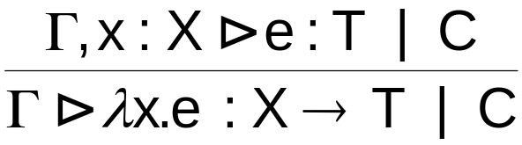
Implicit Type Annotations
Languages supporting type reconstruction (for example, ML)
give the programmer the option of omitting type annotations on
lambda-abstractions. One way to achieve this is to make the
parser fill in omitted annotations with fresh type variables.
A better approach is to add un-annotated abstractions to the
syntax of terms, and add a rule to the constraint typing relation:
(CT-AbsInf)
where X is a fresh type variable.
This allows (requires) a different type variable to be chosen for
every occurrence of this abstraction. This will be important in a
moment...

Slide 13
Type Reconstruction is not Polymorphism
Consider the function double, and an example use:
let double = λf:int→int. λa:int. f(f(a))
in double (λx:int. x+2) 2
end
Alternatively we can define double so that it can be used to
double a boolean function:
let double = λf:bool→bool. λa:bool. f(f(a))
in double (λx:bool. x) false
end

Slide 14
Type Reconstruction is not Polymorphism
To use both double functions in the same program, we must
define two versions:
let double_int = λf:int→int. λa:int. f(f(a))
double_bool = λf:bool→bool. λa:bool. f(f(a))
in let a = double_int (λx:int. x+2) 2
let b = double_bool (λx:bool. x) false
end end

Slide 15
Type Reconstruction is not Polymorphism
Annotating the abstractions in double with a type variable
does not help:
let double = λf:X→X. λa:X. f(f(a))
in let a = double (λx:int. x+2) 2
let b = double (λx:bool. x) false
end end
because the use of double in the definition of a generates the
constraint X→X = int→int and the use of double in the
definition of b generates the constraint X→X = bool→bool .
These constraints cannot both be satisfied, so the program is
untypable.

Slide 16
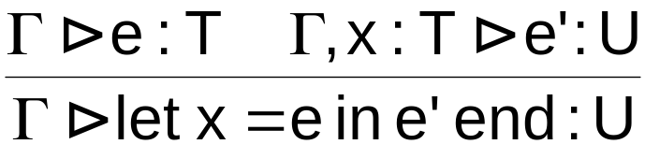
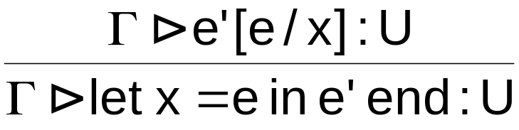
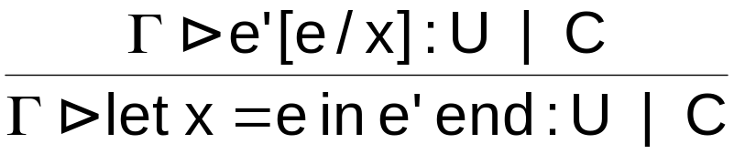
Let-Polymorphism
We need to associate a different type variable with each use of
double.
Change the typing rule for let from this:
(T-Let)
to this:
(T-LetPoly)
and in the constraint typing system we get this:
(CT-LetPoly)

Slide 17
Let-Polymorphism
In effect we have changed the typing rules for let so that they do
a reduction step before calculating types:
let x = v in e → e[v/x]
Also we need to rewrite the definition of double to use implicit
annotations on the abstractions (rule CT-AbsInf):
let double = λf. λa. f(f(a))
in let a = double (λx:int. x+2) 2
let b = double (λx:bool. x) false
end end
Now this program is typable, because rule CT-LetPoly creates
two copies of double, and rule CT-AbsInf assigns a different
type variable to each one.

Slide 18
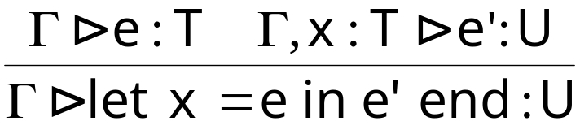
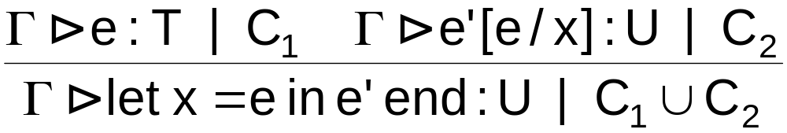
Let-Polymorphism in Practice
An obvious problem with the typing rule
(T-LetPoly)
is that if x does not occur in e’ then e is never typechecked!
Change the rules to
(T-LetPoly)
(CT-LetPoly)

Slide 19
Let-Polymorphism in Practice
If x occurs several times in e’ then e will be typechecked
several times. Instead, a practical implementation would
typecheck let x = e in e’ in an environment Γ as follows.
Use the constraint typing rules to calculate a type S and a set
of constraints C for e.
Use unification to obtain the principal type of e, T.
Generalize any type variables in T, as long as they do not
occur in Γ. If these variables are X, Y, ..., Z then the
principal type scheme of e is ∀X,Y,...,Z.T
Put x into the environment with its principal type scheme.
Start typechecking e’.
When x is encountered in e’, instantiate its type scheme with
fresh type variables.

Slide 20
Polymorphism and References
Combining polymorphism and references can cause problems.
Example:
let r = ref (λx.x)
in r := λx:int. x+1 ;
(!r)true
end
λx.x has principal type X→X so ref (λx.x) has principal type
Ref(X→X) and because X occurs nowhere else we generalize
to the type scheme ∀X. Ref(X→X) and put r into the
environment with this type scheme.

Slide 21
Polymorphism and References
When typechecking r := λx:int. x+1 ; (!r)true we instantiate the
type scheme with a new type variable for each occurrence of r.
So r := λx:int. x+1 is typechecked with r:Ref(Y→Y)
and (!r)true is typechecked with r:Ref(Z→Z).
Solving the constraints results in a successful typecheck with
Y = int and Z = bool .
But this is clearly unsafe: executing this code results in
applying λx:int. x+1 to true.
What has gone wrong? The typing rules allocate two type
variables, one for each occurrence of r, but at runtime only one
location is actually allocated.

Slide 22
Polymorphism and References
The solution to this problem is the value restriction: only
generalize the type of a let-binding if its right hand side is a
syntactic value.
In this example, ref (λx.x) is not a value because it reduces to
a new location m. So it is not valid to generalize the type of r.
It is just X→X and the same X is used when typechecking
both r := λx:int. x+1 and (!r)true . The assignment introduces
the constraint X = int which means that (!r)true is a type error.
It turns out that in practice the value restriction makes very little
difference to programming.

Slide 23
Example of the Value Restriction
In ML, the following code generates a type error because of the
value restriction.
let f = λx.λy.x(y) in
let g = f (λx.x) in
...g(1)...g(true)...
end end
In practice hardly any programs use this style of coding.

Slide 24
Algorithmic Issues
Generalizing principal types to type schemes eliminates the
inefficiency of substituting while typechecking let expressions.
In practice, typechecking with let-polymorphism seems to be
very efficient: “essentially linear” in the size of the term.
The worst-case complexity is exponential, for example:
let a = λx.(x,x) in
let b = λx.a(a(x)) in
let c = λx.b(b(x)) in
let d = λx.c(c(x)) in
let e = λx.d(d(x)) in
let f = λx.e(e(x)) in
f(λx.x)

Slide 25
Let-Polymorphism in Practice
Let-polymorphism, with its principal type schemes, supports
generic data structures and algorithms very nicely, especially
when the language allows polymorphic type constructors to be
defined. This is familiar from Haskell.
Example:
Define a polymorphic type constructor Hashtable, and functions
with principal type schemes like
get : ∀X. Hashtable X → string → X
In a practical language the ∀ is likely to be omitted, for example
in ML:
get : ’a Hashtable → string → ’a
Implicitly all type variables are generalized at the top level.

