Slide 1
HATE SPEECH DETECTION
KEEP YOUR SAFE SPACES SAFE!
This presentation contains harmful language that is not endorsed by the author. - Pedro Velazquez

Slide 2
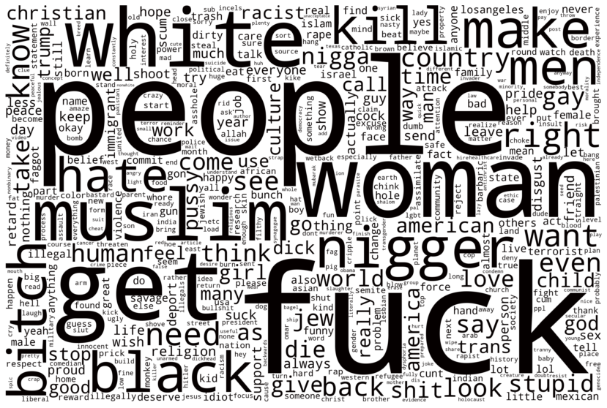
The problem:

Slide 3
The Data:
Text | Target
GEEZ..... I think #NorthKorea may be right. #BarackObama is a monkey! Surely acts like one. | 1
I, a Catholic and a Jesuit, am grateful for this Muslim holy season for challenging me to be a more dedicated child of God. | 1
Saudi can suck a dick tbh, fucking bastards | 1
Yes, in barbaric, authoritarian cultures that have since been condemned. Interesting that Christians desire to perpetuate the same idea. | 0
Holy shit i am just getting dunked on by a cripple this is unreal. | 1
Only cops should have guns!! But... aren't all cops racist and only promote white supremacy and kill blacks on sight? Oh shit, dilemma!! | 0

Slide 4
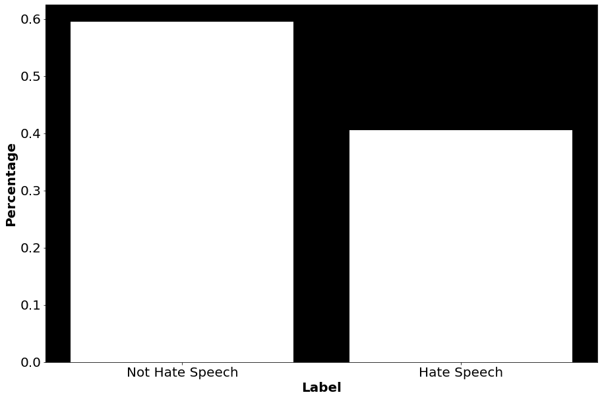
The Data:
This is a public release of the dataset described in Kennedy et al. (2020)
Sourced from three social medias, YouTube, Twitter, and Reddit for 135,556 combined rows
The primary outcome variable is the hate speech score 0 => Not hate speech
1 => hate speech

Slide 5
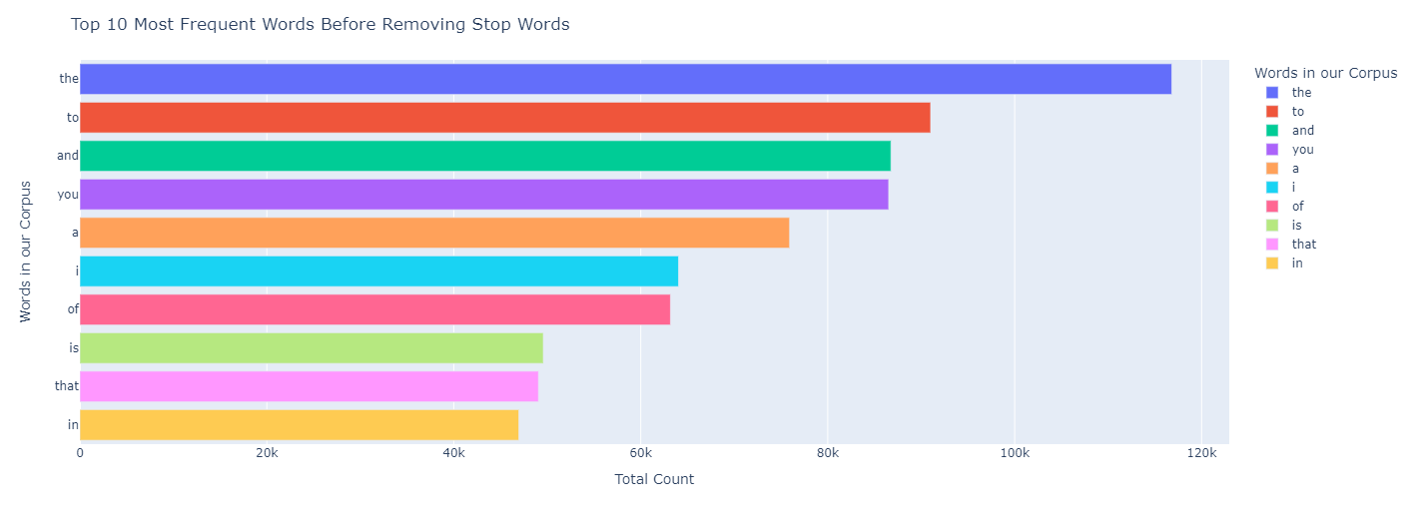
The Data:

Slide 6
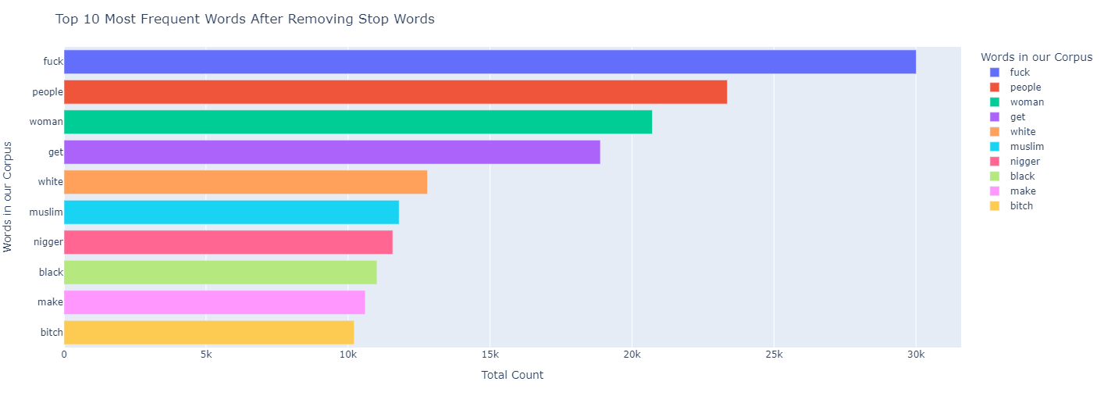
The Data:

Slide 7
Solution
Model Types
Logistic Regression
XGBoost Classifier
Linear SVM
Create a model that can detect instances of hate speech

Slide 8
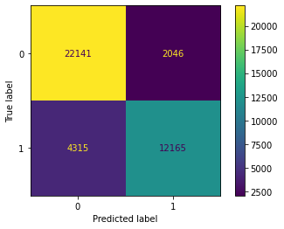
Implementation LOGISTIC REGRESSION
Accuracy | Precision | Recall | F1
0.8436 | 0.8560 | 0.7382 | 0.7927

Slide 9

Implementation XGBOOST
Accuracy | Precision | Recall | F1
0.8049 | 0.8097 | 0.6779 | 0.7379

Slide 10
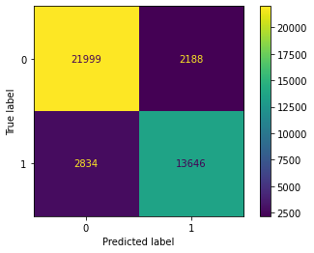
Implementation LINEAR SVM
Accuracy | Precision | Recall | F1
0.8765 | 0.9095 | 0.8859 | 0.8976

Slide 11
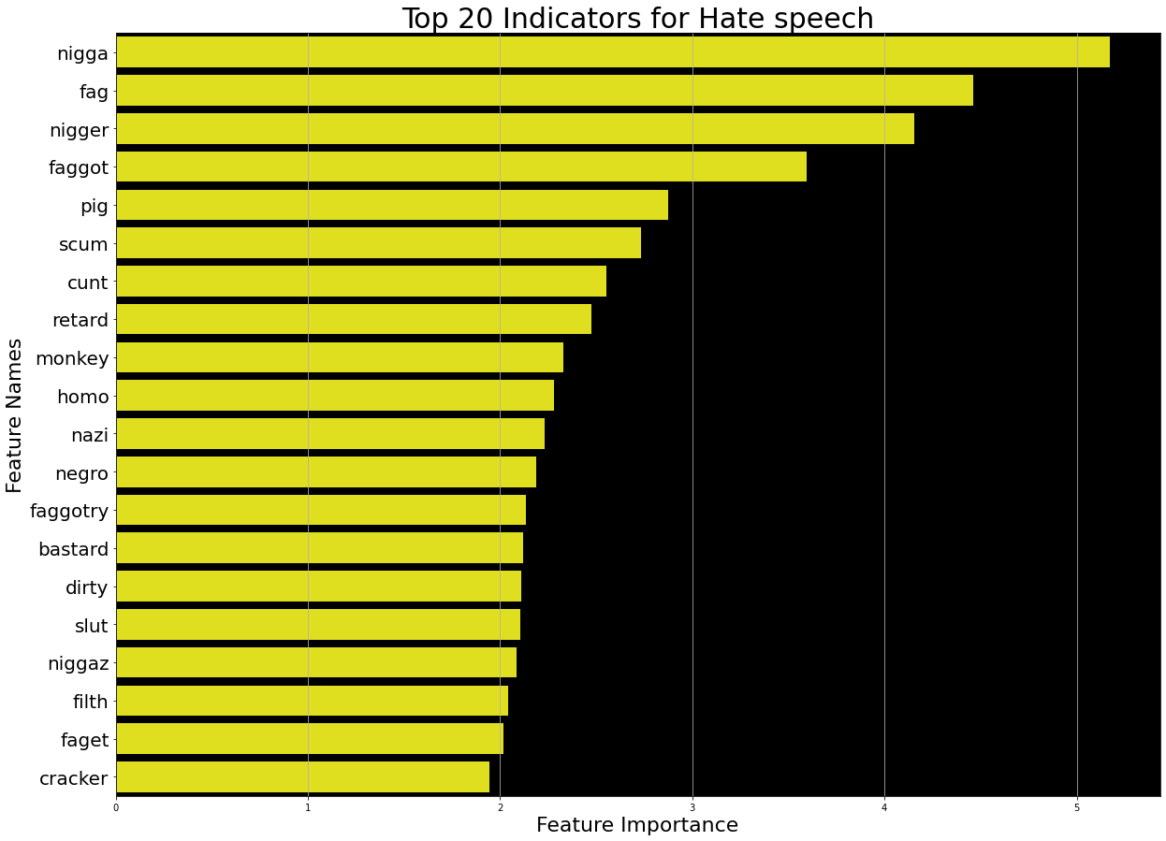
FEATURE IMPORTANCE

Slide 12
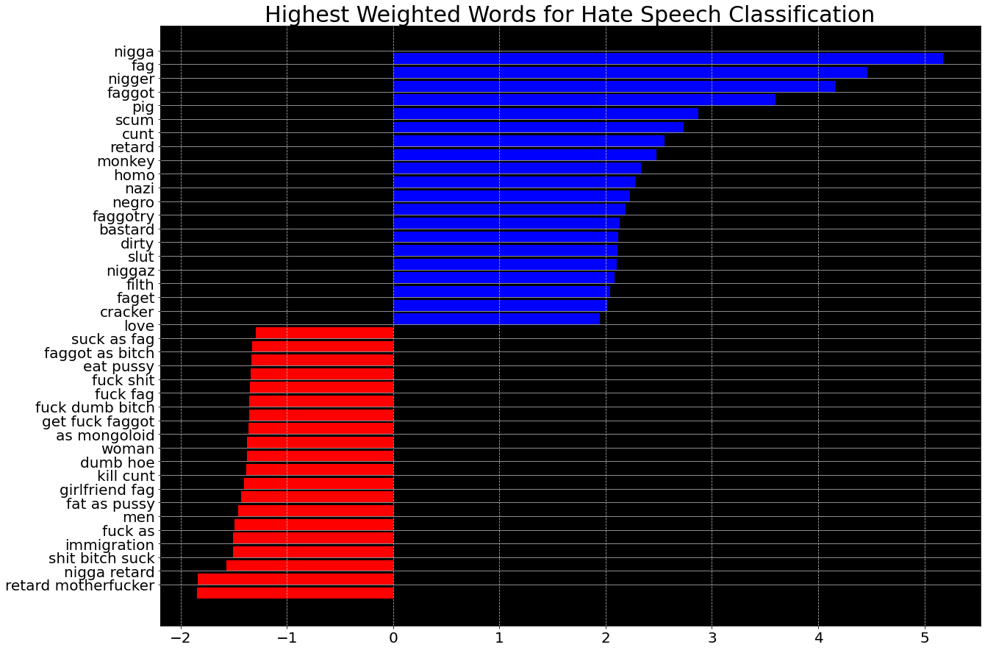
FEATURE IMPORTANCE

Slide 13
The Predictions:
Text | Target | Prediction
My God look at these BARBARIC PPL. And these pigs all watching. They r a very, very sick culture. And Omar and Rashid want this crap here. This is America not the Middle East. Round them up and send them home. | 1 | 0
That's right would have to be at least two more because someone is going to need to shut your whore mouth up while my cock rapes your asshole over and over again while daddy's other friend is in your slutty little cunt. | 1 | 1
Instead of killing americans just kill brown kids instead | 1 | 1
I love that you enjoy being trans. | 0 | 0
Fucking panty waste UK politicians can suck a dick! They sold out their own people for a shit god, preferential rights for moslems. Look at your own policies, calling Trump anything just shows your own dumbmotherfuckery. Stand up UK citizens and take your fucking country back! For nearly 2000 years you've fought off every invader in the world but now your politicians have gone ass up for allah. Some of the greatest kings to ever walk the earth you've decended from, they'd roll over in their graves if they knew | 1 | 0

Slide 14
FUTURE WORK:
Create a Chrome extension that can detect hate speech and censor it
Create a social media bot i.e reddit/twitter/twitch that can detect and flag hate speech
Use text summary generation to replace hate speech text with a censored summary

