Slide 1

Movie Strategy
By: Arsh Patel, Pedro Velazquez

Slide 2
STATE OF THE BOX OFFICE:

Slide 3
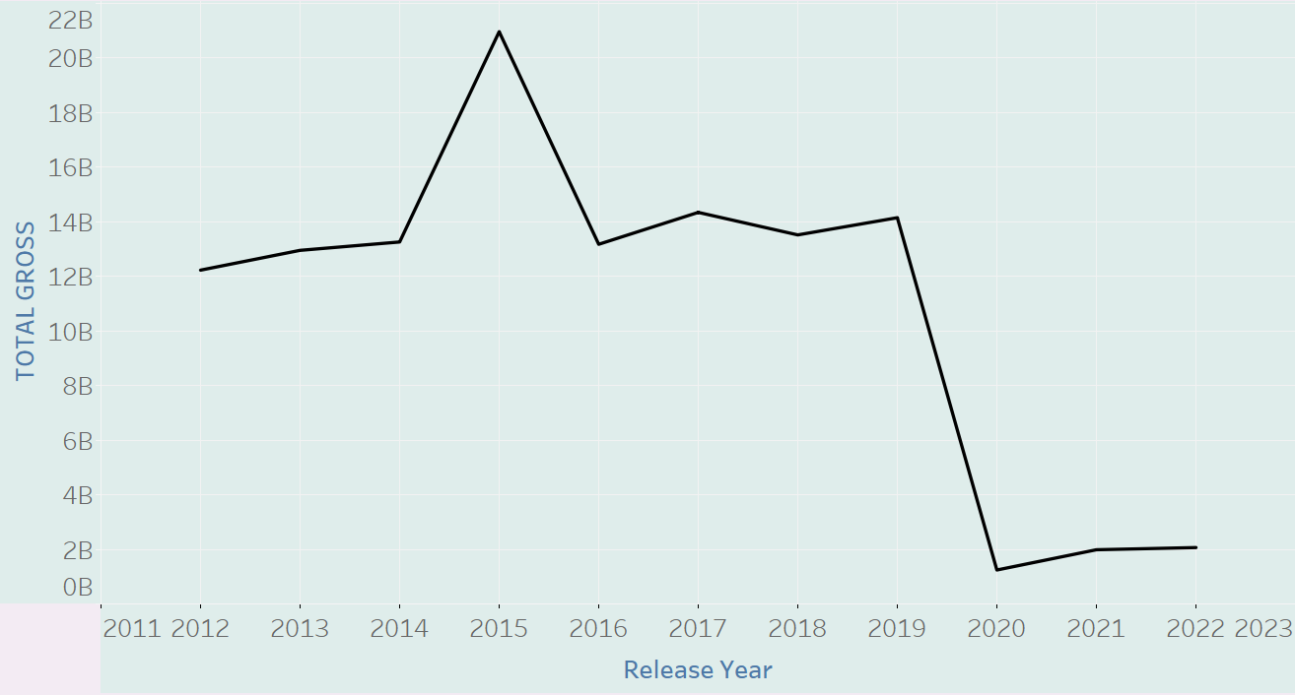
TOTAL GROSS PER YEAR (2012-2022)

Slide 4
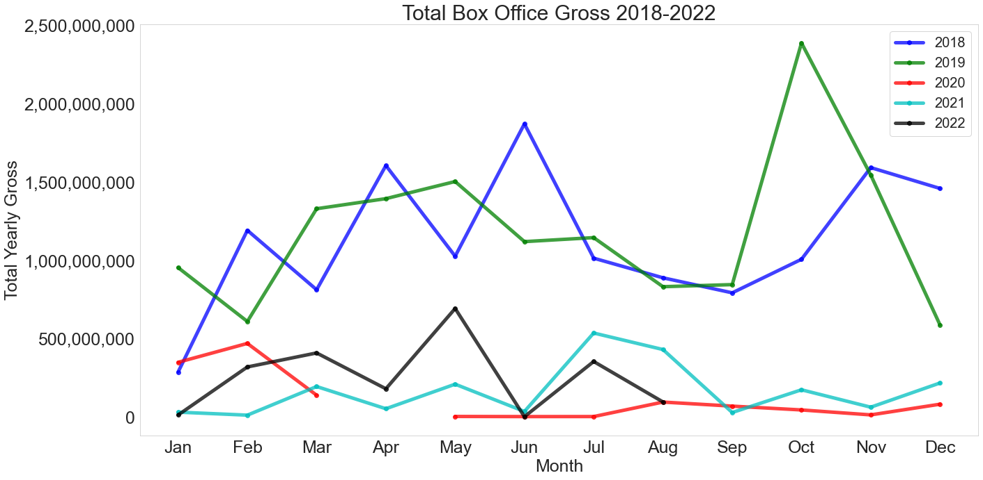

Slide 5
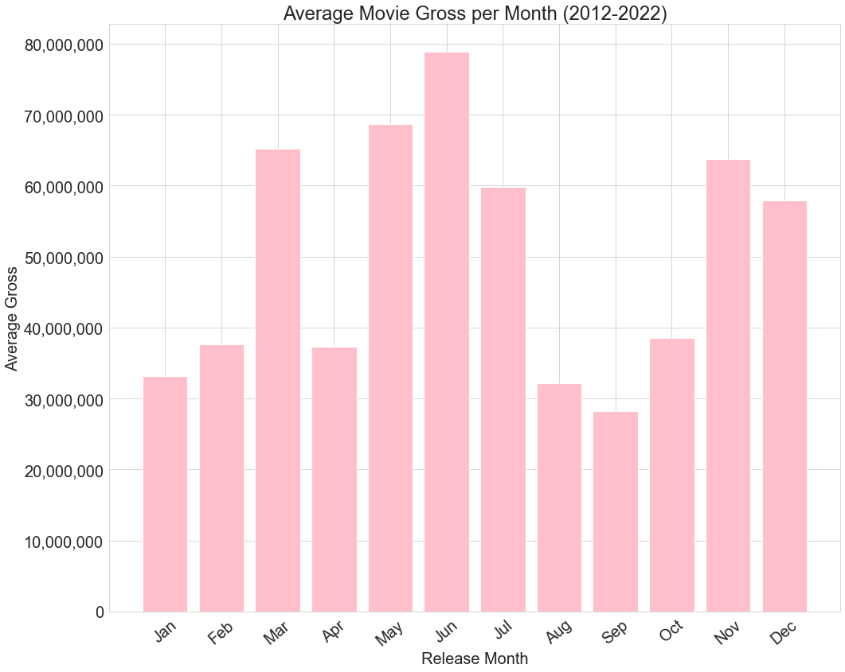

Slide 6
Our Competitors

Slide 7
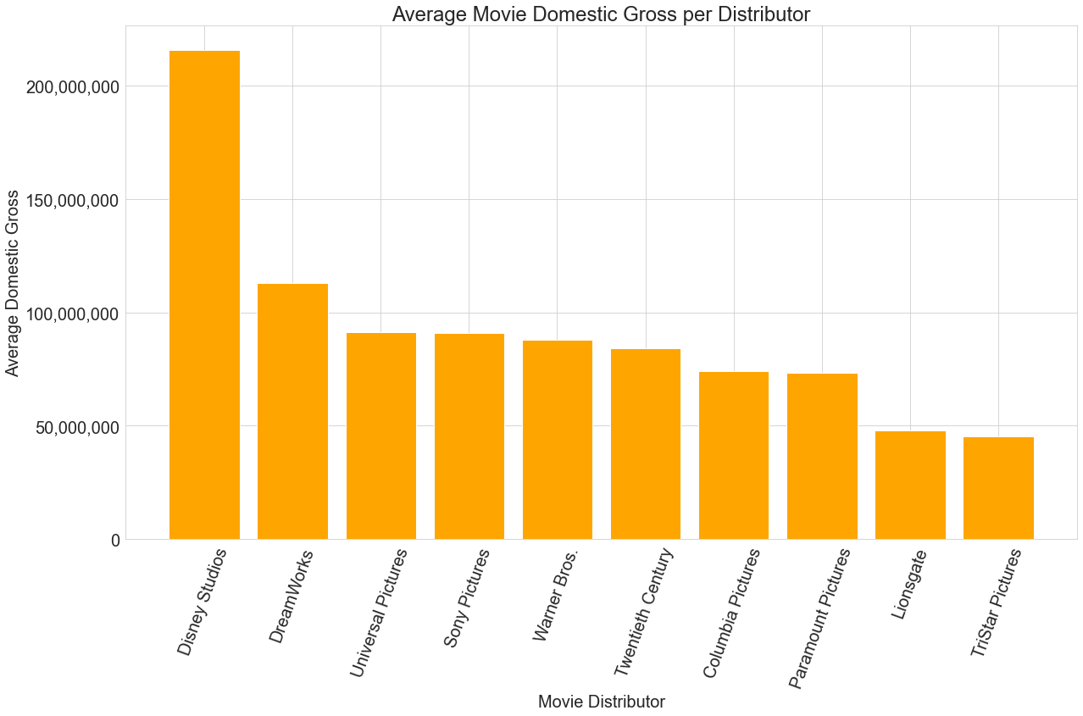

Slide 9
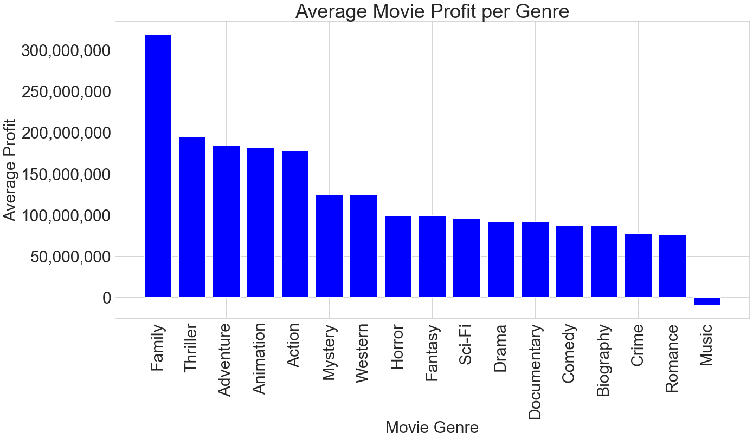

Slide 10
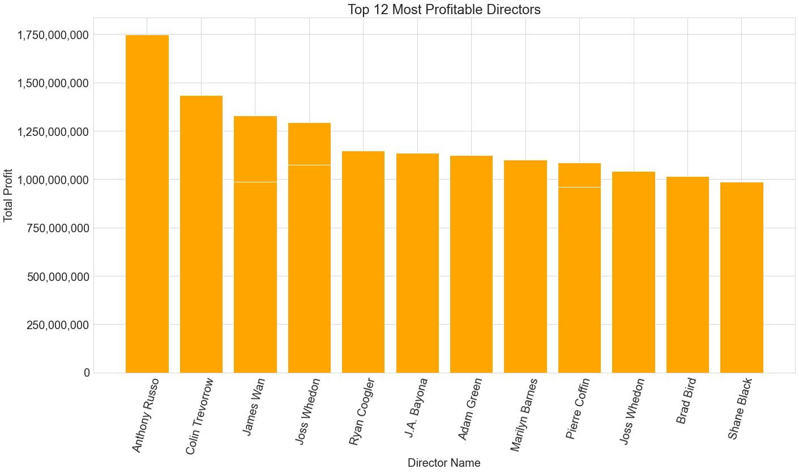

Slide 11
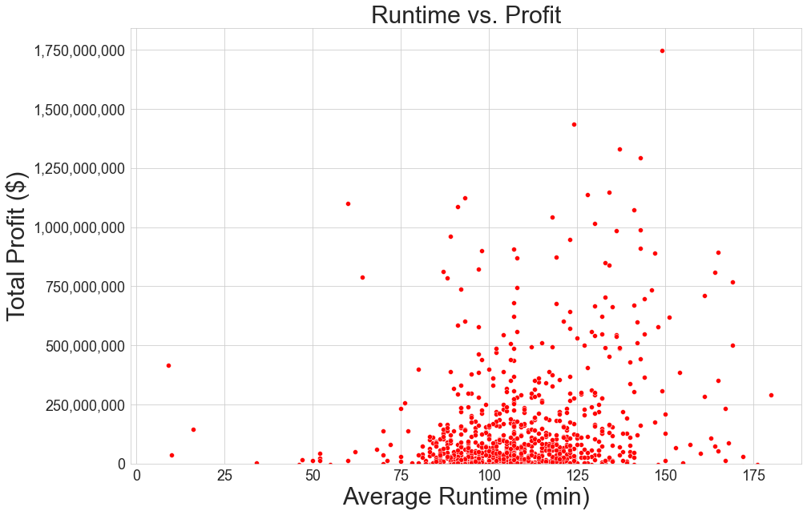

Slide 12
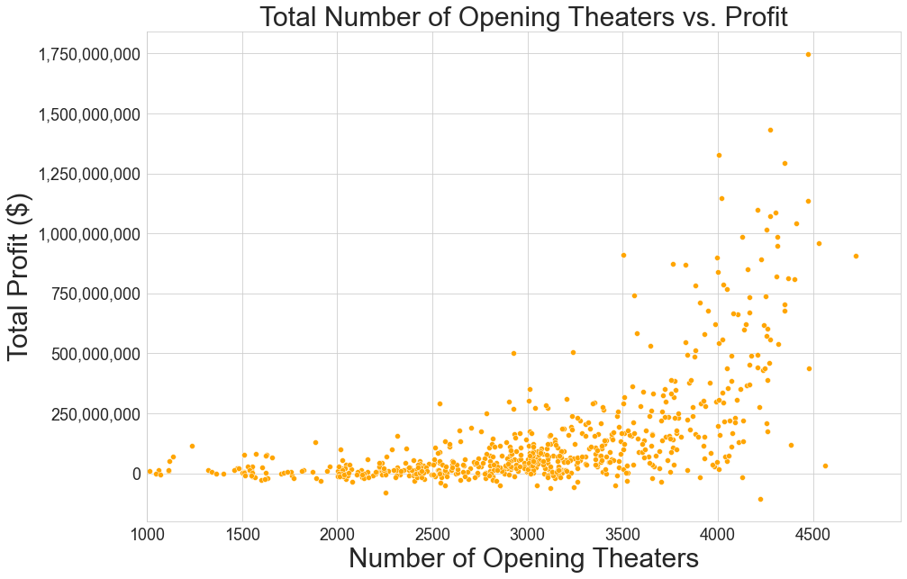

Slide 13
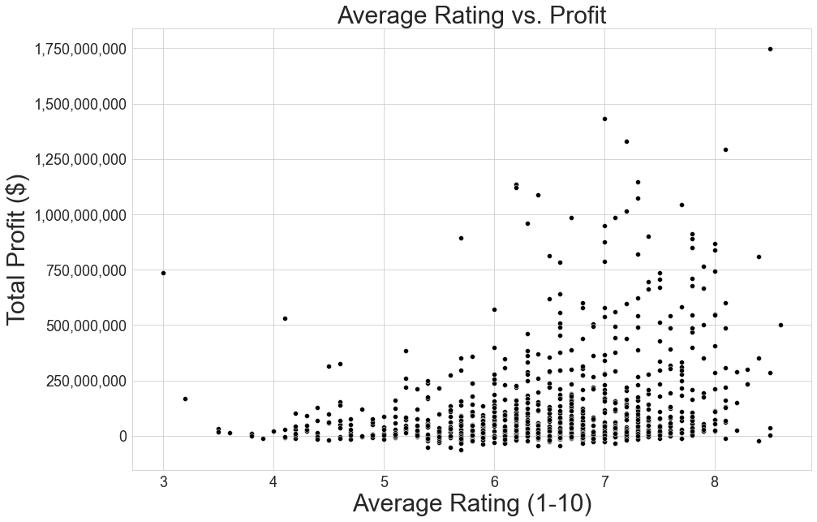

Slide 14
