Slide 1
Python basics III.
Socket programming

Slide 2
Pyton socket, host name resolution
Socket package
gethostname()
gethostbyname()
gethostbyname_ex()
gethostbyaddr()
import socket
hostname = socket.gethostname()
hostname = socket.gethostbyname(‚www.example.org’)
hostname, aliases, addresses = socket.gethostbyname_ex(host)
hostname, aliases, addrs = socket.gethostbyaddr('157.181.161.79')

Slide 3
Task – 1
Run gethostbyname() on the following URL-s:
'homer', 'www', 'www.python.org', inf.elte.hu‚
Query the hostnames of the following IP adressens using gethostbyaddr() :
‚157.181.161.79’, ‚157.181.161.16’

Slide 4
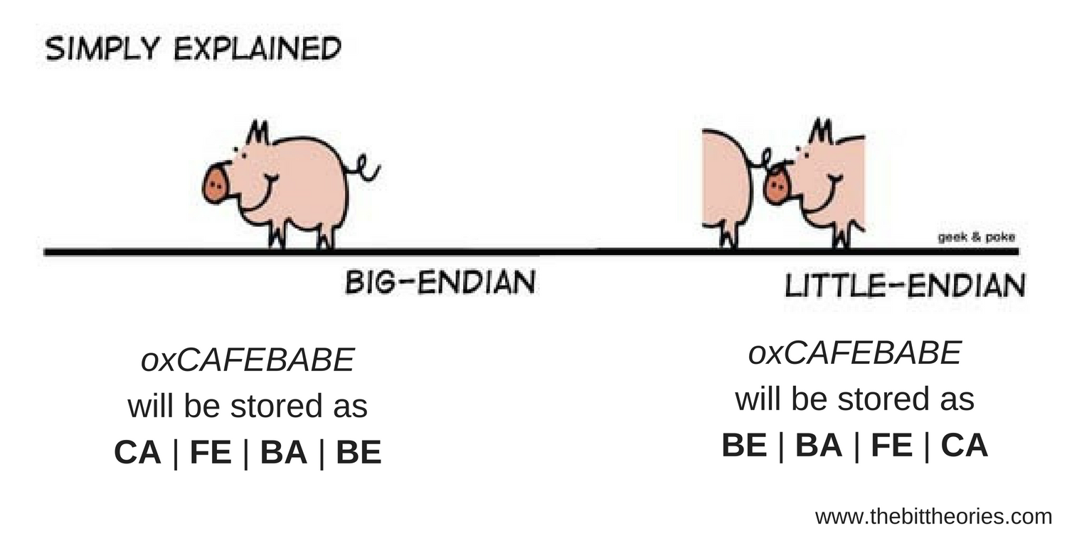
Little endian, big endian
16 and 32 bits long coding
htons(), htonl() – host to network short / long
ntohs(), ntohl() – network to host short / long

Slide 5
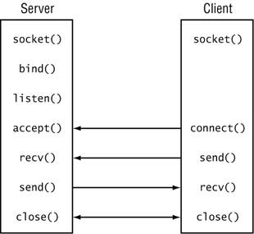
TCP

Slide 6
TCP
socket()
bind()
listen()
accept()
sock = socket.socket(socket.AF_INET, socket.SOCK_STREAM)
server_address = ('localhost', 10000)
sock.bind(server_address)
sock.listen(1)
connection, client_address = sock.accept()

Slide 7
TCP
send(), sendall()
recv()
close()
connect()
connection.sendall(data)
data = connection.recv(16)
connection.close()
server_address = ('localhost', 10000)
sock.connect(server_address)

Slide 8
Task – 2
Write a simple server-client application, where the client sends a „Hello server” message, and the server replies back a „Hello client” message!

Slide 9
Sending structures
Serialize the data to binary
Deserialization
import struct
values = (1, 'ab', 2.7)
packer = struct.Struct('I 2s f') #Int, char[2], float
packed_data = packer.pack(*values)
import struct
unpacker = struct.Struct('I 2s f')
unpacked_data = unpacker.unpack(data)

Slide 10
Task – 3 --- for 2 points by the end of the lesson
Write a simple calculator, where the client sends 2 numbers and an operator to the server in a serialized structure, the server computes the result, and sends it back to the client

Slide 11
Select
setblocking() or settimeout()
select()
connection.setblocking(0) # or connection.settimeout(1.0)
inputs = [ server ]
outputs = [ ]
timeout=1
readable, writable, exceptional = select.select(inputs, outputs, inputs, timeout)
…
for s in readable:
if s is server: #new client connect
connection, client_address = server.accept()
print('New client from %s:%d' % client_address)
inputs.append( connection )
else:
…. #handle client

Slide 12
Homework – file transfer [4 pont]
Write a server-client application, that allows clients to list files and folders on the server and download the selected.
Server functionality:
The server is able to handle multiple clients
After a client connected the server accepts the following commands:
DIR – Send back the content of the actual folder.
DL <filename> – if the file exists, transfer the content of the file. If does not exist respond some error.
FIND <filename> - If the file exists return true otherwise return false.
Client side:
The client connects to the server and gives a consol to the user.
Sends the typed in command.
DIR, and FIND results appear on the console.
DL saves the file with filename <originalfilename_downloaded>
EXIT command disconnects from the server, and terminates the client.

Slide 13
The end!

