Slide 1
Computer Networks
Practice 1

Slide 2
Péter Vörös
website: http://vopraai.web.elte.hu
email: vpetya@mensa.hu
room: 2.519

Slide 3
Requirements
Classwork/Homework (50%)
Final practical exam (50%)
Minimum requirement:
40% in both parts
Minimum 50% together
At most 4 absences are allowed
Cheating is not tolerated!

Slide 4
Python
Created by Guido Van Rossum Dutch programmer at the begining of the 90s
The name comes from Monty Python
Python attributes:
Interpreted
Interactive, it can be used in command line
Portable
Really easy for beginners

Slide 5
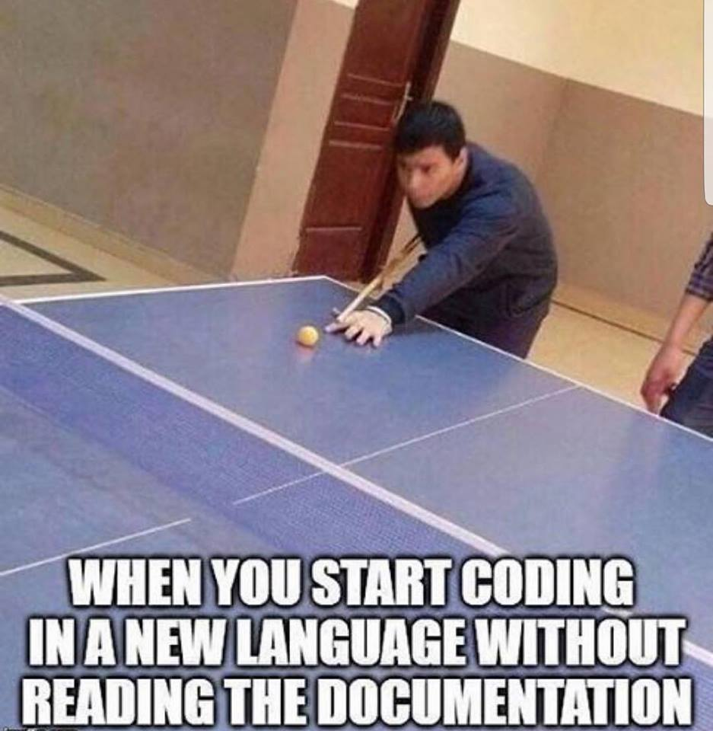
Python hands on

Slide 6
Python command line
#python
python> import this
python> print ”Hello world!”
python> user_name=”Joe”
python> print ”Hello ” + user_name
python> user_age=25
python> print ”You are ” + str(user_age) + ” years old.”

Slide 7
Basic calculations
Python>10+2
12
Python>2*2
4
Python>3**2
9
Python>10%2
0

Slide 8
Variables
Python> a = 42
Python> b = 32
Python> c = a + b
Python> print(c)
74
Python> c = ’something’
Python> print(a+c)
ERROR

Slide 9
String functions
Python>print 'apple'.upper()
APPLE
Python>print( "LO" in "Hello".upper() )
True
Python>print "Decimal Number: %d, Float: %f, String: %s" % (12,33.4,"apple")
Decimal Number: 12, Float: 33.400000, String: apple

Slide 10
Lists
Python> players = [12,31,27,'48',54]
Python> print players
[12, 31, 27, '48', 54]
Python> players[0]
12
Python> players[-1]
54
Python> players + [22, 67]
[12, 31, 27, '48', 54, 22, 67]
Python> print len(players)
5

Slide 11
Lists
Python> players = [12,31,27,'48',54]
Python> players.append(89)
Python> print len(players)
6
Python> players[2:]
[27, 48, 54, 89]

Slide 12
Sets
Python> mylist = [8,3,2,3,2,4,6,8,2]
Python> myset = set(mylist)
Python> print mylist
[8, 3, 2, 3, 2, 4, 6, 8, 2]
Python> print myset
set([8, 2, 3, 4, 6])
Python> mysortedlist = sorted(mylist)
Python> print mysortedlist
[2, 2, 2, 3, 3, 4, 6, 8, 8]

Slide 13
Dictionaries
Python> team = {
91: "Ayers, Robert",
13: "Beckham Jr,",
3: "Brown, Josh",
54: "Casillas, Jonathan",
21: "Collins, Landon”}
Python> len(team)
5
Python> team[3] = "Chihiro„
Python> print team.has_key(91)
True
Python> print team.has_key('apple')
False

Slide 14
Dicitonaries
Python> team = {
91: "Ayers, Robert",
13: "Beckham Jr,",
3: "Brown, Josh",
54: "Casillas, Jonathan",
21: "Collins, Landon”}
Python> print team.keys()
[91,13,3,54,21]
Python> print team.values()

Slide 15
If / else
if 100 in team:
print 'Yes, 100 is in the team'
elif 76 in team:
print '100 is not in the team, but 76 is in it...'
else:
print 'Both 100 and 76 are not in the team'

Slide 16
Loops
mylist = [3,65,2,77,9,33]
for i in mylist:
print 'Element:', i
Print the elements of the list in incremental order!
for i in xrange(2,10,2): #from 2 till 9 by 2 steps
print i

Slide 17
Loops
for i in range(5):
print ”Number” + str(i)
for (k,v) in team.iteritems():
print "Player name: %s; #: %d" % (v,k)
Player name: Brown, Josh; #: 3
Player name: Nassib, Ryan; #: 12
…
i=1
while i<10:
print i
i+=1

Slide 18
Running a python script
#vim test.py
#!/usr/ /python
x = 1
for i in range(1,5):
x+=i
print x,i,'apple', 'x*x = %d' % (x*x)
print(str(i) + " apple")
#python test.py
env
bin

Slide 19
Functions
env
bin
#!/usr/ /python
def is_even(num):
if (num % 2) == 0:
return True
else:
return False
for i in range(1,10):
if (is_even(i)):
print("Num: "+str(i))
print("End")

Slide 20
Excercise-1
Leap years occur according to the following formula: a leap year is divisible by four, but not by one hundred, unless it is divisible by four hundred.
For example, 1992, 1996, and 2000 are leap years, but 1993 and 1900 are not. The next leap year that falls on a century will be 2400.

Slide 21
Excercise-2
Given a day of the week encoded as 0=Sun, 1=Mon, 2=Tue, ...6=Sat, and a boolean indicating if we are on vacation, return a string of the form "7:00" indicating when the alarm clock should ring. On weekdays, the alarm should be at "7:00" and at weekends it should be "10:00". Unless we are on vacation -- then on weekdays it should be "10:00" and weekends it should be "off".
Examples:
alarm_clock(1, False) → '7:00'
alarm_clock(6, False) → '10:00'
alarm_clock(0, True) → '10:00‚
alarm_clock(6, True) → ’OFF'

Slide 22
Excercise-3
Write a function that returns the n-th fibonacci number!
fibonacci(0) -> 0
fibonacci(1) -> 1
fibonacci(2) -> 1
fibonacci(3) -> 2
…
fibonacci(n) -> fibonacci(n-2) + fibonacci(n-1)

Slide 23
Done

