Slide 1

YACM Yet Another Cycling Manager
Databases| P2 Lab Computer and Telematics Engineering
June 06th, 2019
Paulo Vasconcelos 84987
Pedro Teixeira 84715
Notes:
Paulo

Slide 2
Introduction to the problem
After interviewing a student in Sports Area and a team coach
A problem was found: The organization of a simple informal sports event entails the tedious, time consuming and error-prone management of many informations (registrations, teams and tickets, the creation of requests for authorizations to the competent authorities, the creation of a set of supporting documents for all these tasks and the dissemination of the same event).
Which offers an opportunity: Why not decrease the amount of work associated with the organization of these sports events and consequently decrease the time, the number of people used and possible human errors.
Notes:
Gestores
Membros da Equipa
Participantes
Suporte
Observadores
Patrocinadores
de Equipa/Participante
de Evento

Slide 3
Requirements
Who would need this system? For what?
Who | For What (Tasks)
Events Managers | Create and personalize an event See enrolled participants Add results Add teams
Participants | Enroll in an event Search for an event
Support Team | See enrolled participants Add results Add teams
Observers | Search for an event
Sponsors | See events statistics (number of participants, results, etc.)
Notes:
For what?
Events Managers : to manage their events easier and quicker
Team Members
Participants : to enter an event without effort
Support Team
Observers
Sponsors (of the team or the event)

Slide 4
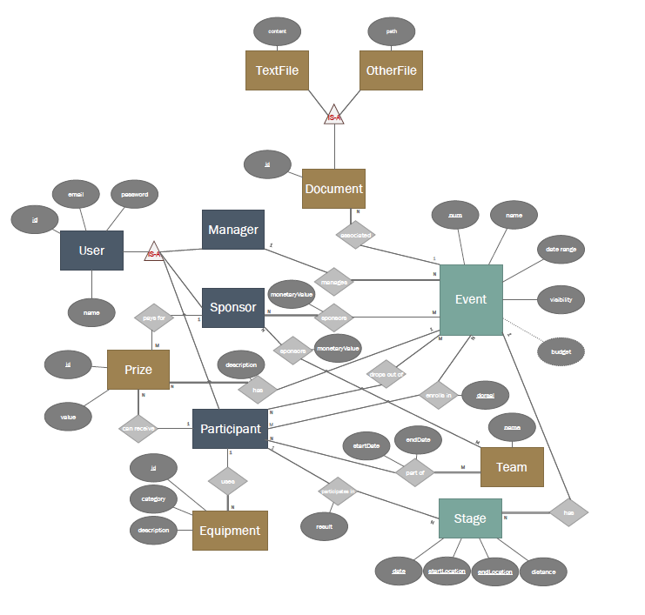
Entity-Relation Diagram

Slide 5
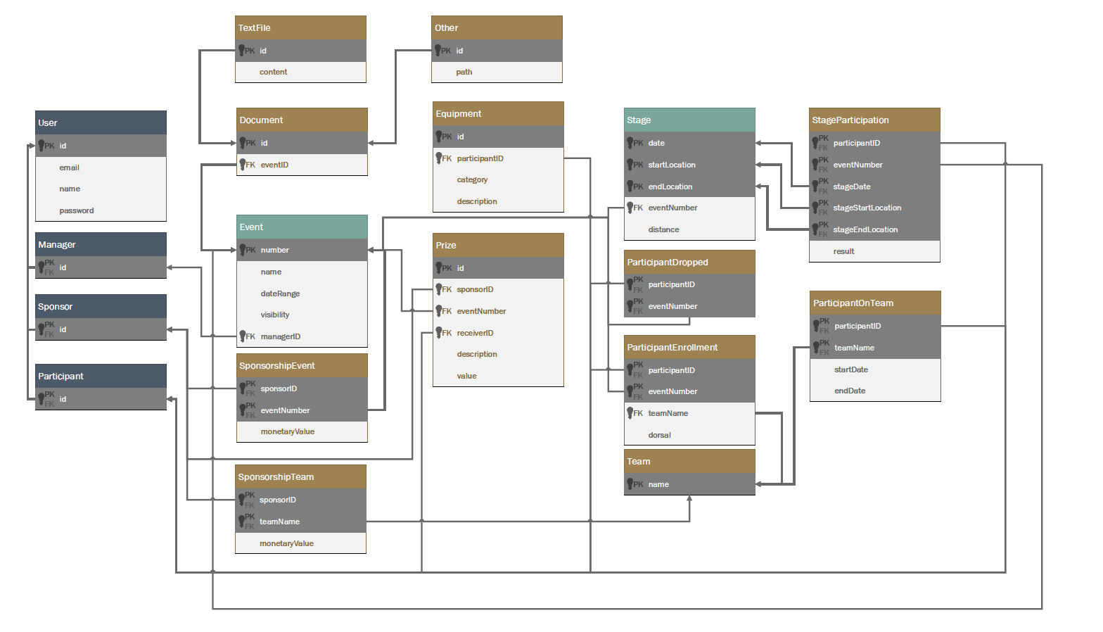
Entity-Relation Model

Slide 6
UDFs, Stored Procedures & Triggers
UDFs, Stored Procedures and Triggers were created and both used for the following situations:
Authenticate;
Retrieve Events managed by a Manager (in a similar way, the system is also able to retrieve the Events that are managed by other people and those of which are public);
Retrieve some event-related info like:
Teams competing in the event and some extra info:
Budget (calculated from team sponsors);
Number of athletes competing in said event by that team.
Documents associated/requested by the event manager.
Create and delete Documents (TextFile or OtherFile);
Create Users (CreateManager, CreateParticipant or CreateSponsor)
Delete Users (Valar Morgulis).

Slide 7
Indexation
In this system there wasn’t the need for many indexes since each Entity Primary Keys would, most of the time, are used to solve the problem.
However, we created indexes for the following Entities, applied to attributes commonly used on selection queries:
Event → managerID
Prize → eventNumber
Stage → eventNumber
User → email

Slide 8
Demo

Slide 10
Thank you!
Questions?

Slide 11
Work Distribution
Paulo Vasconcelos – 50%
Pedro Teixeira – 50%

