Slide 1










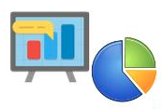


Sends Data
Looks for Sensitive
Data
User
Attacker
Implements
Development Team
Does Business
Application
Environment
Project Owner
Privacy
Assurance
Privacy
Engineer
Analyzes Data
Norms and
Certifications
Data
Recipient
Regulatory Agency

