Slide 1
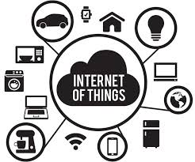
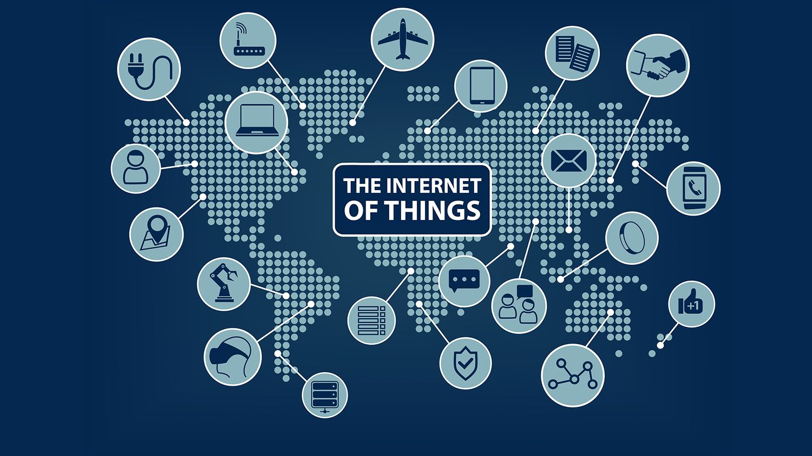
Assessment 2: The Internet of things
Presented by: Phakama Myeni
Date: 09/02/2026
Institution: IT Varsity

Slide 2
What is the Internet of Things?
In its simplest form, the Internet of Things (IoT) is a network of physical objects or things that have sensors, software, and other technologies. This setup allows them to connect and exchange data with other devices and systems over the internet .
IoT serves as a link between the physical and digital worlds. While your laptop and smartphone have always been connected, IoT adds “dumb” objects , such as lightbulbs, toothbrushes, or industrial turbines to the mix.

Slide 3
What is the history of IoT?
The history of the Internet of Things (IoT) shows a journey from a simple “connected machines” to a global network of billions of smart devices. Although the team was introduced in 1999, the idea of a connected world started much earlier.
The first electromagnetic telegraph was invented. It allowed machines to send information using electrical signals
Students connected a vending machine to the university’s local network. This way, they could check if the soda is cold and stock before walking to get one. This is widely seen as the first “IoT” device.
The rollout of5G has removed the “lag that used to affect devices. This change enables real-time autonomous cars and remote robotic surgery

Slide 4
What technologies enable IoT?
As of 2026, The technology stack has advanced beyond simple connectivity into AIoT (Artificial Intelligence of Things). In this realm, devices not only send data , but they also understand it.
The “muscles” enable the IoT system to perform actions, such as a opening a valve, turning on a light, or locking a door.
The new universal standards for smart homes let your Apple, Google, and Amazon devices work together more easily
Virtual 3D replicas of physical objects, like a jet engine , update in real time using sensor data. They predict when the real object will fail .
Hardware-level protection that stop hackers from installing harmful software when a device starts up.

Slide 5
What is its impact?
In 2026, the Internet of Things (IoT) has processed beyond the “smart gadget” stage and has become a crucial part of the global company and everyday life, Its impact is measured not just in convenience , but also in operational metrics, such as downtime avoided, lives saved, and carbon reduced.
In 2026, countries, especially India with its ISM 2.0 mission, are using IoT to track essential minerals and semiconductors in real-time. This help them protect themselves from global supply stocks.
Hospitals now send connected kits, including ECG patches, smart scales, and glucose monitors, to patients. This lets doctors track chronic conditions in real-time. As a result, they can prevent thousands of re-admissions.
Smart grids now automatically balance renewable energy like wind and solar. This approach significantly cuts down on waste.

Slide 6
What is its impact going to be in the future?
By 2030, we expect there will between 32 to 40 billion connected devices across the globe. The biggest change won’t just be the number of devices; it will be the fact that they will finally have brains (AI) and nerves (5G/6G) that function together without requiring our help.
Smart grids and bridges will use sensors to identify structural fatigue or power surges. They can automatically reroute electricity or request a repair robot before a failure happens.
Every major physical object, such as your car or entire city blocks, will have a virtual 3D twin that mirrors it in real-time. This lets engineers test “what if scenarios in the digital world before making changes in the physical.
In the future, products will have “Digital Passports”. When you finish using a phone or a toaster, its IoT tag will inform a recycling robot about the materials inside and how to disassemble it for reuse.

Slide 7
My referenecs
https://www,ibm.com
https://www.tectargets.com
https://www.invesopedia.com
https://www.oracle.com

