Slide 1
Filtering things
With Set()

Slide 2

Set theory

Slide 3

Union
union(Set(1, 2), Set(2, 3)) => Set(1, 2, 3)

Slide 4
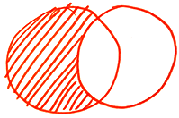
Difference
difference(Set(1, 2), Set(2, 3)) => Set(1)

Slide 5
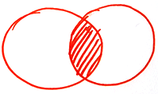
Intersection
intersection(Set(1, 2), Set(2, 3)) => Set(2)

Slide 6

Relative complement
complement(Set(1, 2), Set(2, 3)) => Set(3)

Slide 7
Unique properties of Set()
All values are unique
new Set([iterable]);

Slide 8
Union
const union = (a, b) =>
new Set([...a, ...b]);

Slide 9
Difference
const difference = (a, b) =>
new Set([...a].filter(x => !b.has(x)));

Slide 10
Intersection
const intersection = (a, b) =>
new Set([...a].filter(x => b.has(x)));

Slide 11
Relative complement
const relativeComplement = (a, b) =>
difference(b, a);

Slide 12
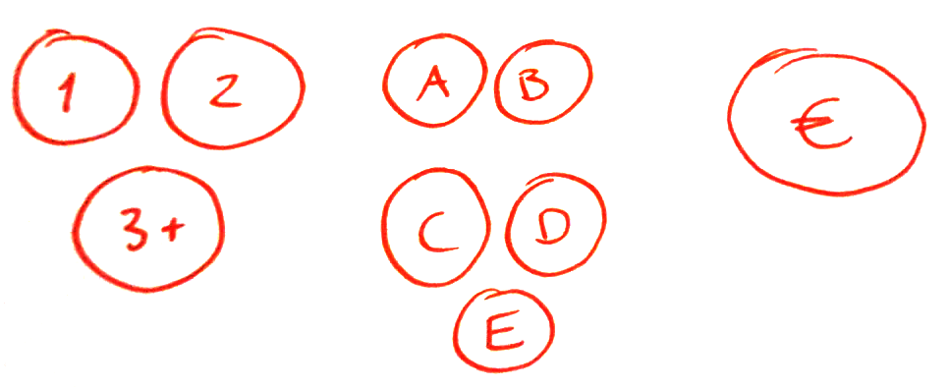
Our filters

Slide 13

Join

Slide 14

Intersection

Slide 15
So what’s a filter?
// Set(ids) => Set(ids)
const filter = ids =>
new Set([...ids].filter(filterFn))

Slide 16
The lookup table
Without respective data, ids are useless
We store an [id, data] pair in a Map
new Map([[key, value], [key, value], …])

Slide 17
The lookup table
const lookupTable =
new Map(data.map(item => [item.id, item]))
// new Map([[key, value], [key, value], …])

Slide 18

The complete set
A set of all the ids, which we can work on
const completeSet =
new Set(lookupTable.keys())

Slide 19
Now, buckle up

Slide 20
Higher order functions 😱

Slide 21
// Returns a lookup table: Map
const makeLookupTable = (data, key) => new Map(data.map(item => [item[key], item])) // Returns a filter: Set(ids) => Set(ids) const makeFilter = filterFn => ids => new Set([...ids].filter(filterFn))

Slide 22
Joining filters
const filters = [filterA, filterB]
const finalResult =
joinFilters(filters, intersection)
// finalResult = Set(ids) => Set(ids)

Slide 23
const joinFilters = (filters, relation) => { return ids => { return filters.reduce((result, filter) => { return result ? relation(result, filter(ids)) : filter(ids) }, null) } }

Slide 24

Coding time!
http://github.com/…

Slide 25
More utilities!

Slide 26
const comparisons = { eq: (a, b) => String(a) === b, gt: (a, b) => a > Number(b), gte: (a, b) => a >= Number(b), lt: (a, b) => a < Number(b), lte: (a, b) => a <= Number(b) }

Slide 27
// Returns a filter: Set(ids) => Set(ids) const makeInputFilter =
(element, lookupTable, comparison) => { return makeFilter(id => { const data = lookupTable.get(id)
return comparison(data[element.name], element.value) }) }

Slide 28
Coding time!
http://github.com/…

Slide 29
Improvement
Use set operations to determine the difference between the old and new result
Animate separate items in & out, instead of updating the whole HTML

Slide 30
Word of caution
Filter logic must live in a single place!
Therefore only filter using JavaScript if…
…you share the filtering logic with a JavaScript backend
…you treat filtering as an enhancement

Slide 31
The end

