Slide 1

NURA
Care that gets documented.
Revenue that gets protected.
EVIDENCE-FIRST DOCUMENTATION FOR AMBULATORY CARE
Revenue-assurance infrastructure for German ambulatory care

Slide 2
THE PROBLEM
The care happened. The paperwork failed.
01
Care delivered
Ambulatory care providers in Germany run on thin margins. A missing signature, an illegible abbreviation, a wrong date turns a completed, legitimate service into a rejected claim — costing thousands of euros per provider, per month, in delayed or lost cash.
02
Documentation
03
Small form error
04
Claim problem
05
Administrative work
06
Cashflow impact
02

Slide 3
BRAND IDEA
Earn trust before billing.
Nura turns care into a verifiable evidence chain — before a claim moves forward.
Care
Verification
Documentation
Validation
Billing-ready
Integration
Reimbursement
Caregiver sees
Nura's infrastructure handles the rest
A service should not silently fall out of the chain because one required field was missed. The fix isn't more paperwork — it's making the chain itself impossible to silently break.
03

Slide 4
THE SOLUTION
Five taps. No menus, no forms.
Arrive
→
Confirm
→
Perform
→
Slide
→
Done
Underneath: multi-signal visit verification, a versioned rules engine, and a billing firewall that checks every service before it's allowed to become a claim.
CLAIM VALIDATION
Patient
✓
Service
✓
Date & time
✓
Required documentation
✓
Confirmation
✓
✓ All checks passed
04

Slide 5
DIFFERENTIATION
Nura doesn't automate risk.
It automates certainty.
Verify
Validate
Record
Escalate
Never trust a single signal.
Never send incomplete billing data.
Never silently overwrite an audit trail.
Never decide automatically under uncertainty.
Low-confidence visit matches escalate to the caregiver instead of guessing.
The billing firewall blocks a claim before it's incomplete, not after.
Corrections create a new event — the original gap stays visible.
Sync conflicts lock billing and route to a supervisor, not auto-resolve.
05

Slide 6
BUSINESS MODEL
One managed digital work station.
HARDWARE-AS-A-SERVICE
Not "an app that costs €129."
€129
~15,300
420,000+
per device, per month
ambulatory care providers in Germany
caregivers as the target market
• Hardware + device management
• Nura software + updates
• Security, remote lock/wipe
• Offline sync + audit trail
• Support & SLA
Market-size figures are from the original concept memo; not independently re-verified in this deck.
06

Slide 7
PROOF, NOT PROMISES
Start small. Prove the economics. Scale.
01
02
03
04
Baseline
Deployment
Measurement
Scale
Measure current documentation-related rejection rate.
Introduce Nura into daily caregiver workflows.
Track rejection rate, correction time, billing readiness.
Expand only once evidence is measurable.
The KPI that matters: documentation-related billing rejection rate — measured before and after deployment, not asserted upfront.
We are not claiming 0% rejection across every cause, and pilot validation is single-site — a case study, not market-wide proof yet.
07

Slide 8
INTELLECTUAL HONESTY
What we're not claiming today.
Not 0% billing rejection.
Only documentation/form-related rejections trend toward zero — Nura can't control every payer-side reason.
Not fraud prevention.
Nura creates an evidence chain, not mathematical proof of care.
Not a TI/KIM replacement.
Nura is integration-ready, not a replacement for regulated infrastructure.
Not market-wide proof.
Pilot validation is single-site — a case study, not proof the model generalizes yet.
08

Slide 9
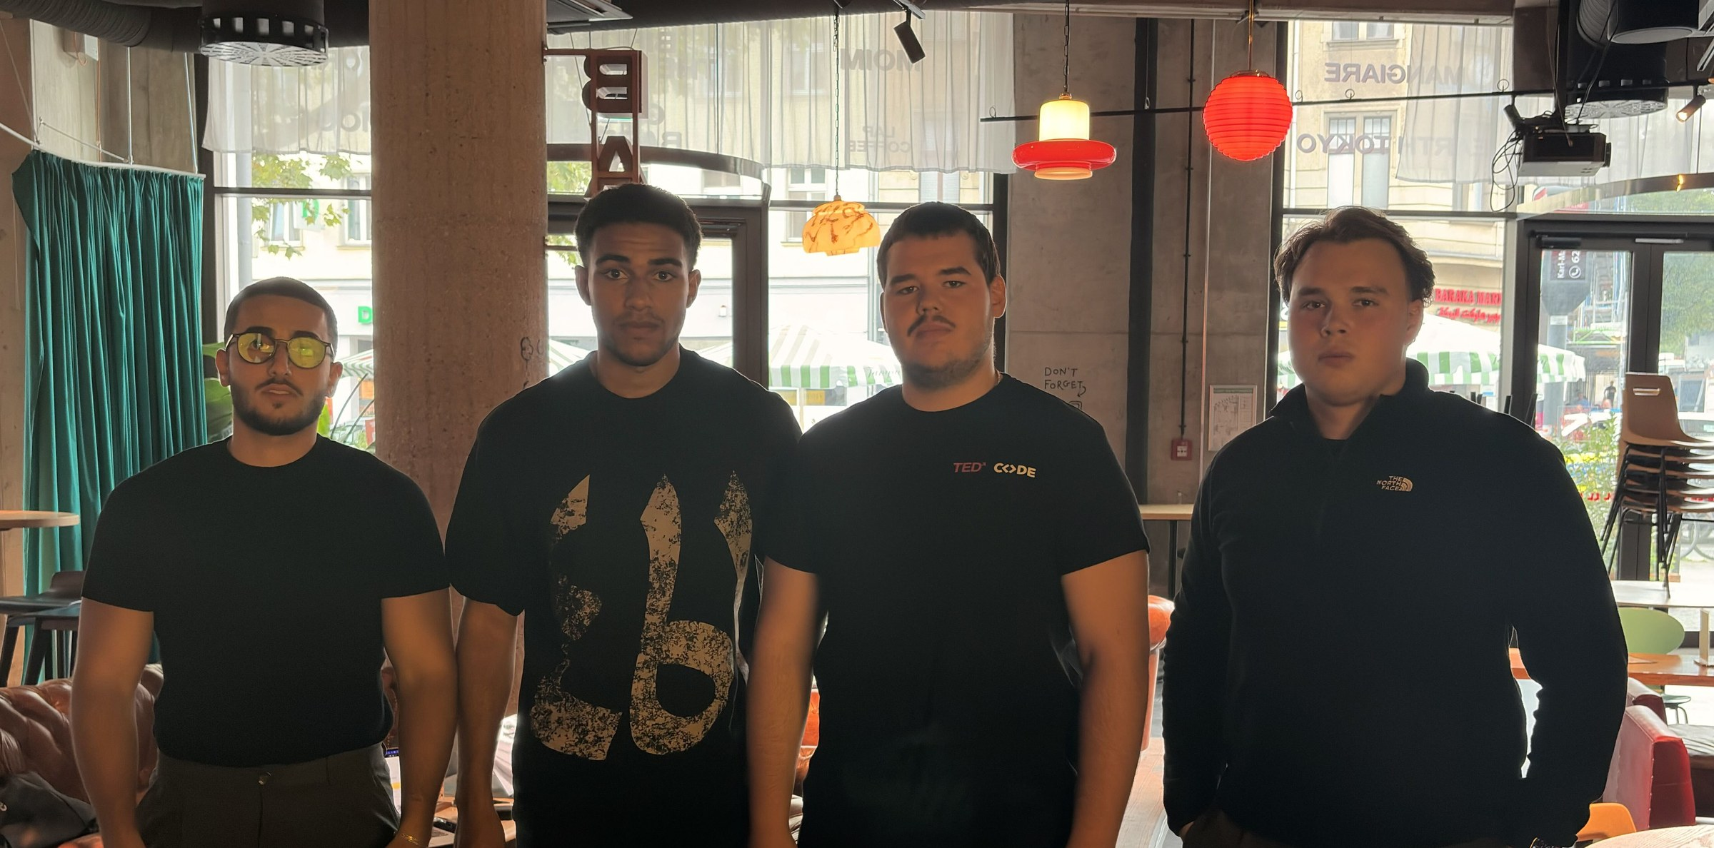
THE TEAM
The founders behind Nura.
Rafael
Louis
Ivan
Oscar
Co-Founder & CSO
Co-Founder & COO
Co-Founder & CTO
Founder & CEO
09

Slide 10
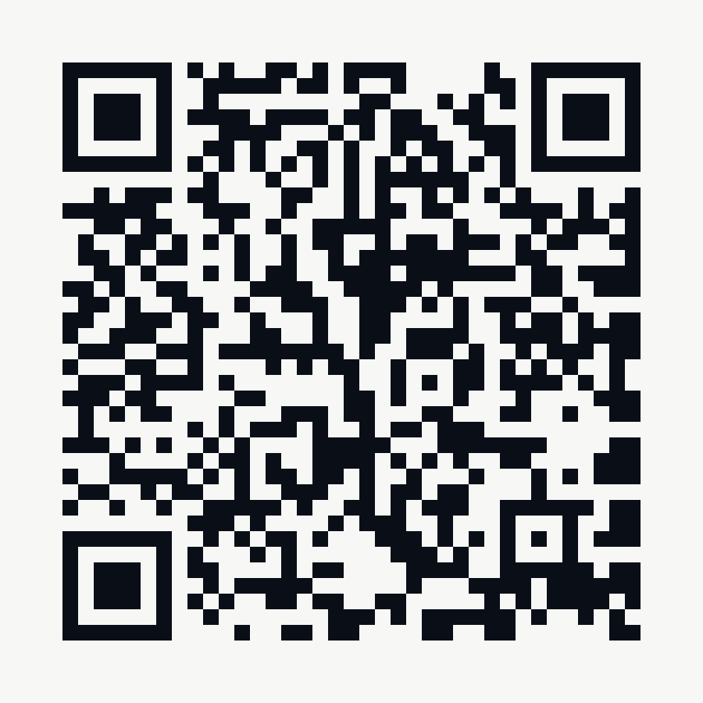
NURA
Nura protects the revenue between
care delivered and cash received.
Scan to try the prototype
peeky-0.github.io/NURA-Health-Care-

