Slide 1
Heart Sound Classification Project
Title: Prediction of Heart Failure and Heart Valve Disorders
Leela Sai Surya Peela
23088635
M.Sc. Data Science Student
University of Hertfordshire
GITHUB LINK: https://github.com/peelaleelasaisurya20/Data_Science_Final_Project.git

Slide 2
Why I Chose This Project
INTRODUCTION :
Heart problems are very common, and early detection can save lives.
Heart sounds carry useful information that doctors listen to.
I wanted to build a system that can help detect valve issues using audio.

Slide 3
Basics of Heart Sounds
A normal heart makes two main sounds: S1 and S2.
Abnormal sounds like murmurs can show valve problems.
Recordings are usually taken from four important chest points.

Slide 4
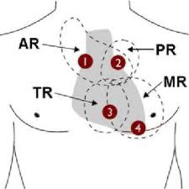
Auscultation Points
AR: aortic valve regurgitation
TR: Tricuspid valve regurgitation
PR: Pulmonary valve regurgitation
MR: Mitral valve regurgitation
Source: Auscultation points

Slide 5
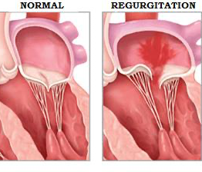
Normal vs Regurgitation
Source: Normal vs Regurgitation

Slide 6
Goal of My Project
Understand heart sounds and identify if a recording is normal or abnormal.
1
Use audio features to train a deep learning model.
2
Make predictions on new heart sound files.
3

Slide 7
Datasets I Used
I used two datasets: one from Kaggle and one from Mendeley.
Both datasets include different types of heart sounds in WAV format upto 400 Audio files.
They contain normal, murmur, extrasystole, and noisy recordings.

Slide 8
Preprocessing Steps
I cleaned and trimmed audio to a fixed duration.
Converted each recording into a Mel‑Spectrogram.
This creates an image-like form that the model can learn from.

Slide 9
Model Architecture
I used a CNN because it works well with image-like inputs.
Input: Mel‑Spectrogram of the heart sound.
Output: Predicted heart condition.

Slide 10
Model-2
CNN extracts local features from Mel-spectrograms (frequency patterns, murmurs).
LSTM processes the temporal sequence of these features (heart cycles over time).
Together, they understand both what the sound looks like and how it changes over time.

Slide 11
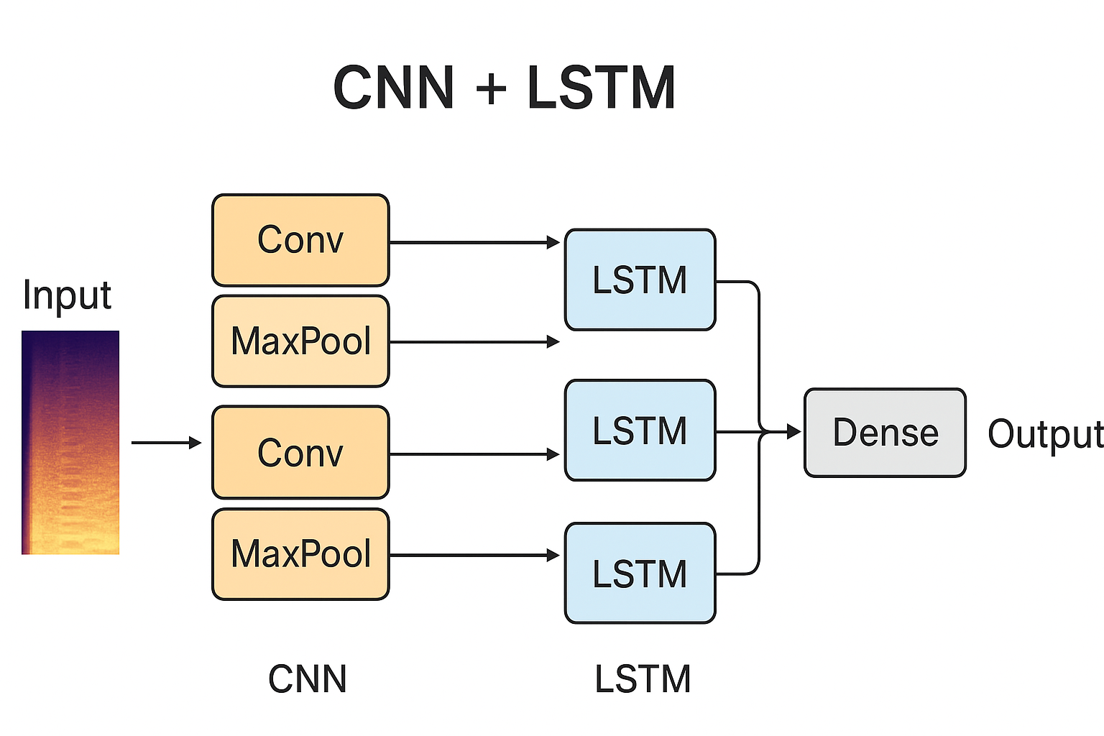
Model-2 Architecture

Slide 12
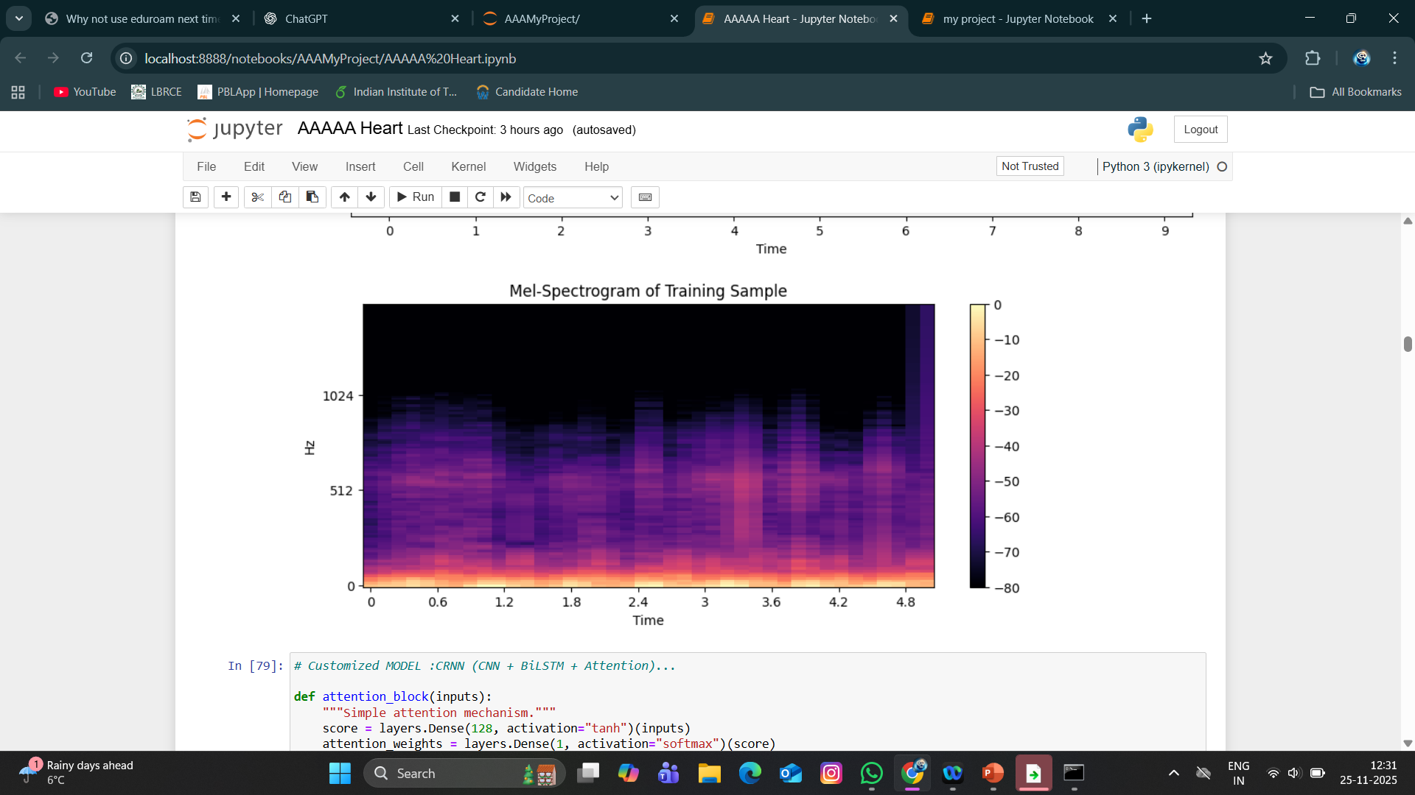
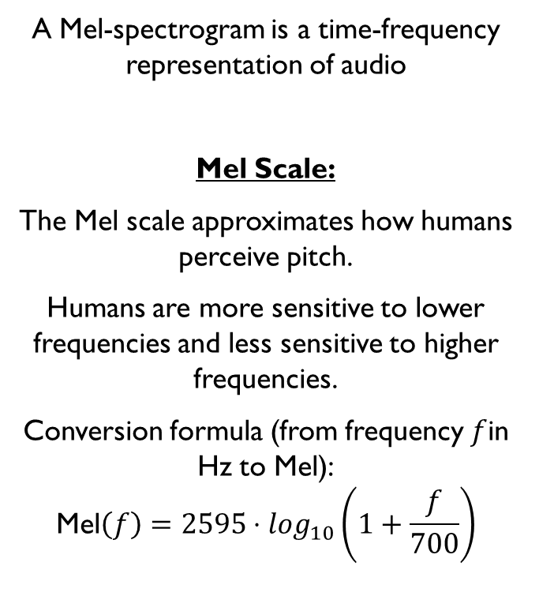
Mel-Spectogram
A Mel-spectrogram is a time-frequency representation of audio
Mel Scale:
The Mel scale approximates how humans perceive pitch.
Humans are more sensitive to lower frequencies and less sensitive to higher frequencies.
Conversion formula (from frequency $f$in Hz to Mel):
$$\text{Mel}\left(f\right)=2595⋅\log_{10}\left(1+\frac{f}{700}\right)$$

Slide 13
Parameter Tuning (for CNN + LSTM Model):
Hyperparameters such as the number of mels (n_mels), learning rate, batch size, number of filters, and LSTM units were systematically tuned to improve accuracy.
Grid search and manual iterative tuning were used to find the best model configuration.
Regularisation (Dropout + Early Stopping) was applied to prevent overfitting.
Final tuned model achieved better generalisation and higher classification confidence than the baseline CNN model.

Slide 14
How Prediction Works
The audio file is loaded and played.
Waveform and spectrogram are generated.
The model analyses the spectrogram and gives the predicted class.
I also show the top‑3 most likely classes.

Slide 15
Results
The model was able to classify most heart sounds correctly.
It also gives confidence scores for each class.
The system can be used to test new recordings easily.

Slide 16
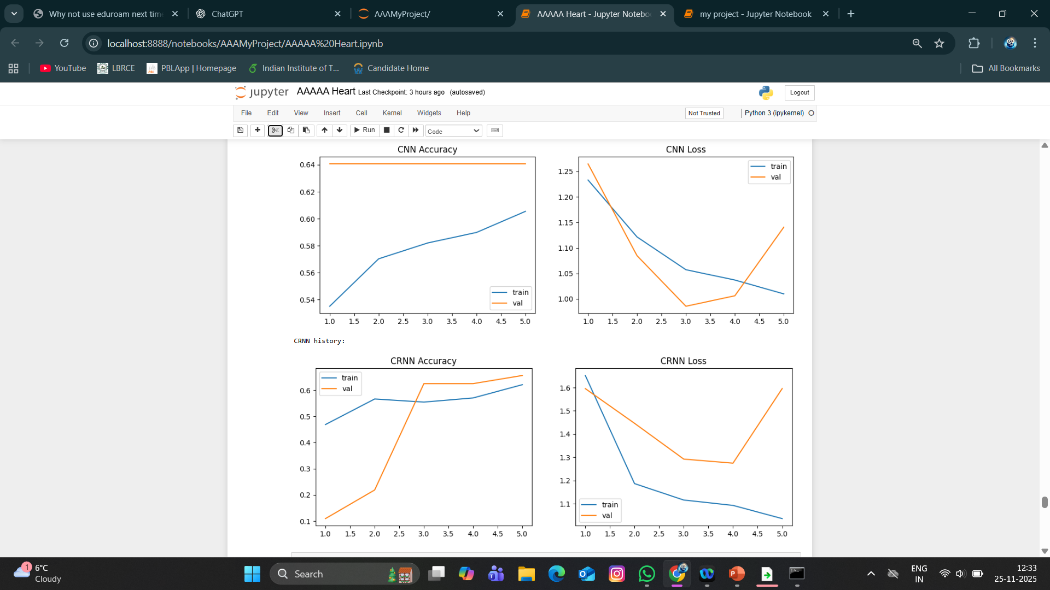
Plots: Comparison between two Models
CNN Results: Training accuracy increases, but validation accuracy stays flat, and validation loss spikes after epoch 3 → model is overfitting.
CRNN Results: Validation accuracy improves sharply around epoch 3, but validation loss also rises later → overfitting begins similarly.
Common Pattern: Both models learn well initially (loss decreases, accuracy increases) but fail to generalise after a few epochs.
Interpretation: The optimal stopping point is around epoch 3, and you may need regularization or more data to improve validation performance.

Slide 17
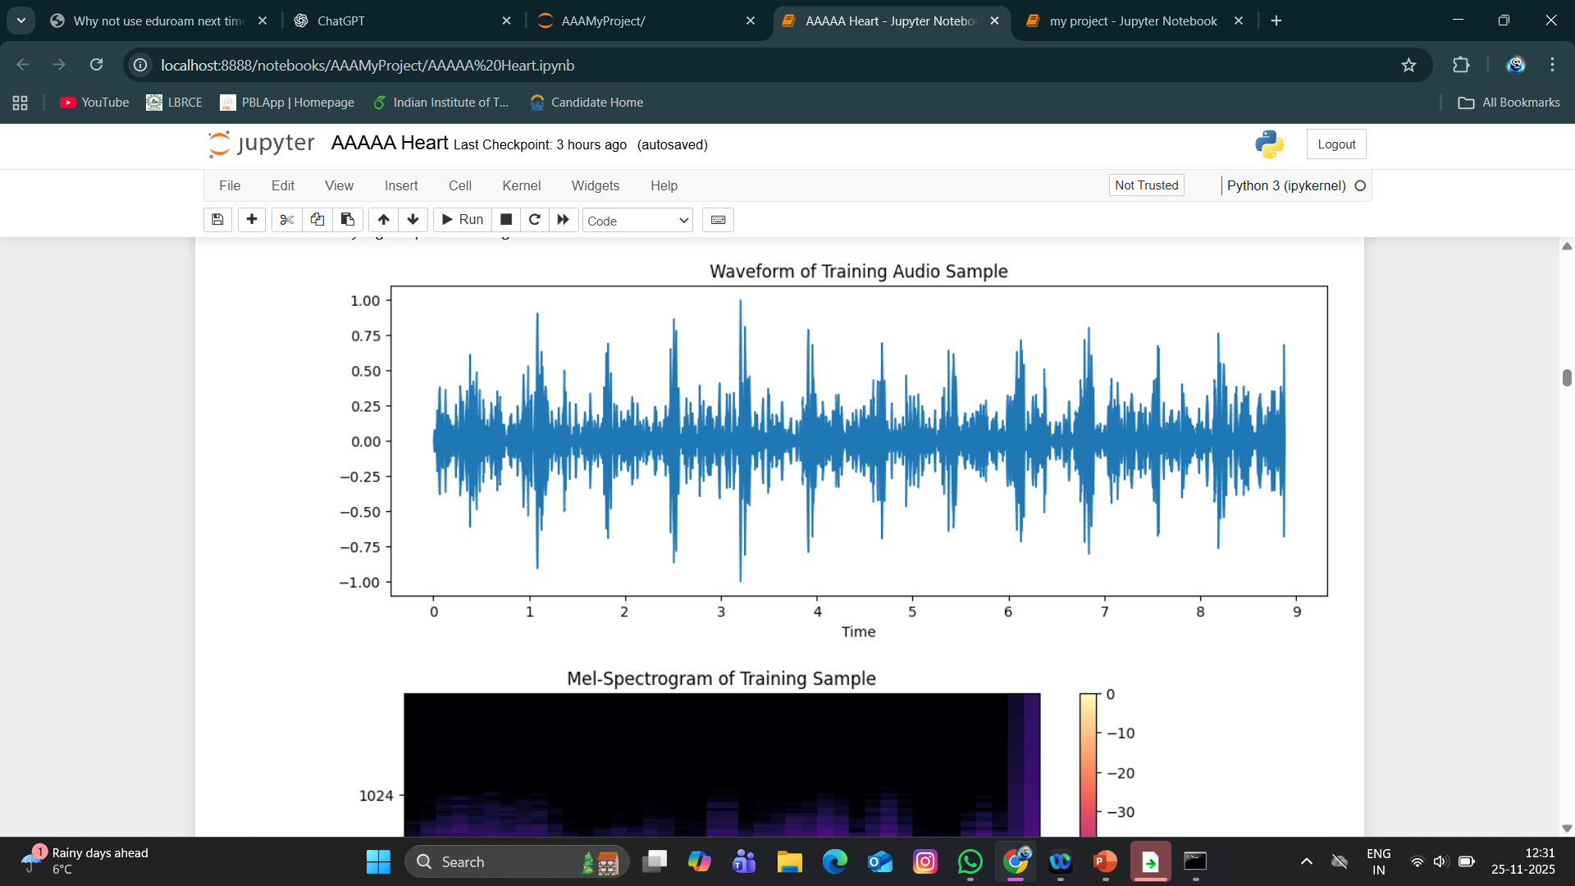
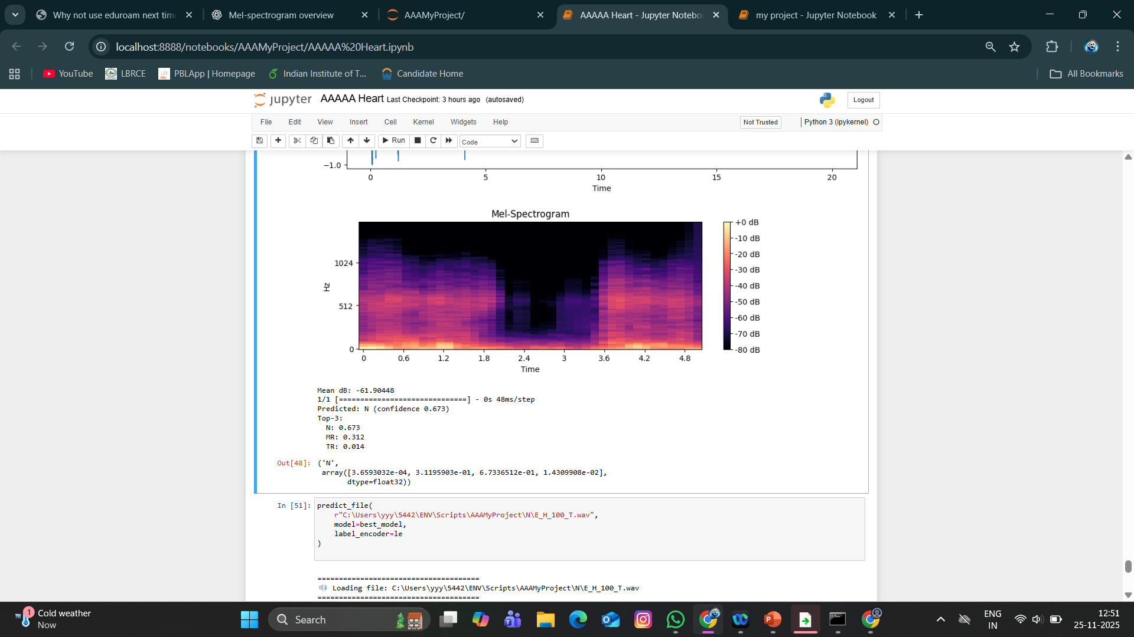
OUTPUT:
The top plot shows the waveform of a heart-related training audio sample, representing how the sound amplitude
varies over time.
The waveform displays many peaks and fluctuations, indicating active and noisy sound activity typical of a heartbeat
audio.

Slide 18
Challenges I Faced
Some audio files had a lot of background noise.
Recordings were taken in different environments.
Some classes had fewer samples than others.

Slide 19
Future Work
Collect
Collect more high‑quality recordings.
Try
Try advanced models with attention layers.
Build
Build a small app where users can upload audio.

Slide 20

Conclusion
This project helped me understand how heart sounds can be used for diagnosis.
Deep learning worked well with spectrogram features.
With better data, the model can support early heart disease detection.

Slide 21
References
Development and validation of a prediction model for heart failure in patients with heart valvular regurgitation WenKang Xiao ¹, Jia‐Lin Yuan ¹, YunYi Chen ¹, GuiPing Ma ², ChaoQiong Zhang ¹, Le Sun ³, ChuangXiong Hong ^{4,✉}, Taochun Ye ^{4,5,✉}
Isaza N, Desai MY, Kapadia SR, Krishnaswamy A, Rodriguez LL, Grimm RA, et al. Long‐term outcomes in patients with mixed aortic valve disease and preserved left ventricular ejection fraction. J Am Heart Assoc 2020;9:e014591. doi: 10.1161/JAHA.119.014591 Epub 2020 Mar 24. PMID: 32204665; PMCID: PMC7428636 [DOI] [PMC free article] [PubMed] [Google Scholar]
The future of valvular heart disease assessment and therapy;Prof Partho P Sengupta, MD DM^{a,b} partho.sengupta@rutgers.edu ∙ Prof Jolanda Kluin, MD PhD^{c} ∙ Prof Seung-Pyo Lee, MD PhD^{d} ∙ Prof Jae K Oh, MDe ∙ Anthal I P M Smits, PhD^{f,g} ;DOI: 10.1016/S0140-6736(23)02754-X External LinkAlso available on ScienceDirect

Slide 22
THANK YOU!

