Slide 1
Identifying misinformation in diabetes videos
Peem Lerdputtipongporn
Advised by Nynke Niezink, Larry Wasserman, Rema Padman
21st March 2022

Slide 2

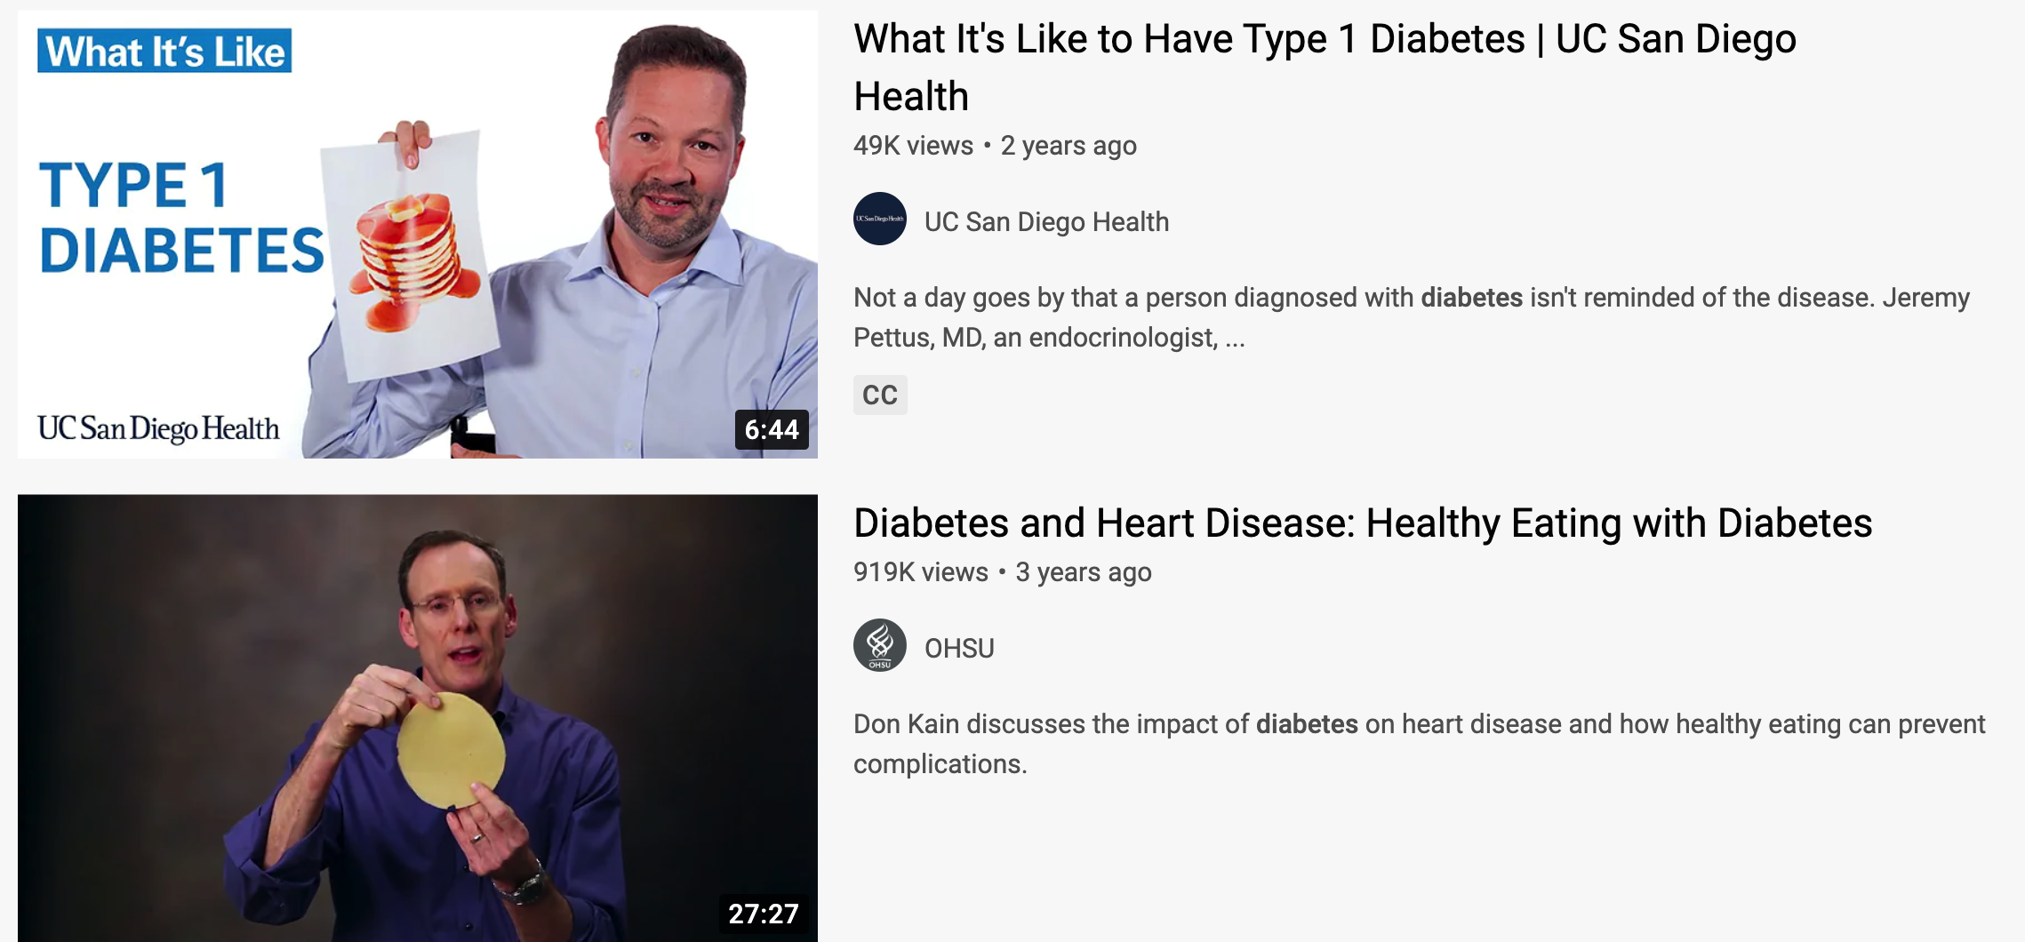
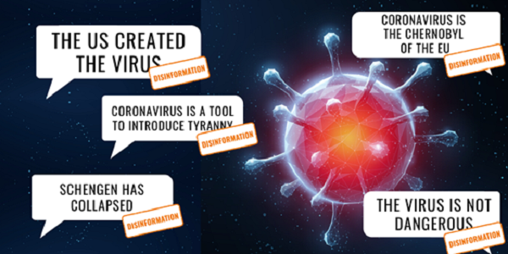
This is the era of health infodemic.
Notes:
- Today, live in an era of infodemic.
- Overabundance of information in the online setting makes making it difficult to identify trustworthy experts whose guidance we can rely upon.
- This presents both promises and perils for us.
- As for promise, online resources allow you to access health information anytime and anywhere you want instead of having to rely on physicians.
As for peril, the abundance of online resources means there exist a lot of misinformation. Misinformation is a serious problem because it not only makes people take actions detrimental to their health and but also undermines public health responses.
That many people today are hesitant to receive COVID vaccines for fear they contain microchips or make one impotent highlights this point.

Slide 3
We want to detect health misinformation.
Notes:
Therefore, we want to detect health information. This is the goal of our project.

Slide 4
Existing work on identifying misinformation.
Requires manual labelling from physicians (Goobie et. al. ‘19, Szmuda et. al. ’20)
Invokes strong structural assumptions:
Accurate and inaccurate videos form a network (Tang et. al. ‘21).
User-reported labels (Knuutila et. al. ‘20).
Text-based misinformation about acute diseases (Muric et. al. ‘21).
Notes:
Many scholars have studied misinformation in online settings.

Slide 5
Our contribution.
Requires manual labelling from physicians (Goobie et. al. ‘19, Szmuda et. al. ’20)
Invokes strong structural assumptions:
Accurate and inaccurate videos form a network (Tang et. al. ‘21).
User-reported labels (Knuutila et. al. ‘20).
Text-based misinformation about acute diseases (Muric et. al. ‘21).
Is scalable because of semi-supervised learning.
Use direct misinformation labels from physicians.
Can be applied to unreleased videos.
Studies audio-visual media on chronic diseases.
Requires manual labelling from physicians (Goobie et. al. ‘19, Szmuda et. al. ’20)

Slide 6
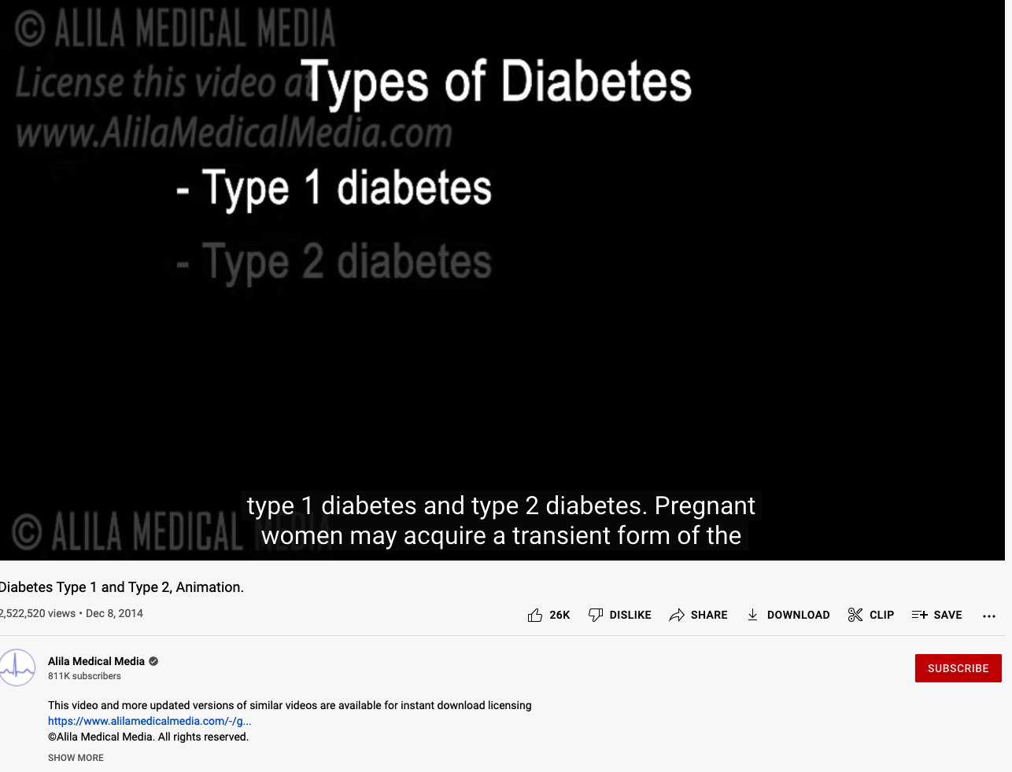
Dataset description
Video content
Transcript
Transcription confidence
Quality
Duration
Number of objects
Video metadata
Description
Channel name/description
Number of subscribers
Outcome features
Number of likes/dislikes
Total views
Comments

Slide 7
Assertion/Evidence
Current status:
Replicating previous work on video understandability (Liu et. al. ‘21).
No misinformation label yet (will be ready in three weeks).
Preliminary EDA results:
Network-exposure model is not possible with current dataset.
Dataset contains many irrelevant videos.
Readability indices are not suitable for understandability.

Slide 8
Dataset generation

Slide 9
How reviewers could help me?
Suggest ways to refine Slide 2-5 (they are intended to be novelty moves). My concern is that the texts are too brief to convey definition.
Based on what you have seen, what are you most interested in (motivation of this project, dataset, current findings, etc.)? What bores you as audience?
Flow of the presentation.

Slide 10
Credit (To be added)
https://oakland.edu/medicine/news/auto-list-news/2021/OUWB-faculty-on-personal-mission-to-fight-misinformation-in-health-care

