Slide 1
Mobile Chat Application
Team 1 : Wasupol, Peter, Ananya, Michael, Raef, Jian
MET CS 673
Professor Yuting Zhang
Notes:
Inner Circle

Slide 2
Project Overview
History (Background)
AIM TO DO (Objective)
Target audience
Notes:
Jian Ma - speaking
Storyboard?

Slide 3
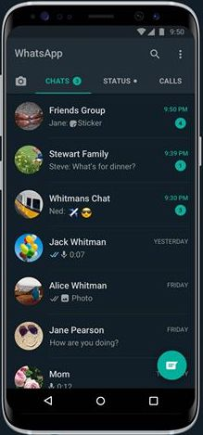
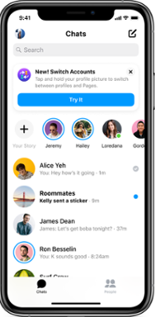
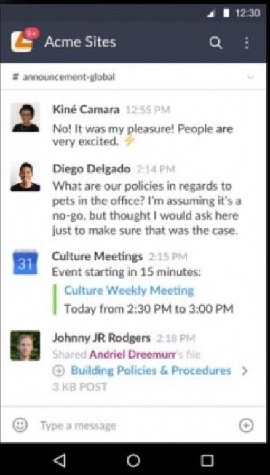
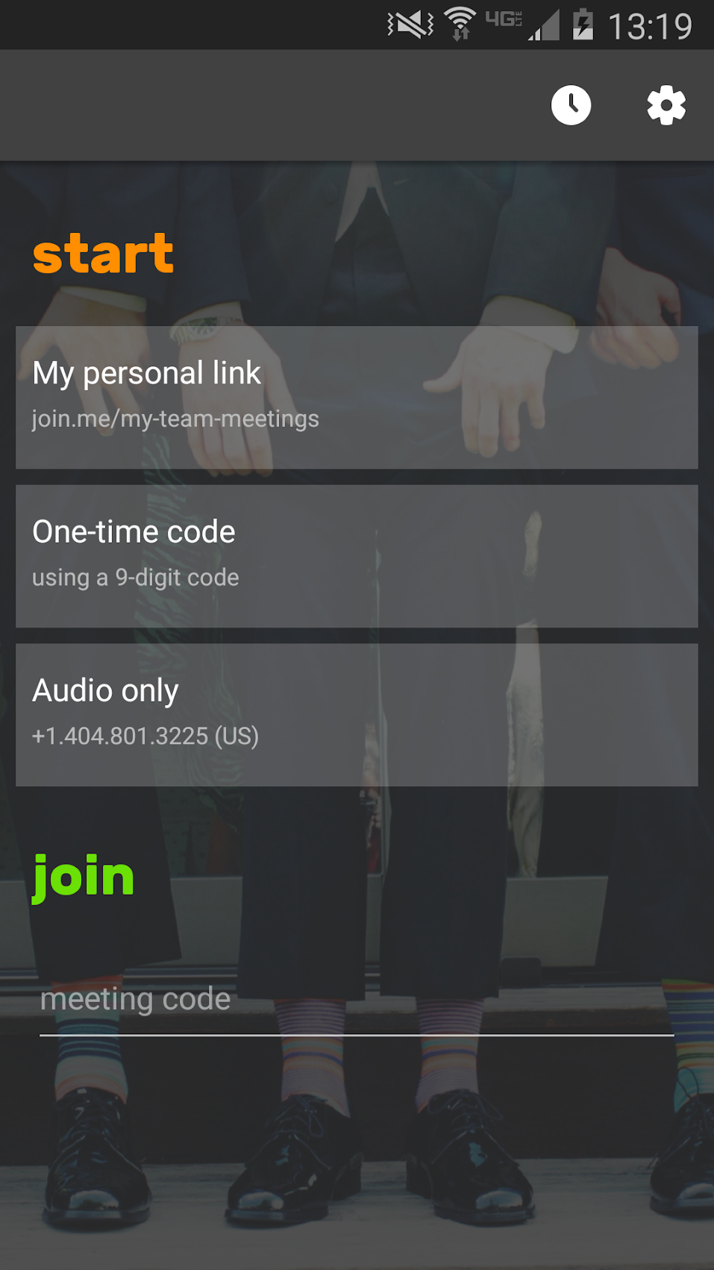
Related Work
WhatApps
Facebook Messenger
Slack
Join.Me
Notes:
Wasupol, Jian MA

Slide 4
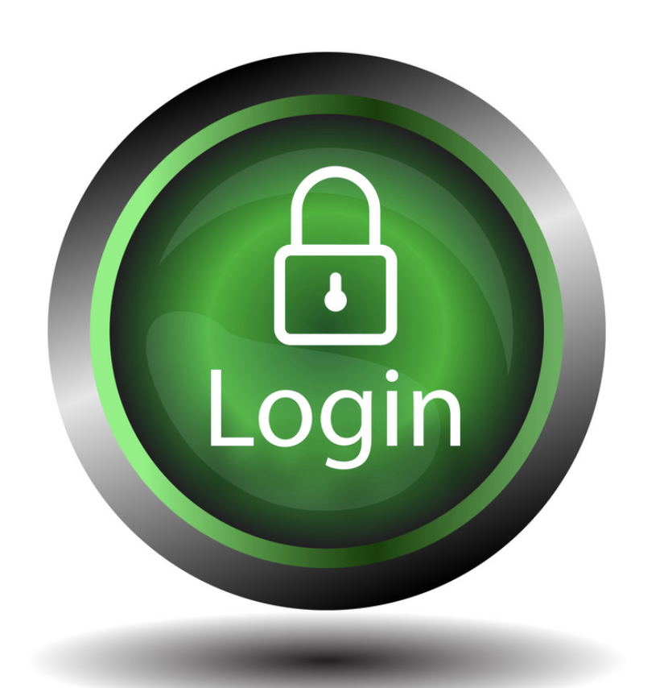
High level requirements
Essential Features
Desirable Features
Optional Features
Notes:
Ananya

Slide 5
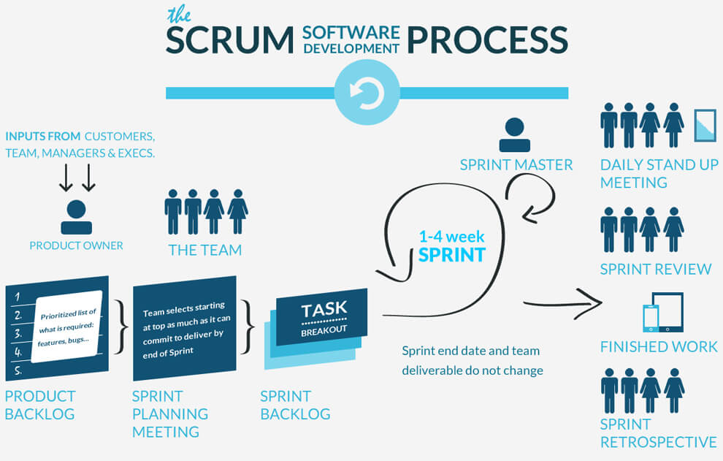
Process Model
Notes:
Process model
Agile Methodology with Scrum Framework
Objectives and Priorities
Maintain acceptable bugs known (85% pass)
No severity / high priorities bugs
All essential features must be implemented and delivered.

Slide 6
Process Model
Just short updates. (2-3 days update)
3 week
Notes:
Process model
Agile Methodology with Scrum Framework
Objectives and Priorities
Maintain acceptable bugs known (85% pass)
No severity / high priorities bugs
All essential features must be implemented and delivered.

Slide 7
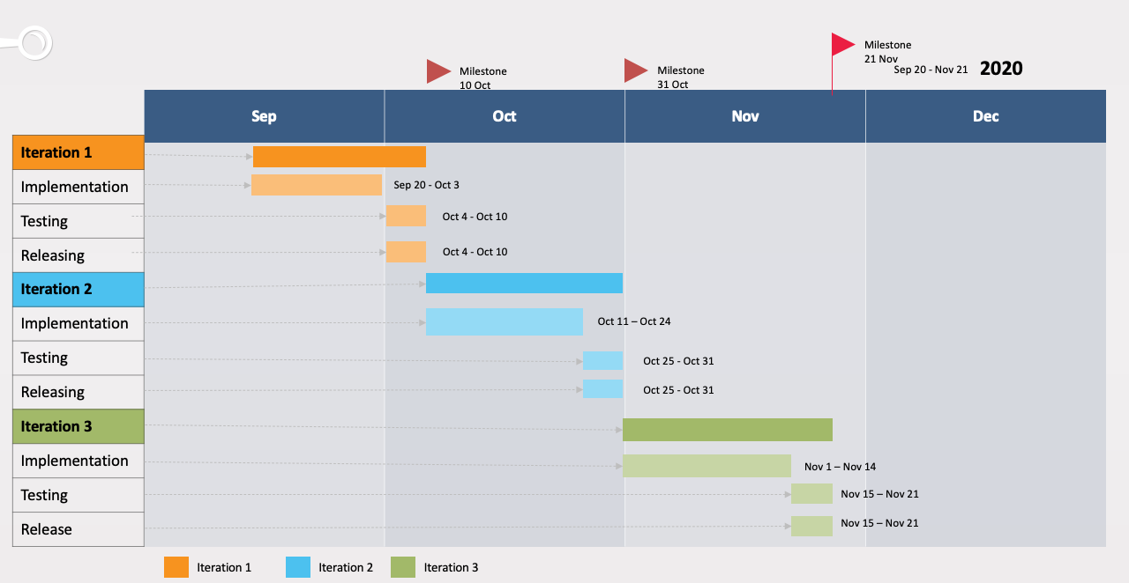
Project timeline

Slide 8














Implementation Plan
Development Tools
Releasing Tools
Notes:
Wasupol will speaking this

Slide 9
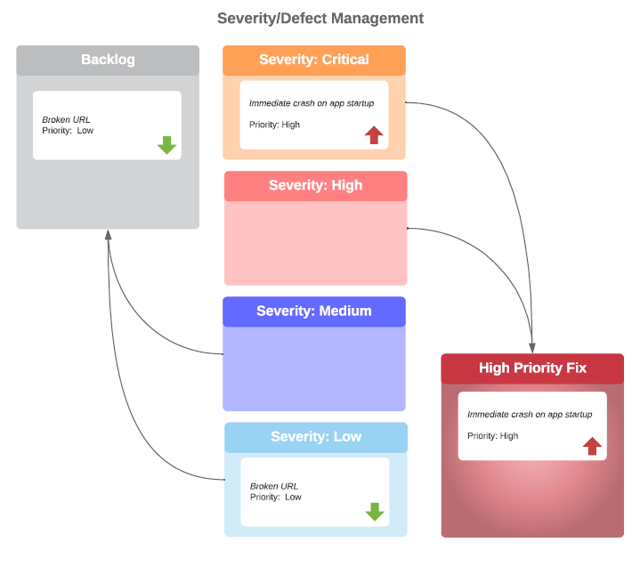
Quality Assurance Plan
Management Tool: Pivotaltracker
Product Metrics:
Defects per lines of code
# failed chat applications per given # of reference chat applications.
Notes:
Metrics: Subject to change as the nature of the program’s complexity becomes clear. Will also use metrics to track the effectiveness of QA (Defects resolved per an iteration/per man hours)
Critical/High defects: Defect addressed in current iteration potentially through a hotfix branch
Medium/Low defects: Story moved to backlog, addressed in future iteration.

Slide 10
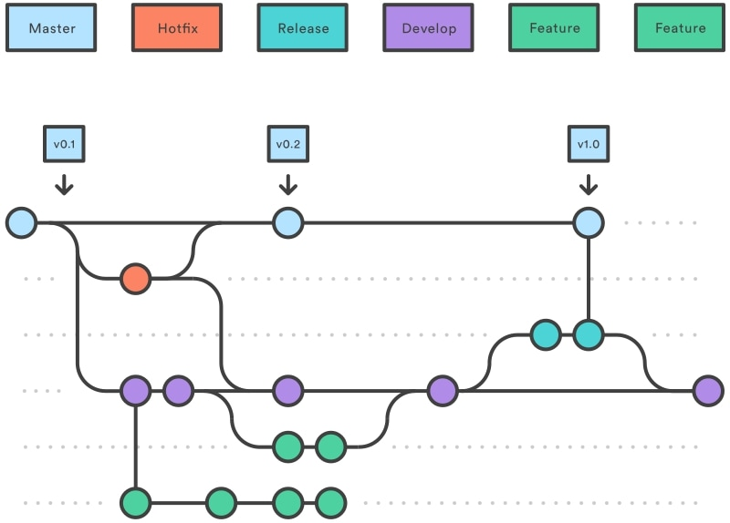

Configuration and Management Plan
Requires 1 reviewer in Github
Unit tests
Notes:
Git branching (Git flow)
Git Flow: Concept of using two main branches (ie master and development) to promote project development. Master branches for product release; Development branch for feature updates.
Continuous Integration/Continuous Delivery
Premerge build
Release publishing
Review process
Github branch rule

Slide 11
Security
Secure Android (Proguard, signed APK)
Firebase database rules
SSL\TLS connections
Encryption/Decryption
Best Practice for Android development
Android Security Best Practices
Notes:
Raef

Slide 12

Notes:
Q&A

