Slide 1

Segmentation
CSS225:OPERATING SYSTEM

Slide 2

Background
Memory management is the functionality of an operating system which handles or manages primary memory and moves processes back and forth between main memory and disk
Main memory and registers are the only storage that the CPU can access directly
CPU can’t access data stored in a disk directly

Slide 3
Memory management
There are two ways to manage memory
Paging - technique in which process address space is broken into blocks of the same size called pages
Segmentation -technique in which each job is divided into several segments of different sizes, Each segment is actually a different logical address space of the program.

Slide 4
Paging vs. Segmentation
Consideration | Paging | Segmentation
Need the program be aware of technique? | No | Yes
How many per-process virtual address spaces? | 1 | Many
Can the total address space exceed physical memory? | Yes | No
Can procedures and data be distinguished? | No | Yes
Sharing of procedures among users facilitated? | No | Yes
Motivation for the technique | Get larger linear space, eliminate external fragmentation | Programs and data in logical independent address spaces, sharing and protection made simpler

Slide 5
Segmentation
A logical address space is a collection of segments.
Each segment has a name and a length.
Different segments do not necessarily have the same length.
The logical addresses specify both the segment name and the offset within the segment.

Slide 6
Segmentation
Logical address consists of an ordered pair:
<segment-number , offset>
The user therefore specifies each address by two quantities: a segment name and an offset
Segments are numbered and referred to by a segment number rather than by a segment name
Ex <1,140> mean Segment 1 , Offset 140

Slide 7
Segmentation
To map logical addresses to physical addresses can be done by a segment table
Segment table – maps two-dimensional physical addresses; each table entry has:
Base – contains the starting physical address where the segments reside in memory
Limit – speciﬁes the length of the segment
Offset must be between 0 and the segment limit, if “YES” added to the segment base to produce the physical address

Slide 8
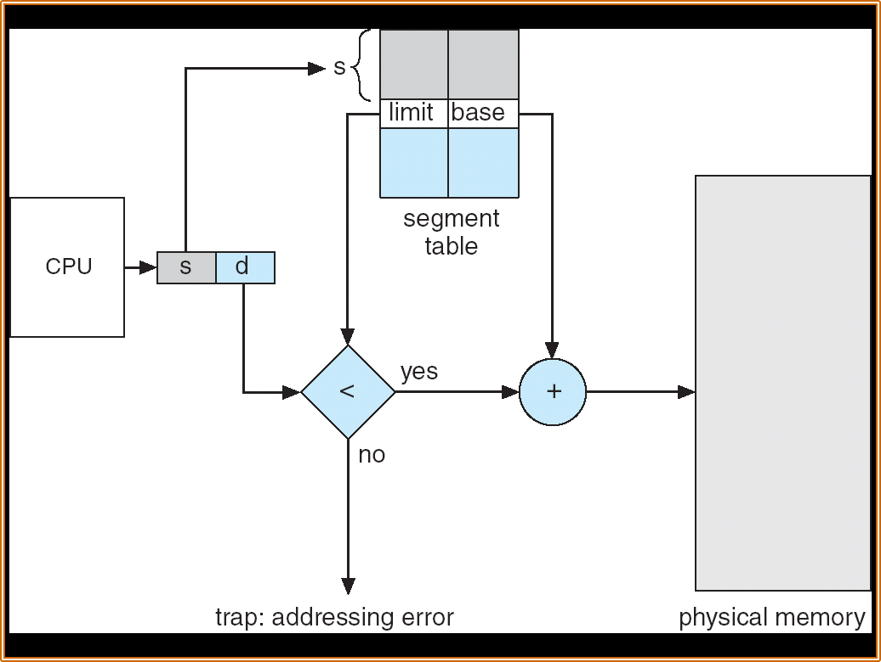
Segment Access

Slide 9
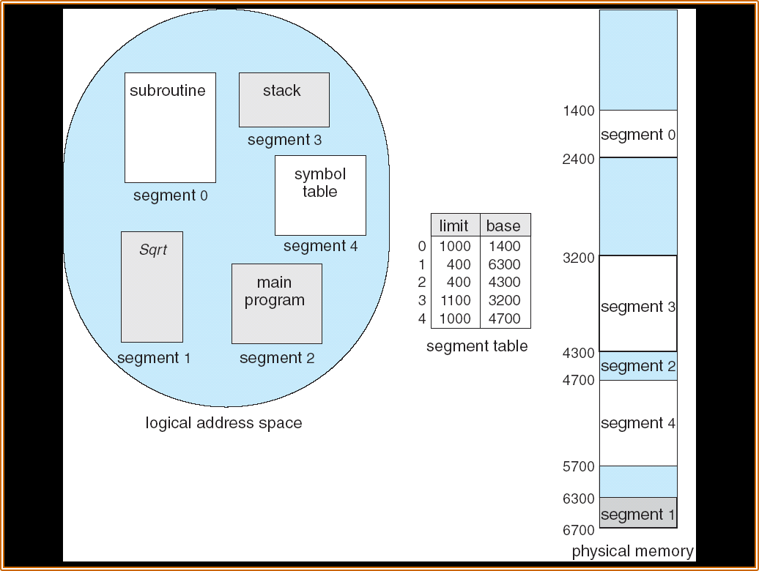
Example of Segmentation

Slide 10

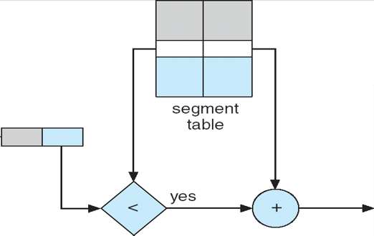
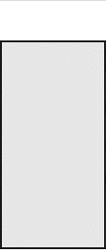
Example of Segmentation
From Table
Logical address <2,53> is mapped onto location 4353 How to do? Segment 2 ,Offset 53Segment 2 base is 4300 and limit is 400 Offset is 53 it is less than limit which is 400 so it can be added Finally Physical address = (Base of The Segment)+(Offset) = 4300+53 = 4353
400
4300
2
53

Slide 11




Logical vs. Physical Address
Logical address – generated by the CPU
It is an address at which a memory location appears to reside from the perspective of an executing program.
Physical address – address seen by the memory unit.
It is the address loaded into the memory-address register and is used to access a particular storage cell of main memory.
Essentially, the location of this data in RAM

Slide 12
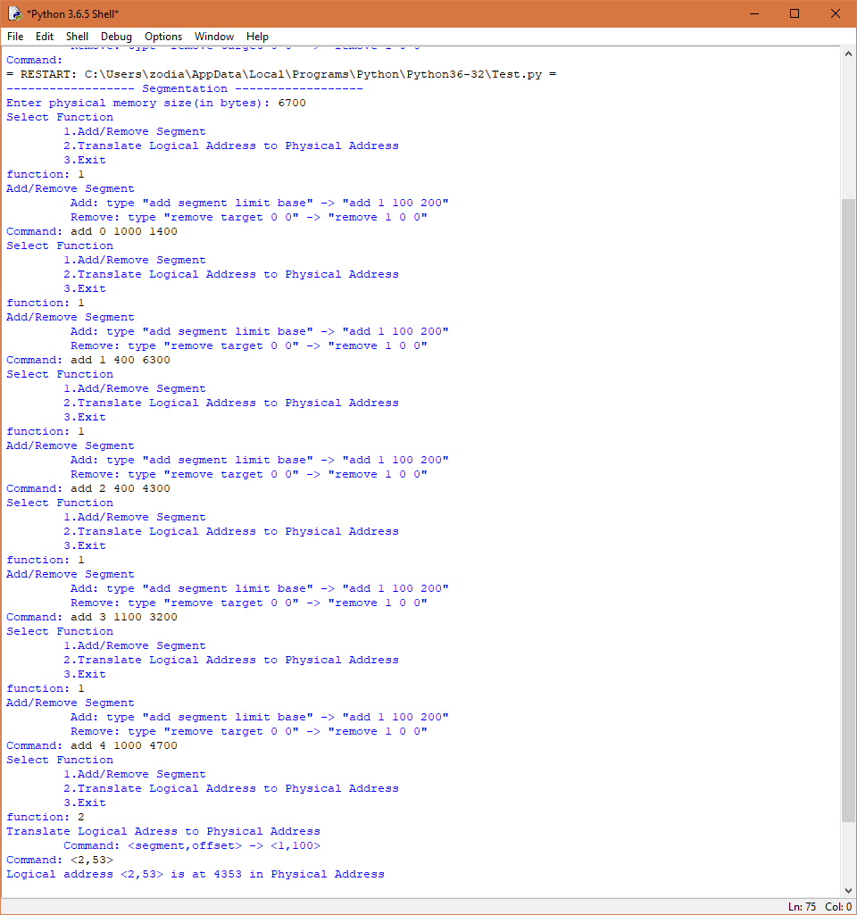
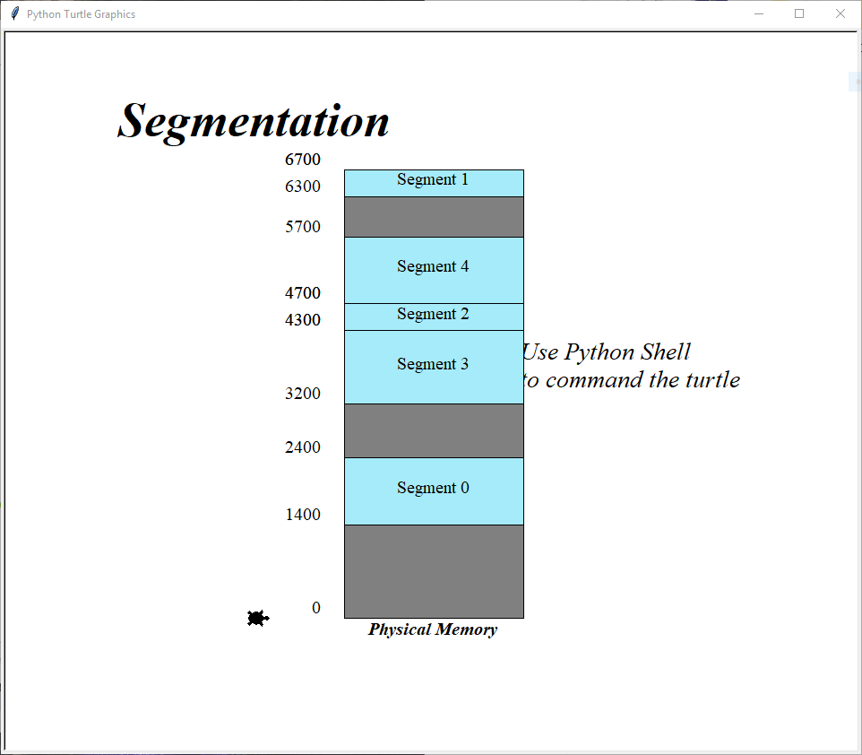

Group Program
Output
We use Python to create a program that can Add and Remove segment manually
It can translate Logical Address to Physical Address

Slide 13
Group Program
How to use it?
Step 1 : Input any number for physical memory size in unit of BYTES and turtle in python will draw a memory with “input” size
Step 2 : Select the function : There are 3 main functions in this program 1)Add or Remove Segment 2)Translate Logical Address to Physical Address 3)Exit
Step 3 : Repeat Step 2 until you finish work and exit program via input 3rd function

Slide 14
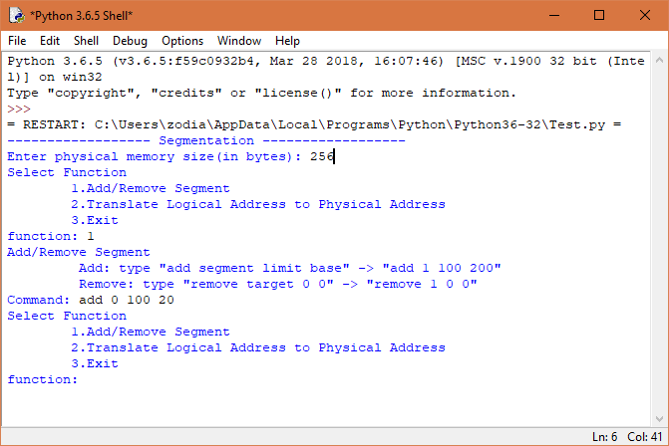
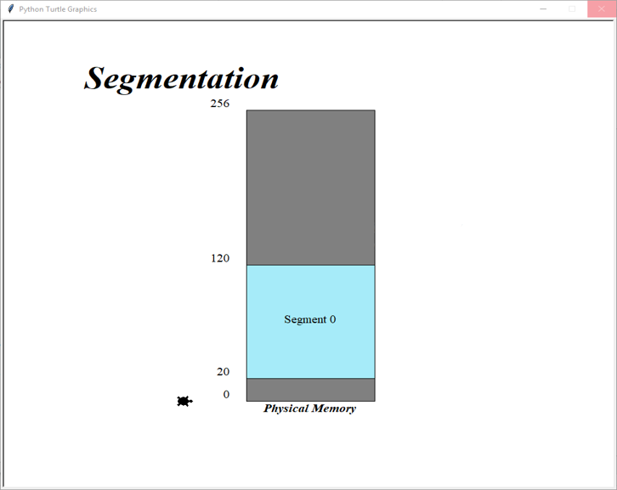
Group Program
Adding we need to input 4 arguments which are “add Segment# Limit Base” for Example add 0 100 20 mean add Segment#0 which limit is 100 and start from 20

Slide 15
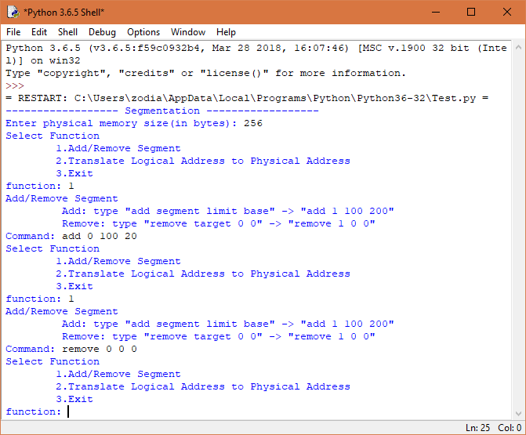
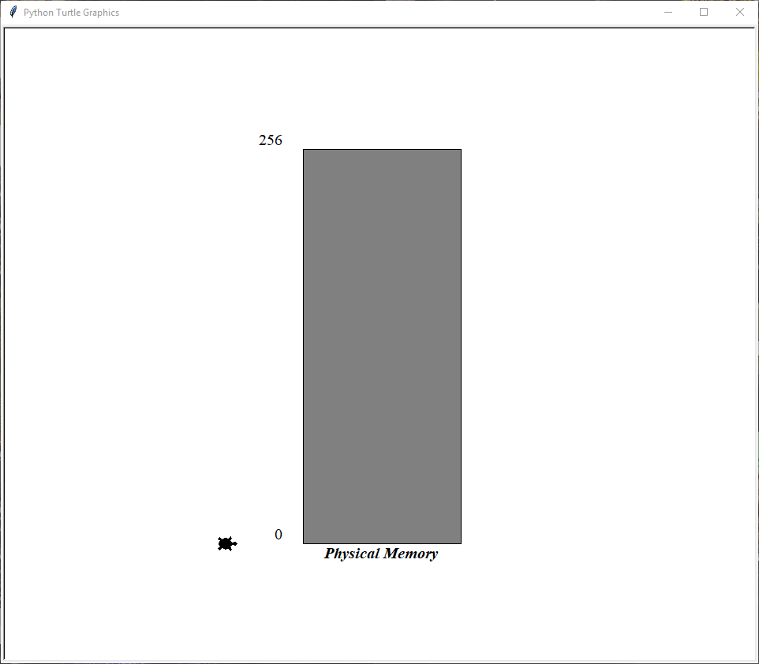
Group Program
Removing we need to input 4 arguments which are “remove Segment# 0 0” for Example remove 0 0 0 mean remove Segment#0

Slide 16
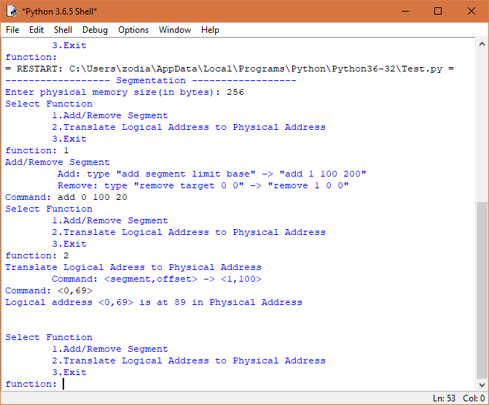
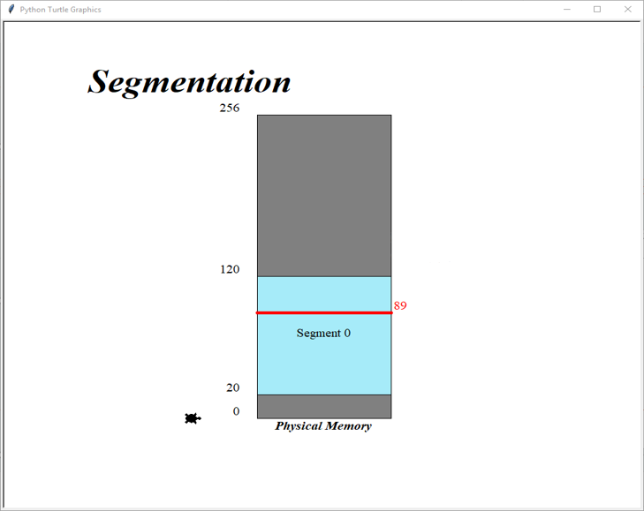
Group Program
Translate we need to input 1 arguments which in form of < Segment# , Offset > for mean remove Segment#0

Slide 17
Group Program
Example Testing Program
Output
Console

Slide 18
Group Members:
Sitthan Janetunyalux 5922770524
Chanon Haruenpon 5922782487
Peeranon Posawang 5922783261
Peerapat Chanawanno 5922783873

