Slide 1
Mutual funds Data Analytics Roadmap
Peerapat Tancharoen • Data Scientist • github.com/peerapat-t

Slide 2



ROLE OF DATA SCIENCE IN MARKETING IS TO PREDICT TARGETED AUDIENCES
Choice of marketing & audience
Good Audience
Bad Audience
Option 1 (Bottom-right)
Send a message to all customers on our platform.
Potential issue: This may overwhelm customers, leading to attrition.
Good Message
Option 2 (Top-right and Bottom-left)
Send a message to customers with specific attributes that align with the message content.
Potential issue: While it reduces bombardment, it may also miss interested customers who don’t fit the specified attributes.
Top-left (Happy)
Top-right (So so)
Option 3 (Top-left)
Data Science Approach.
Send a message only to customers likely to be interested.
Benefits: Minimizes overwhelming customers while maximizing reach to those genuinely interested.
Bad Message
Bottom-left (So so)
Bottom-right (Sad)

Slide 3
APPLY DATA SCIENCE IN EVERY STAGE OF CUSTOMER JOURNEY
4 “M” framework
Make them signup
Make them engage
Make them buy
Make them stay
Invite them at the right time.
Provide content based on their needs.
Offer the right product.
Offer it at the right time.
Offer with the right message.
Avoid overselling.
Recognize redemption signal.
Understand the investment ending period.

Slide 4
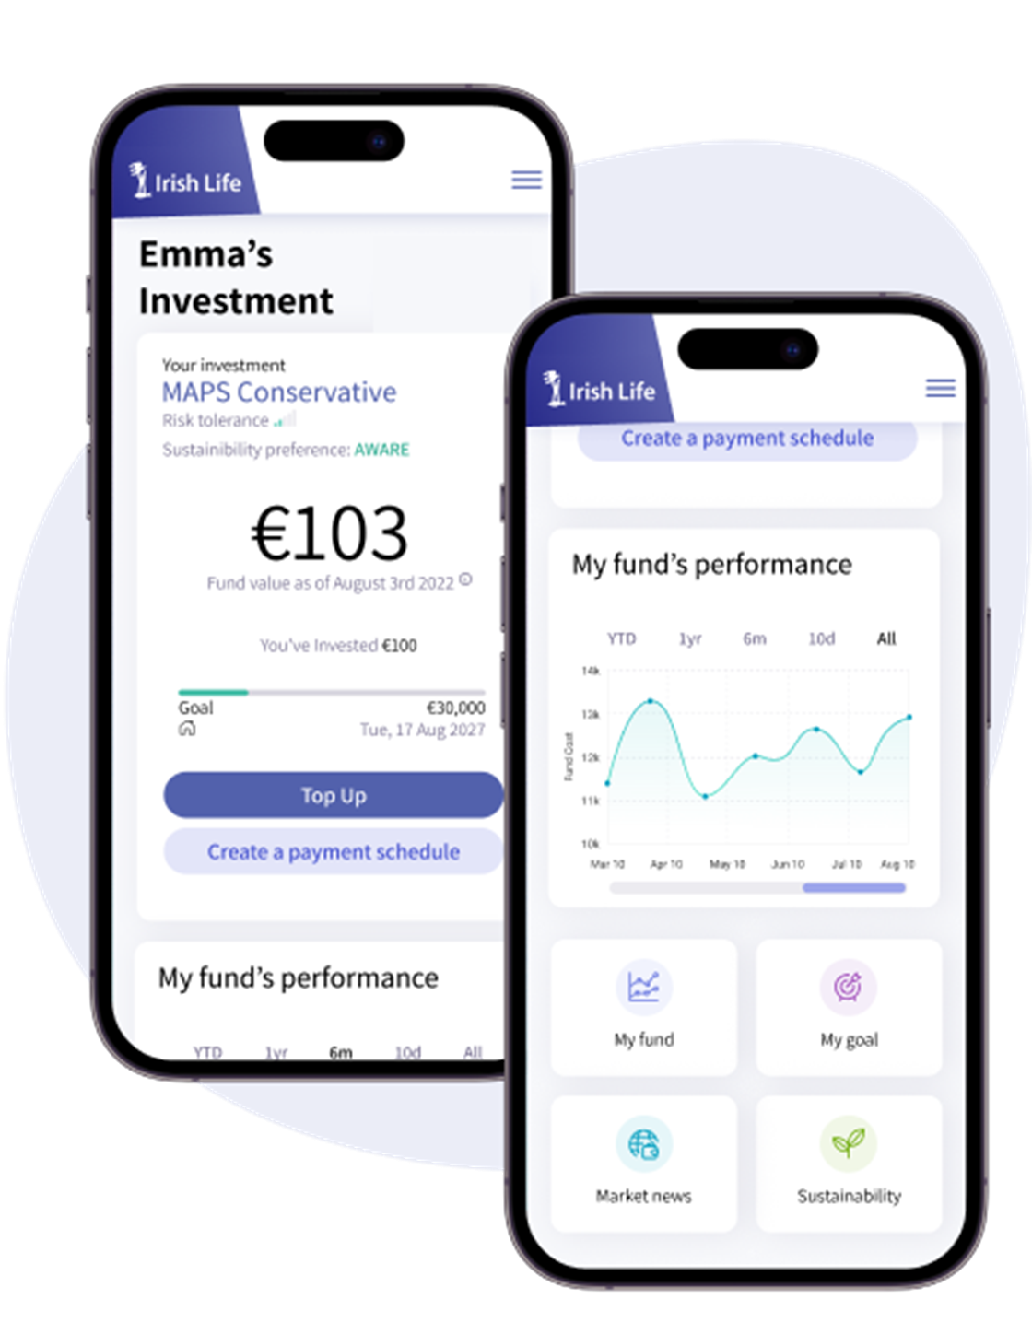
DETECT SIGNALS AND INVITE CUSTOMERS AT THE RIGHT MOMENT
Sign-up signal
Download app
Read the news
Click ads
Get invitation
Open app
See the price
Click
Click
See the price
Click

Slide 5

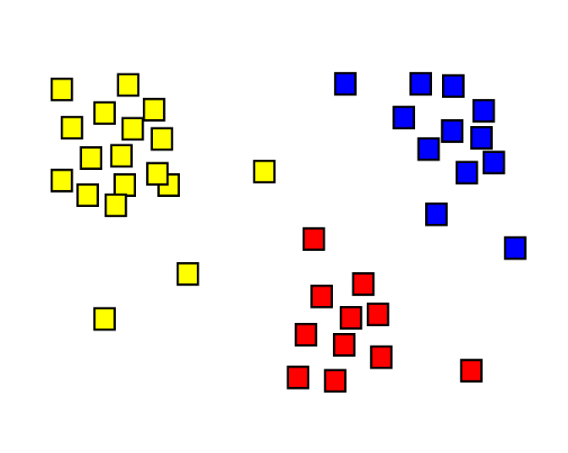
SEGMENT CUSTOMERS AND CREATE CONTENT COVER ALL PERSONA’S NEED
Customer’s persona
Age
PERSONA A
PERSONA B
PERSONA C
AUM Size

Slide 6
ASSIGN RECOMMENDATION ASSET TO EACH PERSONA MONTHLY
Monthly recommendation with “Customer’s persona”
PERSONA A
Price
ATTRIBUTES
Asset B
Asset C
Asset H
Asset Y
Asset A
Asset B
Asset A
Asset C
Asset F
SHORT-RUN GOAL
LONG-RUN GOAL
PRODUCT RECOMMENDATION
Month
Jan
Feb
Mar

Slide 7
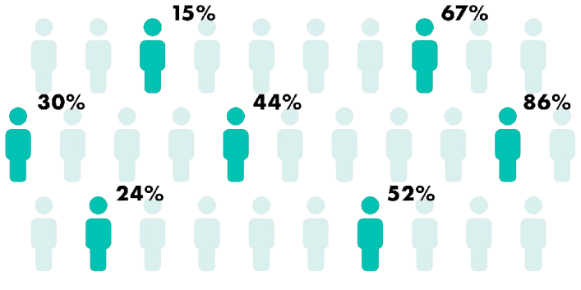
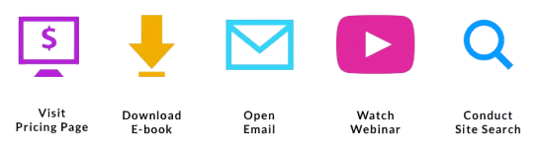
KNOW PURCHASE LIKELIHOOD BEFORE MESSAGING TO THEM
Propensity-to-buy
Price
Asset B – 40%
Asset C – 60%
Asset H – 70%
Asset Y – 20%
Asset A – 15%
Asset B – 10%
Funnel-to-buy
Asset A – 20%
Asset C – 90%
Asset F – 30%
+40
+20
+5
+5
+10
Visit Pricing page
Download Document
Open Notification
Open Pop up
Search Asset
Month
Jan
Feb
Mar

Slide 8


USE PRECISE MESSAGE TO DRIVE MORE CONVERSIONS
FOMO/JOMO prediction
Price
User A experiences FOMO (Fear of Missing Out)
We should send a message like:
"Prices are going up! Buy now to avoid missing out!"
<- Customer A - Buy
<- Customer A - Buy
<- Customer A - Buy
<- Customer B - Buy
User B experiences JOMO (Joy of Missing Out)
We should send a message like:
"Price just dropped! Now's the perfect time to get it!"
<- Customer B - Buy
<- Customer B - Buy
Month
Jan
Feb
Mar

Slide 9
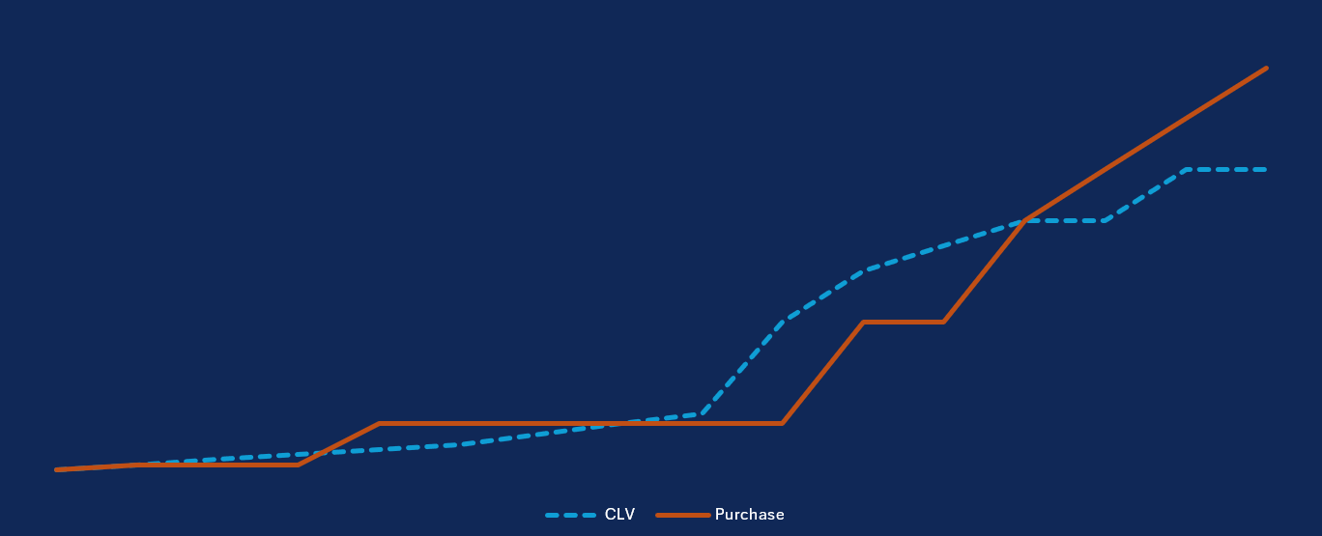

AVOID OVERSELLING ONCE A CUSTOMER REACHES THEIR PURCHASE LIMIT
Salary prediction & Customer’s lifetime investment (CLI)
Invest
Customer A’s salary: 45,000
Investment amount per month: 2,000
Recommended amount: 3,000
Time to sell
Time to stop sell
Time to sell
Time to stop sell
Month

Slide 10


PREDICT REDEMPTION SIGNALS FOR TIMELY ADVISORY
Redemption signal
Price
Asset A
Asset A – 4
Asset B – 2
Asset C – 5
Asset B
Asset A – 4
Asset B – 1
Asset C – 0
Asset A – 2
Asset B – 3
Asset C – 5
Asset C
Month
Jan
Feb
Mar

Slide 11
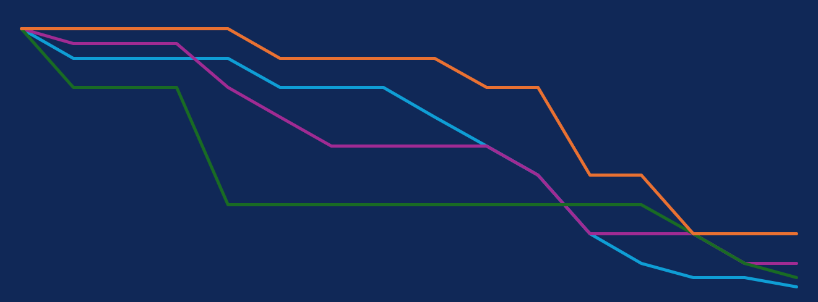
KNOW INVESTMENT ENDING PERIOD AND PROVIDE ADVISORY GUIDANCE
Survival analysis
%
% Survival drop at time step Y
% Survival drop at time step X
% Survival drop at time step Z
Month

Slide 12
APPENDIX: REQUIRED DATA EACH STEP
High-performance marketing
Make them sign-up
Make them engage
Make them purchase
Make them stay
Sign-up signal
Customer’s persona
Customer’s persona
Propensity-to-buy
Funnel-to-buy
App usage
Demographic
Demographic
Transaction
Demographic
Transaction
Transaction
App usage
Salary prediction & CLI
Redemption signal
Survival analysis
Transaction
Demographic
FOMO/JOMO prediction
Transaction
Transaction
Demographic
Demographic
Transaction
4 “M” framework, model and required data

