Slide 1
Clustering Association Rule Mining Matrix Factorization (CARMS)
Peerapat Tancharoen (67076075)
Artificial Intelligence for Business Analytics

Slide 2
1. What is Recommendation System ?
Recommendation System (Recommender System): A core technology for digital platform businesses (e-commerce, streaming, etc.)
Why it matters: Helps users deal with information overload by showing only the most relevant options
How it works: Learns from users’ past behavior/preferences to deliver personalized recommendations
Main Types of Recommendation Systems (4):
  Knowledge-based: rules + domain knowledge
  Content-based: similar item features
  Collaborative filtering: similar users’ behavior/ratings
  Hybrid: combines methods for better accuracy

Slide 3
2. Problem & Research Gap
Collaborative Filtering (CF)—especially Matrix Factorization (MF)—is widely used and high-performing
Main real-world challenge: data sparsity (very few observed ratings/interactions vs. all user–item pairs)
Example (Amazon datasets): typically < 1% of all possible ratings are actually observed
Common solution: hybrid methods that add item/user features (e.g., age, gender, genre)
Limitation: features are not available in every dataset

Slide 4
3. Objective
Design CARMS MF: Develop a Clustering + Association Rule Mining (ARM) + Matrix Factorization (MF) framework, and incorporate Bayesian Personalized Ranking (BPR).
Generate next-item signals from interaction data: Extract CARMS signals directly from the user–item matrix using clustering + ARM, without using any additional item/user features.
Enhance the learning objective with BPR: Improve the MF objective function using BPR so that CARMS signals can be integrated to strengthen personalized ranking.
Evaluate ranking performance: Test whether CARMS-MF improves ranking accuracy (NDCG@K and HR@K) compared with baseline next-item recommendation models.

Slide 5
4. Hypothesis
CARMS-MF achieves higher ranking accuracy than baseline models, measured by NDCG@K and HR@K
Robustness across list sizes: Performance remains better for K = 5, 10, 20, 50, 100 across all metrics
Cluster size, minimum support, minimum confidence, and gamma (𝛾) are the key hyperparameters that drive model accuracy.

Slide 6
3. Theory (1)
1. Clustering
Clustering is an unsupervised learning method that groups data based on the assumption that points within the same cluster are more similar than those in different clusters.
K-Means is a widely used distance-based clustering algorithm (Sinaga & Yang, 2020) that partitions data into k clusters using cluster centroids.
Its goal is to minimize Within-Cluster Sum of Squares (WCSS) by iteratively refining cluster assignments and centroids until the solution converges.
2. Association Rule mining
Association Rule Mining (ARM) finds patterns of items that appear together in transactional data and expresses them as rules like A → B.
Rules are typically evaluated using support, confidence, and lift to measure how frequent and strong the association is.
ARM is useful for market-basket analysis and recommendations (e.g., cross-selling and bundling).

Slide 7
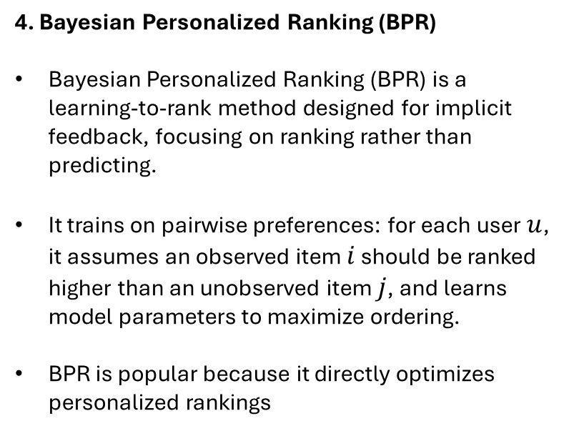
3. Theory (2)
3. Matrix Factorization
Matrix Factorization (MF) is a collaborative filtering method that learns hidden (latent) factors from a user–item interaction matrix to predict missing preferences (e.g., ratings or implicit feedback).
It approximates the interaction matrix as the product of two low-dimensional matrices—user embeddings (P) and item embeddings (Q)—so a user’s preference for an item is estimated by the similarity (e.g., dot product) of their latent vectors.
4. Bayesian Personalized Ranking (BPR)
Bayesian Personalized Ranking (BPR) is a learning-to-rank method designed for implicit feedback, focusing on ranking rather than predicting.
It trains on pairwise preferences: for each user $u$, it assumes an observed item $i$ should be ranked higher than an unobserved item $j$, and learns model parameters to maximize ordering.
BPR is popular because it directly optimizes personalized rankings
MF loss function
BPR Loss

Slide 8
4. Literature Review (1)
1. Matrix Factorization Techniques for Recommendation System
Matrix Factorization (MF) is a widely successful method for recommender systems, especially popular after the Netflix Prize, due to its high accuracy and scalability (Scalability).
Koren et al. (2009) noted that observed ratings are not driven only by user–item interaction, but also by bias effects, such as some users rating higher on average or some items receiving higher ratings overall.
Key takeaways: Adding bias terms significantly improves prediction accuracy, although Bias MF still faces the challenge of data sparsity, which motivates further extensions.
2. Leveraging clustering to improve collaborative filtering
Mirbakhsh & Ling (2015) propose Cluster-based Matrix Factorization (CBMF) using user and item clustering.
MF is extended into a contextual Matrix Factorization, allowing the model to learn preferences at the cluster level.
Accuracy improvement is marginal (RMSE improved from 0.9025 to 0.9020), while model complexity increases significantly.
Key takeaways: clustering can be extracted directly from the user–item matrix without additional features.

Slide 9
4. Literature Review (2)
3. Factorization Meets the Item Embedding: Regularizing Matrix Factorization with Item Co-occurrence
Co-Factor MF by Liang et al., 2016, integrates item–item co-occurrence into Matrix Factorization to improve recommendations, especially for rare items.
The model learns from both User–Item interactions and an Item–Item co-occurrence.
Co-occurrence information is pre-computed using SPPMI and acts as a regularization signal. This improves item representations and overall accuracy.
Key takeaways: co-occurrence can be noisy; applying ARM-based filtering (support, confidence, lift) is a promising extension.
4. A Hybrid Recommendation System Based On Association Rules
Alsalama (2013) propose a hybrid recommender combining Association Rule Mining (ARM) and Content-Based Filtering (CBF).
The key idea is to use both favorite and non-favorite items as informative signals.
ARM (Apriori) is used to generate item–item rules from user histories.
Favorite items are recommended via ARM rules, while non-favorite items are handled using content similarity.
Key takeaways: The study shows that ARM improves accuracy by capturing structured decision patterns in user behavior.

Slide 10
5. CARMS MF - Objective Function
SSE
BPR
Regularization
1. SSE
When Y > 0, the model learns only from the user–item matrix as the first objective.
The goal is to minimize the gap between observed ratings and predicted ratings (a pointwise prediction approach), so smaller errors mean better fit.
2. BPR
When Y = 0 and S > 0, the model learns only from CARMS as the second objective.
CARMS represents importance signals, not 1–5 rating values, so it is used mainly for re-ranking.
BPR is added to shift learning from pointwise prediction to pairwise ranking (making sure item 𝑖 is ranked above item 𝑗).

Slide 11
5. CARMS MF - Signal
1. Build Like/Disliked Matrix (Warm only)
5. Build rule weights
6. Generate CARMS scores
2. User clustering
Warm users: score items using their transaction + cluster
3. Create augmented transactions
Cold users: score items using cluster-level patterns.
7. Remove seen items
4. Mine ARM relationships

Slide 12
Experiments (1)
Number of Users & Item
Evaluate CARMS-MF on Amazon 5 Ratings (filtered to users/items with > 5 ratings).
Use 5 categories: Luxury Beauty, Industry, Pantry, Music, Instruments (robust comparison across product types).
Size varies: Luxury Beauty has the largest matrix; Instruments has the most users/items.
All datasets are extremely sparse (very few observed ratings vs. total cells).
Ratings are 1–5, and average > 4 in all datasets (ratings skew high).
% Sparsity
Average of Ratings

Slide 13
Experiments (2)
1. Evaluation Metrics
Unlike rating prediction (e.g., RMSE), ranking evaluation measures how well the model orders items by relevance.
Hit Rate (HR@K): Checks whether the true item appears in the Top-K list.
Normalized Discounted Cumulative Gain (NDCG@K): Considers both relevance and position, rewarding higher-ranked correct items.
3. Hyperparameter tuning
This study uses Randomized Search instead of Grid Search to explore hyperparameter space.
Randomized Search samples random combinations of hyperparameters, allowing broader coverage with lower computational cost.
Each sampled configuration is trained for 200 epochs to ensure stable convergence.
param_space_common = {
'latent': [20, 30, 50, 70, 100],
'learning_rate': [0.001, 0.005, 0.01, 0.05, 0.1],
'lambda_rate': [0.001, 0.005, 0.01, 0.05, 0.1],
'epoch': [20, 30, 50, 70, 100],
}
param_space_signal = {
'k_user': [1, 3, 5, 7, 10],
'min_support': [0.0, 0.00001, 0.0001, 0.001, 0.01],
'min_confidence': [0.0, 0.0001, 0.001, 0.01, 0.1],
}
param_space_carms_specific = {
'gamma_rate': [0.0, 0.1, 1, 10, 100]
}
2. Train/Test Split
A commonly used and realistic approach is Leave-One-Out / Leave-Last-One-Out (Zangerle & Bauer, 2022).
Leave-Last-One-Out hides the latest interaction of each user for testing, trains on the remaining data.

Slide 14
Results
Dataset | Model | NDCG@K |  |  |  |  | HR@K
 |  | @5 | @10 | @20 | @50 | @100 | @5 | @10 | @20 | @50 | @100
Amazon Luxury | Bias MF | 17.8% | 18.2% | 18.6% | 19.3% | 19.8% | 19.6% | 21.1% | 22.7% | 26.1% | 29.5%
 | CARMS Bias MF | 25.7% | 26.7% | 27.3% | 28.2% | 28.9% | 29.5% | 32.4% | 35.1% | 39.3% | 43.9%
Amazon Industry | Bias MF | 4.4% | 4.6% | 4.9% | 5.3% | 5.6% | 5.2% | 6.1% | 7.0% | 9.0% | 10.9%
 | CARMS Bias MF | 5.6% | 6.3% | 7.0% | 7.8% | 8.6% | 7.0% | 9.0% | 11.8% | 16.1% | 20.8%
Amazon Pantry | Bias MF | 0.5% | 0.7% | 0.9% | 1.3% | 1.8% | 0.8% | 1.4% | 2.3% | 4.4% | 7.0%
 | CARMS Bias MF | 1.7% | 2.1% | 2.7% | 3.6% | 4.5% | 2.6% | 4.0% | 6.2% | 11.0% | 16.4%
Amazon Music | Bias MF | 1.9% | 2.1% | 2.4% | 2.8% | 3.2% | 2.7% | 3.4% | 4.6% | 6.5% | 8.8%
 | CARMS Bias MF | 3.0% | 3.6% | 4.3% | 5.3% | 6.1% | 4.4% | 6.3% | 9.1% | 14.0% | 19.2%
Amazon Instrument | Bias MF | 3.9% | 4.2% | 4.4% | 4.7% | 4.9% | 4.6% | 5.5% | 6.3% | 7.8% | 9.3%
 | CARMS Bias MF | 6.4% | 7.0% | 7.6% | 8.3% | 8.8% | 8.0% | 10.0% | 12.3% | 15.7% | 19.0%

Slide 15
Best Hyperparameter
Dataset | Model | Latent | LR | Lambda | Epoch | K Cluster | Support | Confidence | Gamma | Time (Minutes)
Amazon Luxury | Bias MF | 100 | 0.001 | 0.1 | 20 | - | - | - | - | 0.028115
 | CARMS Bias MF | 100 | 0.01 | 0.001 | 50 | 10 | 0.001 | 0.1 | 100 | 0.119709
Amazon Industry | Bias MF | 100 | 0.001 | 0.05 | 20 | - | - | - | - | 0.124298
 | CARMS Bias MF | 30 | 0.001 | 0.005 | 100 | 7 | 0.0001 | 0.1 | 100 | 0.922929
Amazon Pantry | Bias MF | 20 | 0.001 | 0.05 | 30 | - | - | - | - | 0.195214
 | CARMS Bias MF | 100 | 0.01 | 0.005 | 70 | 7 | 0.0001 | 0.1 | 100 | 0.955132
Amazon Music | Bias MF | 100 | 0.001 | 0.001 | 30 | - | - | - | - | 0.397533
 | CARMS Bias MF | 100 | 0.01 | 0.01 | 50 | 1 | 0.0001 | 0.1 | 100 | 1.476288
Amazon Instrument | Bias MF | 100 | 0.001 | 0.005 | 20 | - | - | - | - | 0.462623
 | CARMS Bias MF | 100 | 0.01 | 0.001 | 100 | 7 | 0.0001 | 0.1 | 100 | 3.669551

Slide 16
Discussion
1. Model Accuracy
CARMS MF outperforms the Bias MF baseline on all datasets.
NDCG@10 improves across all categories, with the largest gain in Amazon Pantry.
CARMS MF consistently wins at all recommendation list lengths (K = 5, 10, 20, 50, 100).
HR@K results also confirm superior ranking performance of CARMS MF.
3. ARM Support and Confidence
No dataset selects zero support or confidence values.
ARM-based rule filtering is necessary for CARMS effectiveness.
4. Gamma (BPR Weight)
All datasets select Gamma = 100.
BPR loss is highly influential in improving ranking accuracy.
Confirms that CARMS significantly enhances Bias MF through the BPR component.
2. Number of User Clusters
Most datasets select more than 7 user clusters, indicating heterogeneous user behavior.
User clustering and rule grouping contribute positively to accuracy.
Amazon Music selects K = 1, suggesting user clustering has limited impact for this dataset.
5. Computational Time
CARMS MF has higher computational complexity due to signal construction and BPR integration with an average of 5.64X.

Slide 17
Git
All scripts and experimental results are available at:
https://github.com/peerapat-t/kmitl-thesis-proposal

