Slide 1
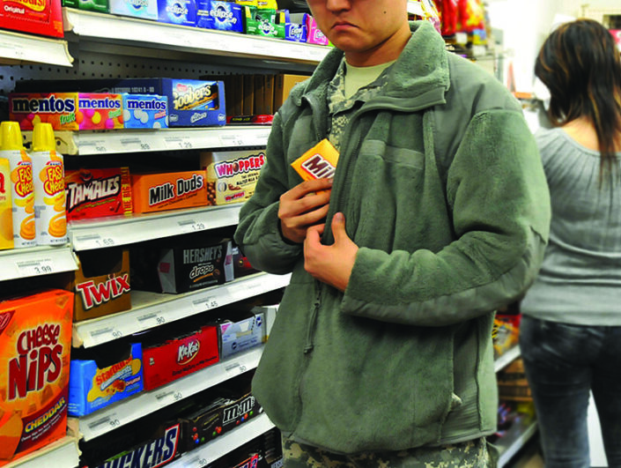
Shoplifting Detection Using YOLOv5 and ML
Peerawit Wettayakorn
Notes:
[Insert Image: University logo or retail surveillance image]

Slide 2

Introduction to the Problem
Shoplifting causes major financial losses globally
Manual surveillance is error-prone and inefficient
Need for automated systems in retail environments
Notes:
[Insert Image: Surveillance camera footage or retail aisle]

Slide 3

Project Goals
Detect suspicious behavior automatically from video
Use YOLOv5 for real-time object detection
Use ML to classify shoplifting behavior
Ensure system is low-cost and deployable in small shops
Notes:
[Insert Image: Camera to detection pipeline diagram]

Slide 4
Tools & Technologies Used
YOLOv5 (Object Detection)
OpenCV (Frame Extraction)
Scikit-learn & XGBoost (Classification)
Python + Pandas + Matplotlib
Notes:
[Insert Image: Tool logos or code editor screenshot]

Slide 5

Dataset & Labeling Process
Used DCSASS + Kaggle shoplifting datasets
Frames extracted with OpenCV
Auto-labeled using YOLOv5 and filename heuristics
Notes:
[Insert Image: Sample frame with bounding boxes + example label file]

Slide 6
Classification Models
Models: Random Forest, XGBoost, LightGBM and Stacked Ensemble
Input: YOLO-derived temporal and spatial features
Output: Shoplifting or Normal label
Split: 80% train / 20% test with class balancing
Notes:
[Insert Image: Model icons or config table]

Slide 7
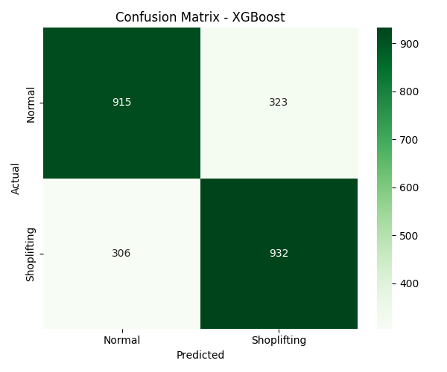
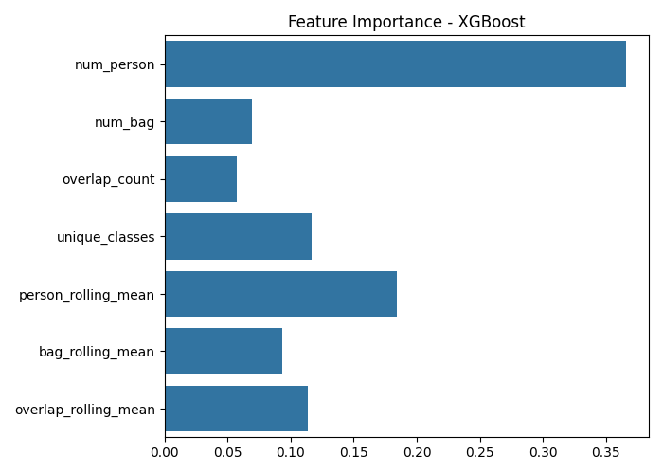
XGBoost Results

Slide 8
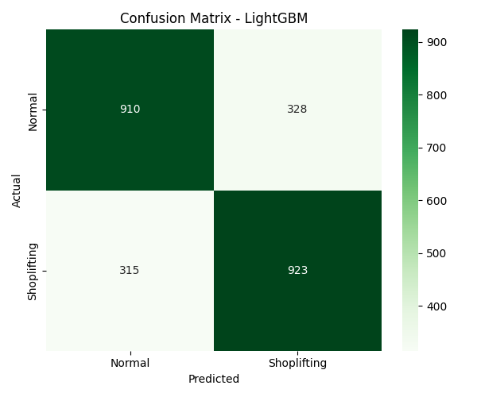
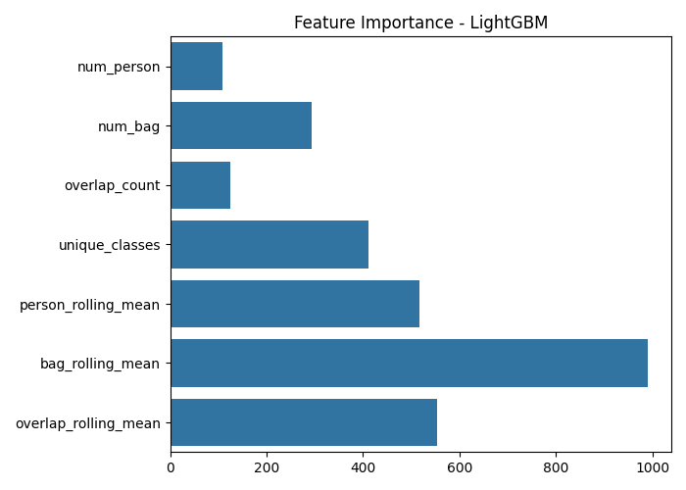
LightGBM Results

Slide 9
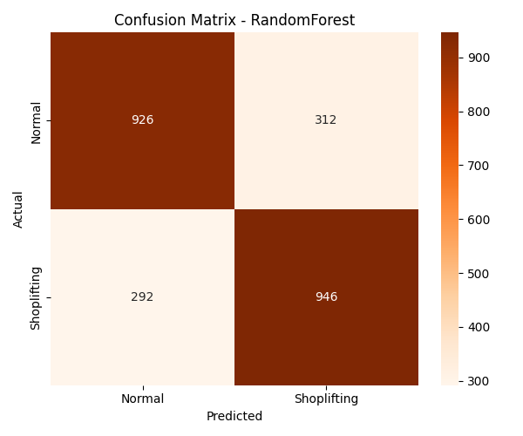
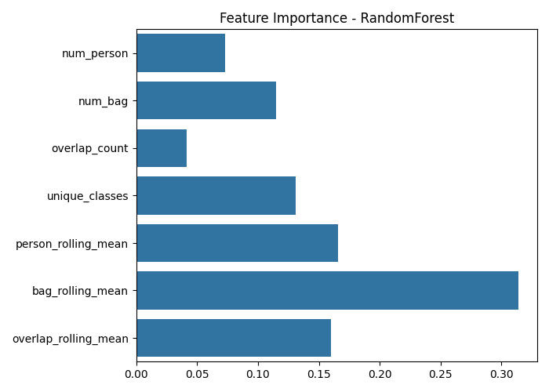
RandomForest Results

Slide 10
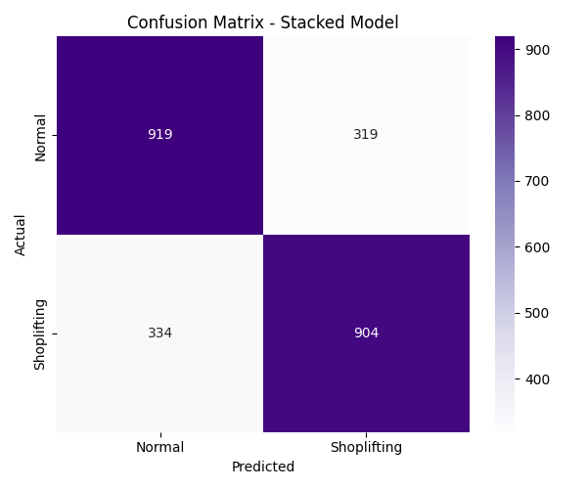
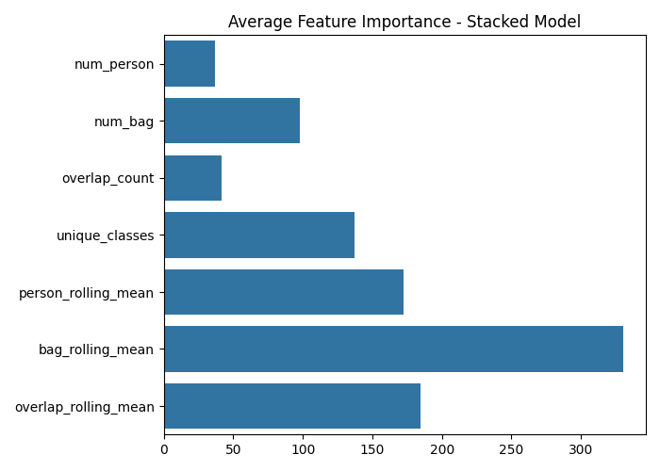
Stacked Model Results

Slide 11
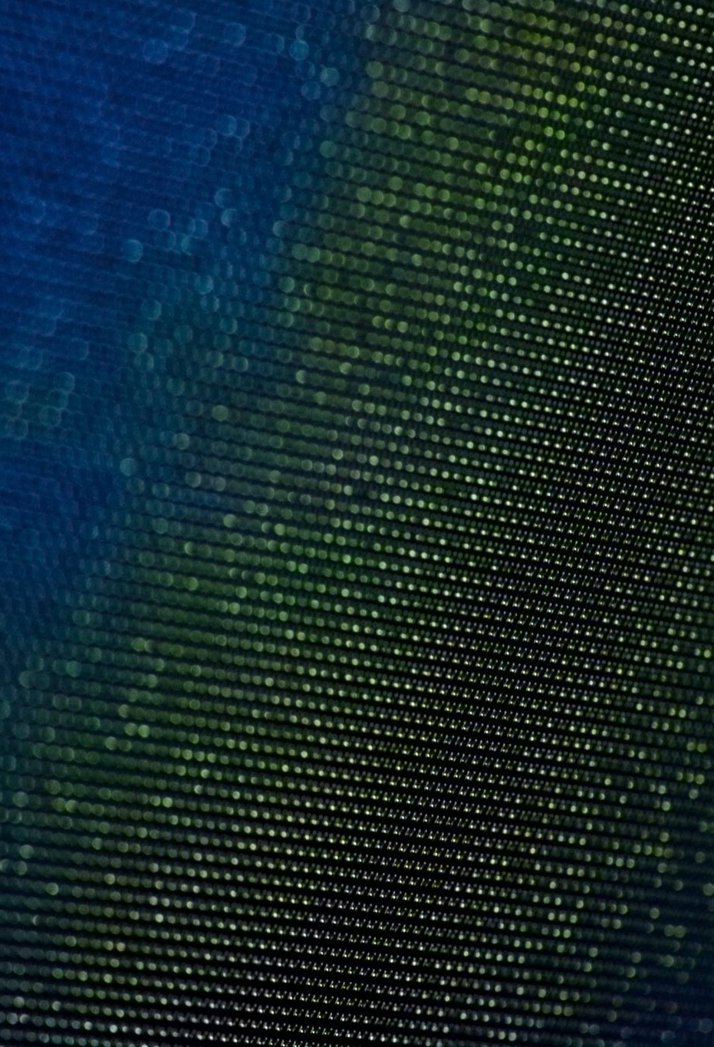
Limitations & Challenges
Moderate accuracy (~74%)
Limited frame-level context
False positives from normal customer behavior
Data imbalance and manual assumptions
Notes:
[Insert Image: Suspicious but innocent frame example]

Slide 12
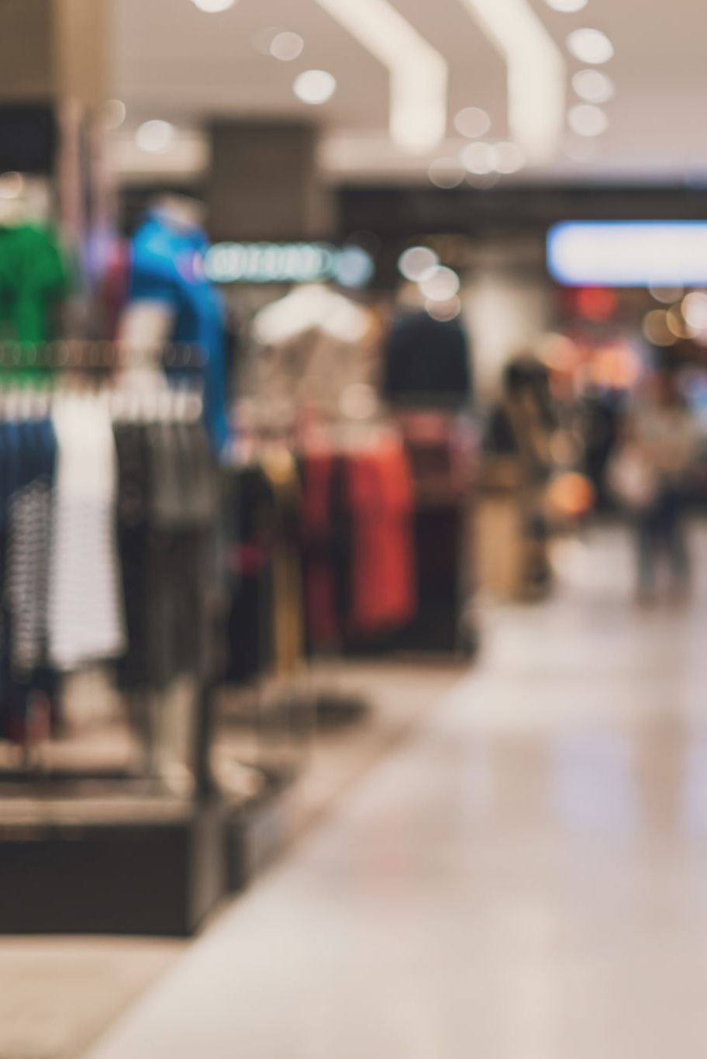
Real-World Application
Deployable in small retail shops
Real-time alerts to shop staff
Extendable to other behaviors
Notes:
[Insert Image: Retail shop photo or smart camera icon]

Slide 13
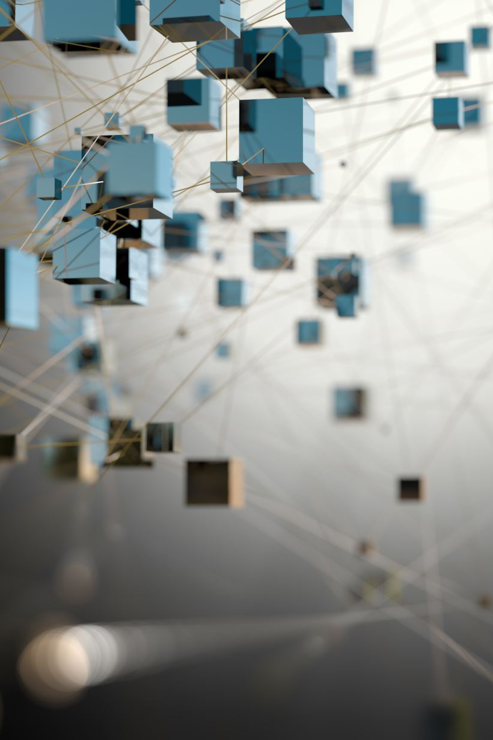
Future Work
Add temporal context / tracking
Multi-frame behavior modeling
Real-time alert system integration
Custom dataset fine-tuning
Notes:
[Insert Image: Roadmap or checklist visual]

Slide 14

Thank You / Q&A
Notes:
[Insert Image: Thank you slide or university background]

