Slide 1
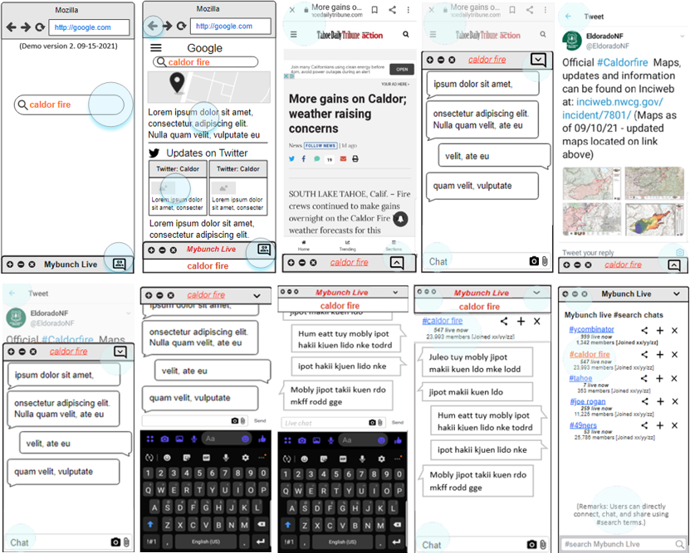
(Modified on September 15, 2021. The Invision mockup at below link has been revised. The remainder of this PPT is untouched since 2020.)
1 min founder YouTube video (made for the Y Combinator September 8, 2021 deadline for their Winter 2022 program):
https://youtu.be/J5pu0ZHkHeg
Invision app-mockup at: https://michaelchung147400.invisionapp.com/console/share/PR317826EY/777409007
The user has the benefit of their search results and also the option to open the MyBunch content and community based on that search term and the web page they are on.
Users can go to their regular search results or to the MyBunch chat. Firefox-mobile extensions are possible from Jan. 2021
This image shows the MyBunch chat at the respective Tweet “URL”. Users can chat and connect here instead of at Twitter.
This image shows the MyBunch “live” chat. MyBunch users can connect directly based on #search terms without needing to rely on the search engines.

Slide 2
A new way to do search: “live search” vs. the current static-dated search.
By, Michael Chung, Ideator.
San Francisco, CA.
https://www.linkedin.com/in/michaelmjchung/
August. 2021

Slide 3
Mybunch: Real Time Information and Connection
What it
Serving up “regular” search results with “organic” content generated (posted) by other users of the Mybunch app/service.
Adding an organic people generated latest and organic information to the “static” search results. The chat window in the browser could be a source of the “latest” information and news. The users are habituated to rely on the search results, thus we can serve up additional real-time information in the chat window.
Why the browser and extension?
The browser is our gateway to information. It’s the first go-to for many people. And we can let the users have both the regular search results and as “option”
The Goals: A dual and more balanced information and connecting platform:
1. To enable people to find each other and get information not available or filterable by the technology giants, but also get the regular content and services.
2. A by product: The fastest way to get the latest human generated and organic information. IN effect, it competes a bit with the Twitter search results that Google serves up for certain category of search words.
3. To solved the filtering, the defacto walls, and gatekeeping: Twitter, Reddit, Quora, etc. – a thought here is that, the users may not need to go to those SM channels; instead hang out in the browser and directly post and chat there; and that a meaningful amount of the posts and distribution that currently go to these channels may be better served by immediate sharing and displaying at the instance of the search query in the browser.

Slide 4
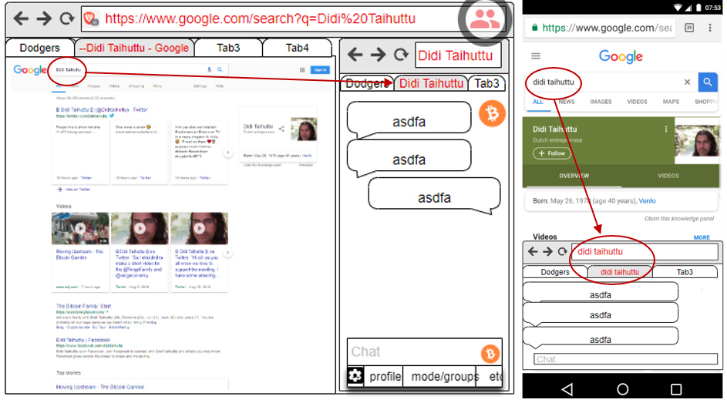
A new way to: do search, browse for information, and do social
To deliver more real time information and encouraging users to post and share.
The UX strategy is to use the side-bar along the right side of the regular search-results.
A faster delivery and more direct information and news.

Slide 5
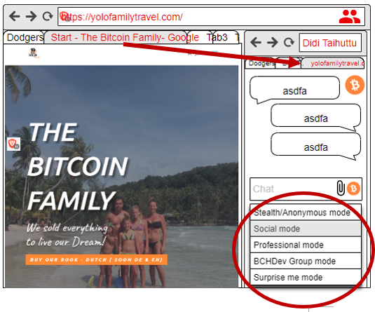
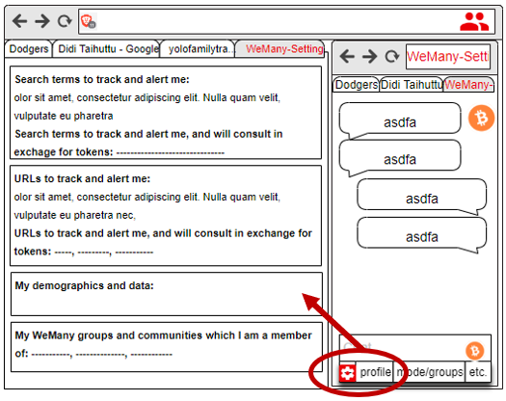
Personalization options

Slide 6
Summary
The browser extension design strategy: Searching and chatting are among of the top online behaviors and uses and Mybunch* will merge them.
For the MVP, the plan can be to do a Brave extension. This Mybunch app model may fit with the Brave browser model and if a prototype can be made, perhaps they will help sponsor the full on development.
For the chat, possibly could use one of the several open source programs (e.g. Rocket.Chat).
There could be tokenomics component to both incentivize and provide earning opportunities, and to possibly crowdfund the Mybunch development “by exchanging Mybunch tokens” for donations/investments.

Slide 7
Top user benefits
The new combination offers several new benefits, is intriguing, and some UX explorations will be done, however:
Adding socialization to the search and browser, the biggest activity and “portal”
Mybunch will be the fastest way to get the latest information and also to build ad hoc - a community around trending news, and compete with news sites and Twitter.
Many people want to leave comments at news and article sites – but, quite often don’t want to sign up, or use Disqus, etc. Thus, Mybunch is reducing sharing friction.
Mybunch is an uber-chat/social and a new direct way to connect, at the point of search.
Mybunch will Intercept and disintermediate some of the use and need to go any further, e.g. to the search results and the web site or page. The browser itself becomes an information and social portal. This will reduce the need to use Quora, Reddit, and even Twitter to see trending information. In time, some users will come to the Mybunch enabled browser just to see the Mybunch content. This is a “browser as a portal” type of strategy.
Web sites and search terms are virtual places (like physical places) – thus, we will help the people meet there and chat and connect with each other Opening and expanding the very personal browsing to a community or crowd. It’s time! This will enhance the search results and the web site visit. For example, even a visit to Facebook or Ebay or WhiteHouse will lead to chatting about these respective sites – thus, the discourse at Mybunch will *be different* than anywhere else, i.e. the new medium will result in new types of conversations and activities.

Slide 8
Other thoughts on the Mybunch model
The availability of Brave as open source browser helps the Mybunch business strategy. We could start as extension on Chrome or Brave; or even “fork” the Brave browser*.
Possibly, using the open source Brave as a platform - we will start a new paradigm and enable the open source community to build their own and “launch 10,000 browsers”, as we will enable and encourage customization and localizations. This strategy to enable “10,000 open source browsers” maybe the cheapest and organic way to get market share. It’s a bit of new tactic to try to take market share from the big search engines and browsers. I.e. since a frontal “attack” on Chrome, etc. is near impossible, perhaps we can try this 10,000 bites flanking strategy.
It *does seem* that chat is more popular than ever. This may be due to globalization and especially in the crypto community. Thus, why not put chat into the browser? In the least, it ought to find several sustainable niches and business models.
People want to connect and chat more than ever. We believe that we are in maturing digital phase, and especially boosted by the great leveling and connecting energies in the crypto space will further break down barriers among strangers to chat and connect. This “energy” and new openness ought to help the Mybunch model.
There is the inexorable change now to the user ownership and control of their data. Also, added is the user monetizing their own behavior and data. There are several companies and tokenized models, however, working models are still very limited or new. We will design tokenomics into the model to cycle back revenues to the users.

