Slide 1
Fastest way to get real time information – the world’s first(?) browser search query + chat.
3/30/2019
By, Michael Chung
Inventor and founder
https://www.linkedin.com/in/chungmojo/

Slide 2
WeBunch: Real Time Information and Connection
What it is (still in a bit of exploratory stage)
Combining search query with chat at the point of the query, in the browser. Two great propositions:
1) Solving the search and socialization. Chatting (e.g. via Slack) is the #1 communication behavior in enterprises – thus, why not enable chatting in the browser itself? Barriers are coming down; people are connecting more and more; friends and family and followers and strangers are blending – because “the 10 years of Facebook social experience” has fundamentally changed and RESET how we were dealing with “strangers” a short 10 years ago. Thus, bring the FB “experience” to the browser. What not? the search query can be used to provide increased sharing and connectivity. Is browser the next frontier in social?
2) Adding a real-time information to the “static” search results. The chat window in the browser could be a source of the “latest” information and news. The users are habituated to rely on the search results, thus we can serve up additional real-time information in the chat window.
Why?
The browser is our gateway to information. It’s the first go-to for many people.
Let’s add the social, and also the channel for sharing and exchanging real time information.
The world is getting smaller, why wait until we are connected on a SM platform or on Slack to “do collaboration” – we can let our common interest in the “search query” topic to connect us and to share knowledge and information.
The Goal
1. To enable connection based on the topic and subject matter of the “search query”.
2. The fastest way to get the latest human generated and organic information.
3. To “disintermediate” some of the uses for and behavior of such as Twitter, Reddit, Quora, etc. – the thought here is that, the users may not need to go to those SM channels and instead hang out in the browser and that a meaningful amount of the the posts and distribution that currently go to these channesl may be better served by immediate sharing and displaying at the instance of the search query in the browser.

Slide 3
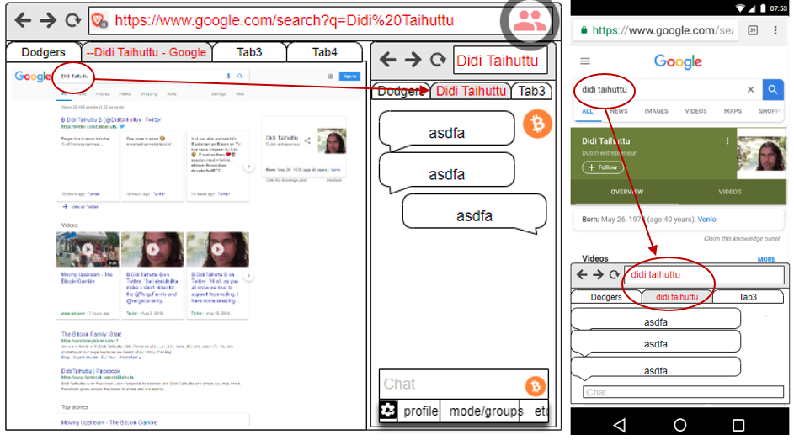
A new way to: do search, browse for information, and do social
To deliver more real time information and encouraging users to post and share.
The thought is that new collaborative behavior and new information will be created - by the people and with minimalistic effort - that is not otherwise being done currently.

Slide 4
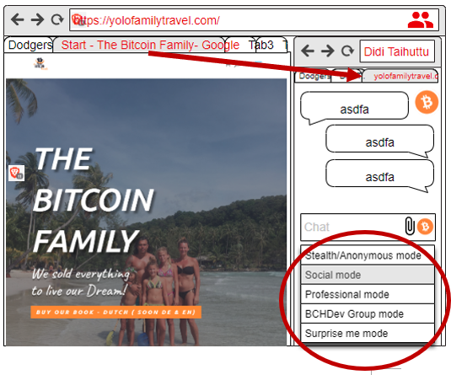
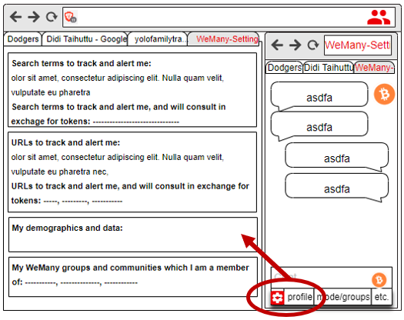
Personalization options

Slide 5
Summary
Searching and chatting are among of the top online behaviors and uses and WeBunch* will merge them. For the MVP, the plan is to do a Chrome or Brave extension, and for the chat, to use one of the several open source programs (e.g. Rocket.Chat) or build our own. There will be tokenomics component to both incentivize and provide earning opportunities. (*Placeholder name.)
When the user enters a search term or a URL in the browser, a chat window will open based on them. For the MVP, we will focus on the search terms and the home URL (as opposed to having the chat to be for each specific page/content). The user will see chats/posts and can chat, post, pose questions, and connect. The chat window will open next to the search results page, and on the web site. (We are debating if to file patent maybe filed on the WeBunch methods, or to leave it open.)
Added April 26, 2019:
We can’t let the Google search engine and experience to continue their “hegemony”. We have take a run at it. The answer lies in “hijacking” or disrupting or _____ the search result experience. And how do you eat an elephant? One bite at a time. But, we can have 10,000 mouths on it at the same time.
They are vulnerable by a flanking maneuver at their greatest strength. There are few additional tactics (in stealth, excuse) to add to this war…to be continued.

Slide 6
Top user benefits
The new combination offers several new benefits, is intriguing, and some UX explorations will be done, however:
Adding socialization to the search and browser, the biggest activity and “portal”
WeBunch will be the fastest way to get the latest information and also to build ad hoc - a community around trending news, and compete with news sites and Twitter.
Many people want to leave comments at news and article sites – but, quite often don’t want to sign up, or use Disqus, etc. Thus, WeBunch is reducing sharing friction.
WeBunch is an uber-chat and a new direct way to connect, at the point of search.
WeBunch will Intercept and disintermediate some of the use and need to go any further, e.g. to the search results and the web site or page. The browser itself becomes an information and social portal. This will reduce the need to use Quora, Reddit, and even Twitter to see trending information. In time, some users will come to the WeBunch enabled browser just to see the WeBunch content. This is a “browser as a portal” type of strategy.
Web sites and search terms are virtual places (like physical places) – thus, we will help the people meet there and chat and connect with each other Opening and expanding the very personal browsing to a community or crowd. It’s time! This will enhance the search results and the web site visit. For example, even a visit to Facebook or Ebay or WhiteHouse will lead to chatting about these respective sites – thus, the discourse at WeBunch will *be different* than anywhere else, i.e. the new medium will result in new types of conversations and activities.

Slide 7
Other thoughts on the WeBunch model
The availability of Brave as open source browser helps the WeBunch business strategy. We could start as extension on Chrome or Brave; or even “fork” the Brave browser*.
Possibly, using the open source Brave as a platform - we will start a new paradigm and enable the open source community to build their own and “launch 10,000 browsers”, as we will enable and encourage customization and localizations. This strategy to enable “10,000 open source browsers” maybe the cheapest and organic way to get market share. It’s a bit of new tactic to try to take market share from the big search engines and browsers. I.e. since a frontal “attack” on Chrome, etc. is near impossible, perhaps we can try this 10,000 bites flanking strategy.
It *does seem* that chat is more popular than ever. This may be due to globalization and especially in the crypto community. Thus, why not put chat into the browser? In the least, it ought to find several sustainable niches and business models.
People want to connect and chat more than ever. We believe that we are in maturing digital phase, and especially boosted by the great leveling and connecting energies in the crypto space will further break down barriers among strangers to chat and connect. This “energy” and new openness ought to help the WeBunch model.
There is the inexorable change now to the user ownership and control of their data. Also, added is the user monetizing their own behavior and data. There are several companies and tokenized models, however, working models are still very limited or new. We will design tokenomics into the model to cycle back revenues to the users.

