Slide 1
World’s first search with chat, and salted with tokenomics.
By, Michael Chung
Founder
Dec. 22, 2018

Slide 2
WeBunch: Real Time Information and Connection
What it is:
Combining search query with chat - in a browser, and as the browser is the “most used” and go to application.
What is does – the core value proposition:
Providing the fastest way to get information, expertise, and the latest news, and to also connect and do-social. (We are leveraging the browser and the habit of going to the browser as the first-stop.)
How it does:
The search query in the browser is used to pull up the appropriate chat (content is users generated); and also as option, for the system to get information from selected sources such as the social apps (Twitter and Instagram) and self-publishing sites (Medium, Reddit). (Thus, in addition to the chat (as shown in the following mockups), we may put the appropriate extracted content from the various Twitter, Instagram, Medium Reddit into the chat stream or perhaps into a separate “Social” tab (and yes, as Google also shows them when searching for “Kim Kardashian”, some content will be duplicated; anyway this is TBD.)
(BTW- the following images are based on the chat alone, and not the Twitter, etc.)

Slide 3
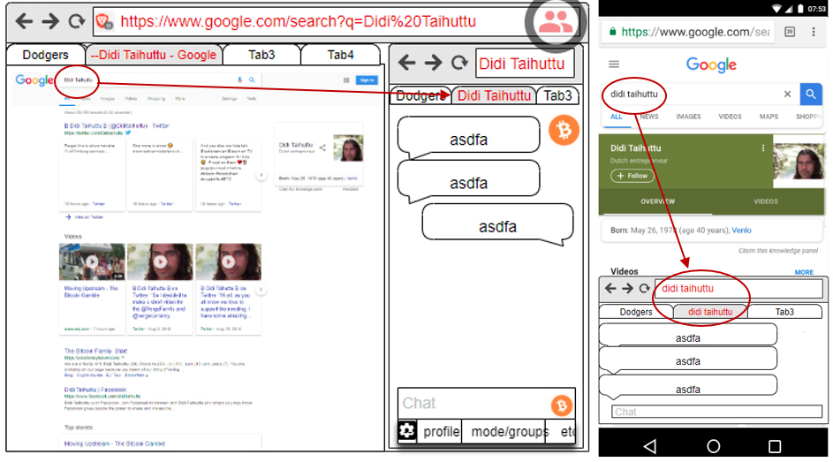
A new way to: do search, browse, and do social
Webunch integrates chat into the search. This will be the basis to create a new browsing and search service, and to compete and modify the current dominant browser-use paradigm which is to get the search results or going to web sites at the browser.

Slide 4
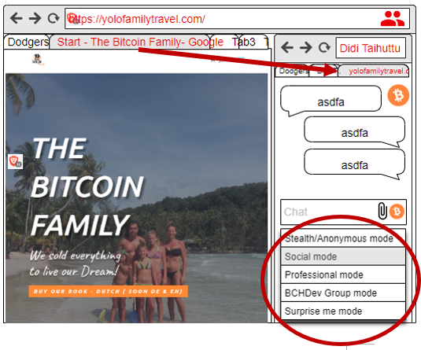
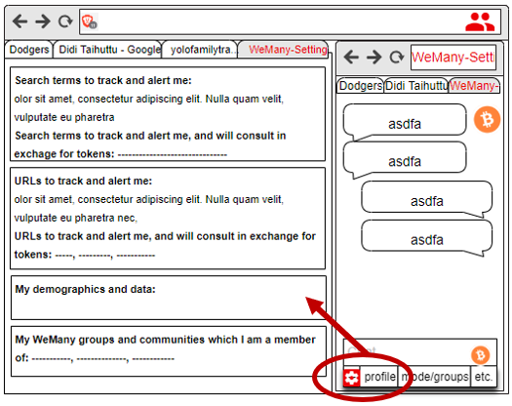
Personalization options

Slide 5
Summary
Searching and chatting are among of the top online behaviors and uses and WeBunch* will merge them. We believe that this is the first such combination. For the MVP, the plan is to do a Chrome and Brave extension, and for the chat, to use one of the several open source programs or build our own. There will be tokenomics component to both incentivize and provide earning opportunities. (*Placeholder name.)
When the user enters a search term or a URL in the browser, a chat window will open based on them. For the MVP, we will focus on the search terms and the home URL (as opposed to having the chat to be for each specific page/content). The user will see chats/posts and can chat, post, pose questions, and connect. The chat window will open next to the search results page, and on the web site. (A patent is to be filed.)

Slide 6
Top user benefits
The new combination offers several new benefits, is intriguing, and some UX explorations will be done, however:
Targeting and adding socialization to the greatest online activity, the search.
WeBunch will be the fastest way to get the latest information and also to build ad hoc - a community around trending news, and compete with news sites and Twitter.
Many people want to leave comments at news and article sites – but, quite often don’t want to sign up, or use Disqus, etc. Thus, WeBunch is reducing sharing friction.
WeBunch is an ad-hoc uber-chat and a new direct way to connect, at the point of search.
WeBunch will Intercept and disintermediate some of the use and need to go any further, e.g. to the search results and the web site or page. The browser itself becomes an information and social portal. This will reduce the need to use Quora, Reddit, and even Twitter to see trending information. In time, some users will come to the WeBunch enabled browser just to see the WeBunch content. This is a “browser as a portal” type of strategy.
Web sites and search terms are virtual places (like physical places) – thus, we will help the people meet there and chat and connect with each other Opening and expanding the very personal browsing to a community or crowd. It’s time! This will enhance the search results and the web site visit. For example, even a visit to Facebook or Ebay or WhiteHouse will lead to chatting about these respective sites – thus, the discourse at WeBunch will *be different* than anywhere else, i.e. the new medium will result in new types of conversations and activities.

Slide 7
Other thoughts on the WeBunch model
The availability of Brave as open source browser helps the WeBunch business strategy. We can start as extension on both Chrome and Brave; even fork Brave immediately depending on resources*. Also, we will start a new revolution – and “launch 10,000 browsers”, as we will enable and encourage customization and localizations – this will help to reduce the hegemony of the big search engines.
It *does seem* that chat is more popular than ever. This may be due to globalization and especially in the crypto community. Thus, why not put chat into the browser? In the least, it ought to find several sustainable niches and business models.
People want to connect and chat more than ever. We believe that we are in maturing digital phase, and especially boosted by the great leveling and connecting energies in the crypto space will further break down barriers among strangers to chat and connect. This “energy” and new openness ought to help the WeBunch model.
There is the inexorable change now to the user ownership and control of their data. Also, added is the user monetizing their own behavior and data. There are several companies and tokenized models, however, working models are still very limited or new. Brave is the best well known and with the most traction. We believe that WeBunch will be one of the more practical uses and early adopters maybe very interested. We will design tokenomics into the model to cycle back revenues to the users.

Slide 8
Tokenomics
The WeBunch value proposition stands on its own and people will use it regardless.
The tokenization of the users and behaviors will help the users and grow the communities.
Users and groups or communities will earn points or tokens based on participation and contributions.
As per Brave, we may implement an opt-in ad viewing service. The ads will be in separate tabs and users will earn points if they participate.
The WeBunch platform will enable new group commerce:
Users will find and connect with experts and pay for additional services.
It can become a new feeder or funnel for reaching audiences.

Slide 9
Founder and team
Michael Chung – self taught technology entrepreneur, all-in on the blockchain; invents business models on demand* (knock on wood). https://www.linkedin.com/in/chungmojo/
Recent 5 years in San Francisco Bay area: worked on own startups in mobile and IoT, and now for the blockchain space, read some 200 white paper in past year.
Previous 25 years in New York City: worked in the real estate industry as broker and dealer; and other experience include - finance, managing retail businesses, credit card merchant services, direct marketing, etc.
*The WeBunch aha moment was due to my intense study of Rocket.Chat in early 2018 on the the subject of communities, chat applications, and groups - for the purpose of adding a tokenomics model and possible ICO. Rocket.Chat is the largest open source version of Slack. Then recently, I observed the rising popularity of the Brave browser, and that it was due to first, being a fast browser, and second, the tokenomics. This made me to begin to look for a new browser based application and use cases which could offer new utility and benefits.
Team – there is a small group of developers and technologists who like the project and are available as the founding team. I network actively, have been a member of the Hacker Dojo for 4 years and have big number of connections.

