Slide 1
TOTL (top of the list) Fastest way to get real time information – the world’s first search combined with chat. 3/30/2019
By, Michael Chung
Inventor and founder
https://www.linkedin.com/in/chungmojo/

Slide 2
TOTL: Real Time Information and Connection
What it is (still in a bit of exploratory stage)
Combining search query with chat at the point of the query, in the browser.
Solving the search and socialization.
Adding a real-time information to the “static” search results.
Chatting (e.g. via Slack) is the #1 communication behavior in enterprises – thus, the search query can be used to provide increased sharing and connectivity.
Why?
The browser is our gateway to information.
Let’s add the social, and also the channel for sharing and exchanging real time information.
The world is getting smaller, why wait until we are connected on a SM platform or on Slack to “do collaboration” – we can let our common interest in the “search query” topic to connect us and to share knowledge and information.
The Goal
The fastest way to get the latest human generated and organic information.
To enable connection based on the topic and subject matter of the “search query”.
To “disintermediate” some of the uses for and behavior of such as Twitter, Reddit, Quora, etc. – the thought is that, a meaningful of the posts that goes at these sites is better served by immediate sharing and displaying at the instance of the search query in the browser.

Slide 3
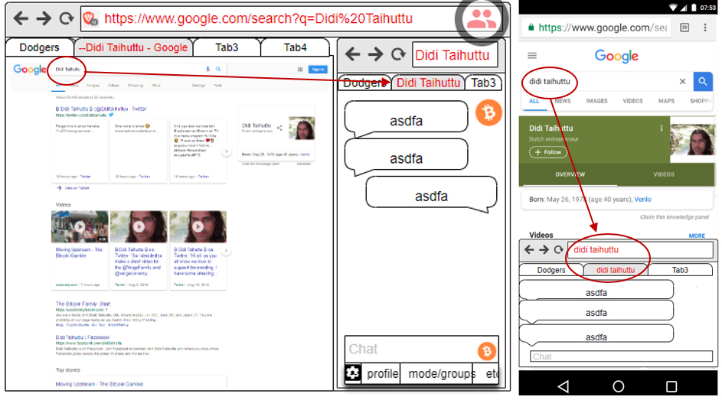
A new way to: do search, browse for information, and do social
To deliver more real time information and encouraging users to post and share.
The thought is that new collaborative behavior and new information will be created - by the people and with minimalistic effort - that is not otherwise being done currently.

Slide 4
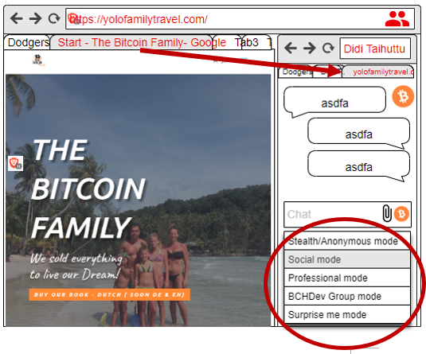
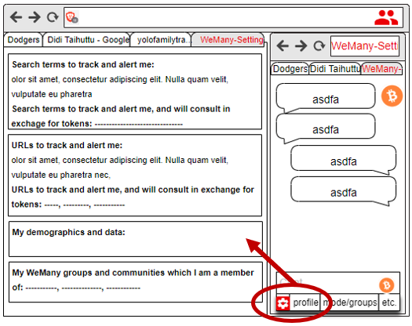
Personalization options

Slide 5
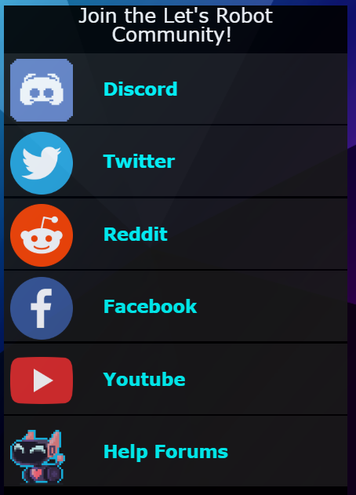
TOTL or First Stop

Slide 6
Summary
Searching and chatting are among of the top online behaviors and uses and TOTL* will merge them. We believe that this is the first such combination. For the MVP, the plan is to do a Chrome or Brave extension, and for the chat, to use one of the several open source programs (e.g. Rocket.Chat) or build our own. There will be tokenomics component to both incentivize and provide earning opportunities. (*Placeholder name.)
When the user enters a search term or a URL in the browser, a chat window will open based on them. For the MVP, we will focus on the search terms and the home URL (as opposed to having the chat to be for each specific page/content). The user will see chats/posts and can chat, post, pose questions, and connect. The chat window will open next to the search results page, and on the web site. (A patent is to be filed.)

Slide 7
Top user benefits
The new combination offers several new benefits, is intriguing, and some UX explorations will be done, however:
Adding socialization to the search and browser, the biggest activity and “portal”
TOTL will be the fastest way to get the latest information and also to build ad hoc - a community around trending news, and compete with news sites and Twitter.
Many people want to leave comments at news and article sites – but, quite often don’t want to sign up, or use Disqus, etc. Thus, TOTL is reducing sharing friction.
TOTL is an uber-chat and a new direct way to connect, at the point of search.
TOTL will Intercept and disintermediate some of the use and need to go any further, e.g. to the search results and the web site or page. The browser itself becomes an information and social portal. This will reduce the need to use Quora, Reddit, and even Twitter to see trending information. In time, some users will come to the TOTL enabled browser just to see the TOTL content. This is a “browser as a portal” type of strategy.
Web sites and search terms are virtual places (like physical places) – thus, we will help the people meet there and chat and connect with each other Opening and expanding the very personal browsing to a community or crowd. It’s time! This will enhance the search results and the web site visit. For example, even a visit to Facebook or Ebay or WhiteHouse will lead to chatting about these respective sites – thus, the discourse at TOTL will *be different* than anywhere else, i.e. the new medium will result in new types of conversations and activities.

Slide 8
Other thoughts on the TOTL model
The availability of Brave as open source browser helps the TOTL business strategy. We could start as extension on Chrome or Brave; or even “fork” the Brave browser*.
Possibly, using the open source Brave as a platform - we will start a new paradigm and enable the open source community to build their own and “launch 10,000 browsers”, as we will enable and encourage customization and localizations. This strategy to enable “10,000 open source browsers” maybe the cheapest and organic way to get market share. It’s a bit of new tactic to try to take market share from the big search engines and browsers. I.e. since a frontal “attack” on Chrome, etc. is near impossible, perhaps we can try this 10,000 bites flanking strategy.
It *does seem* that chat is more popular than ever. This may be due to globalization and especially in the crypto community. Thus, why not put chat into the browser? In the least, it ought to find several sustainable niches and business models.
People want to connect and chat more than ever. We believe that we are in maturing digital phase, and especially boosted by the great leveling and connecting energies in the crypto space will further break down barriers among strangers to chat and connect. This “energy” and new openness ought to help the TOTL model.
There is the inexorable change now to the user ownership and control of their data. Also, added is the user monetizing their own behavior and data. There are several companies and tokenized models, however, working models are still very limited or new. We will design tokenomics into the model to cycle back revenues to the users.

