Slide 1
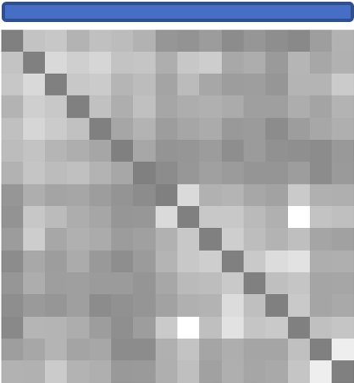



50k x 50k CorMats
k x k CorMats
Feature selection
Classification
k x k CorMats
Feature selection

