Slide 1
Online Bilateral Trade: Learning the Optimal Policy in a Stochastic Environment
M. Castiglioni
Mattia Piccinato
A. Lunghi
A. Marchesi
A.y. 2024-25
Notes:
Bilateral Trade through the lenses of Online Learning.

Slide 2
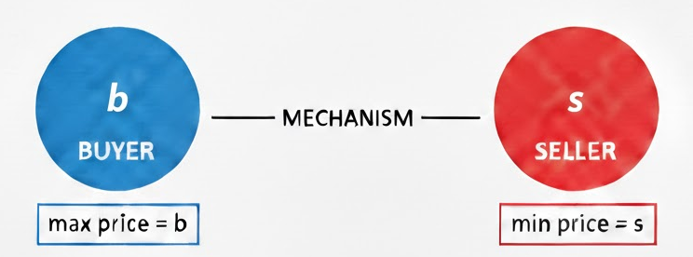

Scenario
Bilateral Trade
Myerson-Satterthwaite (1983)
“Efficiency, Incentive Compatibility, Individual Rationality and Budget Balance cannot all hold.”
Notes:
Pricing problem with a Buyer and a Seller, Real-world Example No Interest in Making a Profit, Impossibility Result

Slide 3
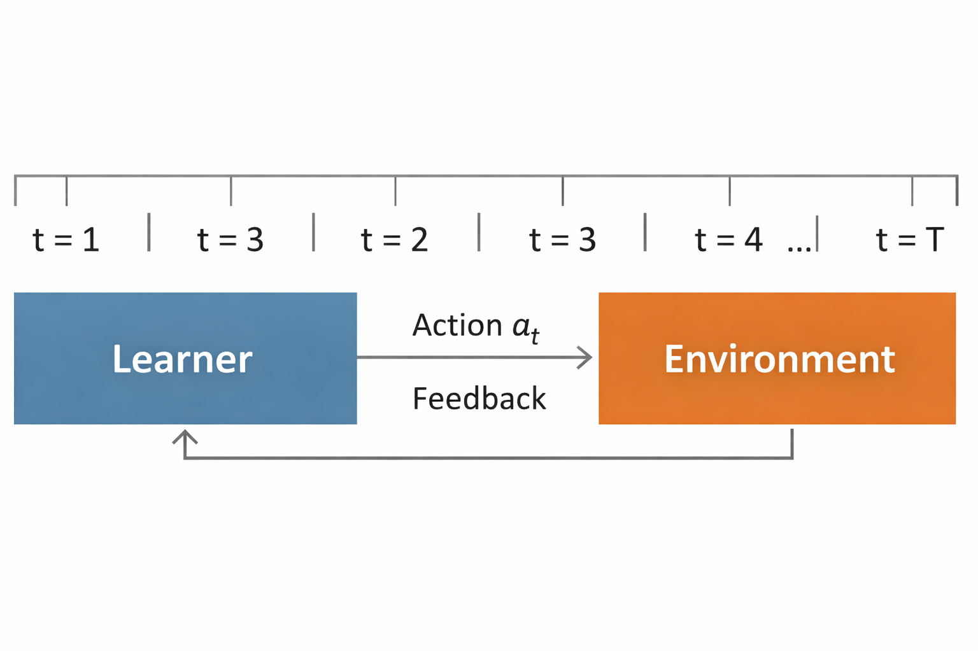
Framework
Online Learning
Cesa-Bianchi et. al (2021)
“Bilateral Trade: A Regret Minimization Perspective”
Notes:
Known Distributions Approach, Cesa Bianchi: Repeated Interaction With Environment (Horizon, Realistic Feedback, Benchmark)

Slide 4
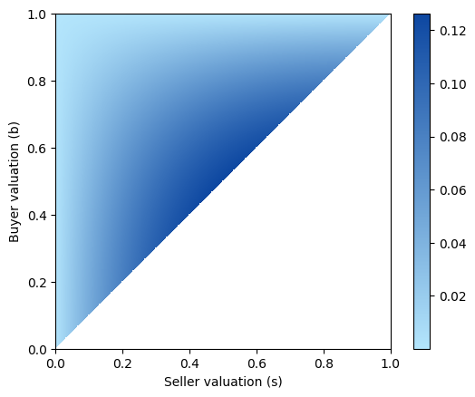
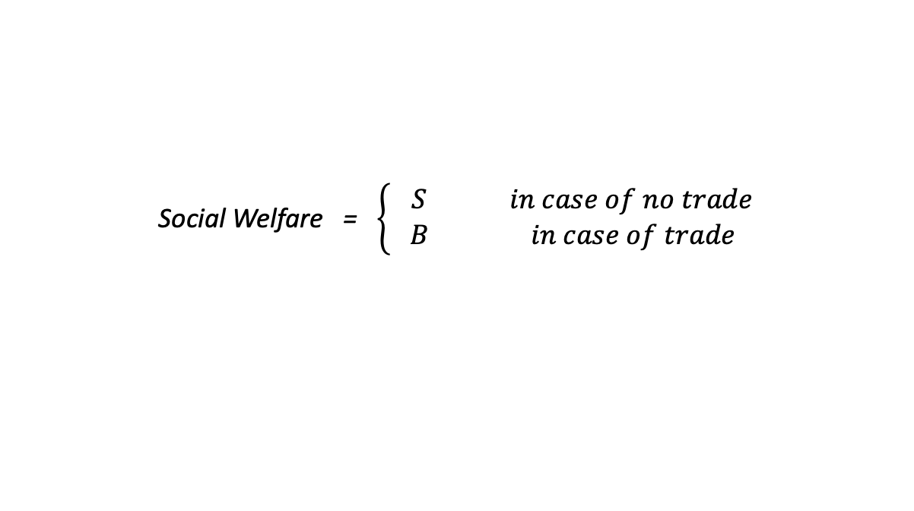
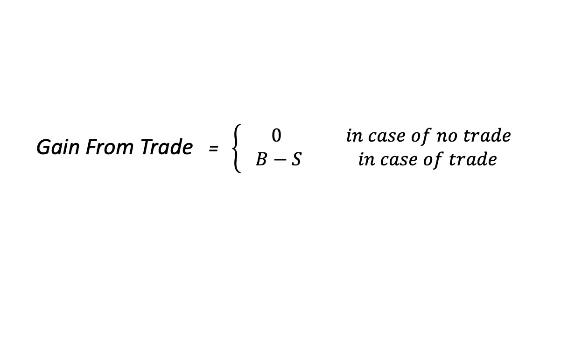

Objective function
Gain From Trade
Expected GFT associated to $(p,q)$
Social Welfare = $\left\{\begin{aligned} S in case of no trade \\ B in case of trade \end{aligned}\right.$
Gain From Trade = $\left\{\begin{aligned} 0 in case of no trade \\ B−S in case of trade \end{aligned}\right.$
Notes:
Social Welfare vs Gain From Trade. Sketch. We Want to Get similar GFT to Benchmark.

Slide 5
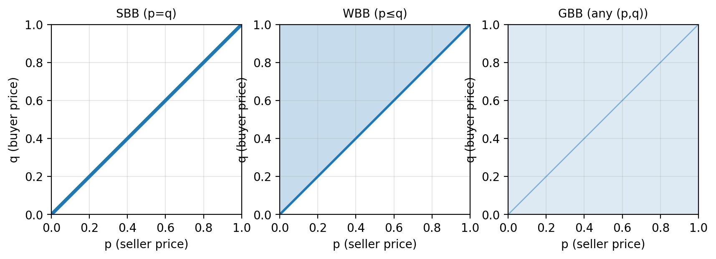
Global Budget Balance
Budget Balance
Bernasconi et al. (2024)
“Is it possible to achieve sublinear regret in the adversarial setting under a reasonable notion of budget balance?”
Notes:
No Interest in Making a Profit! SBB (old). GBB (new), So Now 2D, Best Fixed Price in Adversarial

Slide 6
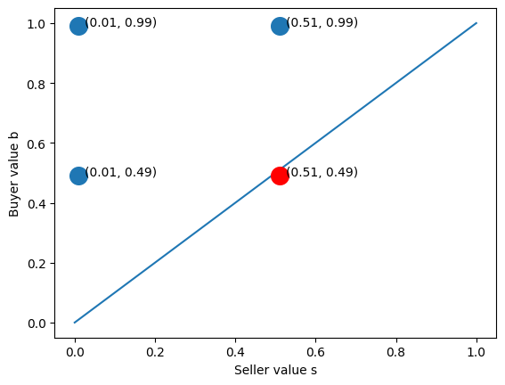
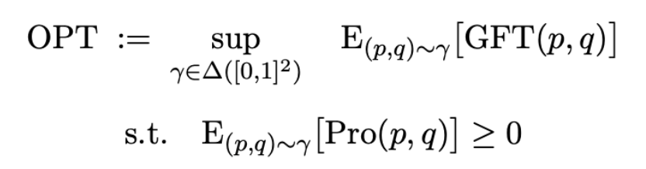
A new benchmark
Strictly stronger – A sketch
Distributional Benchmark
This benchmark is surely not weaker than the best fixed price, and strictly stronger.
Notes:
A new Benchmark “OPTIMAL POLICY”, Strictly stronger (Sketch), Impossible in Adversarial

Slide 7
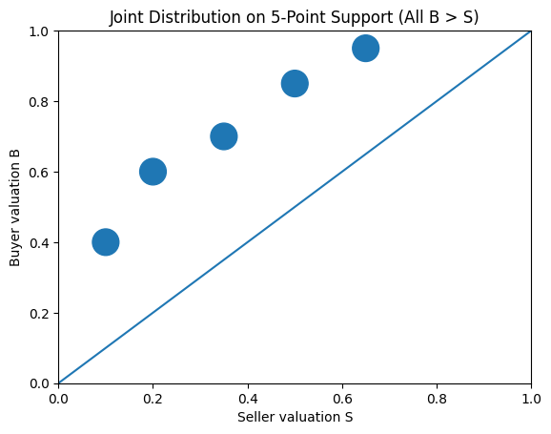
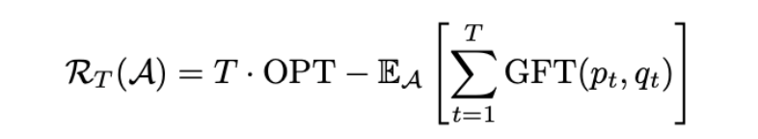
A theoretical work
Stochastic Environment
Worst-case
Regret Analysis
A sequence of $T$ $\left(S,B\right)$ i.i.d. pairs over ${[0,1]}^{2}$
Notes:
This work: Stochastic Environment. Provide Algorithm with Sublinear Upper Bound in the Worst Case.

Slide 8
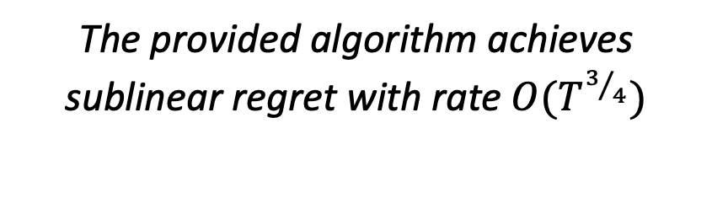
An overview of results
Problem setting recap
Main result
Stochastic environment
Realistic (one bit) feedback
Global Budget Balance
Distributional benchmark
The provided algorithm achieves sublinear regret with rate $O(T^{3/4})$
Notes:
Recap, Spoiler

Slide 9


Three-Phase approach
Algorithm
I. Budget Accumulation
II. Pure Exploration
III. Optimization
Estimate the non-observable parts of $GFT$.
Solve the optimistic linear program.
Collect a profit buffer $β.$
Notes:
Phase I, Phase II, Phase III.

Slide 10
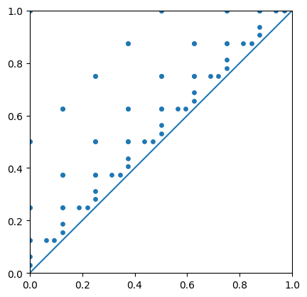
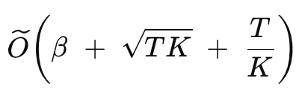

Phase I – Budget Accumulation
Multiplicative grid $F_{K}$
Phase I
Regret:
Notes:
Not possible to Explore Continuous in this Setting (mention bounded density). Gain sometimes to explore then. Multiplicative grid: not K$\sqrt{T}$.

Slide 11
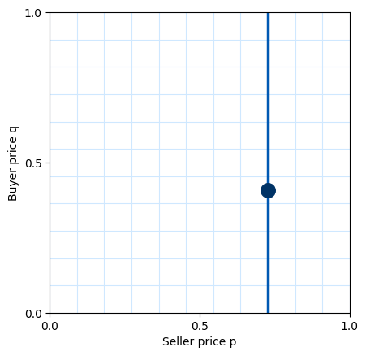


Phase II – Pure Exploration
Unbiased estimator
Phase II
Probing $(p,V)$
Regret:
Notes:
Poor feedback: not observable parts of GFT. Smart unbiased estimator formula: not $mK^{2}$.

Slide 12
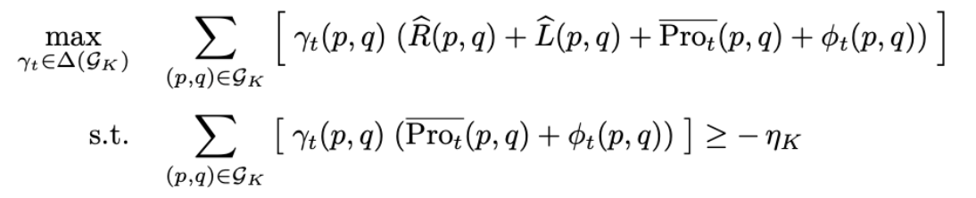
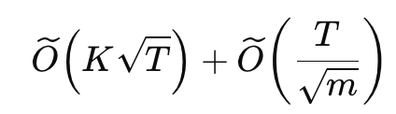
Phase III – Optimization
Optimistic LP
Phase III
Regret:
Notes:
LP: Optimism of GFT + Optimism on feasibility constraint. An algorithm designed for theory.

Slide 13
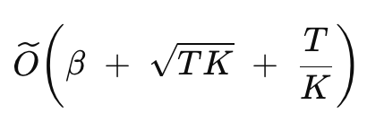
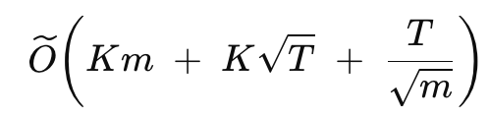
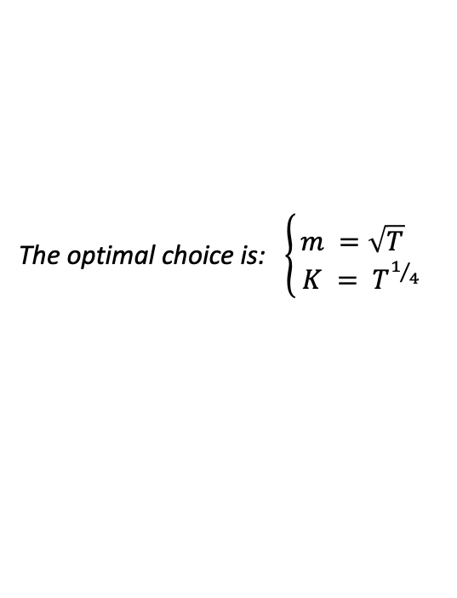
Parameters
Parameters choice
Regret of Phase I
Regret of Phases II and III
The optimal choice is: $\left\{\begin{aligned}m =\sqrt{T} \\ K = T^{1/4}\end{aligned}\right.$
Notes:
Considering: discretization error, running out of budget, rrror of estimation with poor feedback, spending rounds in Phases I and II. Optimize parameters.

Slide 14
Conclusion
Main results
« In stochastic i.i.d. dual markets with bounded density under one-bit realistic feedback, sublinear regret with rate $O( T^{3/4} )$ is achievable against the optimal GBB distribution of prices, while guaranteeing global budget balance. »
« The new distributional benchmark is attainable in stochastic environments. »
Notes:
Expected pseudo-regret is bounded in the worst case by T^3/4 in this setting. NEW DISTRIBUTIONAL IS ATTAINABLE.

Slide 15
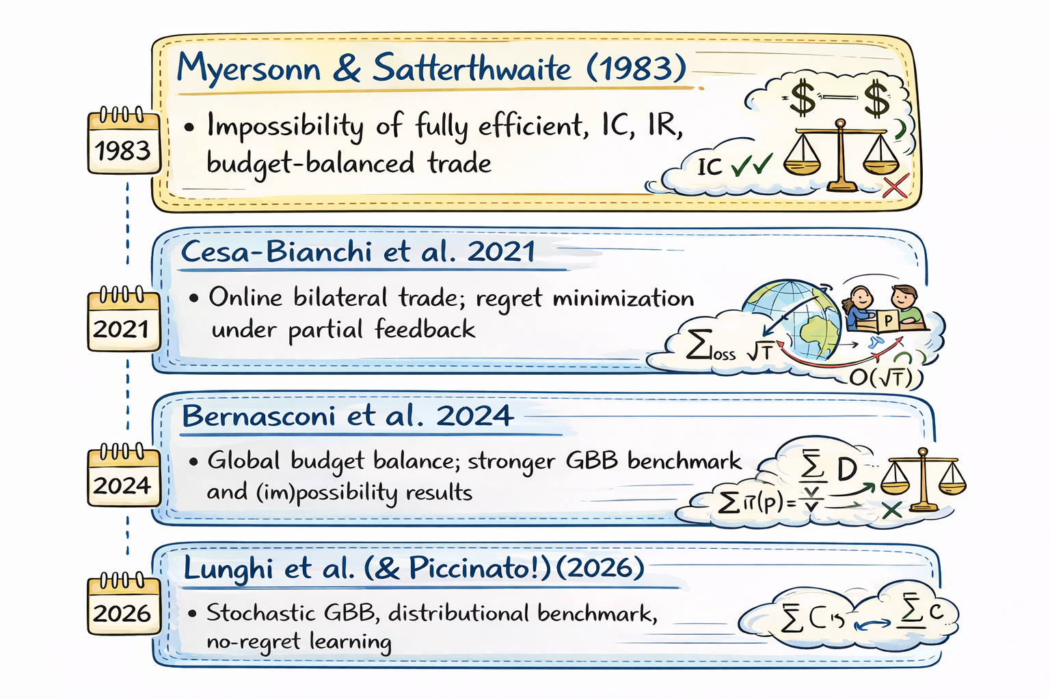
Main references
Under submission to ICML 2026!
ADV
ST
Notes:
Line of research ☺ ICML2026!!

Slide 16
Final slide
THE END

Slide 17
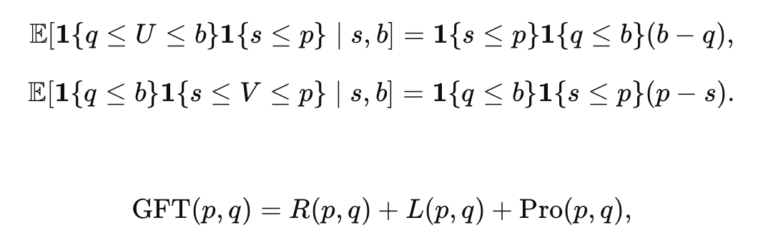

Extra
GFT Estimator
Idea of the decomposition
Geometrically
If you play$\left(p,U\right)$ and $\left(V,q\right)…$

Slide 18
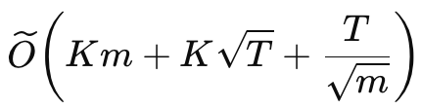

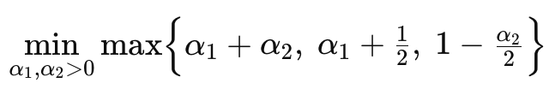
Extra
Choice of parameters
Regret of Phase II and III
Set
Solve

Slide 19

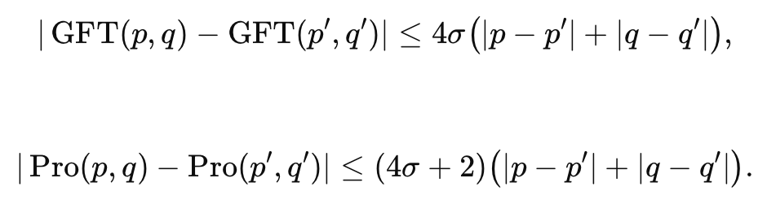
Extra
Bounded density
Definition
Implies

Slide 20

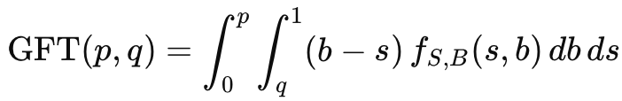
Extra
Expected GFT
Remember
Explicitly

Slide 21

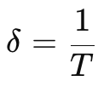
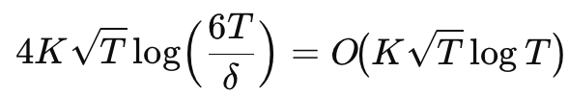
Extra
High-probability analysis
So that
Set failure probability
And in the logarithm

Slide 22



Extra
Feedback models
Full feedback
$$\left(s_{t},b_{t} \right)$$
Bandit feedback
$$GFT\left(p_{t},q_{t},s_{t},b_{t} \right)$$
Realistic feedback

Slide 23
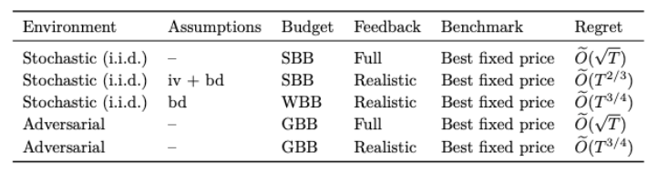
Extra
More results

