Slide 1
OLA Project 2024/2025
Mattia Piccinato
Francesco Allegrini
Mattia Repetti

Slide 2
Requirement 1
Single product with production capacity constraint

Slide 3
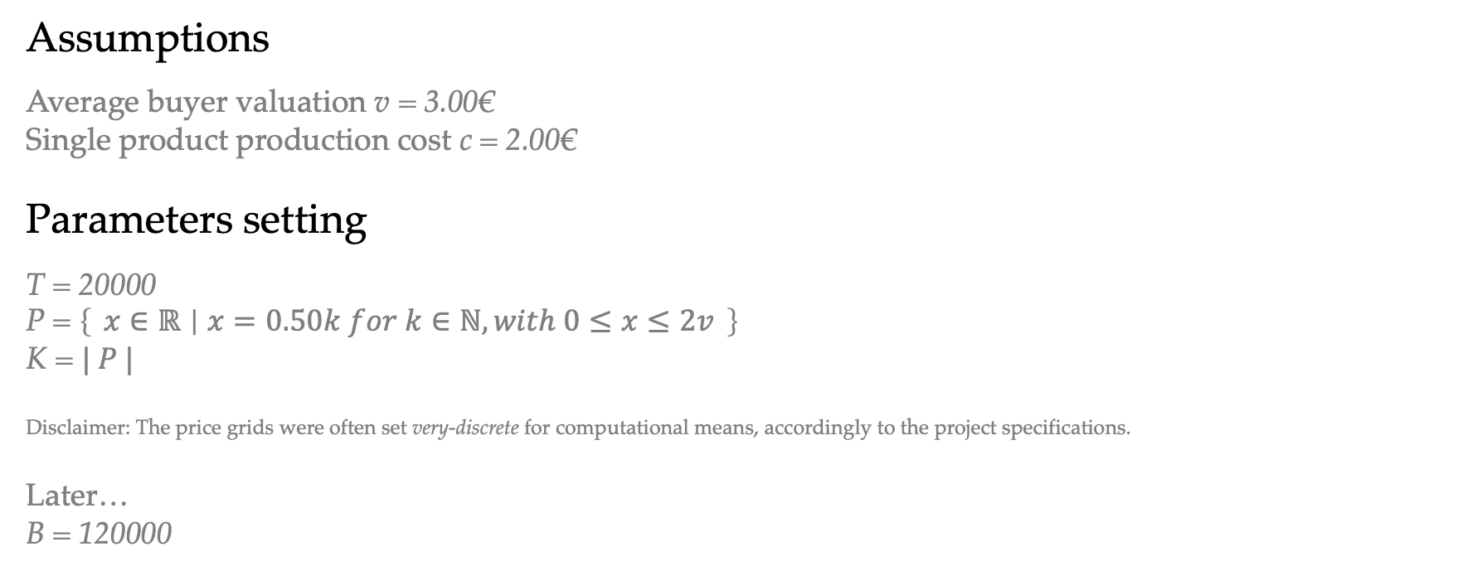
Setting - General
Assumptions
Average buyer valuation v = 3.00€
Single product production cost c = 2.00€
Parameters setting
T = 20000
P = $\left\{ x∈ℝ ∣ x=0.50k for k∈ℕ, with 0≤x≤2v \right\}$
K = $| P |$
Disclaimer: The price grids were often set very-discrete for computational means, accordingly to the project specifications.
Later…
B = 120000

Slide 4
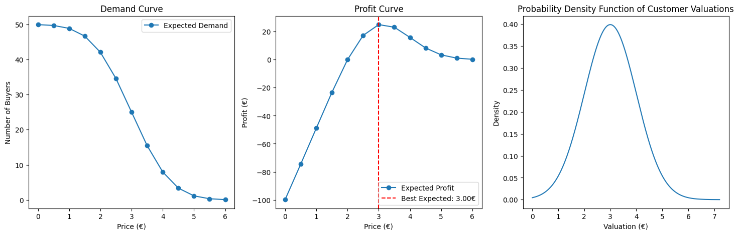
Setting - General

Slide 5
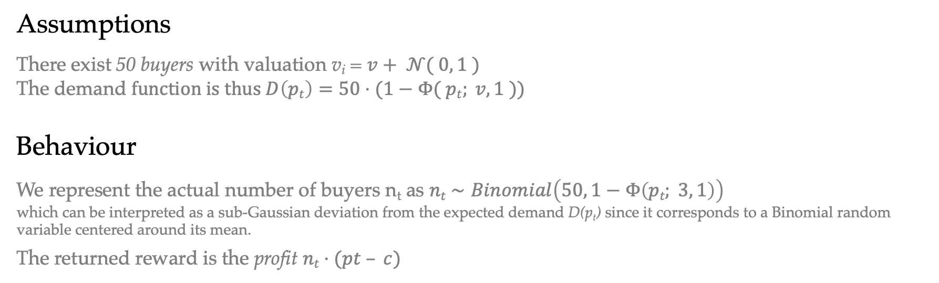
Environment - General
Assumptions
There exist 50 buyers with valuation v_{i} = $v+ 𝒩( 0, 1 )$
The demand $function is thus D\left(pt\right)=50⋅(1−Φ( pt; v, 1 ))$
Behaviour
We represent the actual number of buyers n_{t} as $nt​∼Binomial\left(50, 1−Φ\left(pt​; 3, 1\right)\right)$
which can be interpreted as a sub-Gaussian deviation from the expected demand D(p_{t}) since it corresponds to a Binomial random variable centered around its mean.
The returned reward is the profit $nt⋅(pt – c)$

Slide 6
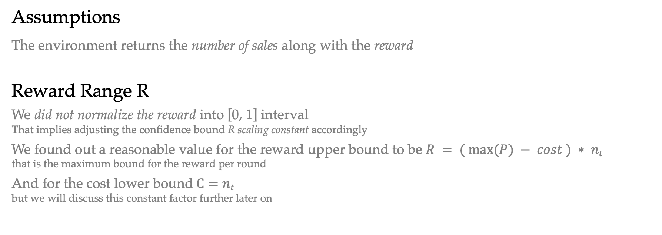
Feedback - General
Assumptions
The environment returns the number of sales along with the reward
Reward Range R
We did not normalize the reward into [0, 1] interval That implies adjusting the confidence bound R scaling constant accordingly
We found out a reasonable value for the reward upper bound to be $R = ( max⁡(P) − cost ) ∗ nt$
that is the maximum bound for the reward per round
And for the cost lower bound$C=nt$ but we will discuss this constant factor further later on

Slide 7
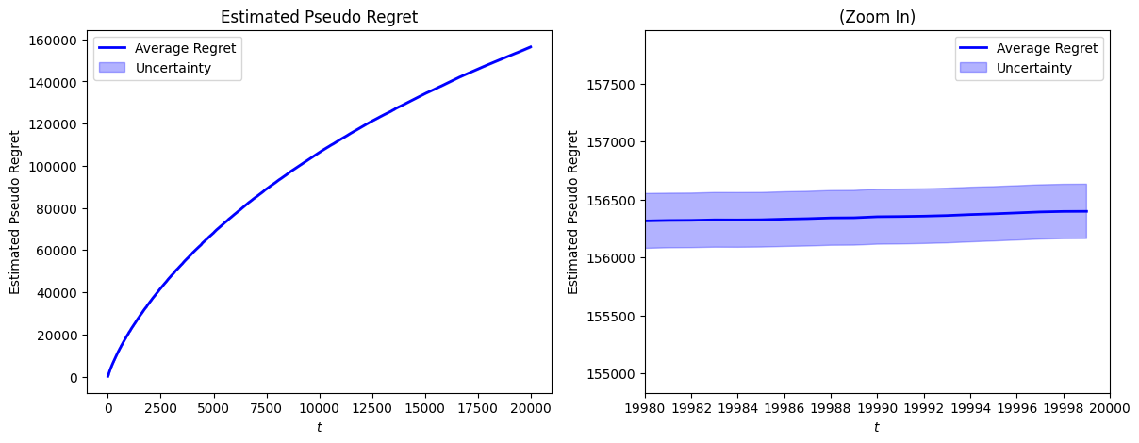
Performance Analysis - General
Regret Methodology
Due to the difficulty of calculating the expected reward of UCB1, we estimate it through its sample mean over n independent trials, in order to compute the pseudo-regret

Slide 8
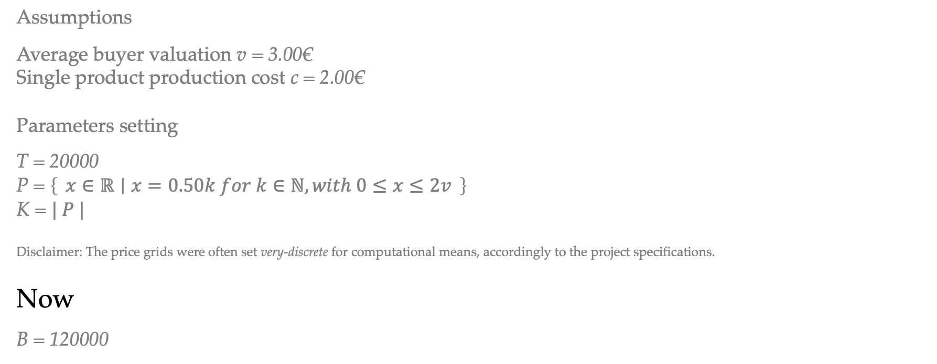
Setting – How to deal with budget?
Assumptions
Average buyer valuation v = 3.00€
Single product production cost c = 2.00€
Parameters setting
T = 20000
P = $\left\{ x∈ℝ ∣ x=0.50k for k∈ℕ, with 0≤x≤2v \right\}$
K = $| P |$
Disclaimer: The price grids were often set very-discrete for computational means, accordingly to the project specifications.
Now
B = 120000

Slide 9
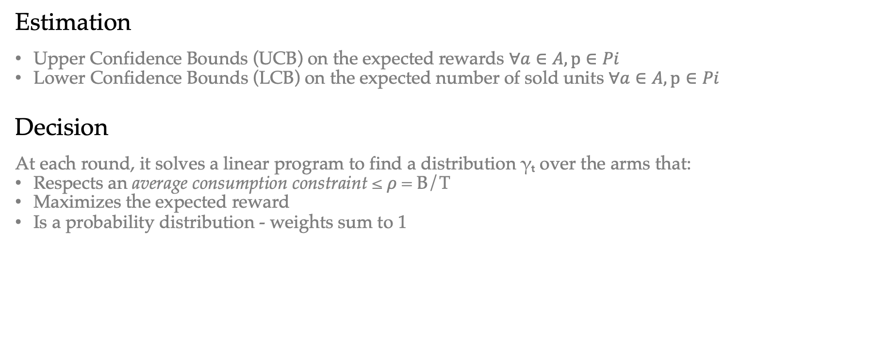
Strategy
Estimation
Upper Confidence Bounds (UCB) on the expected rewards $∀a∈A, p∈Pi$
Lower Confidence Bounds (LCB) on the expected number of sold units $∀a∈A, p∈Pi$
Decision
At each round, it solves a linear program to find a distribution γₜ over the arms that:
Respects an average consumption constraint ≤ $ρ$ = B/T
Maximizes the expected reward
Is a probability distribution - weights sum to 1

Slide 10
Strategy
Idea
By incorporating lower confidence bounds on consumption, this UCB1 extension ensures that decisions are budget-aware, while being optimistic about overconsumption in order to promote exploration, and to avoid waste of budget
To do that, we allocate probability across arms through a linear programming problem, which constrainedly avoids overconsumption (optimistically)

Slide 11
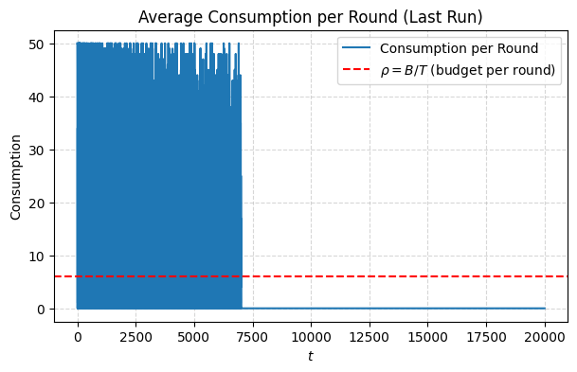
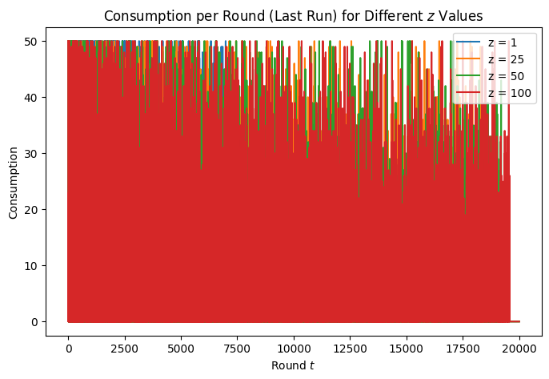
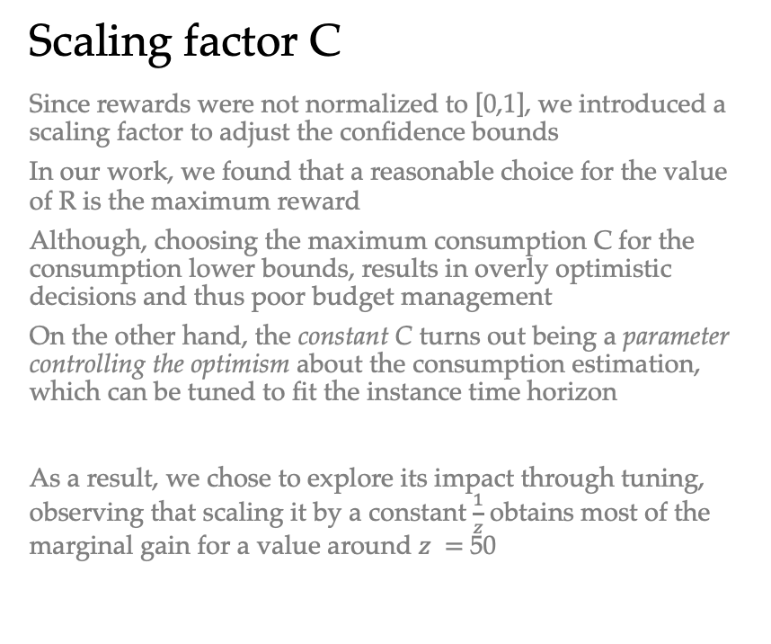
To be discussed
Scaling factor C
Since rewards were not normalized to [0,1], we introduced a scaling factor to adjust the confidence bounds
In our work, we found that a reasonable choice for the value of R is the maximum reward
Although, choosing the maximum consumption C for the consumption lower bounds, results in overly optimistic decisions and thus poor budget management
On the other hand, the constant C turns out being a parameter controlling the optimism about the consumption estimation, which can be tuned to fit the instance time horizon
As a result, we chose to explore its impact through tuning, observing that scaling it by a constant $\frac{1}{z}$obtains most of the marginal gain for a value around $z =$50

Slide 12
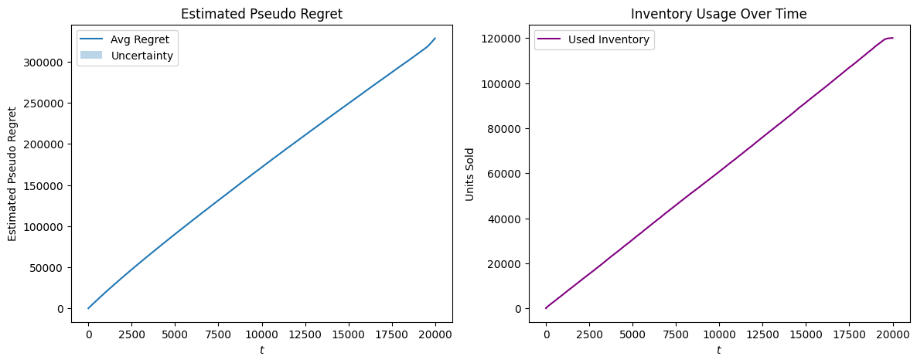
Budget
Consumption
Thanks to the scaling factor adaptation, the algorithm successfully optimizes the usage per round until the end of the time horizon

Slide 13
Performance Analysis
Baseline
At first glance, it seems that the algorithm does not achieve sub-linear regret against the standard baseline…
The reason in this case is that we are comparing an algorithm playing with a max capacity against a clairvoyant which can keep selling an unlimited quantity of items
Further discussion later on

Slide 14
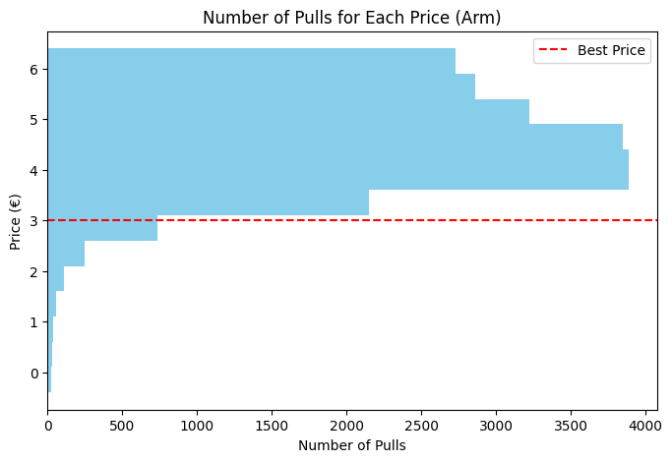
Performance Analysis
Learning Quality
In fact, the algorithm - due to the constraint - barely plays the optimal arm… Implying linear regret
Which is the desired behaviour!
By playing the optimal arm, it consumes more than it should, turning not actually optimal in this setting
Here, the algorithm "decides to sell less to sell enough” - at better price!

Slide 15
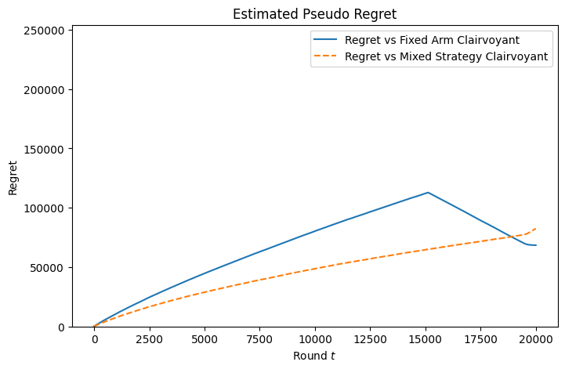
Performance Analysis
New clairvoyants
The “Budget-aware Fixed-price Clairvoyant” Optimal price: 4.00 Expected total profit: 240k
The “Per-round Budget-aware Mixed-Policy Clairvoyant” Optimal policy: [0. 0. 0. 0. 0. 0. 0. 0. 0.58 0.42 0. 0. 0. ] Expected total reward: 254k
Notice: our algorithm converges to [0. 0. 0. 0. 0. 0. 0. 0. 0.58 0.42 0. 0. 0. ]
Regret
Given that our algorithm converges to a policy closely aligned with that of the BAMP clairvoyant, we believe the observed regret stems only from the time initially required by the algorithm to learn.
Considering the budget-constrained nature of the problem - which somehow counters the clairvoyant strength - we expect the regret to grow very slowly as the time horizon increases further.

Slide 16
Requirement 2
With multiple products

Slide 17
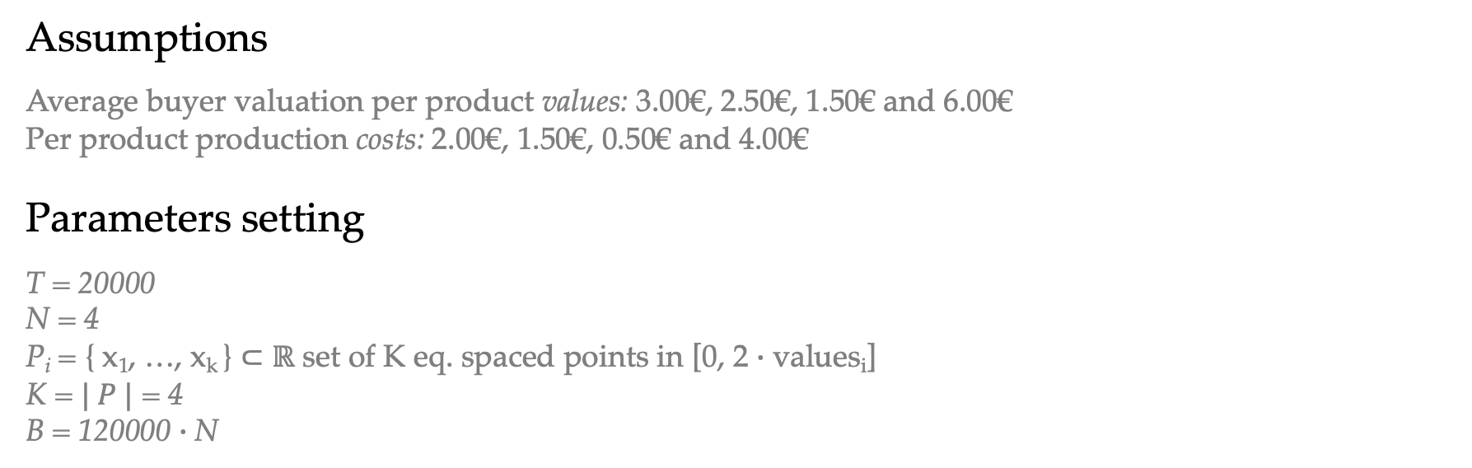
Setting
Assumptions
Average buyer valuation per product values: 3.00€, 2.50€, 1.50€ and 6.00€
Per product production costs: 2.00€, 1.50€, 0.50€ and 4.00€
Parameters setting
T = 20000
N = 4
P_{i} = { x₁​, …, x_{k} ​} ⊂ $ℝ$ set of K eq. spaced points in [0, 2 $∙$ values_{i}]
K = $| P |$ = 4
B = 120000 $∙$N

Slide 18
Setting
Best Expected Prices
Product 1: optimal price = €3.33, expected profit = €24.63
Product 2: optimal price = €2.75, expected profit = €23.58
Product 3: optimal price = €1.58, expected profit = €23.50
Product 4: optimal price = €6.67, expected profit = €43.78
Best Super Arm – Overall
Best expected profit = €115.49
Expected total demand: 75.45 units

Slide 19
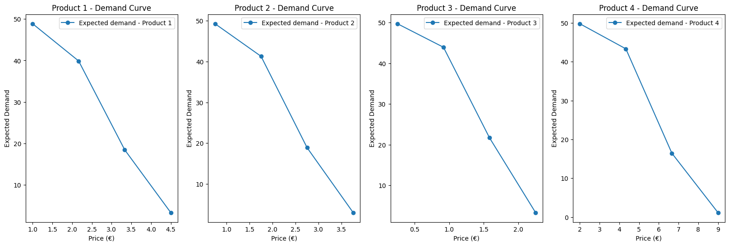
Setting

Slide 20
Environment
Assumptions
There are 50 buyers per each product, each with valuations similarly to R1
Changes
We extended the environment to a multi-product environment, that is equivalent to N independent single-product environments

Slide 21
Feedback
Assumptions
The environment returns the number of sales per product and the reward per product, along with the total reward

Slide 22
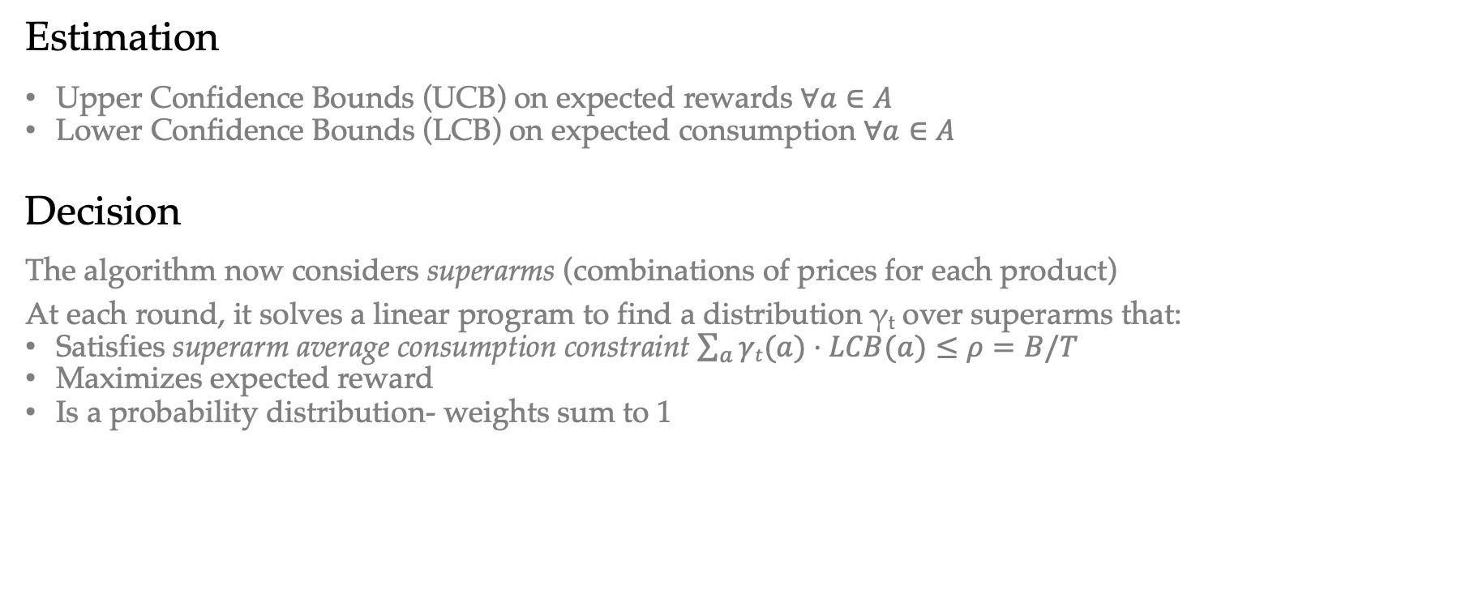
Strategy
Estimation
Upper Confidence Bounds (UCB) on expected rewards $∀a∈A$
Lower Confidence Bounds (LCB) on expected consumption $∀a∈A$
Decision
The algorithm now considers superarms (combinations of prices for each product)
At each round, it solves a linear program to find a distribution γ_{t} over superarms that:
Satisfies superarm average consumption constraint $\sum_{a}{γt(a)⋅LCB(a)}≤ρ=B/T$
Maximizes expected reward
Is a probability distribution- weights sum to 1

Slide 23
Strategy
Idea
We build per-arm statistics for each product-price pair (arm) and use them to estimate the expected reward and consumption of every combination of prices (superarm)
Such approach enables better efficiency than estimating the confidence bounds for every possible product mix
To be discussed
In the next slides we will discuss:
The choice of the the scaling factor R
How to initialize the algorithm
How to handle the case of LPP failure

Slide 24
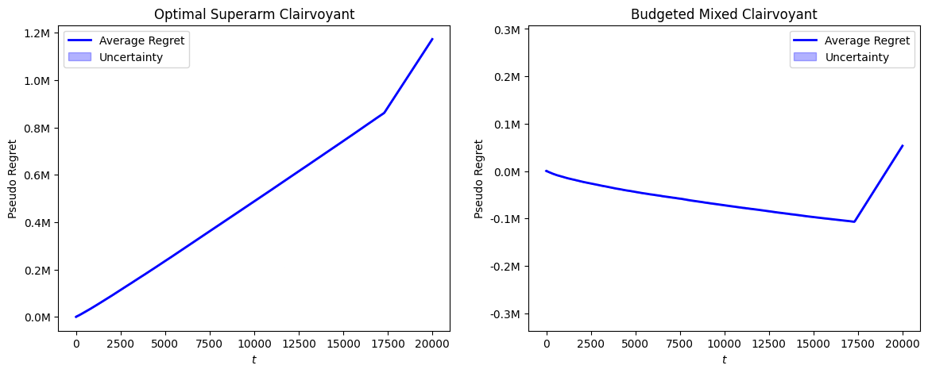
To be discussed
Scaling factors R and C
Similarly to what we did for R1, we had to choose a reasonable value for R and C.
Due to the presence of multiple products, and considering how we estimate the bounds for the superarms, we decided to just divide R and C by N
In this case, this choice turns out to be enough to obtain satisfying results
Hint: Notice the y-axis

Slide 25
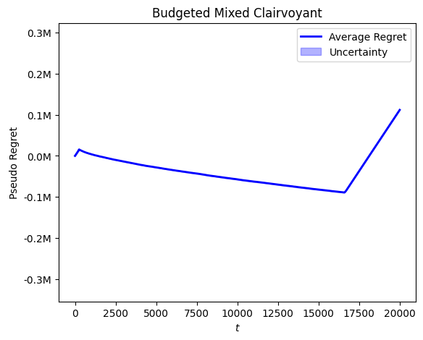

To be discussed
Algorithm initialization
We chose to compare two different strategies:
Making sure to run each arm at least once in the first $N∙K$ rounds
Making sure to run each superarm at least once in the first $|S|$ rounds
The latter option achieves higher regret than the former.
Hint: 53.3k vs 111.9k

Slide 26
To be discussed
Linear Program failure
During the execution of the algorithm, the Linear Programming problem (LPP) used to select the optimal superarms probability distribution may fail to return a feasible solution
To handle such cases gracefully, we implemented a fallback mechanism that finds an alternative solution when the LPP becomes infeasible
The idea is simple: among the feasible superarms, we return the one with maximum expected reward; if no feasible superarm is available, we choose the one with minimum cost
Although, in our work this case never occurred, our algorithm does not need to stop in case of LPP failure

Slide 27
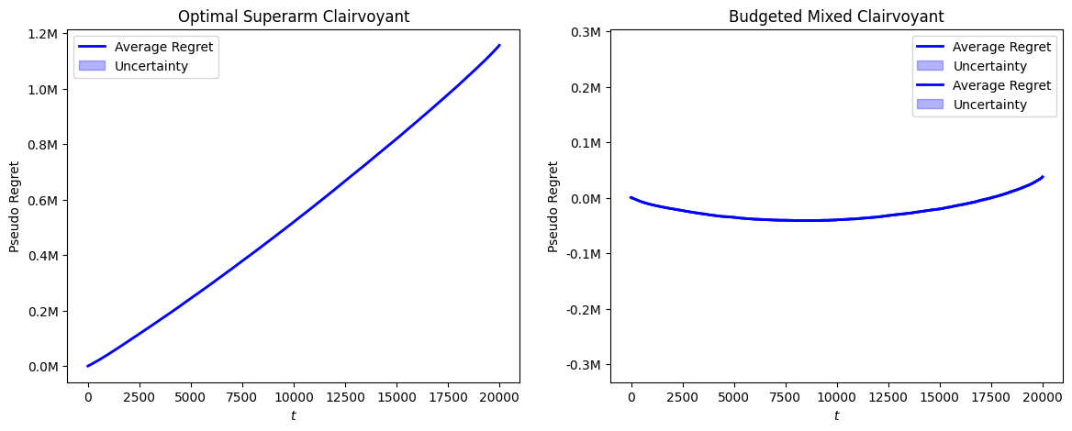
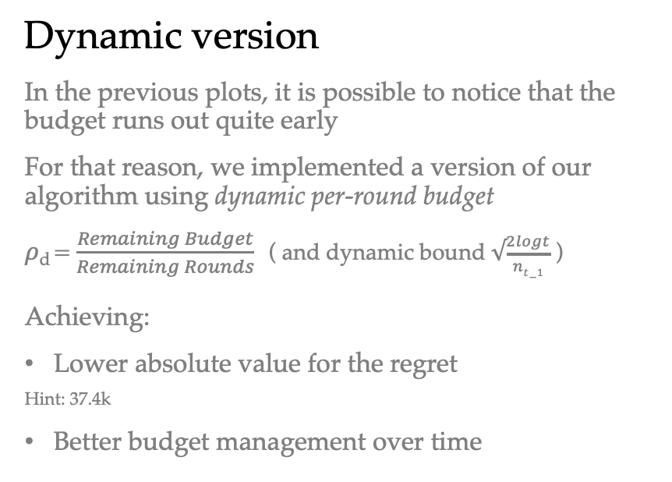
Budget
Dynamic version
In the previous plots, it is possible to notice that the budget runs out quite early
For that reason, we implemented a version of our algorithm using dynamic per-round budget
$ρ$_{d} = $\frac{Remaining Budget}{Remaining Rounds}$ ( and dynamic bound $√\frac{2logt}{nt−1}$ )
Achieving:
Lower absolute value for the regret
Hint: 37.4k
Better budget management over time

Slide 28
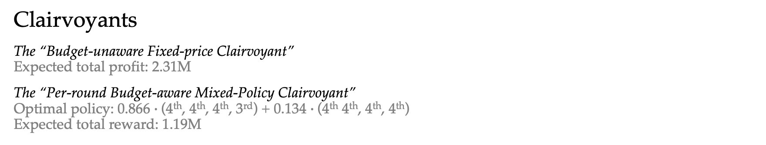
Performance Analysis
Clairvoyants
The “Budget-unaware Fixed-price Clairvoyant” Expected total profit: 2.31M
The “Per-round Budget-aware Mixed-Policy Clairvoyant” Optimal policy: 0.866 $∙$(4th, 4th, 4th, 3rd) + 0.134 $∙$(4th 4th, 4th, 4th)
Expected total reward: 1.19M
Regret
The regret against our BAMP clairvoyant is surprisingly low: less than 5% for this instance

Slide 29
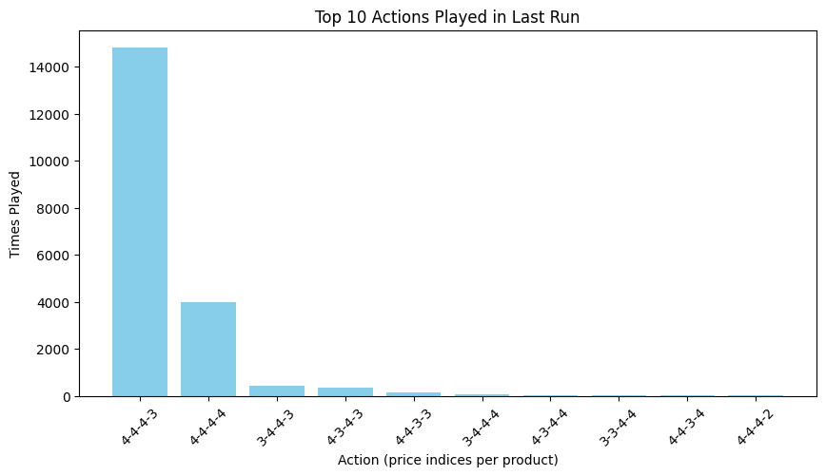
Performance Analysis
Learning Quality
Our algorithm successfully converges to our “Per-round Budget-aware Mixed-Policy Clairvoyant” optimal policy.

Slide 30
Requirement 3
Single product with highly non-stationary environment

Slide 31
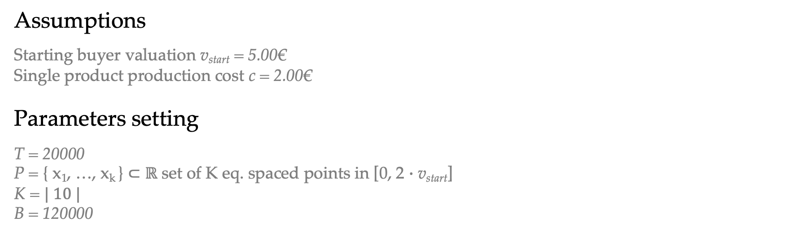
Setting
Assumptions
Starting buyer valuation v_{start} = 5.00€
Single product production cost c = 2.00€
Parameters setting
T = 20000
P = { x₁​, …, x_{k} ​} ⊂ $ℝ$ set of K eq. spaced points in [0, 2 $∙$ v_{start}]
K = $| 10 |$
B = 120000

Slide 32
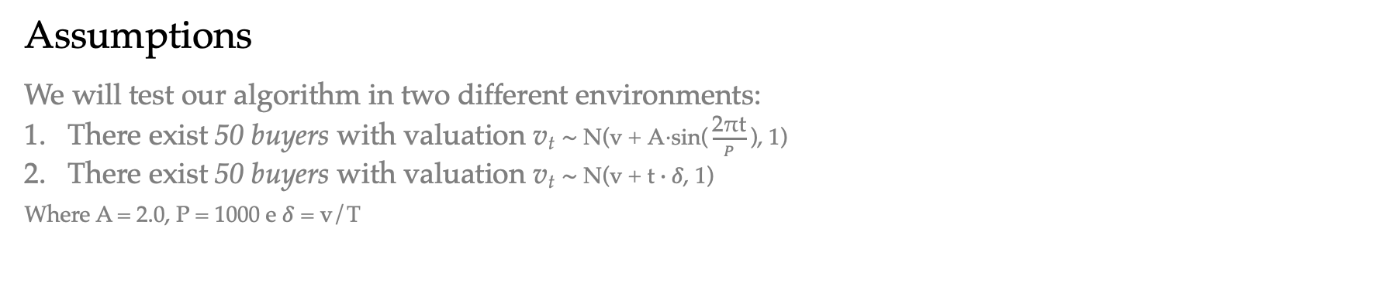
Environment
Assumptions
We will test our algorithm in two different environments:
There exist 50 buyers with valuation v_{t} $\text{∼} \text{N}\text{(}\text{v} \text{+} \text{A}\text{⋅}\text{sin}\text{(}\frac{\text{2}\text{π}\text{t}}{P}\text{​}\text{),} \text{1)}$
There exist 50 buyers with valuation v_{t} $\text{∼} \text{N}\text{(}\text{v} \text{+} \text{t}∙δ\text{,} \text{1)}$
Where A = 2.0, P = 1000 e $δ$ = v/T

Slide 33
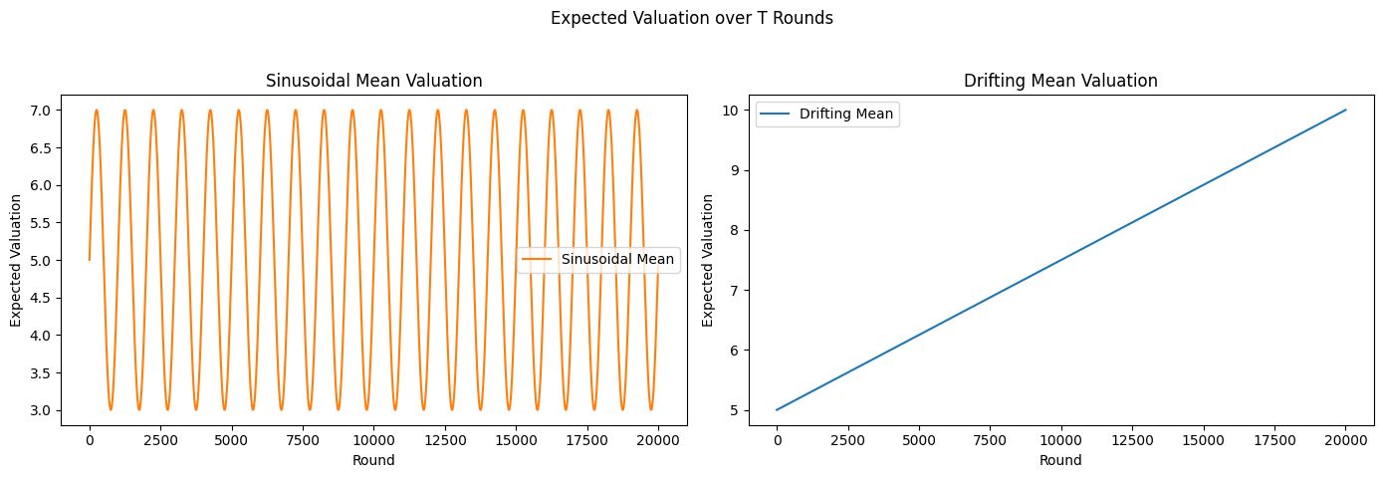
Environments

Slide 34
Strategy
Idea
Our primal-dual agent combines a regret minimizer with a dynamic adjustment of a Lagrange multiplier to manage highly non-stationary environments with consumption constraint
The primal component selects prices by learning from newly observed rewards, allowing it to track changes in buyer behaviour over time — even in highly non-stationary settings
The dual component, on the other hand, enforces the budget constraint by updating the Lagrange multiplier λ, which penalizes price choices leading to excessive consumption
Such dual component can be seen as an adversary that seeks to minimize the agent's effective reward by increasing the penalty when the agent exceeds the per-round budget

Slide 35
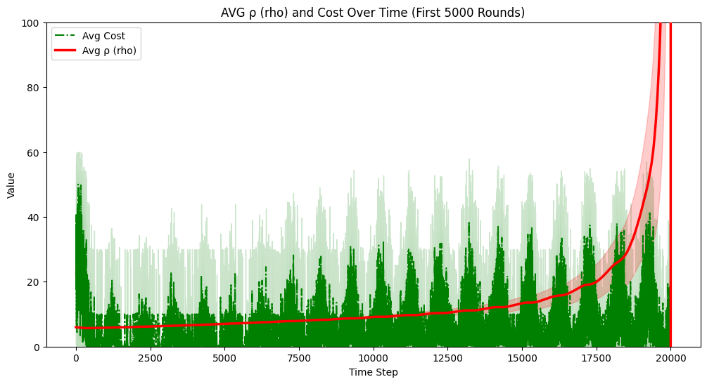
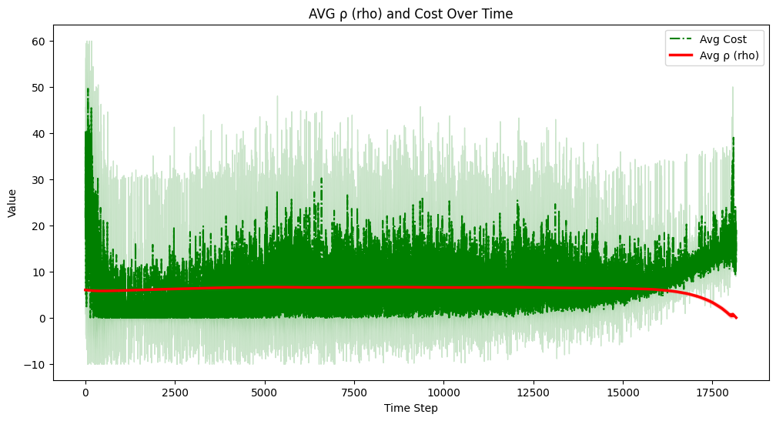
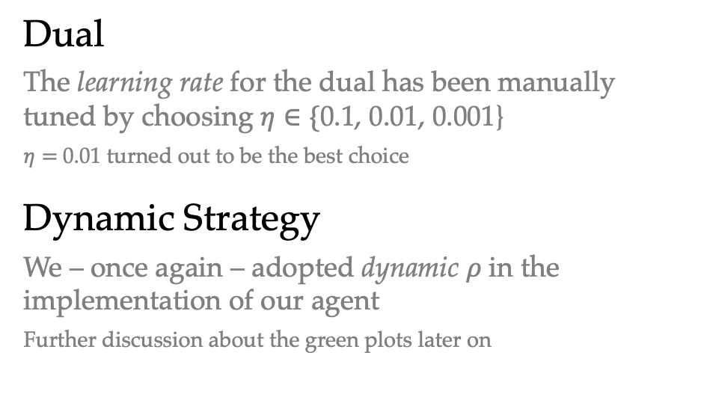
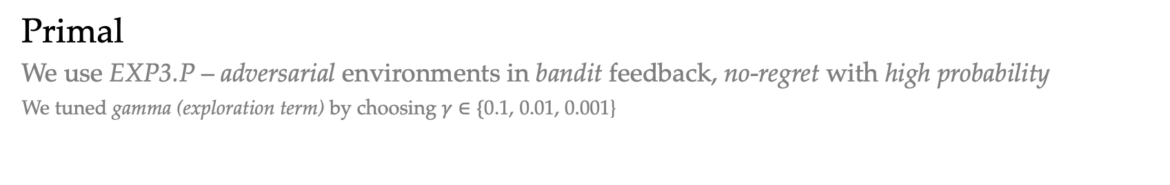
To be discussed
Primal
We use EXP3.P – adversarial environments in bandit feedback, no-regret with high probability
We tuned gamma (exploration term) by choosing $γ∈\{$0.1, 0.01, 0.001}
Dual
The learning rate for the dual has been manually tuned by choosing $η∈\{$0.1, 0.01, 0.001}
$η=$0.01 turned out to be the best choice
Dynamic Strategy
We – once again – adopted dynamic $ρ$ in the implementation of our agent
Further discussion about the green plots later on

Slide 36
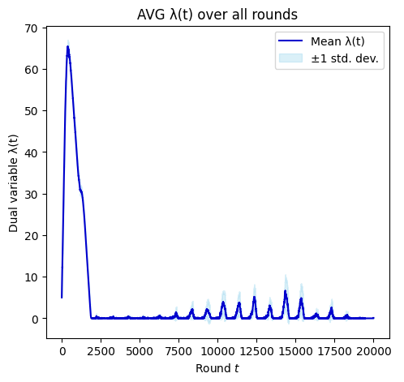
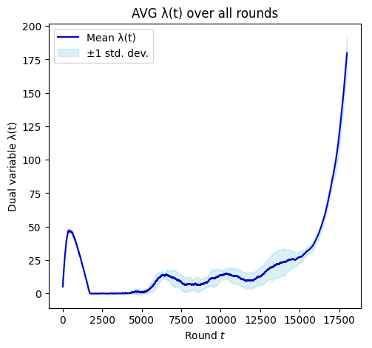
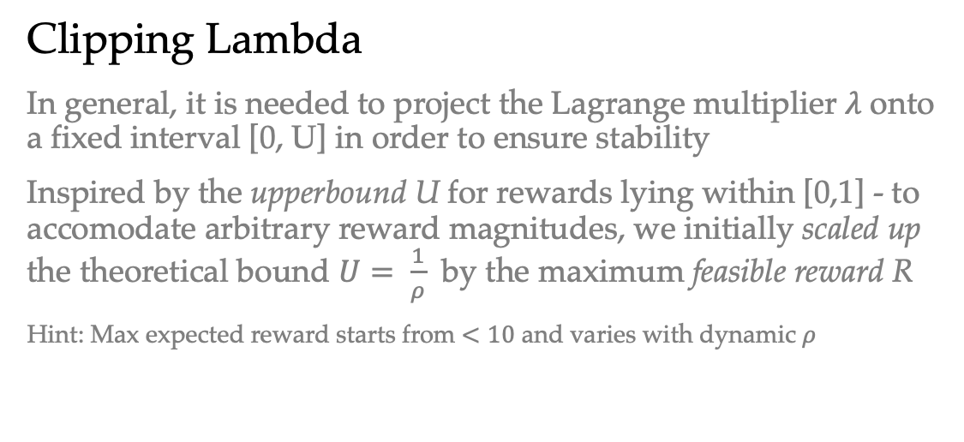
To be discussed
Clipping Lambda
In general, it is needed to project the Lagrange multiplier $λ$ onto a fixed interval [0, U] in order to ensure stability
Inspired by the upperbound U for rewards lying within [0,1] - to accomodate arbitrary reward magnitudes, we initially scaled up the theoretical bound $U= \frac{1}{ρ}$ by the maximum feasible reward R
Hint: Max expected reward starts from $<10$ and varies with dynamic $ρ$

Slide 37
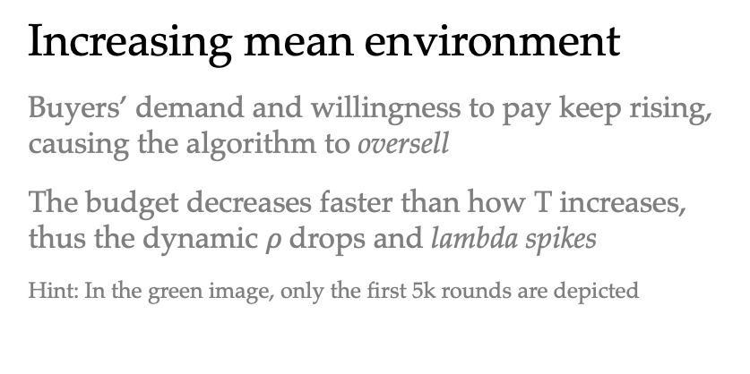
Budget
Sinusoidal environment
The algorithm successfully manages the budget until the end (red line spikes at the end)
The proper behaviour can be inferred by observing the overall decrease of lambda
Increasing mean environment
Buyers’ demand and willingness to pay keep rising, causing the algorithm to oversell
The budget decreases faster than how T increases, thus the dynamic $ρ$drops and lambda spikes
Hint: In the green image, only the first 5k rounds are depicted

Slide 38
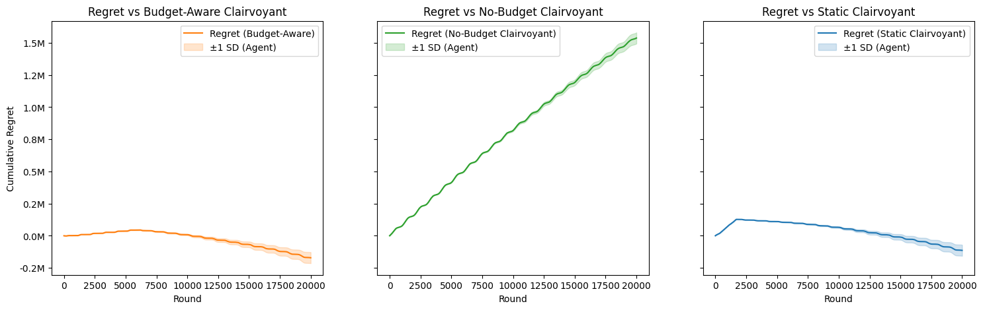
Performance Analysis – Sinusoidal
Clairvoyants
Defining a smart baseline for highly non-stationary environments was challenging – here we propose three:
The “Budget-aware Fixed-price Clairvoyant” Expected total profit: 89.1k
The “Budget-unaware Overpower Clairvoyant” Expected total reward: 1.8M
The “Static-assupmtion Fixed-price Clairvoyant” Expected total reward: 146.6k
Regret
Obviously, the regret against the overpower clairvoyant does not achieve sub-linear regret
On the other hand, both the two other baselines lose to our algorithm

Slide 39
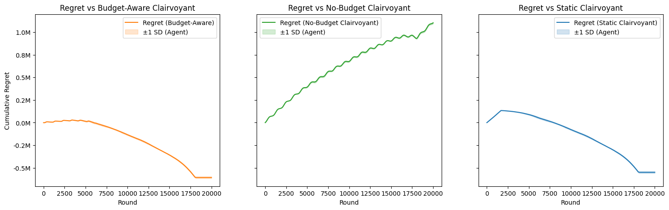
Performance Analysis – Increasing mean
Clairvoyants
The “Budget-aware Fixed-price Clairvoyant” Expected total profit: 89.1k
The “Budget-unaware Overpower Clairvoyant” Expected total reward: 1.8M
The “Static-assupmtion Fixed-price Clairvoyant” Expected total reward: 146.6k
Regret
Despite the bad behaviour – due to the impossibility of learning – the regret in this case is somehow even better!
Although, the bad budget management worsens the result by the time horizon T

Slide 40
Requirement 4
Multiple product with highly non-stationary environment

Slide 41
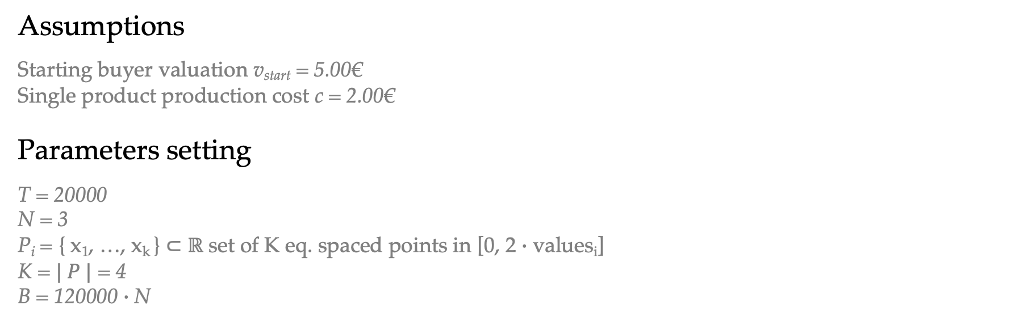
Setting
Assumptions
Starting buyer valuation v_{start} = 5.00€
Single product production cost c = 2.00€
Parameters setting
T = 20000
N = 3
P_{i} = { x₁​, …, x_{k} ​} ⊂ $ℝ$ set of K eq. spaced points in [0, 2 $∙$ values_{i}]
K = $| P |$ = 4
B = 120000 $∙$N

Slide 42
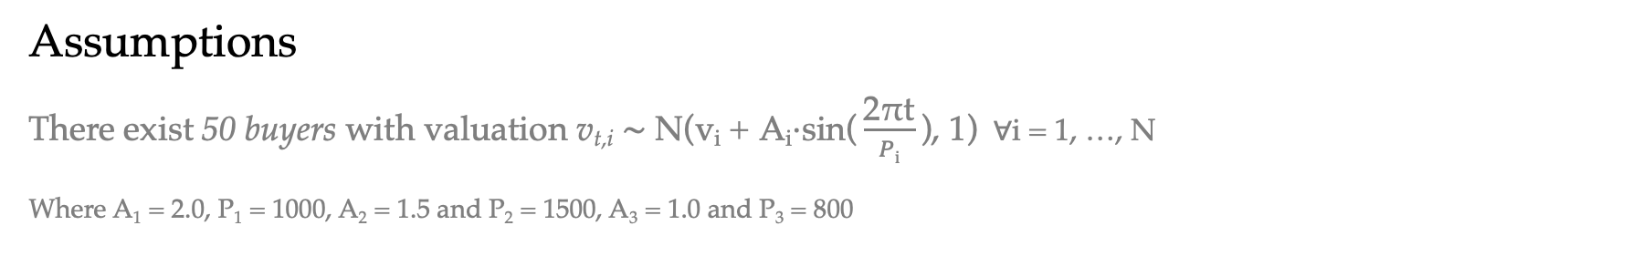
Environment
Assumptions
There exist 50 buyers with valuation v_{t,i} $\text{∼} \text{N}\text{(}\text{v}\text{i} \text{+} \text{A}\text{i}\text{⋅}\text{sin}\text{(}\frac{\text{2}\text{π}\text{t}}{Pi}\text{​}\text{),} \text{1)}$ $∀$i = 1, …, N
Where A₁ = 2.0, P₁ = 1000, A₂ = 1.5 and P₂ = 1500, A₃ = 1.0 and P₃ = 800

Slide 43
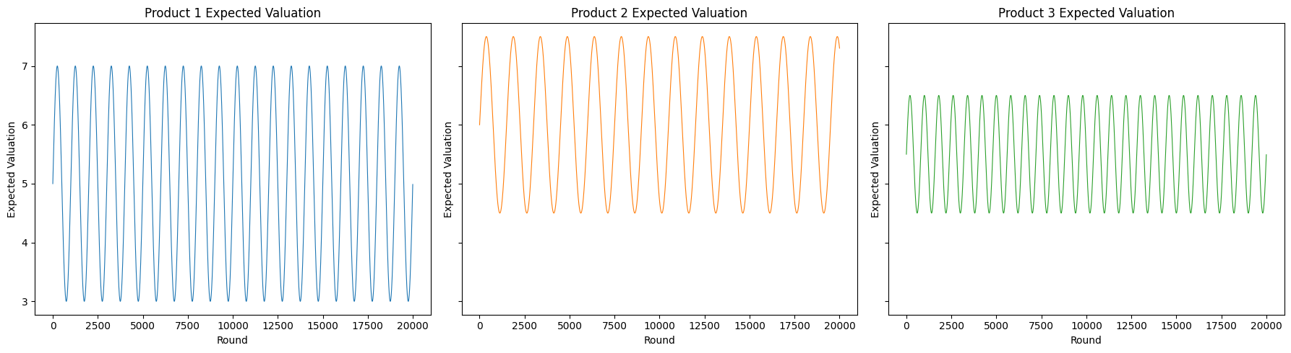
Environment

Slide 44
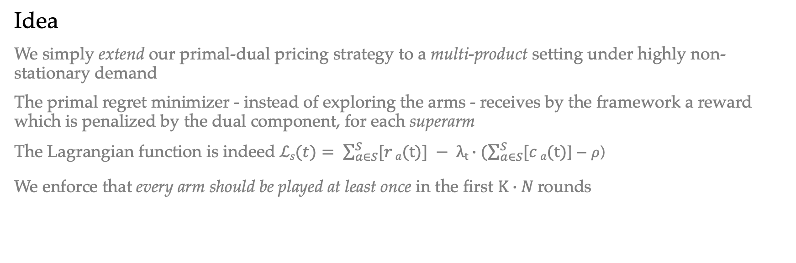
Strategy
Idea
We simply extend our primal-dual pricing strategy to a multi-product setting under highly non-stationary demand
The primal regret minimizer - instead of exploring the arms - receives by the framework a reward which is penalized by the dual component, for each superarm
The Lagrangian function is indeed $ℒs(t)= \sum_{a∈S}^{S}{[r}a(t)] − λt∙(\sum_{a∈S}^{S}{[c}a(t)$] $−$ $ρ$)
We enforce that every arm should be played at least once in the first $K∙N$rounds

Slide 45
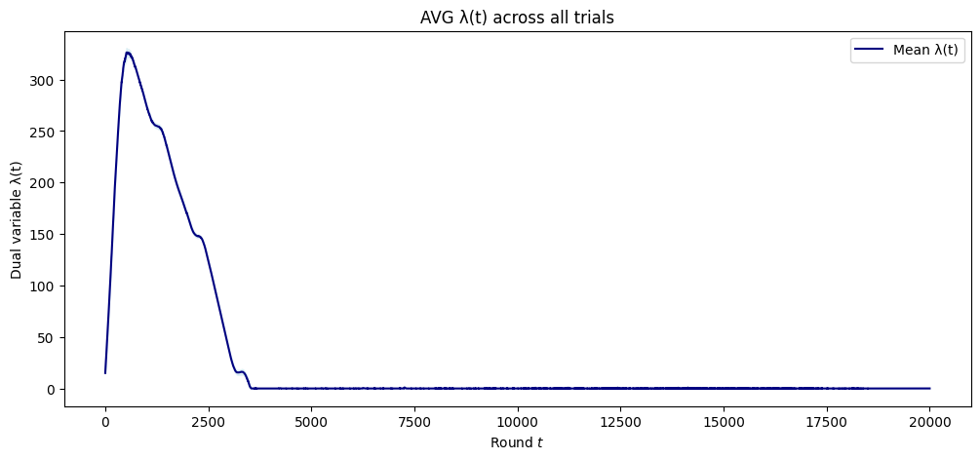
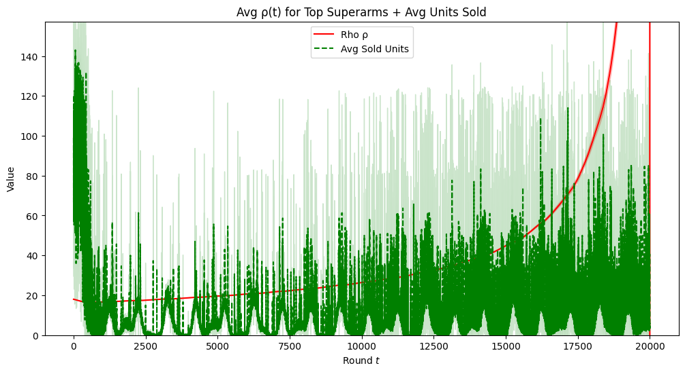
Budget
Behaviour
The algorithm behaviour was in every way equivalent to the single product case

Slide 46
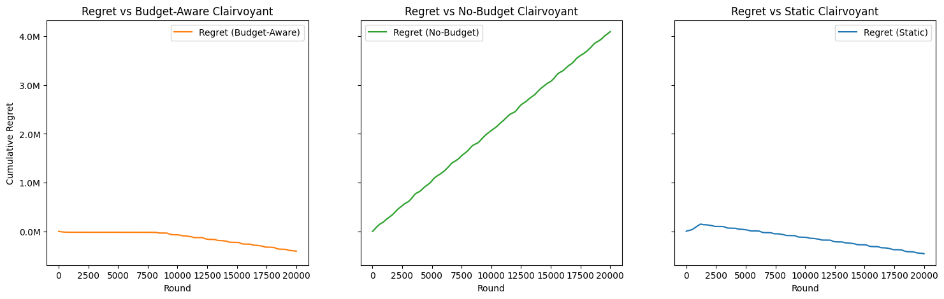
Performance Analysis
Clairvoyants
The “Budget-aware Fixed-price Clairvoyant” Best static superarm: [7.50, 9.00, 8.25]
Total expected reward: 261.7K
The “Budget-unaware Overpower Clairvoyant” Total expected reward: 4.77M
The “Static-assupmtion Fixed-price Clairvoyant” Best static superarm: [5.33, 6.42, 8.25]
Total expected reward: 210.6K
Regret
We obtain similar results to the single product case

Slide 47
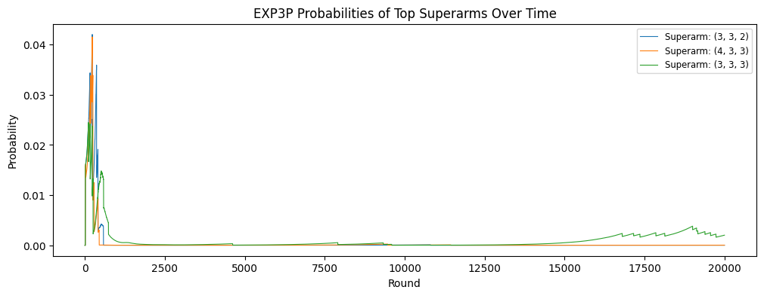
Performance Analysis
One last observation
We just would like to highlight that our algorithm appears to follow this pattern:
Starts by playing arms with highest average reward quite enough
Observes a spike by lambda to quickly penalize such arms
Keeps playing arms which guarantee good budget management (with higher per-buyer profit)
Eventually gives a chance to the best arms by the end of the rounds
Hint: We plotted the three arms with highest average reward at the end of the simulation

Slide 48
Requirement 5
Multiple product with slightly non-stationary environment

