Slide 1
OLA Project 2024/2025
Mattia Piccinato
Francesco Allegrini
Mattia Repetti

Slide 2
Requirement 1
Without production capacity constraint

Slide 3
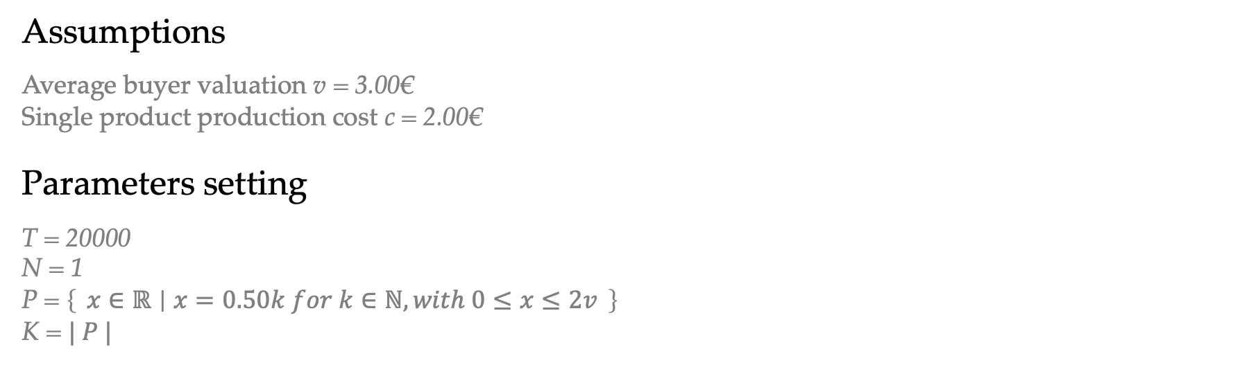
Setting
Assumptions
Average buyer valuation v = 3.00€
Single product production cost c = 2.00€
Parameters setting
T = 20000
N = 1
P = $\left\{ x∈ℝ ∣ x=0.50k for k∈ℕ, with 0≤x≤2v \right\}$
K = $| P |$

Slide 4
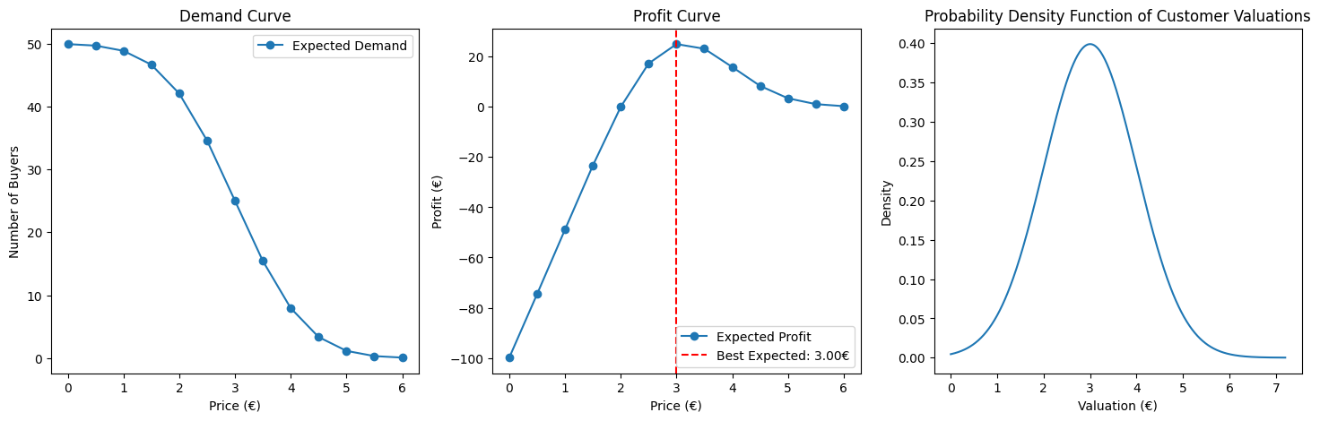
Setting

Slide 5
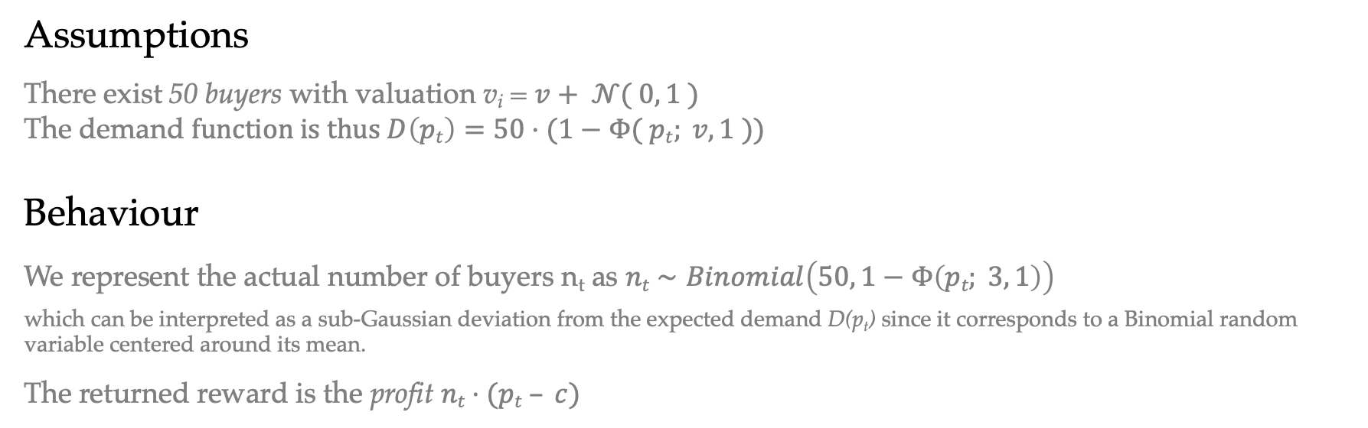
Environment
Assumptions
There exist 50 buyers with valuation v_{i} = $v+ 𝒩( 0, 1 )$
The demand $function is thus D\left(pt\right)=50⋅(1−Φ( pt; v, 1 ))$
Behaviour
We represent the actual number of buyers n_{t} as $nt​∼Binomial\left(50, 1−Φ\left(pt​; 3, 1\right)\right)$
which can be interpreted as a sub-Gaussian deviation from the expected demand D(p_{t}) since it corresponds to a Binomial random variable centered around its mean.
The returned reward is the profit $nt⋅(pt – c)$

Slide 6
Feedback
Assumptions
The environment returns the number of sales along with the reward
Reward range
We did not normalize the reward into [0, 1] interval That implies adjusting the confidence bounds accordingly

Slide 7
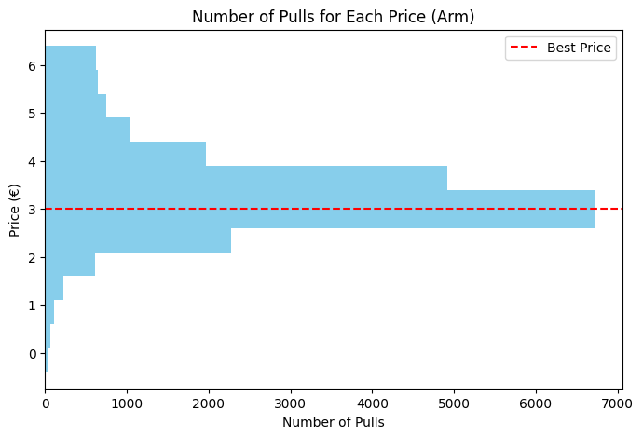
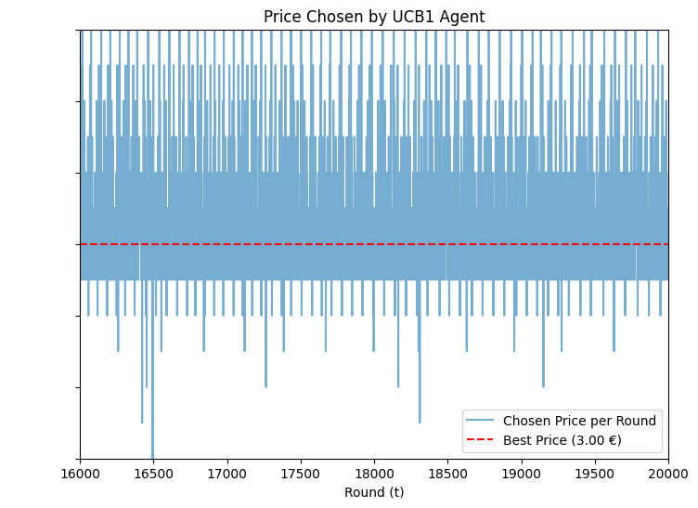
Performance Analysis
Learning quality
The algorithm effectively learns the best arm and mostly plays such arm.
Shouldn’t it play it more? Is the convergence too slow?
Learning time
Actually, it manages to “find” the best arm pretty soon…
It plays sub-optimal because it invests a lot in exploration: until the very end of the time horizon.

Slide 8
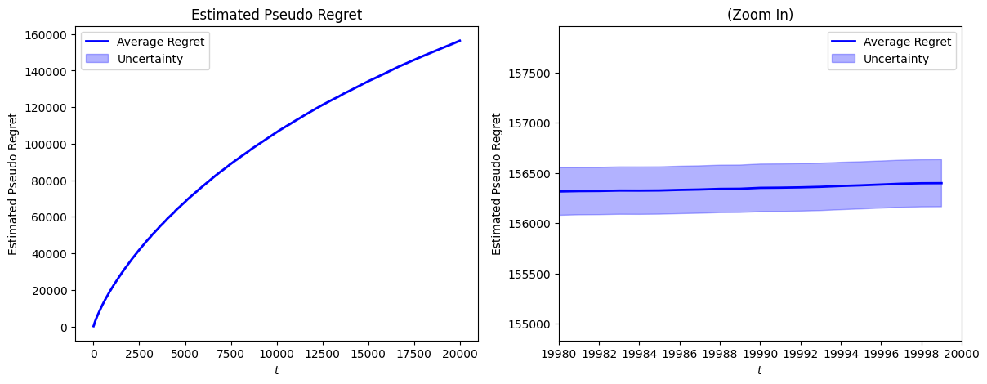
Performance Analysis
Regret Methodology
Due to the difficulty of calculating the expected reward of UCB1, we estimate it through its sample mean over n independent trials, in order to compute the pseudo-regret

Slide 9
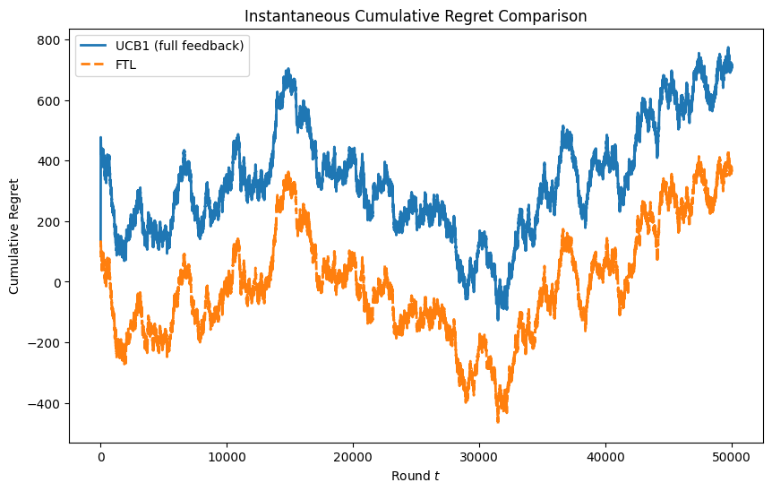
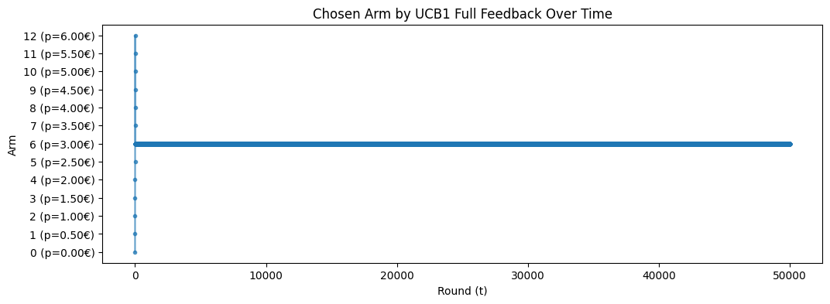
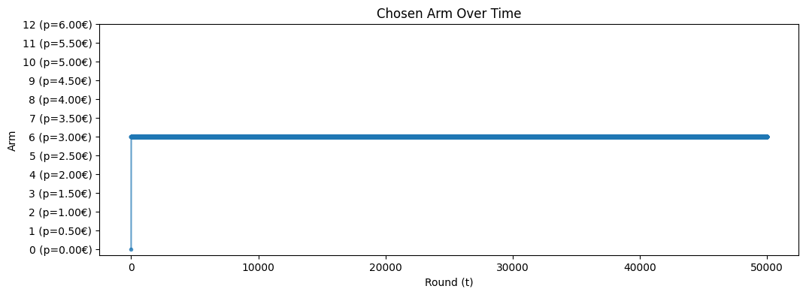
Further Analysis
What happens with full feedback?
UCB1 is an algorithm designed for bandit feedback. How would it behave with full feedback?
Here we plot instantaneous regret for UCB1 and Follow the Leader. They’re the same… Almost
Hint: UCB1 bounds are the same for all the arms!

Slide 10
Requirement 1
With production capacity constraint

Slide 11
Setting
Parameters setting
B = 120000

Slide 12
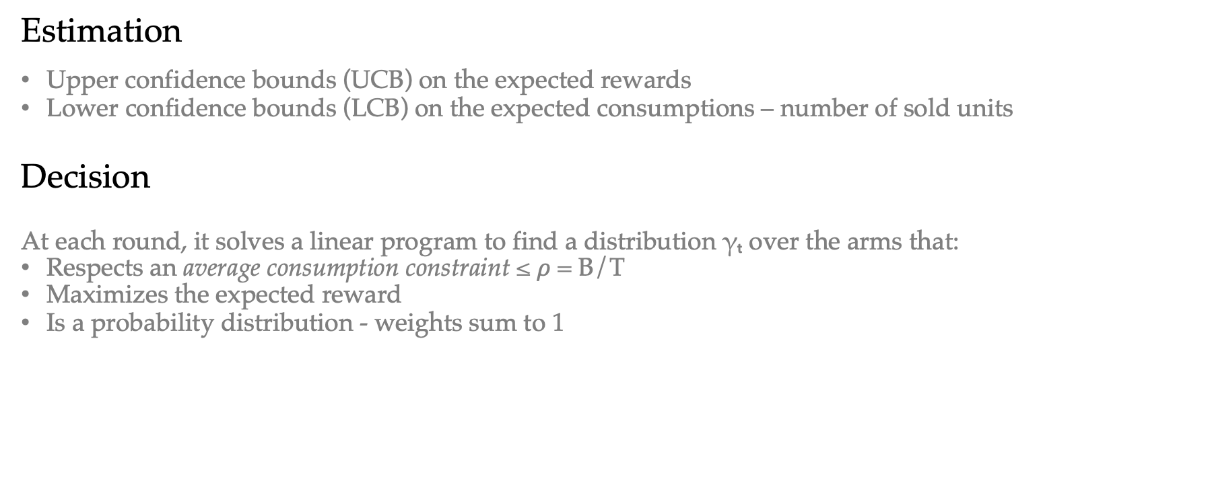
Strategy
Estimation
Upper confidence bounds (UCB) on the expected rewards
Lower confidence bounds (LCB) on the expected consumptions – number of sold units
Decision
At each round, it solves a linear program to find a distribution γₜ over the arms that:
Respects an average consumption constraint ≤ $ρ$ = B/T
Maximizes the expected reward
Is a probability distribution - weights sum to 1

Slide 13
Strategy
Idea
By incorporating lower confidence bounds on consumption, this UCB1 extension ensures that decisions are budget-aware, while being optimistic about overconsumption in order to promote exploration, and to avoid waste of budget
To do that, we allocate probability across arms through a linear programming problem, which avoids overconsumption (optimistically)

Slide 14
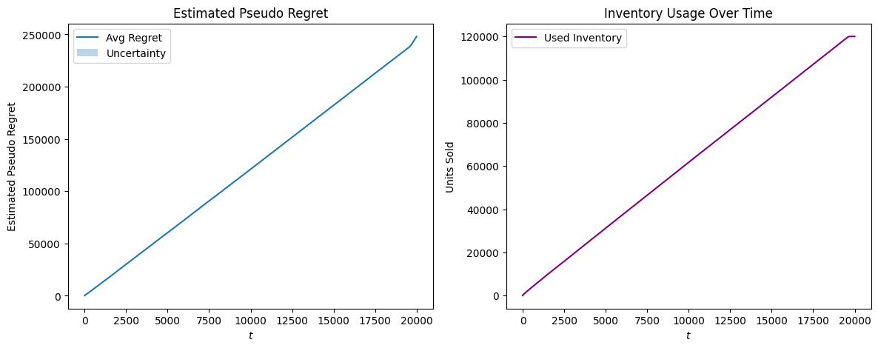
Budget
Consumption
The algorithm successfully optimizes the usage per round

Slide 15
Performance Analysis
Baseline
At first glance, it seems that the algorithm does not achieve sub-linear regret against the standard baseline…
The reason in this case is that we are comparing an algorithm playing with a max capacity against a clairvoyant which can keep selling an unlimited quantity of items

Slide 16
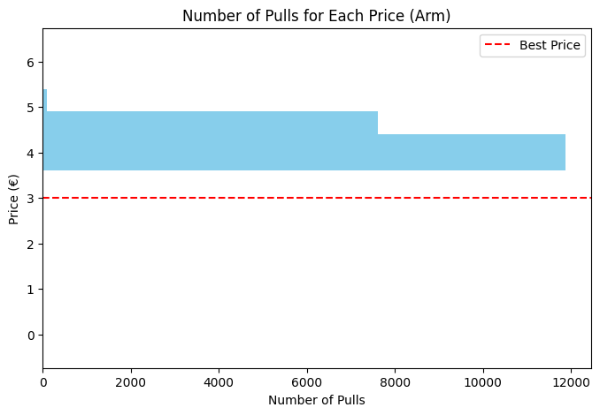
Performance Analysis
Learning Quality
In fact, the algorithm - due to the constraint - does NEVER play the optimal arm, implying linear regret…
Which is the wanted behaviour!
By playing the optimal arm, it consumes more than it should, turning not actually optimal in this setting
Here, the algorithm "decides to sell less to sell enough” - at better price!

Slide 17
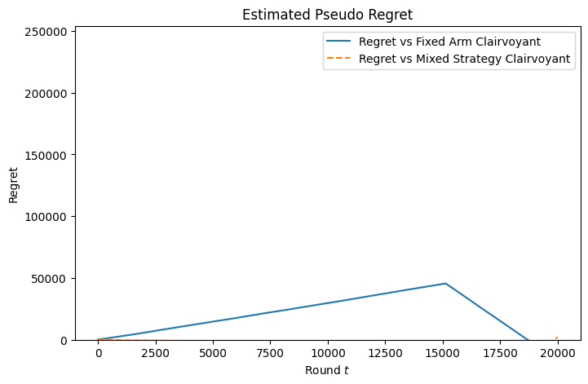
Performance Analysis
New clairvoyants
The “Budget-aware Fixed-price Clairvoyant” Optimal price: 4.00 Expected total profit: 240k
The “Budget-aware Mixed-Policy Clairvoyant” Optimal policy: [0. 0. 0. 0. 0. 0. 0. 0. 0.58 0.42 0. 0. 0. ] Expected total reward: 254k
Notice: our algorithm converges at such policy
Regret
The cumulative regret against the fixed-price clairvoyant ends up negative
Against the mixed-policy clairvoyant, the cumulative regret is slightly negative until the very last rounds, when a better usage leads the clairvoyant to a higher cumulative reward

Slide 18
Requirement 2
With multiple products

Slide 19
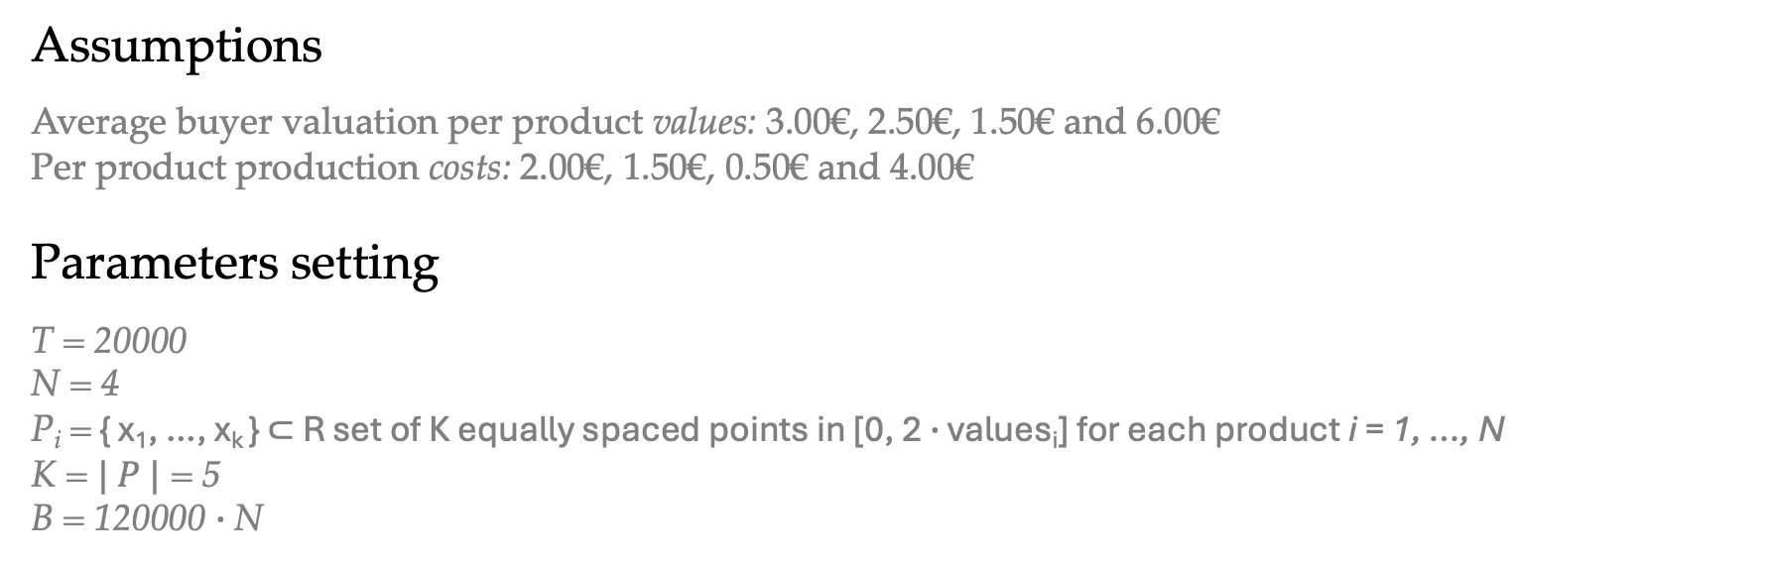
Setting
Assumptions
Average buyer valuation per product values: 3.00€, 2.50€, 1.50€ and 6.00€
Per product production costs: 2.00€, 1.50€, 0.50€ and 4.00€
Parameters setting
T = 20000
N = 4
P_{i} = { x₁​, …, x_{k} ​} ⊂ R set of K equally spaced points in [0, 2 $∙$ values_{i}] for each product i = 1, …, N
K = $| P |$ = 5
B = 120000 $∙$N

Slide 20
Setting
Best Expected Prices
Product 1: optimal price = €3.50, expected profit = €23.14
Product 2: optimal price = €2.88, expected profit = €21.97
Product 3: optimal price = €1.62, expected profit = €22.57
Product 4: optimal price = €7.00, expected profit = €37.87
Best Super Arm - Overall
Total expected profit = €105.56
Expected total demand: 64.10 units

Slide 21
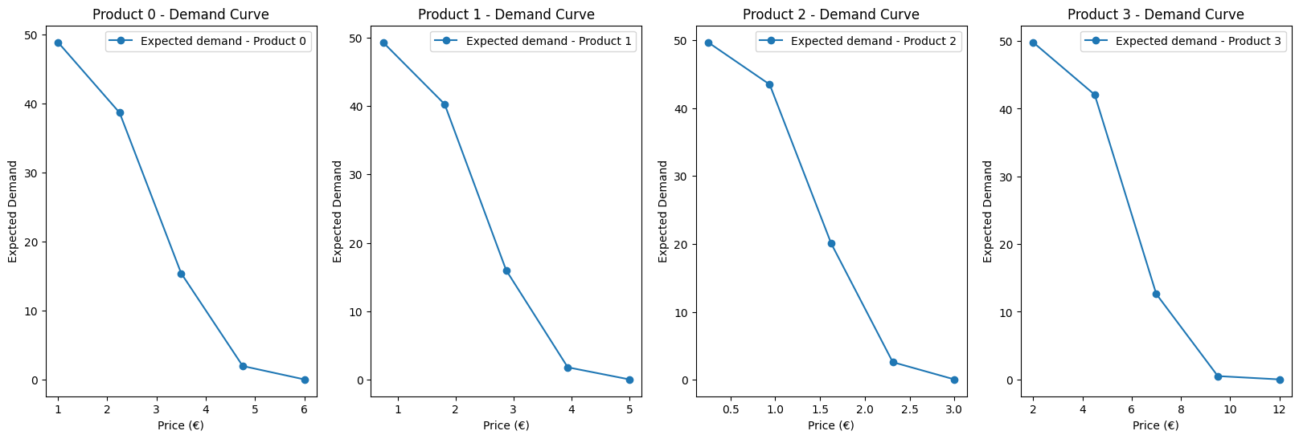
Setting

Slide 22
Environment
Assumptions
There are 50 buyers per each product, each with valuations similarly to R1
Changes
We extended the environment to a multi-product environment, that is equivalent to N independent single-product environments

Slide 23
Feedback
Assumptions
The environment returns the number of sales per product and the reward per product, along with the total reward

Slide 24
Strategy
Estimation
Decision

Slide 25
Strategy
Idea

