Slide 1
OLA Project 2024/2025
Mattia Piccinato
Francesco Allegrini
Mattia Repetti

Slide 2
Requirement 1
Without production capacity constraint

Slide 3
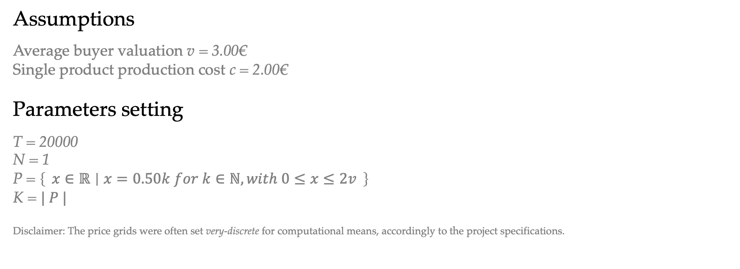
Setting
Assumptions
Average buyer valuation v = 3.00€
Single product production cost c = 2.00€
Parameters setting
T = 20000
N = 1
P = $\left\{ x∈ℝ ∣ x=0.50k for k∈ℕ, with 0≤x≤2v \right\}$
K = $| P |$
Disclaimer: The price grids were often set very-discrete for computational means, accordingly to the project specifications.

Slide 4
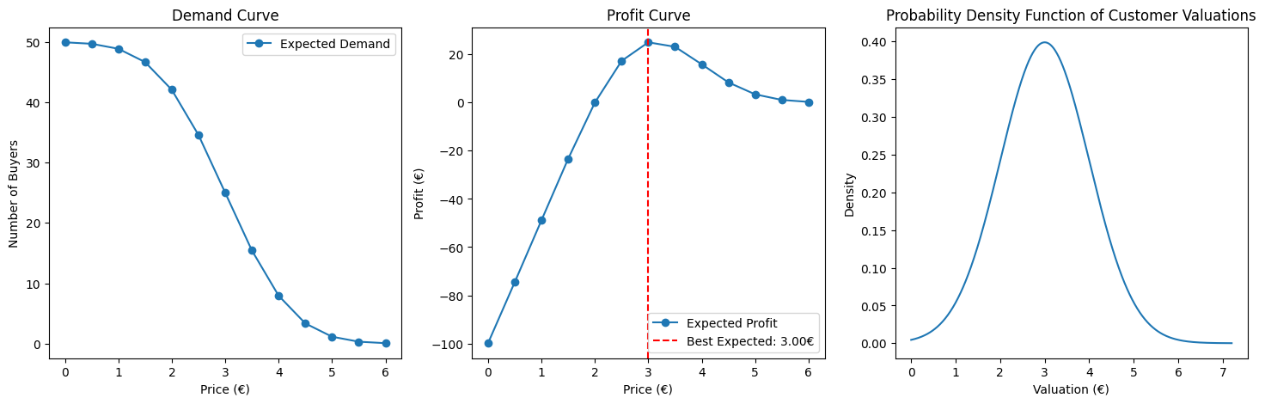
Setting

Slide 5
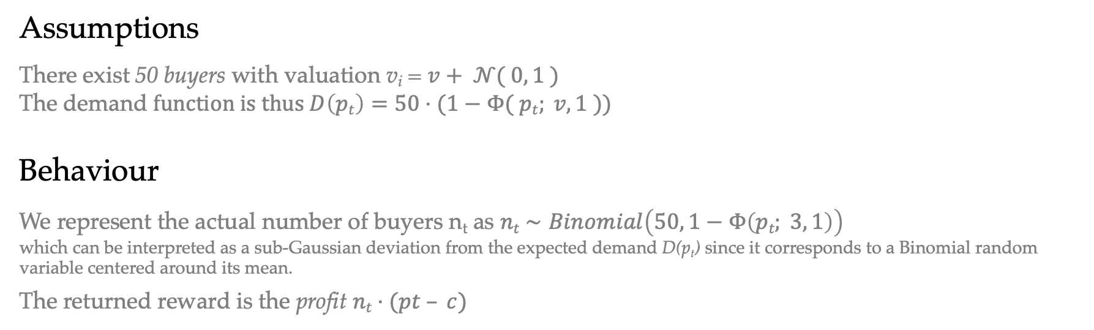
Environment
Assumptions
There exist 50 buyers with valuation v_{i} = $v+ 𝒩( 0, 1 )$
The demand $function is thus D\left(pt\right)=50⋅(1−Φ( pt; v, 1 ))$
Behaviour
We represent the actual number of buyers n_{t} as $nt​∼Binomial\left(50, 1−Φ\left(pt​; 3, 1\right)\right)$
which can be interpreted as a sub-Gaussian deviation from the expected demand D(p_{t}) since it corresponds to a Binomial random variable centered around its mean.
The returned reward is the profit $nt⋅(pt – c)$

Slide 6
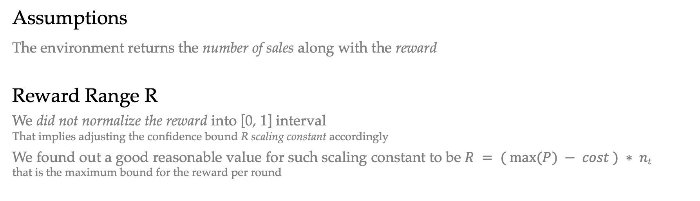
Feedback
Assumptions
The environment returns the number of sales along with the reward
Reward Range R
We did not normalize the reward into [0, 1] interval That implies adjusting the confidence bound R scaling constant accordingly
We found out a good reasonable value for such scaling constant to be $R = ( max⁡(P) − cost ) ∗ nt$
that is the maximum bound for the reward per round

Slide 7
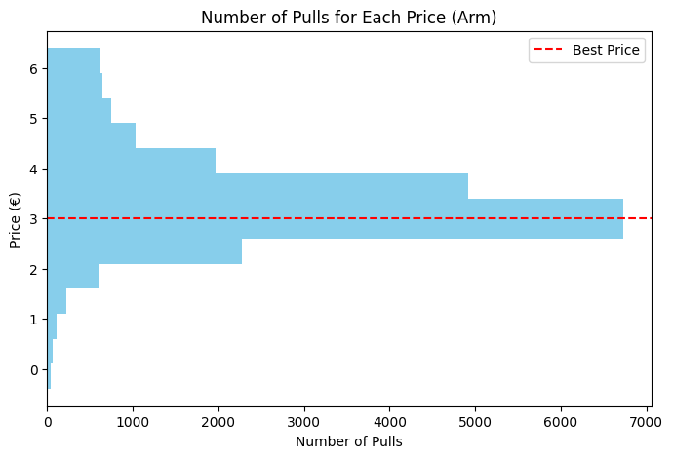
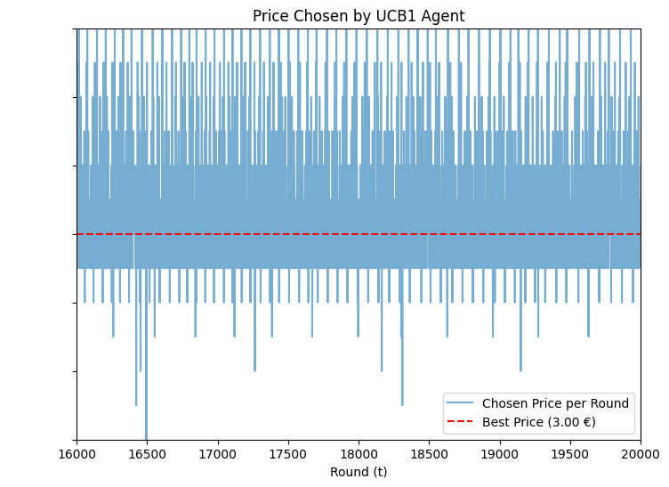
Performance Analysis
Learning quality
The algorithm effectively learns the best arm and mostly plays such arm.
Shouldn’t it play it more? Is the convergence too slow?
Learning time
Actually, it manages to “find” the best arm pretty soon…
It plays sub-optimal because it invests a lot in exploration: until the very end of the time horizon.

Slide 8
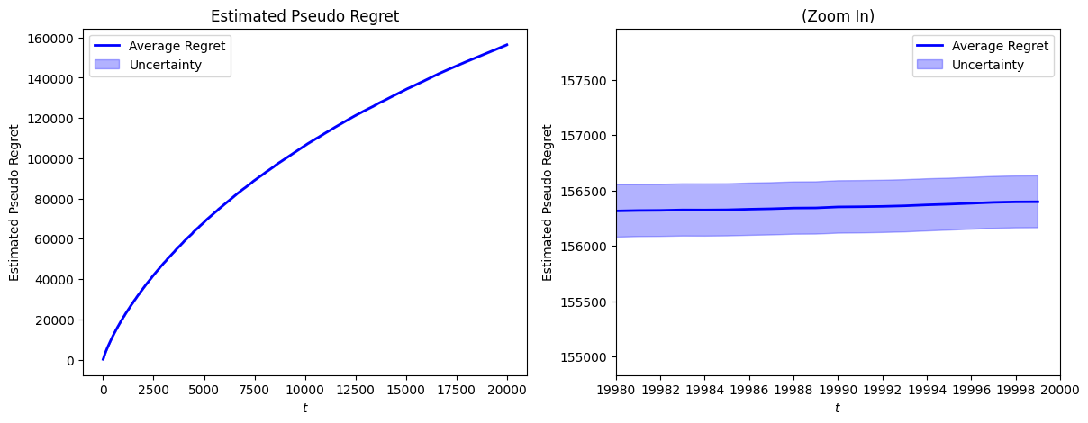
Performance Analysis
Regret Methodology
Due to the difficulty of calculating the expected reward of UCB1, we estimate it through its sample mean over n independent trials, in order to compute the pseudo-regret

Slide 9
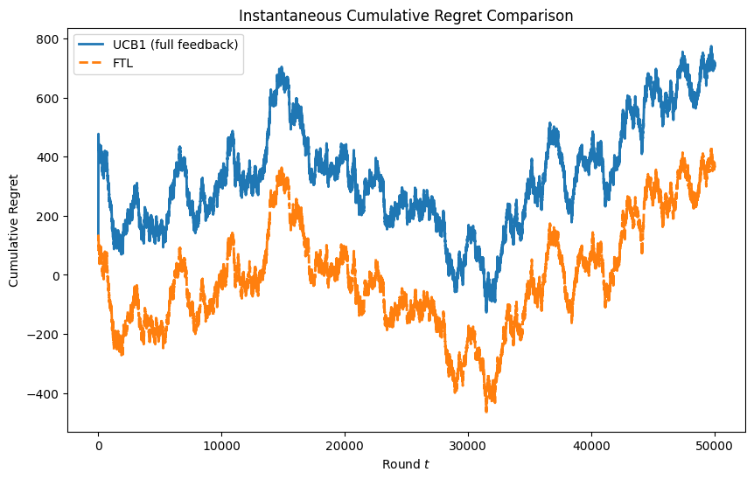
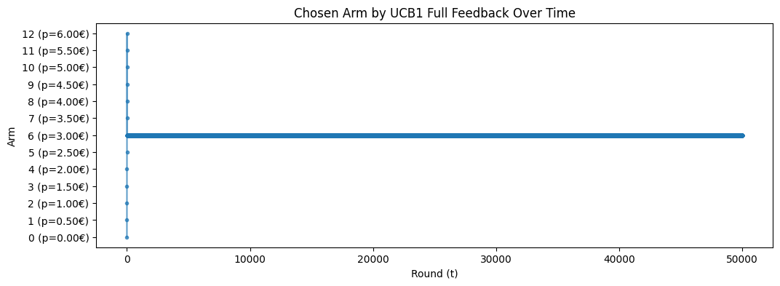
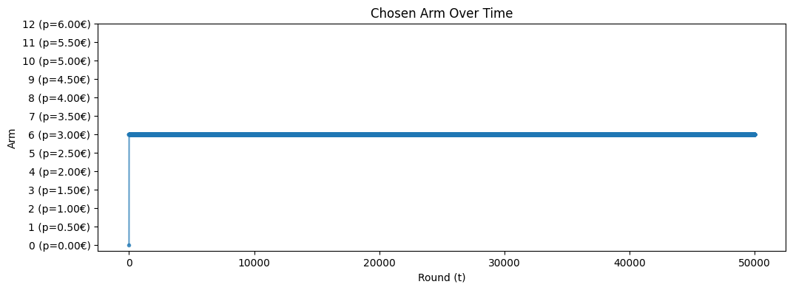
Curiosity
What happens with full feedback?
UCB1 is an algorithm designed for bandit feedback. How would it behave with full feedback?
Here we plot instantaneous regret for UCB1 and Follow the Leader. They’re the same… Almost
Hint: UCB1 bounds are the same for all the arms

Slide 10
Requirement 1
With production capacity constraint

Slide 11
Setting
Parameters setting
B = 120000

Slide 12
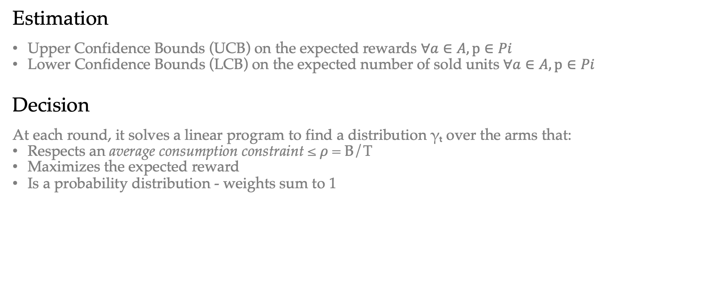
Strategy
Estimation
Upper Confidence Bounds (UCB) on the expected rewards $∀a∈A, p∈Pi$
Lower Confidence Bounds (LCB) on the expected number of sold units $∀a∈A, p∈Pi$
Decision
At each round, it solves a linear program to find a distribution γₜ over the arms that:
Respects an average consumption constraint ≤ $ρ$ = B/T
Maximizes the expected reward
Is a probability distribution - weights sum to 1

Slide 13
Strategy
Idea
By incorporating lower confidence bounds on consumption, this UCB1 extension ensures that decisions are budget-aware, while being optimistic about overconsumption in order to promote exploration, and to avoid waste of budget
To do that, we allocate probability across arms through a linear programming problem, which avoids overconsumption (optimistically)

Slide 14
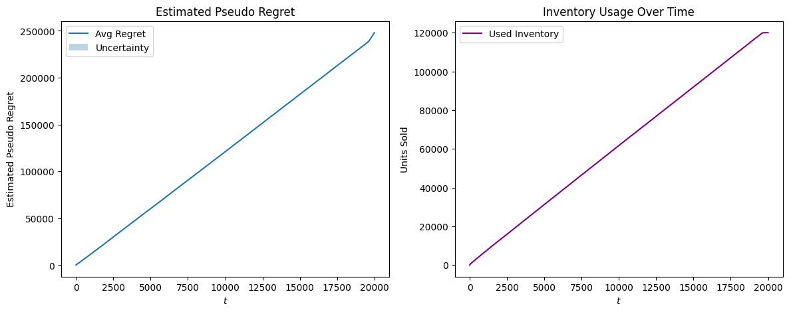
Budget
Consumption
The algorithm successfully optimizes the usage per round

Slide 15
Performance Analysis
Baseline
At first glance, it seems that the algorithm does not achieve sub-linear regret against the standard baseline…
The reason in this case is that we are comparing an algorithm playing with a max capacity against a clairvoyant which can keep selling an unlimited quantity of items

Slide 16
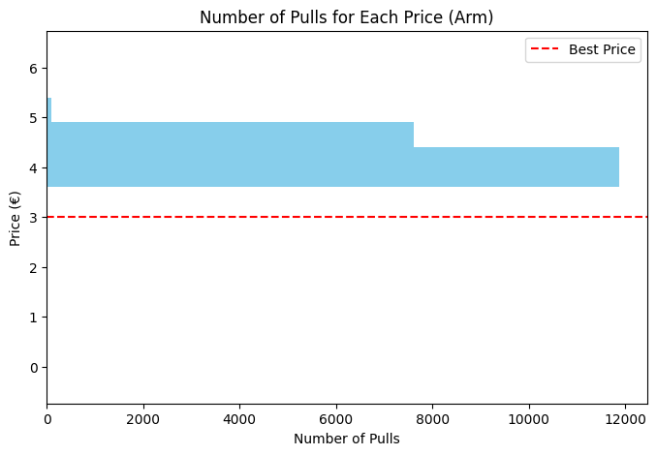
Performance Analysis
Learning Quality
In fact, the algorithm - due to the constraint - does NEVER play the optimal arm, implying linear regret…
Which is the wanted behaviour!
By playing the optimal arm, it consumes more than it should, turning not actually optimal in this setting
Here, the algorithm "decides to sell less to sell enough” - at better price!

Slide 17
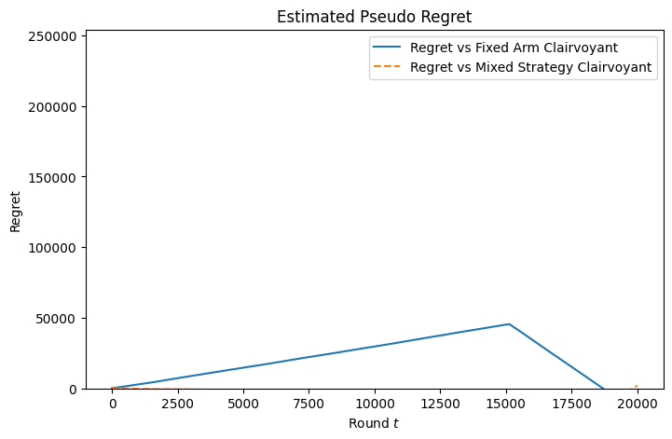
Performance Analysis
New clairvoyants
The “Budget-aware Fixed-price Clairvoyant” Optimal price: 4.00 Expected total profit: 240k
The “Per-round Budget-aware Mixed-Policy Clairvoyant” Optimal policy: [0. 0. 0. 0. 0. 0. 0. 0. 0.58 0.42 0. 0. 0. ] Expected total reward: 254k
Notice: our algorithm converges at such policy
Regret
The cumulative regret against the fixed-price clairvoyant ends up negative
Against the mixed-policy clairvoyant, the cumulative regret is slightly negative until the very last rounds, when a better usage leads the clairvoyant to a higher cumulative reward

Slide 18
Requirement 2
With multiple products

Slide 19
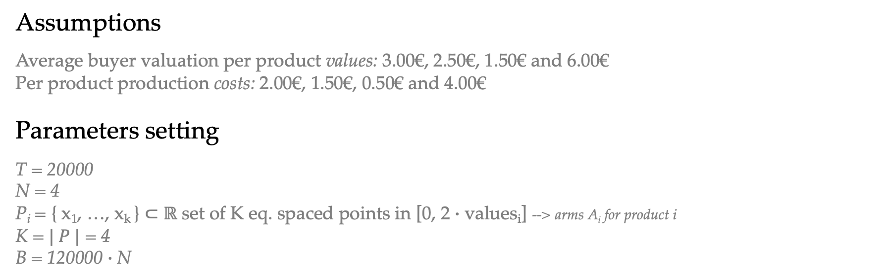
Setting
Assumptions
Average buyer valuation per product values: 3.00€, 2.50€, 1.50€ and 6.00€
Per product production costs: 2.00€, 1.50€, 0.50€ and 4.00€
Parameters setting
T = 20000
N = 4
P_{i} = { x₁​, …, x_{k} ​} ⊂ $ℝ$ set of K eq. spaced points in [0, 2 $∙$ values_{i}] --> arms A_{i} for product i
K = $| P |$ = 4
B = 120000 $∙$N

Slide 20
Setting
Best Expected Prices
Product 1: optimal price = €3.33, expected profit = €24.63
Product 2: optimal price = €2.75, expected profit = €23.58
Product 3: optimal price = €1.58, expected profit = €23.50
Product 4: optimal price = €6.67, expected profit = €43.78
Best Super Arm – Overall
Best expected profit = €115.49
Expected total demand: 75.45 units

Slide 21
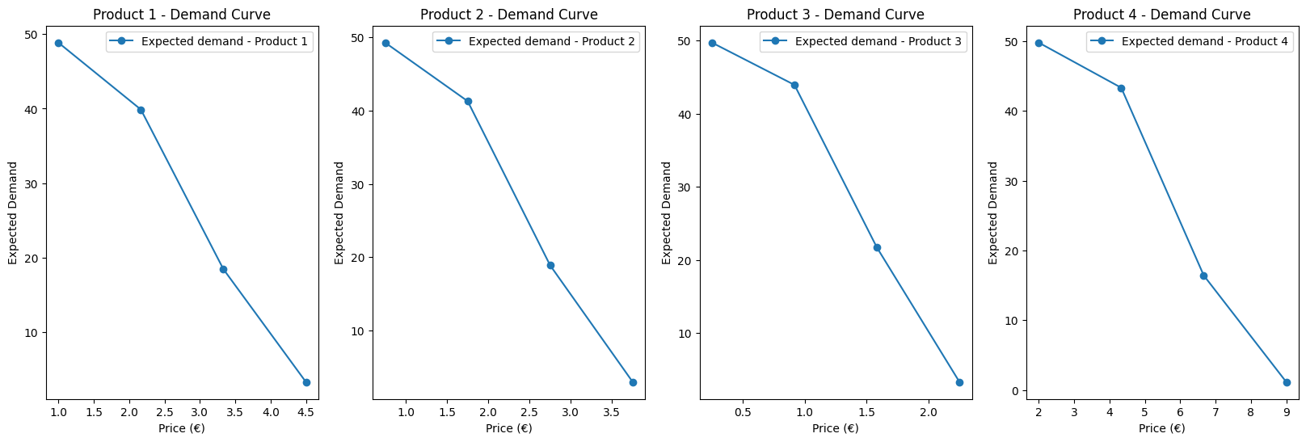
Setting

Slide 22
Environment
Assumptions
There are 50 buyers per each product, each with valuations similarly to R1
Changes
We extended the environment to a multi-product environment, that is equivalent to N independent single-product environments

Slide 23
Feedback
Assumptions
The environment returns the number of sales per product and the reward per product, along with the total reward

Slide 24
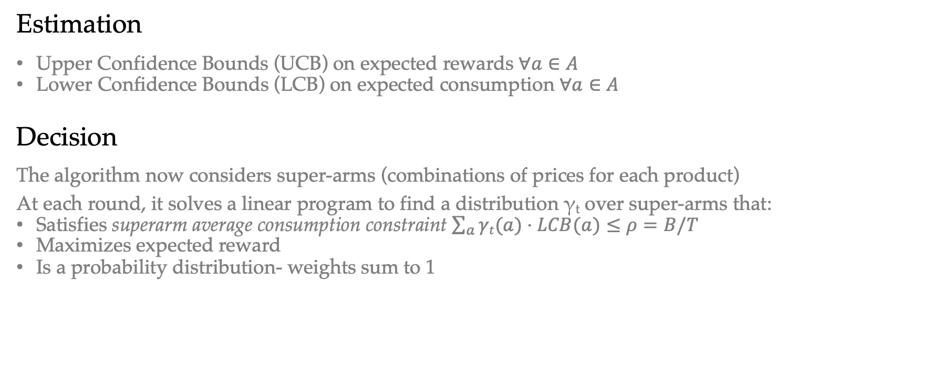
Strategy
Estimation
Upper Confidence Bounds (UCB) on expected rewards $∀a∈A$
Lower Confidence Bounds (LCB) on expected consumption $∀a∈A$
Decision
The algorithm now considers super-arms (combinations of prices for each product)
At each round, it solves a linear program to find a distribution γ_{t} over super-arms that:
Satisfies superarm average consumption constraint $\sum_{a}{γt(a)⋅LCB(a)}≤ρ=B/T$
Maximizes expected reward
Is a probability distribution- weights sum to 1

Slide 25
Strategy
Idea
We build per-arm statistics for each product-price pair (arm) and use them to estimate the expected reward and consumption of every combination of prices (super-arm)
Such approach enables better efficiency than estimating the confidence bounds for every possible product mix
To be discussed
In the next slides we will discuss:
The choice of the the scaling factor R
How to initialize the algorithm
How to handle the case of LPP failure

Slide 26
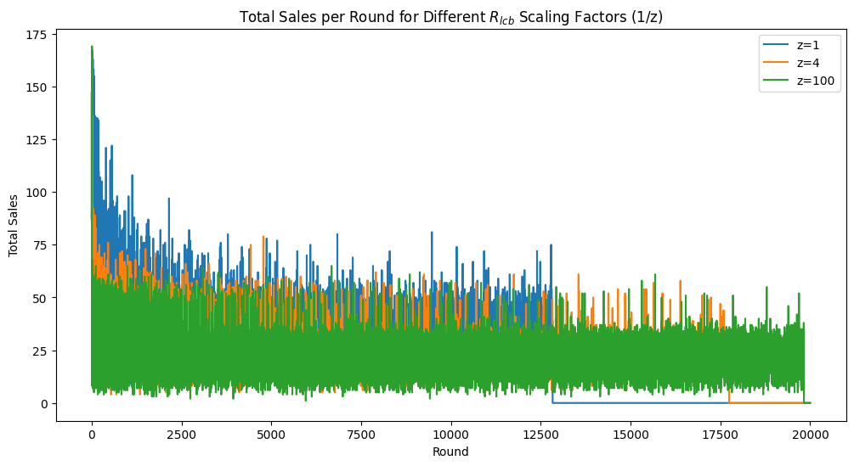
To be discussed
Scaling factor R
Since rewards were not normalized to [0,1], we introduced a scaling factor R to adjust the confidence bounds
In our work, we found that a reasonable choice for the value of R is the maximum possible reward per round
Although, due to the existence of multiple products, the overall bound for the superarms became too large, resulting in overly optimistic decisions and poor budget management
Thus, we normalized such constant R by dividing it by N, to avoid overly optimistic cost estimates
__________________________________________
Ultimately, since R effectively acts as a parameter controlling the algorithm’s optimism about superarm costs, we chose to explore its impact through tuning, observing that dividing it by N a second time obtains most of the marginal gain one may desire

Slide 27
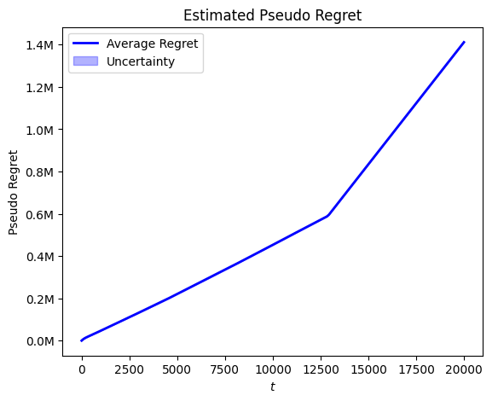
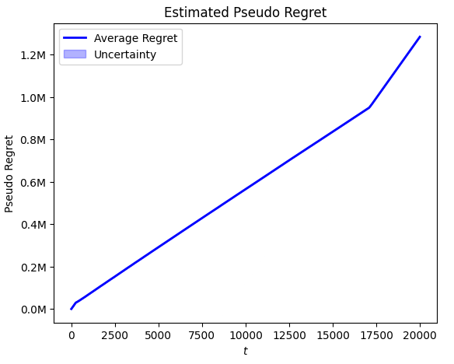

To be discussed
Algorithm initialization
We chose to compare two different strategies:
Making sure to run each arm at least once in the first $|A|$ rounds
Making sure to run each superarm at least once in the first $|S|$ rounds
While this second option comes at a higher initial cost due to the exponential number of superarms, it provides more informative observations about product interactions and their combined effect on budget consumption and rewards, resulting in a lower regret
Hint: Notice the y-axis

Slide 28
To be discussed
Linear Program failure
During the execution of the algorithm, the Linear Programming problem (LPP) used to select the optimal superarms probability distribution may fail to return a feasible solution
To handle such cases gracefully, we implemented a fallback mechanism that finds an alternative solution when the LPP becomes infeasible
The idea is simple: among the feasible superarms, we return the one with maximum expected reward; if no feasible superarm is available, we choose the one with minimum cost
Although, in our work this case never occurred, our algorithm does not need to stop in case of LPP failure

Slide 29
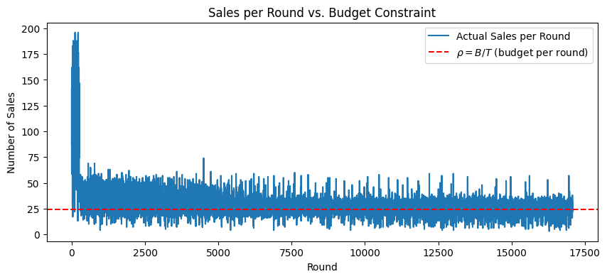
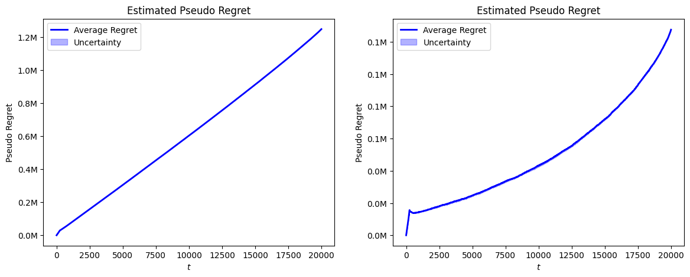
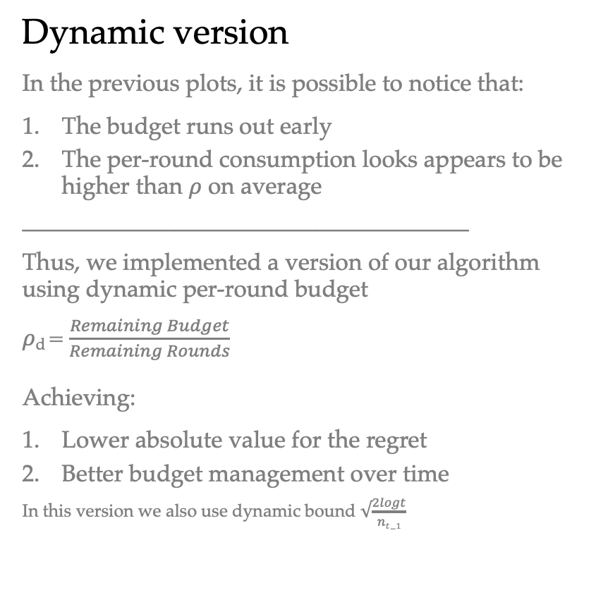
Budget
Dynamic version
In the previous plots, it is possible to notice that:
The budget runs out early
The per-round consumption looks appears to be higher than $ρ$ on average
______________________________________
Thus, we implemented a version of our algorithm using dynamic per-round budget
$ρ$_{d} = $\frac{Remaining Budget}{Remaining Rounds}$
Achieving:
Lower absolute value for the regret
Better budget management over time
In this version we also use dynamic bound $√\frac{2logt}{nt−1}$

Slide 30
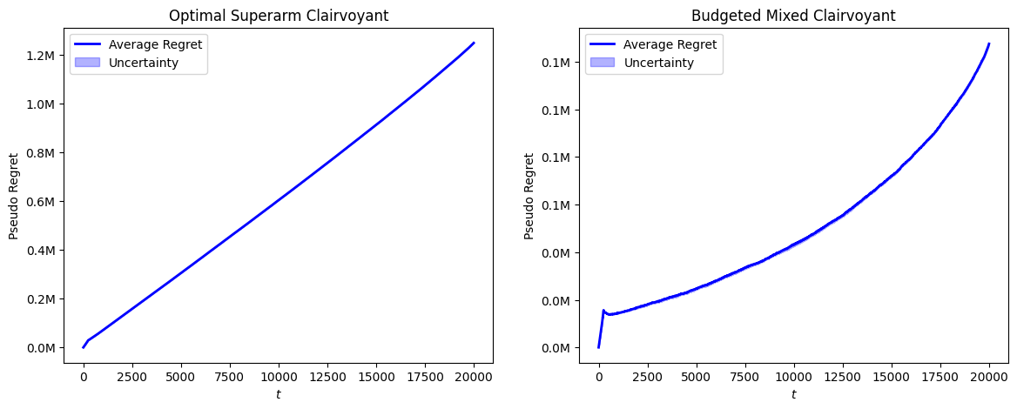
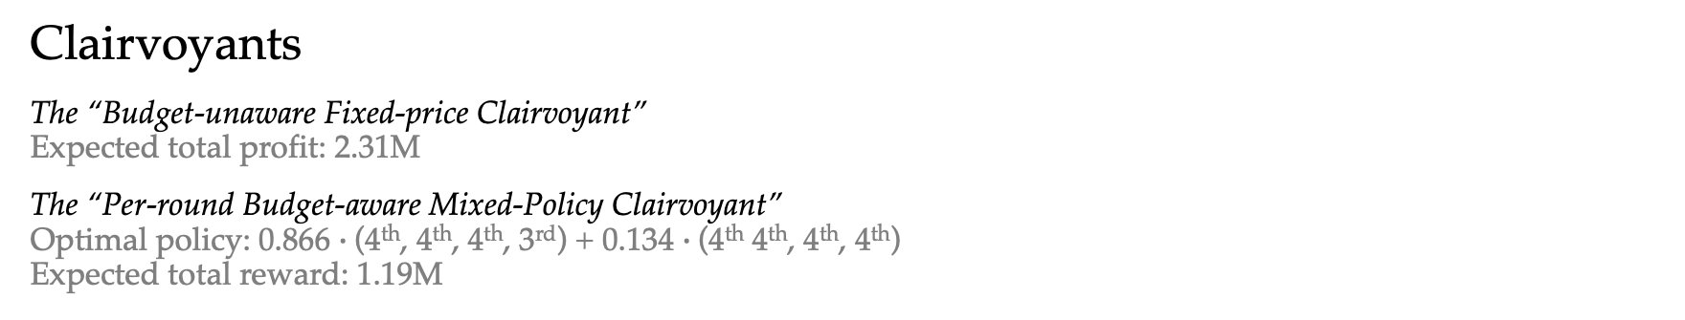
Performance Analysis
Clairvoyants
The “Budget-unaware Fixed-price Clairvoyant” Expected total profit: 2.31M
The “Per-round Budget-aware Mixed-Policy Clairvoyant” Optimal policy: 0.866 $∙$(4th, 4th, 4th, 3rd) + 0.134 $∙$(4th 4th, 4th, 4th)
Expected total reward: 1.19M
Regret
The regret against our BAMPC appears super-linear due to the dynamic budget constraint behaviour
Despite its look in the plot, it is surprisingly low: less than 10% for this instance

Slide 31
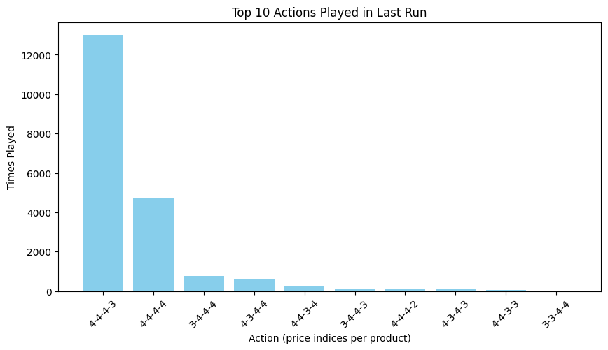
Performance Analysis
Learning Quality
Our algorithm successfully converges to our “Per-round Budget-aware Mixed-Policy Clairvoyant” optimal policy.

Slide 32
Requirement 3
With highly non-stationary environment

