Slide 1
Codecamp
Learn to program in javascript

Slide 2
What is a computer program?

Slide 3
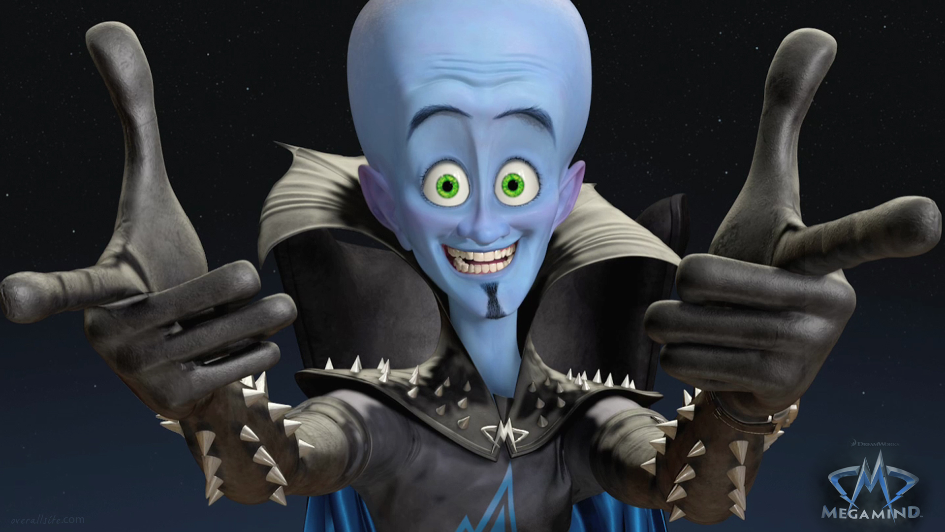
What is memory?

Slide 4
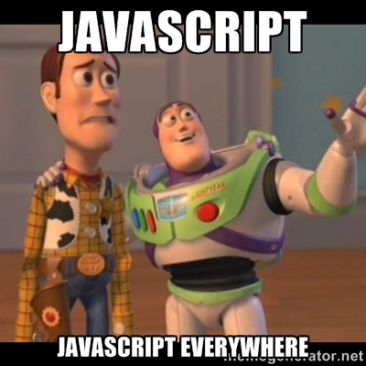
What is javascript?

Slide 5
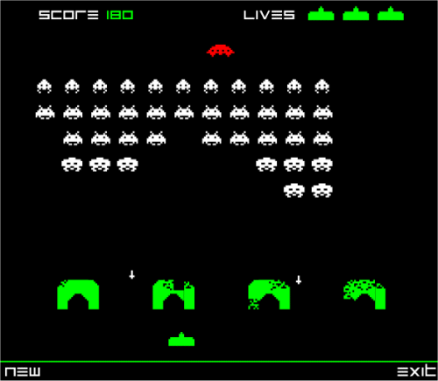
Name the objects!

Slide 6
What is an object ?
“An OBJECT is a ‘thing’ that has properties and optionally methods”

Slide 7
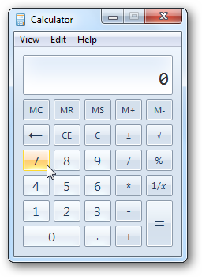

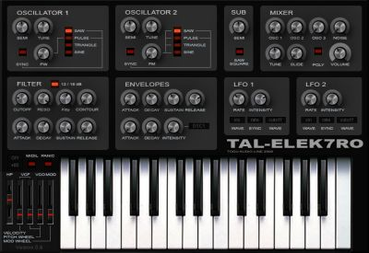
Hardware vs software
Objects in the real world can be found in software. Can anyone name one?

Slide 8
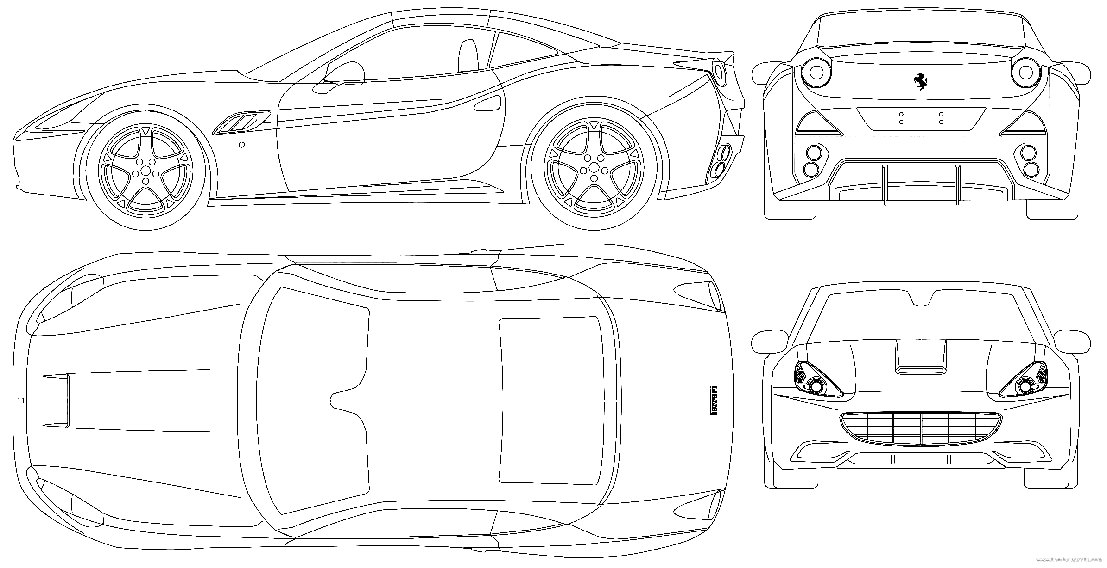
An object definition
A Ferrari….but is it the car?

