Slide 1
Dynamic Scaling in Action KEDA + Solace PubSub+ with Partitioned Queues
Jan 23rd 2024

Slide 2

Who am I?
Peter Kester
Senior Consultant PSG

Slide 3
Purpose of this demo
Provide an introduction to the Solace PubSub+ Event Broker Queue Scaler for KEDA
Scale Consumers of Solace Queues elastically in a Kubernetes environment

Slide 4
What is KEDA?
KEDA is a Kubernetes-based Event Driven Autoscaler. With KEDA, you can drive the scaling of any container in Kubernetes based on the number of events needing to be processed.
KEDA is a single-purpose and lightweight component that can be added into any Kubernetes cluster. KEDA works alongside standard Kubernetes components like the Horizontal Pod Autoscaler and can extend functionality without overwriting or duplication. With KEDA you can explicitly map the apps you want to use event-driven scale, with other apps continuing to function. This makes KEDA a flexible and safe option to run alongside any number of any other Kubernetes applications or frameworks.
Notes:
Horizontal Pod Scaler scales from 1 -> n or from n→ 1

Slide 5
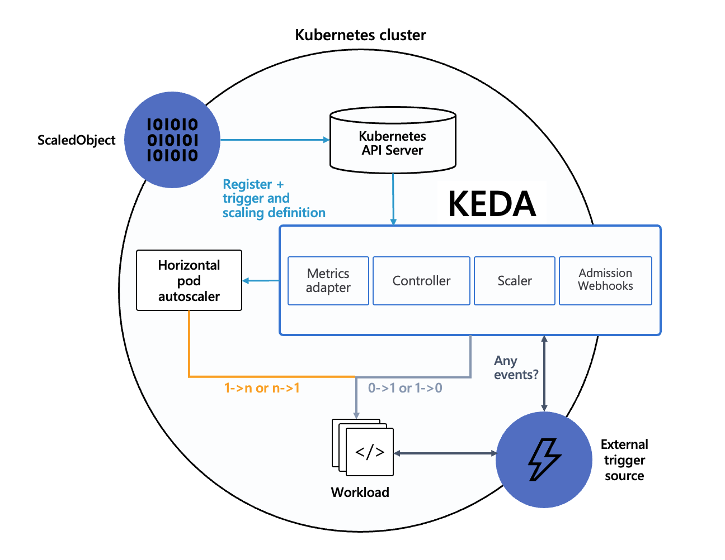
How does KEDA work?
KEDA performs three key roles within Kubernetes:
Agent
Metrics
Admission Webhooks
KEDA has a wide range of scalers that can both detect if a deployment should be activated or deactivated, and feed custom metrics for a specific event source.
Notes:
Agent — KEDA activates and deactivates Kubernetes Deployments to scale to and from zero on no events. This is one of the primary roles of the keda-operator container that runs when you install KEDA.
Metrics — KEDA acts as a Kubernetes metrics server that exposes rich event data like queue length or stream lag to the Horizontal Pod Autoscaler to drive scale out. It is up to the Deployment to consume the events directly from the source. This preserves rich event integration and enables gestures like completing or abandoning queue messages to work out of the box. The metric serving is the primary role of the keda-operator-metrics-apiserver container that runs when you install KEDA.
Admission Webhooks - Automatically validate resource changes to prevent misconfiguration and enforce best practices by using an admission controller. As an example, it will prevent multiple ScaledObjects to target the same scale target.

Slide 6
What is the Solace Scaler?
The Solace Scaler defines an interface that allows KEDA to scale applications based on Solace Queues, specifically the current Message Count and Message Spool Usage. Based on the observed values of these metrics, KEDA and HPA can scale target Deployments, Jobs, and Stateful Sets in response to fluctuating demand. The Solace Scaler itself is merged into the KEDA project and is therefore available when KEDA is installed.

Slide 7
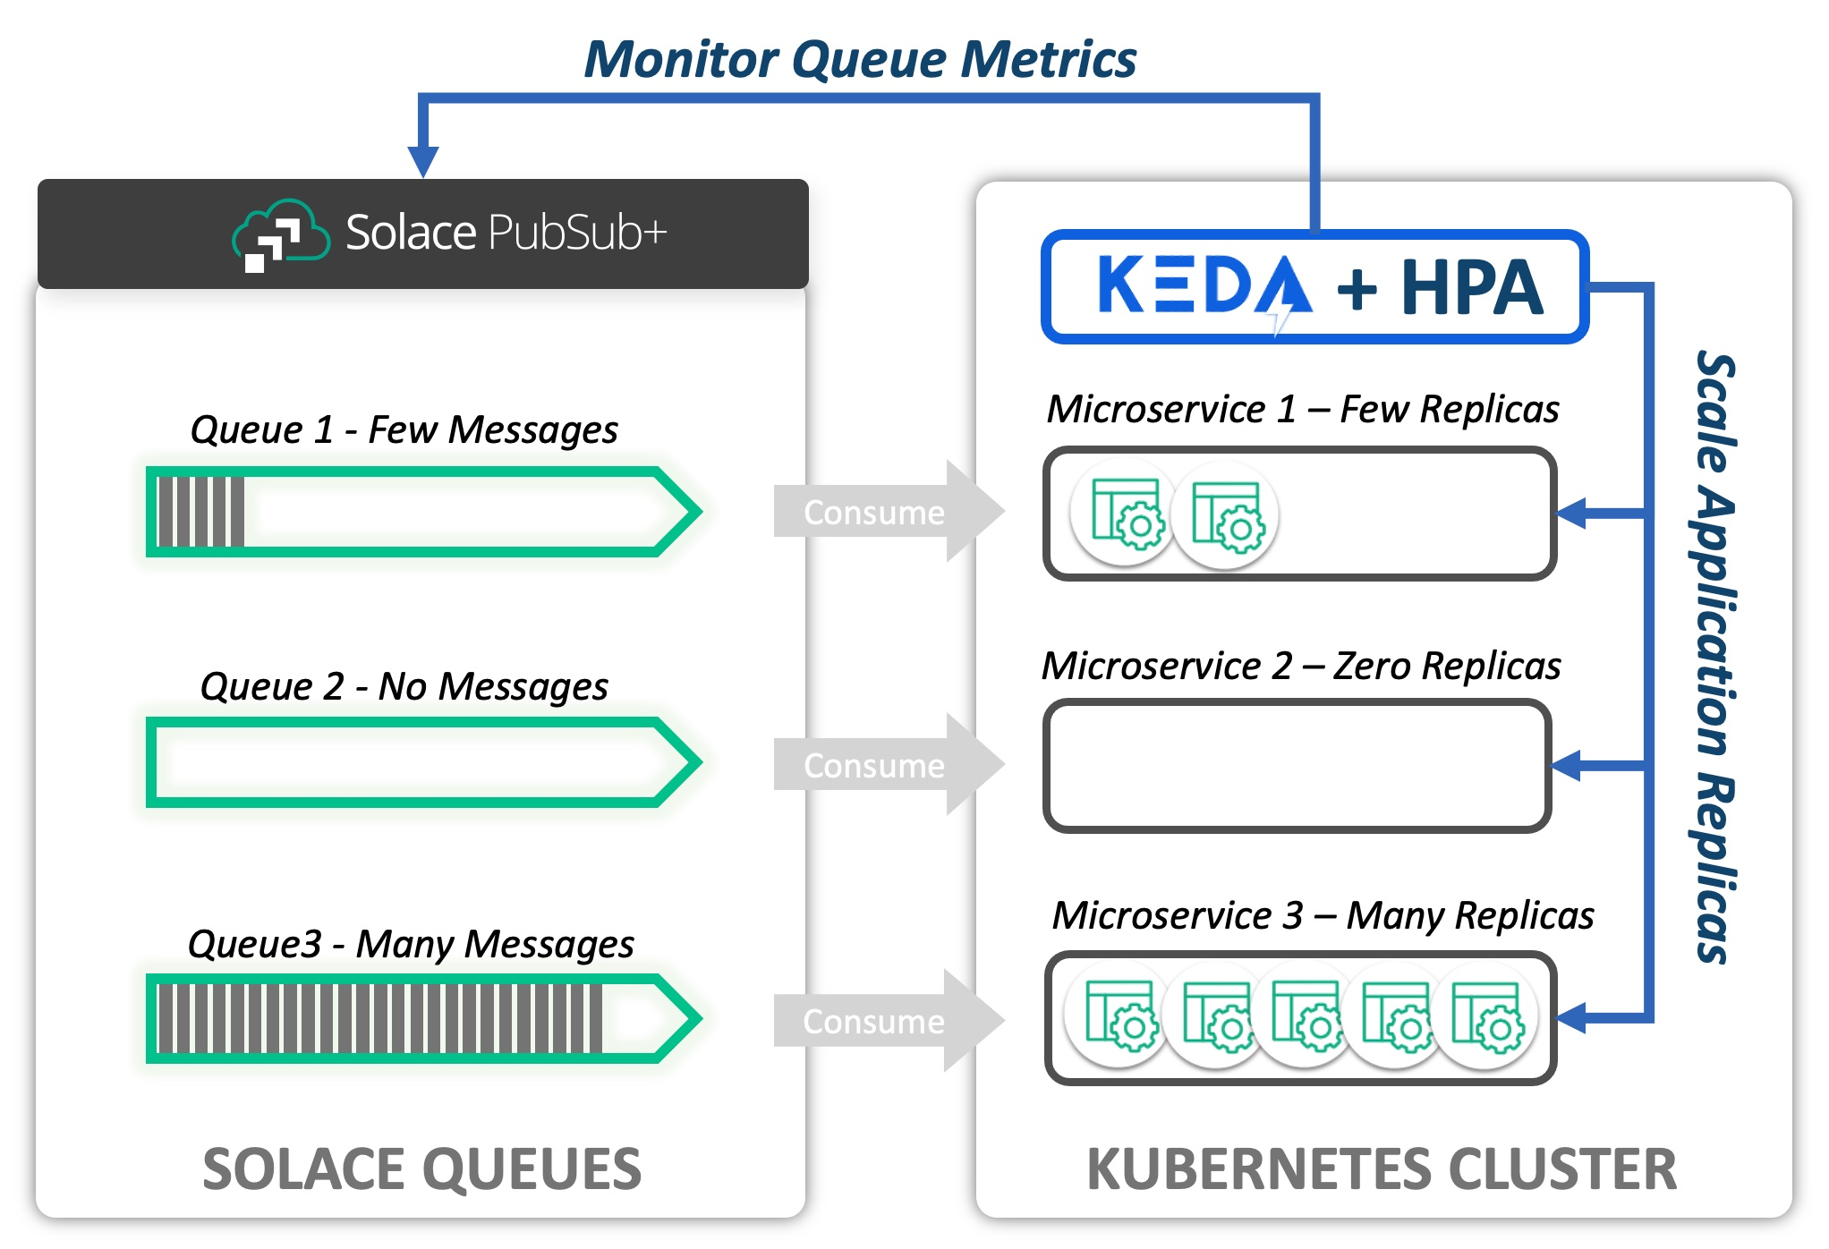
Solace Scaler
Notes:
Consider the following diagram. A Solace PubSub+ Event Broker hosts a set of queues.
The messages from each queue are being consumed by a microservice deployed to a Kubernetes cluster.
KEDA uses the Solace Scaler to interface with the PubSub+ Broker via the SEMP API to obtain metrics related to the queue.
In this example, we are interested in Message Count.
Based on the Message Count retrieved for each queue, KEDA and the Horizontal Pod Autoscaler maintain the appropriate number of desired replicas.

Slide 8
Demonstrate the Solace Scaler
Install KEDA
Install Solace Broker
Install Consumer
Observe nr of consumers
Install Scaler
Observe replicas
Scale on Message Count
Scale on Message Spool Size
Notes:
Scale Deployment on message count
We will publish messages to the queue of sufficient volume that KEDA and HPA will scale the solace-consumer Deployment to 10 replicas.
Publish Messages
We will use SDK-Perf (Java Command-Line app) to write messages to the queue read by the solace-consumer application.
SDK-Perf is available on the kedalab-helper pod and we will execute it from there.
At this point, there should be no active instances of the solace-consumer application.
We will publish 400 messages to the queue at a rate of 50 messages per second.
Each message will have a 256 byte payload. On your command line, enter:
kubectl exec kedalab-helper -n solace -- ./sdkperf/sdkperf_java.sh -cip=kedalab-pubsubplus-dev:55554 -cu consumer_user@keda_vpn -cp=consumer_pwd -mr 50 -mn 400 -msx 256 -mt=persistent -pql=SCALED_CONSUMER_QUEUE1
Note: If running on MacOS , make sure to use port 55554 instead of port 55555. Port 55555 is a reserved port on MacOS
Observe Scaling
View the scaling of solace-consumer deployment in the command line window Upon publication of our messages. We expect:
KEDA will detect that the application should be active and scale the application to 1 replica.
Horizontal Pod Autoscaler will then take over and scale the application to 10 replicas.
When the messages have finished processing, HPA will reduce the total replicas to 1.
KEDA scales the application zero replicas
Scale Deployment on Message Spool Size
In the last exercise, we scaled based on message count. In this exercise, we will scale the deployment to 10 replicas based on message spool usage. We will publish 50 messages to the queue at a rate of 10 messages per second. Each message will have a size of 4 megabytes so that KEDA and HPA will scale the solace-consumer Deployment to 10 replicas. (4 megabytes = 4 * 1024 * 1024 = 4194304 bytes) Our trigger is configured with a messageSpoolUsageTarget of 1 megabyte, so a message spool size > (9 megabytes + 1 byte) will cause our deployment to scale to 10 replicas.
Publish Messages
Again we will use SDK-Perf (Java Command-Line app) to write messages to the input queue of the solace-consumer application. We will publish 50 messages to the queue at a rate of 10 messages per second. Each message will have a 4194304 byte (4 megabyte) payload. On your command line, enter:
kubectl exec kedalab-helper -n solace -- ./sdkperf/sdkperf_java.sh -cip=kedalab-pubsubplus-dev:55554 -cu consumer_user@keda_vpn -cp=consumer_pwd -mr 10 -mn 50 -msx 4194304 -mt=persistent -pql=SCALED_CONSUMER_QUEUE1
Observe Scaling
View the scaling of solace-consumer deployment in the command line window Upon publication of our messages. We expect:
KEDA will detect that the application should be active and scale the application to 1 replica.
Horizontal Pod Autoscaler will then take over and scale the application to 10 replicas.
When the messages have finished processing, HPA will reduce the total replicas to 1.
KEDA scales the application zero replicas

Slide 9
Demonstrate the Solace Scaler part 2
Modify HPA behaviour
Install modified Scaler
Observe replicas
Scale on Message Count
Notes:
we will modify the KEDA ScaledObject to adjust the Horizonal Pod Autoscaler settings.
The settings will be adjusted so that HPA can increase and decrease the number of desired replicas by a maximum of two pods in an interval of ten seconds.
In this way, we can control how quickly replicas are added or removed from our deployment in order to prevent undesirable churn or flapping as observed metrics fluctuate.
See Kubernetes Horizonal Pod Autoscaler for more details.
Observe Scaling
View the scaling of solace-consumer deployment in the command line window Upon publication of our messages. We expect:
KEDA will detect that the application should be active and scale the application to 1 replica.
Horizontal Pod Autoscaler will then take over and scale the application, incrementing by 2 replicas at a time (It may not reach the maximum of 10 replicas).
The maximum replica count reached will hold longer than necessary to process all of the messages due to the stabilizationWindowSeconds=30 setting on scaleDown
When the messages have finished processing and the stabilization window expires, HPA will scale down to 1 replica, decrementing by a maximum of 5 at a time.
KEDA scales the application zero replicas

Slide 10
Demonstrate Partitioned Queues with Keda
Configure Solace Broker
Install subscriber
Install the http server for visualization
Adjust the parameters and show on screen
Notes:
On start it will run with a single subscriber
When we deploy the pq-demo scaler it will increase the nr of

Slide 11
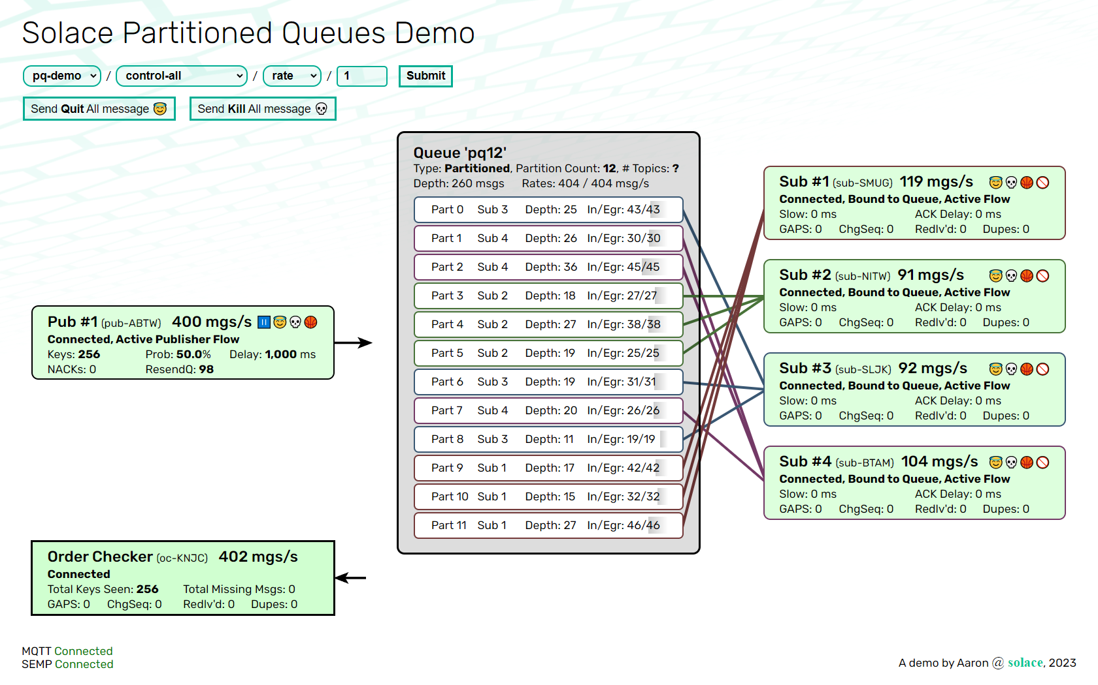
Demonstrate Partitioned Queues with Keda

Slide 12
The End
Notes:
we will modify the KEDA ScaledObject to adjust the Horizonal Pod Autoscaler settings.
The settings will be adjusted so that HPA can increase and decrease the number of desired replicas by a maximum of two pods in an interval of ten seconds.
In this way, we can control how quickly replicas are added or removed from our deployment in order to prevent undesirable churn or flapping as observed metrics fluctuate.
See Kubernetes Horizonal Pod Autoscaler for more details.
Observe Scaling
View the scaling of solace-consumer deployment in the command line window Upon publication of our messages. We expect:
KEDA will detect that the application should be active and scale the application to 1 replica.
Horizontal Pod Autoscaler will then take over and scale the application, incrementing by 2 replicas at a time (It may not reach the maximum of 10 replicas).
The maximum replica count reached will hold longer than necessary to process all of the messages due to the stabilizationWindowSeconds=30 setting on scaleDown
When the messages have finished processing and the stabilization window expires, HPA will scale down to 1 replica, decrementing by a maximum of 5 at a time.
KEDA scales the application zero replicas

