Slide 1
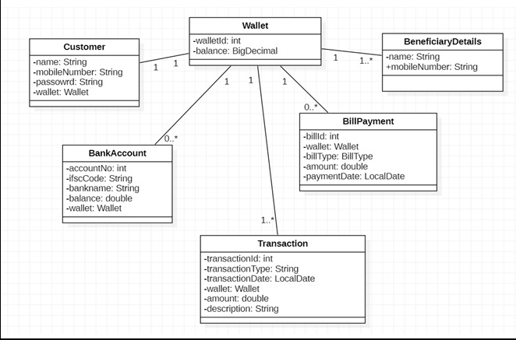

Slide 2
8082
8081
Payment-handler-service
Bank-info-service
Bank Account Controller
Beneficiary Controller
Transaction Controller
Bill Payment Controller
8083
Online-Payment-Application
Customer Controller
Wallet Controller
8761
Eureka Server

Slide 3
Step-1
Create wallet First
Step-2
Create BankAccount
Step-3
Register User

