Slide 1
AAPNA Library

Slide 2
User Login/Register
Two Types of Users: (Only Students)
  To Find Books
  To Post Books
  Login:
    Email
    Password.
  Register: (All kinds of Validations will be there) [will be Approved within 24hr]
  Name, Email, Age, Any kind of ID – School College ID, Govt ID etc. ,

Slide 3
We can ask users who register to post their ID and verify it from the Admin panel.
To avoid from any kind of scam we can add a verified tag along the user whose id have been verified from backend (Admin)

Slide 4
Admin Page
Will be hidden from normal users.
It will act as a CMS (Content Management System)
Approve Users
Create New Categories

Slide 5
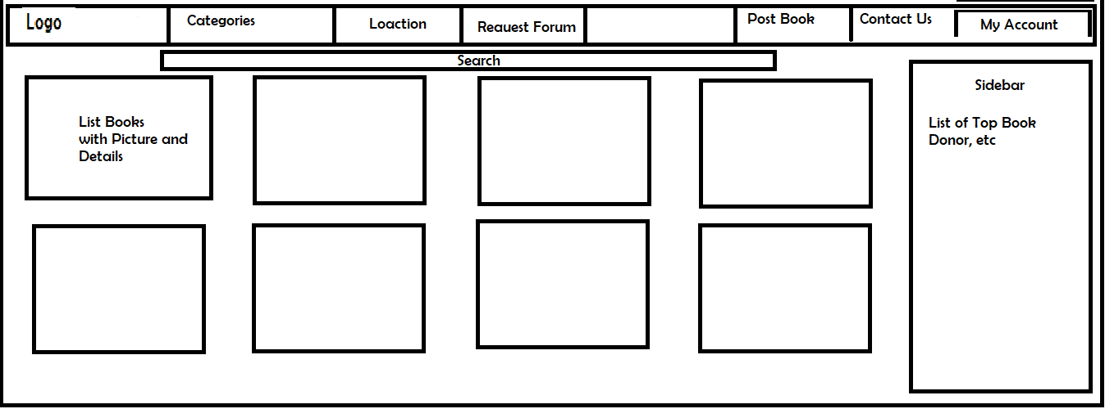
Home Page

Slide 6
Books
When clicked on Books, this page will open
Book Details
Posted By
Contact Option (Chat)

Slide 7
Categories
Book Categories added by Admin Page
List Book in each categories

Slide 8
Location
Filer by Location for easy communication.

Slide 9
Request Forum
A chat forum to request books

Slide 10
Post Book
Post Book page to post the book.

Slide 11
Chat
Option to chat between Book Poster and Book Finder.

Slide 12
My Account
See my account, edit details, change password etc.
See Books posted by me, etc

Slide 13
Contact Us
To contact us

Slide 14
Database
Backend (NodeJS)

