Slide 1

Reliability-Aware Fault Injection for Microscaling-Based DNNs
Undergraduate Project (CS496), Final Presentation
Peeyush Agarwal
Roll No. 230749, Department of Aerospace Engineering
Supervisor: Prof. Urbi Chatterjee
Indian Institute of Technology Kanpur
November 2026
Notes:
OPENING (about 30 seconds)
Good morning. My project is on the reliability of neural networks that store their numbers in microscaling formats.
In one line: modern AI chips store numbers in very small 4 to 8 bit formats where many numbers share one common scale. I studied what happens to the network's answers when a hardware fault flips one stored bit, and how to protect against it.
The talk has four parts: the problem, my method (a fault injector and a flip-case algorithm), the results for five objectives, and the design guidance that follows.

Slide 2
Background: microscaling formats and the reliability gap
What is a microscaling (MX) format?
One MX block has two different fault sites
Why narrow numbers. DNN accelerators use 4 to 8-bit numbers because memory traffic and arithmetic get cheaper as bit width falls. One narrow number cannot cover the range of a whole tensor.
The MX idea (OCP specification, 2023). Values are grouped into blocks of K = 32. A block stores one 8-bit shared scale X and K small element codes: value = decode(element) × 2^(X − 127).
Hardware is not fault-free. Radiation, voltage droop and ageing flip stored bits. In a DNN a flip can silently change the prediction (silent data corruption, SDC).
The gap. Earlier tools (Ares, PyTorchFI, TreeFI) study FP32 or integers, where one flip changes one number. None models a shared scale, so the reliability of MX networks had not been measured.
Reliability here means: the probability that one stored-bit fault changes one prediction. Inputs are clean; the fault is in the stored numbers.
scale, 8 bits
K element codes, w bits each
Element fault
X
m1
m2
m3
m4
...
mK
1 value changes
Scale fault
X
m1
m2
m3
m4
...
mK
all K values × 2^(±2^j)
MX element formats studied
MX format | Element | Bits S/E/M | Largest value | Special codes
MXFP8 | e4m3 | 1 / 4 / 3 | 448 | 2 (NaN)
MXFP8 | e5m2 | 1 / 5 / 2 | 57344 | 8 (2 Inf, 6 NaN)
MXFP6 | e3m2 | 1 / 3 / 2 | 28 | none
MXFP6 | e2m3 | 1 / 2 / 3 | 7.5 | none
MXFP4 | e2m1 | 1 / 2 / 1 | 6 | none
The shared scale uses the E8M0 encoding: an unsigned power of two, with code 255 reserved for NaN.
Flipping bit j of X moves the exponent by exactly ±2^j. Bit 7 is worth 128 exponent steps.
Takeaway: Scale bits are only about 3% of a block (8 of 8 + K·w bits), yet in an 8-bit format about half of all corrupted values arrive through them.
Notes:
WHAT TO SAY (about 2 minutes)
1. Start with why. AI chips want small numbers because they save memory and power. But a 4 or 8 bit number has a tiny range, so microscaling groups 32 numbers into a block and gives the block one shared scale. Think of it as 32 small numbers that share one common multiplier.
2. Point to the formula: value = element × 2 to the power (X minus 127). X is the shared scale, stored once per block in 8 bits.
3. Point to the diagram. A bit can flip in two places. If it flips in an element (top row), one value is wrong. If it flips in the scale (bottom row), all 32 values in the block are multiplied by the same wrong factor.
4. The table lists the five element formats. The name e4m3 means 4 exponent bits and 3 mantissa bits, plus a sign bit. Remember the last column: only the two 8-bit formats have special codes for NaN (not a number) and infinity. This column explains most of the results later.
5. The gap: all earlier fault-injection work assumed one flip damages one number. That is not true for MX, and nobody had measured it.
IF ASKED
- SDC = silent data corruption: the network gives a wrong answer and nothing reports an error.
- OCP = Open Compute Project, the body that published the MX specification.
- Why "half of corrupted values": expected corrupted values are 8·K from scale bits and K·w from element bits, a ratio of 8 : w. For w = 8 that is 1 : 1.

Slide 3
Objectives, fault injector and experimental setup
Five objectives
mxfi: a bit-accurate MX fault injector (open source)
 | Objective | Question answered
O1 | Fault propagation | How do element and scale faults propagate?
O2 | Formats | Does equal accuracy mean equal reliability?
O3 | Block size | How does K trade storage for reliability?
O4 | Tensor type, location | Weights vs activations, which bit, which layer?
O5 | Vulnerability drivers | What makes a model fragile, and what protects it?
Deployment form. Batch norm is folded and RepVGG branches fused before quantisation, so nothing downstream re-normalises the damage.
Code-domain injection. Tensors are encoded into real MX bit patterns, the bit is flipped in the stored code, then the block is decoded. A scale fault really changes all K values; an element fault can land on a NaN code.
Faithful special values. A NaN anywhere in a block makes the whole block NaN on re-quantisation, as in the OCP conversion.
Fault model and metric
Networks and campaigns
Single-bit flip in one stored element code or one scale byte; every stored bit equally likely.
Weight faults are persistent (every inference reads them); activation faults are transient (one inference).
Per-inference rate: damage d(f) = fraction of 200 class-balanced test images whose top-1 prediction changes from the fault-free MX model; rate = mean of d(f) over faults. NaN or Inf output counts as changed.
Network | Type | Params | CIFAR-10 | CIFAR-100
ResNet8 (widths: 20–692 K) | CNN | 78 K | 87.0% | 58%
RepVGG-A0, fused | Re-param. CNN | 7.0 M | 91.4–91.5% | 70–71%
ViT (DeiT-Tiny width) | Transformer | 2.7 M | 80.4–81.9% | 47–49%
5 formats × 4 block sizes × weights and activations × every bit.
1.44 M sampled faults in 119 campaigns; 3 seeds per large model.
Takeaway: Two exhaustive ResNet8 campaigns (1.12 M injections, every stored bit) give exact ground truth; a 3,000-fault sampled campaign reproduces them (0.427 vs 0.417, and 0.107 vs 0.108).
Notes:
WHAT TO SAY (about 2 minutes)
1. Objectives (left table): the project abstract asked for a study along four axes: format, block size, tensor type and fault location. I turned these into five questions, O1 to O5. The results slides follow this order.
2. Fault model: the standard single-bit flip. One bit of one stored number is inverted. A weight fault stays until memory is rewritten, so every inference sees it. An activation fault lives for one inference only.
3. Metric: for each fault I run 200 test images and count how many predictions change compared with the fault-free network. The average over all faults is the per-inference failure rate: the probability that one fault corrupts one inference.
4. The injector, mxfi (right): three choices make it faithful to real hardware. First, the network is put in the form a chip would run. Second, and most important, the fault is injected into the real stored bit pattern, not into the floating-point value. Third, NaN handling follows the specification.
5. Setup: one small CNN, one large CNN and one Transformer, on CIFAR-10 and CIFAR-100, all trained from scratch.
6. Validation (takeaway box): on ResNet8 the fault space is small enough to inject every single bit, 1.12 million injections. A normal sampled campaign agrees with this exact answer, so the injector and the statistics can be trusted.
IF ASKED
- Why not the usual "did any image change" SDC rate? It depends mostly on which images were picked (slide 9).
- Why CIFAR-100 and not ImageNet? ImageNet was not reachable on the machines available, so CIFAR-100 is the harder-task stand-in.
- Compute: a 4-core laptop and the IIT Kanpur A100 GPU server.

Slide 4
Flip-case algorithm: from a stored bit to a wrong prediction
Stage 0: Fault model
Does the bit really change? (0→1 or 1→0, stuck-at)
Stage 1: Encoding
Which of the 22 cases? (S0 to S7, E0 to E7)
Stage 2: Read checks
Is it caught for free when read? (D1, D2, D3)
Stage 3: Datapath
Is the error carried forward? (NaN, ReLU, sums)
Stage 4: Decision
Does the top-1 prediction change?
Stage 1: the 22 cases (first matching condition wins)
Worked examples
Case | Scale byte X | Effect | Case | Element bit | Effect
S0 | all elements ±0 | masked | E0 | sign of ±0 | masked
S1 † | X' = 255 | 32 NaNs | E1 † | into NaN/Inf code | NaN or ±Inf
S2 † | Δ = +128 | ±Inf or huge | E2 | sign | v → −v
S3 | Δ ≥ 8 | × 256 or more | E3, E3a, E3b | exponent 0→1 | grows
S4 | Δ = 1, 2, 4 | × 2 to × 16 | E4, E4a, E4b | exponent 1→0 | shrinks
S5 | Δ = −1, −2 | ÷ 2, ÷ 4 | E5, E5a | mantissa 0→1 | small growth
S6 | Δ ≤ −4 | ÷ 16 or more | E6, E6a | mantissa 1→0 | small shrink
S7 | X = 255 | prior fault only | E7 | code already special | prior fault only
Scale X = 118 = 0111 0110 (ResNet8 scales lie in 114 to 120):
flip bit 7: X' = 246, Δ = +128, case S2 (block × 2^128)
flip bit 3: X' = 126, Δ = +8, case S3 (block × 256)
flip bit 4: X' = 102, Δ = −16, case S6 (block almost erased)
e4m3 element 448 = 0 1111 110: flip the last bit and it becomes 0 1111 111, the NaN code: case E1
Two properties, proved and checked
Complete: every (code, bit) pair of all 5 formats falls in exactly one case (brute force, 38 unit tests).
Catastrophic flips are always 0→1: NaN/Inf codes are runs of 1s, so one flip reaches them only by setting a 0.
† catastrophic: creates NaN or ±Inf. X' = X xor 2^j, Δ = X' − X (block is scaled by 2^Δ).
Read-time guards (no extra memory): G1 decodes a NaN/Inf element code as 0. G2 zeroes a block whose scale is above its tensor's clean band.
Takeaway: The case of every stored bit is computed from the stored code alone, before any injection, so the algorithm tells us in advance which flips are catastrophic.
Notes:
WHAT TO SAY (about 2.5 minutes) - this is the main contribution, take it slowly
1. A fault-injection campaign only gives one number: the failure rate. To explain that number I follow a single flip through five stages (the boxes on top). A flip becomes a wrong answer only if it passes all five. If it stops at any stage, nothing happens.
2. Stage 1 is the core: a decision tree that puts every possible single-bit flip into one of 22 cases. The S cases are for a flip in the scale byte, the E cases for a flip in an element.
3. Read the scale side: a scale flip changes the exponent X by plus or minus a power of two. I call this change Delta. If Delta is +128 the whole block overflows (S2). If Delta is 8 or more the block grows 256 times (S3). Negative Delta shrinks the block, which is mild.
4. Read the element side: the flip either turns the code into a NaN or infinity code (E1), flips the sign (E2), or changes the exponent or mantissa a little (E3 to E6).
5. The three cases marked with a dagger, S1, S2 and E1, are the catastrophic ones: they create NaN or infinity.
6. Do one worked example from the right: scale 118 in binary is 0111 0110. Bit 7 is zero. Flip it and you get 246, a change of +128, case S2: every value in the block is multiplied by 2 to the 128.
7. Two properties: the tree is complete (checked by brute force on every code of every format), and every catastrophic flip sets a 0 to a 1. That second fact is used later.
8. Guards: because clean data never contains a NaN code or an out-of-band scale, both can be detected at read time with a comparator and no extra memory.
IF ASKED
- Why does the same bit position give different cases? Because the case depends on the stored code, not only on the bit position.
- D1/D2/D3 are the read-time checks; G1/G2 are the corrective guards built on D1 and D2.

Slide 5
O2: Equal accuracy does not mean equal reliability
What the measurements show
Same accuracy, 2,000× the risk. On the Transformer e5m2 and e3m2 reach 81.74% and 81.73% top-1, yet one element fault in e5m2 is about 2,000 times as likely to corrupt an inference.
A stable order. e3m2 < e4m3 < e5m2 on all 8 CIFAR-10 configurations (disjoint 95% intervals) and on all 9 CIFAR-100 networks.
More bits is not safer. The 6-bit e3m2 beats both 8-bit formats. The order follows the number of special codes: 0, 2 and 8.
Bigger models help only e3m2. From width 8 to 48, e3m2 improves 25×, e4m3 1.5×, e5m2 not at all.
Network | Seeds | e3m2 | e4m3 | e5m2
RepVGG-A0 | 3 | 0.00001 | 0.00688 | 0.05381
ViT | 3 | 0.00003 | 0.01258 | 0.06897
ResNet8 | 1 | 0.00332 | 0.01699 | 0.07801
ResNet8, width 8 | 5 | 0.01003 | 0.02005 | 0.08143
ResNet8, width 48 | 4 | 0.00035 | 0.01302 | 0.07812
CIFAR-10, K = 32, weights, mean over seeds. Lower is better.
Takeaway: Accuracy and bit width are not a guide to reliability: formats within one accuracy point differ by up to three orders of magnitude.
Notes:
WHAT TO SAY (about 1.5 minutes)
1. This answers objective O2 and is the headline result of the project.
2. Read the chart: each group is a network, each bar a format. The height is the probability that one element fault corrupts one inference. Note the axis is logarithmic: each gridline is ten times the previous one.
3. The grey bars (e5m2) are always the tallest, the blue bars (e3m2) always the shortest. On RepVGG and the Transformer the gap is more than a thousand times.
4. The key example: on the Transformer, e5m2 and e3m2 have the same accuracy to within 0.01 percentage points, but e5m2 is about 2,000 times more likely to fail from one fault.
5. Why? Look back at the formats table: e3m2 has no NaN or infinity code, e4m3 has 2 and e5m2 has 8. A flip that lands on a special code destroys the inference, and no network can absorb a NaN.
6. So a 6-bit format is more reliable than both 8-bit formats. Someone choosing a format by accuracy alone would never see this.
IF ASKED
- "Disjoint 95% intervals" means the confidence intervals do not overlap, so the ordering is statistically solid.
- Width 8 and width 48 are narrower and wider versions of ResNet8, used to study model size.

Slide 6
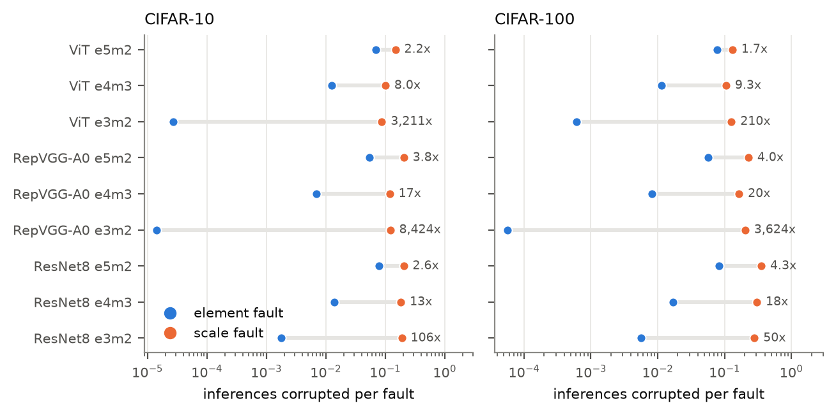
O1: Shared-scale faults dominate, and a few flip cases cause most damage
Share of total damage by case (1.1 M exhaustive faults)
Rare but decisive. S2 is 0.5% of e3m2 faults and causes 57% of the damage; E1 is 1.2% of e4m3 faults and causes 52%.
Common but harmless. Ordinary element flips (E2 to E6) are 80 to 95% of faults but only 9 to 16% of damage.
Direction matters. All catastrophic faults are 0→1 (2,468 of 2,468 and 10,321 of 10,321). 0→1 flips carry 87.5 to 88.7% of damage, 7.0 to 7.8× the 1→0 rate.
Explanatory power. The case explains 91 to 97% of the variance in damage; the fault site alone only 9 to 22%.
Inferences corrupted per fault: scale (orange) vs element (blue); label = ratio.
Always worse. A scale fault beats an element fault on every network, format and dataset: 13× to over 1,000×.
Exhaustive ResNet8 e4m3: 94.4% of scale flips change a prediction; a scale fault corrupts 49.9 of 200 inferences vs 3.3 for an element fault (15×).
Even NaN-free formats. Scale faults give non-finite outputs in 7 to 13% of cases for every format, e3m2 included.
Takeaway: Three cases (S1, S2, E1) are 1 to 2% of stored bits but cause more than half of all failures, and every one of them is a 0→1 flip.
Notes:
WHAT TO SAY (about 2 minutes)
1. This answers O1: how the two kinds of fault propagate.
2. Left figure: each row is a network and format. The blue dot is the damage of an element fault, the orange dot the damage of a scale fault, on a log axis. Orange is always to the right, so the scale fault is always worse. The number on the right is the ratio, from about 2 times up to 8,000 times.
3. The ratio is smallest for e5m2. That is not because its scale is safe, but because its element faults are already very bad (NaN codes).
4. On the exhaustive ResNet8 campaign, a single scale fault corrupts on average 50 of 200 predictions, an element fault 3.
5. Right charts: I labelled all 1.1 million exhaustive faults with their case and added up the damage. For e3m2, the S2 scale overflow is half a percent of faults but 57% of the damage. For e4m3, E1 (a flip into the NaN code) is 1.2% of faults and 52% of the damage.
6. The ordinary flips that make up 80 to 95% of all faults cause only around a tenth of the damage.
7. Direction: as the proof predicted, every single catastrophic fault was a 0-to-1 flip. So a memory technology whose errors are mostly 1-to-0, such as DRAM charge loss, would see roughly 7 to 8 times fewer failures than the usual symmetric model predicts.
IF ASKED
- "Explains 91 to 97% of variance" is a two-fold held-out R squared: knowing only the case of a fault predicts its damage very well.
- What the case does not explain: the size of small finite errors. For those, error size times input activity matters (raises R squared to 64 to 67%).

Slide 7
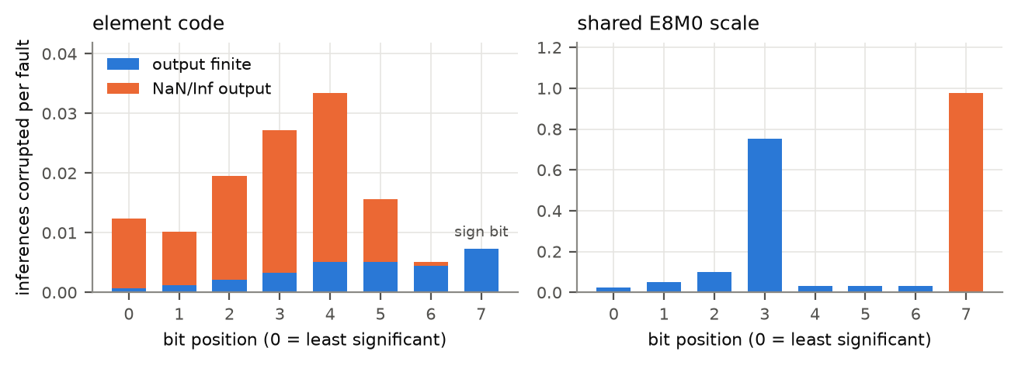
O3 and O4: Block size, tensor type and fault location
O3: Block size is a trade-off (ResNet8, e4m3)
O4: Which bit? Exhaustive per-bit damage (ResNet8, e4m3)
 | K = 8 | K = 16 | K = 32 | K = 64
Scale bits, share of storage | 11.1% | 5.9% | 3.1% | 1.7%
Scale fault: inferences corrupted (of 200) | 40.1 | 45.3 | 48.7 | 50.1
Element fault: per-inference rate | 0.0241 | 0.0208 | 0.0159 | 0.0136
Accuracy barely moves (about 1 point from K = 8 to 64), so K is a clean reliability axis.
Larger blocks: a scale is hit less often, but each scale fault reaches more values. Element faults become milder.
O4: Weights vs activations (element faults, CIFAR-10)
Element bits. Among faults that leave the output finite, the sign bit is worst. In total damage it is only 7th of 8, because most damage comes from flips into the NaN code and a sign flip can never make one.
Scale bits. Scales lie in 114 to 120, so bits 3 and 7 are normally 0. Flipping bit 3 multiplies the block by 256 (75% of inferences corrupted); bit 7 overflows it (98%); bits 4 to 6 shrink it (3%).
Layers. The 3,584-bit stem convolution is the most fragile layer (any-image SDC 0.853); the 304,128-bit final convolution the most robust (0.289). Uniform sampling spends 48% of its budget on the robust one.
Network | Format | Weight | Activation [95% CI] | Ratio
ResNet8 | e4m3 | 0.0170 | 0.0122 [0.0077, 0.0182] | 1.4×
RepVGG-A0 | e4m3 | 0.0048 | 0.0075 [0.0049, 0.0101] | 0.64×
ViT | e4m3 | 0.0122 | 0.0114 [0.0080, 0.0150] | 1.07×
ResNet8 | e5m2 | 0.0780 | 0.0359 [0.0302, 0.0421] | 2.2×
ViT | e5m2 | 0.0659 | 0.0486 [0.0420, 0.0554] | 1.36×
Per fault: similar (0.6–2.2×). Weight faults persist; activation faults last one inference.
Takeaway: Growing a block is catastrophic and shrinking it is mild. Large blocks are safe only if their few scale bytes are protected, and protection should follow vulnerability, not layer size.
Notes:
WHAT TO SAY (about 2 minutes)
1. This slide covers O3 (block size) and O4 (tensor type and fault location).
2. Block size, top-left table: K is how many values share one scale. Going from 8 to 64, the scale's share of memory drops from 11% to under 2%, so a random fault is less likely to hit a scale. But when it does, it damages more values, so each scale fault gets worse (40 to 50 of 200 inferences). Element faults get slightly milder. So block size is a trade-off, not a free choice.
3. Weights versus activations, bottom-left table: per fault they are about equally dangerous; the ratio is between 0.6 and 2.2. The real difference is exposure time: a wrong weight stays wrong for every inference, a wrong activation lasts for one.
4. Bit position, right figure: left panel is the 8 element bits, right panel the 8 scale bits. Orange means the output became NaN or infinity.
5. For elements, most damage comes from the middle bits that can turn the code into NaN. The sign bit is the worst for ordinary finite damage, but it can never create a NaN.
6. For the scale, bits 3 and 7 stand out. These bits are normally 0, so flipping them makes the block grow by 256 times or overflow. Flipping bits that are normally 1 shrinks the block, which the network tolerates.
7. Layers: the smallest layer (the first convolution) is the most fragile. Random sampling mostly hits the big robust layer.
IF ASKED
- The OCP scale rule can clip the block maximum, which distorts block-size trends; the trend here holds under both the OCP rule and a non-clipping rule.
- An earlier codec bug mapped NaN to 0 for activations; it was fixed and all activation results were re-measured.

Slide 8
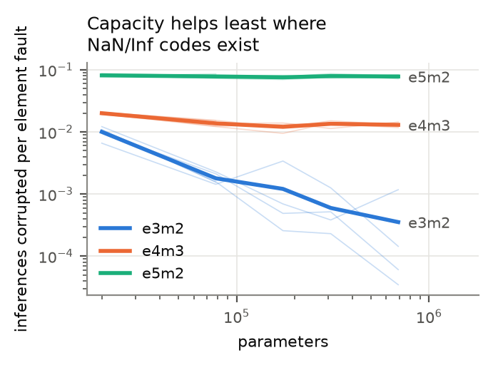
O5: What makes a model vulnerable, and two guards that cost no memory
Drivers
Read-time checks and guards
Special codes. 94% of e5m2 element failures on the ViT are non-finite (92% on RepVGG); e3m2 never produced one.
In e4m3 only 1.27% of element faults reach the NaN code, but they carry 78% of element damage.
D1 / G1: no clean element code is NaN/Inf. Guard G1 decodes such a code as 0, so an E1 fault only zeroes one weight.
D2 / G2: every scale lies in its tensor's clean band [Xmin, Xmax], known offline. Guard G2 zeroes a block whose scale is above the band, so S1, S2, S3 become a mild erase.
D3: every non-zero block has an element in the top binade.
Exhaustive ResNet8 campaigns | e3m2 | e4m3
Damage flagged by D1 (NaN/Inf code) | n/a | 52.2%
Damage flagged by D2 (scale band) | 85.7% | 32.1%
Damage flagged by D1 + D2 + D3 | 85.8% | 84.5%
Failure rate, no guard | 0.00878 | 0.0236
Failure rate, G1 + G2 (reduction) | 0.00206 (4.3×) | 0.00454 (5.2×)
ResNet8 at five widths (35× parameter range).
Capacity absorbs perturbations, not NaNs. Across a 35× range of parameters the non-finite rate stays flat. The benefit of a bigger model falls in exact order of special-code count: e3m2 25×, e4m3 1.5×, e5m2 none.
Margins, not mantissa width. Among NaN-free formats, damage follows the network's sensitivity to the top-two logit margin (r = +0.93), not the mantissa width (r = −0.25).
The checks flag only 3.5 to 4.1% of faults, but those carry about 85% of the damage.
G1 alone cuts element damage 29 to 4,100× on RepVGG and ViT (e5m2 falls to the e3m2 level); 3.9 to 53× on ResNet8.
Takeaway: Vulnerability comes from special codes and the shared scale, not from model size or bit width. A comparator on the read path removes most of it.
Notes:
WHAT TO SAY (about 2 minutes)
1. This answers O5: what makes a model fragile and what protects it.
2. Driver one, special codes: on the larger models more than 90% of e5m2 element failures are NaN or infinity outputs. e3m2, which has no such code, never produced one in any campaign.
3. Driver two, left figure: I trained ResNet8 at five widths, a 35 times range in parameters. The blue line (e3m2) falls steeply: a bigger model absorbs small errors. The green line (e5m2) stays flat: a bigger model does not absorb a NaN. So making the model bigger only helps formats without special codes.
4. Driver three: among formats without NaN, what matters is how close the network's top two answers are (the margin), not how many mantissa bits the format has.
5. Guards (right): clean MX data obeys simple rules. No element is ever a NaN code, and every scale lies in a known narrow band. Both can be checked when the value is read, using only a comparator, no extra memory and no error-correcting code.
6. G1 turns a NaN code into zero. G2 zeroes a block whose scale is too large. In both cases a catastrophic fault becomes a small one.
7. The table: the checks flag only about 4% of faults, but those are 85% of the damage. With both guards the failure rate on ResNet8 drops 4 to 5 times. On the larger models G1 alone cuts element damage by 29 to 4,100 times, bringing e5m2 down to the level of e3m2.
IF ASKED
- Why a smaller gain on ResNet8? A small network is also fragile to ordinary perturbations, which the guards do not touch.
- ReLU detail: an E1 fault has damage 1.00 when the ReLU passes NaN and 0.085 when the ReLU zeroes it. S2 stays at 0.97 because it produces +Inf, which passes any ReLU; only the scale check stops it.
- "Top binade" in D3 means the highest exponent range of the element format.

Slide 9
Case-guided campaigns, a harder task, and what the method taught us
E29: failure rate with and without protection
E29 on 7 runs (rate ± SE from the stratified estimator)
Network | Fmt | Fault space | Injected | Var. red. | G1+G2 cut
ResNet8, C-10 | e3m2 | 483,904 | 1,020 | 41× | 4.1×
ResNet8, C-10 | e4m3 | 638,624 | 881 | 108× | 5.0×
ResNet8, C-100 | e3m2 | 519,904 | 1,020 | 11× | 1.9×
ResNet8, C-100 | e4m3 | 686,144 | 862 | 75× | 4.1×
ResNet8, C-100 | e5m2 | 686,144 | 724 | 199× | 12×
RepVGG-A0, C-10 | e3m2 | 43,980,128 | 425 | 210× * | 258× *
RepVGG-A0, C-10 | e4m3 | 58,053,504 | 450 | 724× * | 1030× *
* optimistic: no ordinary fault changed a prediction at 25 faults per stratum.
CIFAR-100 and methodological findings
Everything replicates on CIFAR-100: same format order on all 9 networks, scale worse everywhere (1.7 to 3,600×). Smaller margins make NaN-free formats 3 to 22× more vulnerable, so the gap narrows (ViT e4m3/e3m2: 461× to 19×).
The usual SDC metric misleads. "Any image changed" tracks the hardest image in the set (Spearman +0.80 to +0.93) and called e3m2 and e4m3 equal; per inference they differ 5.6 to 7.6×.
Single-bit injection is enough. A double flip does 1.04 to 1.55× a single flip (390 K injections).
Per-inference failure rate, log scale. C10/C100 = CIFAR-10/100.
Cheap and accurate. About 1,000 case-stratified injections recover the exhaustive rate within 0.2 standard errors (0.00880 vs 0.00878; 0.02347 vs 0.02356) instead of 484 to 639 thousand.
Catastrophic can be silent. On RepVGG e3m2, S2 damages 87% of predictions but only 8% give a non-finite output: an output NaN check misses them, the scale check D2 catches all.
Takeaway: Using the case of each bit as a sampling plan measures a network with about 1,000 injections instead of half a million, with 11 to 724× less variance than uniform sampling.
Notes:
WHAT TO SAY (about 2 minutes)
1. This slide shows the algorithm being used as a tool, plus two checks on the whole study.
2. E29: because the case of every stored bit can be counted without injecting anything, I use the cases as strata. I inject a fixed number of faults per case (60 on ResNet8, 25 on RepVGG) and weight each case by its exact size. The rare catastrophic cases are no longer left to chance.
3. Result: about 1,000 injections give the same answer as the exhaustive campaign of half a million, within 0.2 standard errors. The "Var. red." column is how much smaller the variance is than a random campaign of the same size.
4. This also makes RepVGG measurable: its fault space is 44 to 58 million bits, far too many to enumerate.
5. Left chart: blue is no protection, orange is the two guards, grey is a ReLU that turns NaN into zero. The guards cut the rate 4 to 12 times on ResNet8 and more than 250 times on RepVGG. The ReLU trick helps only formats that have NaN codes.
6. Be honest about the star: on RepVGG no ordinary fault changed a prediction with 25 samples per stratum, so those two numbers are optimistic.
7. CIFAR-100: I retrained everything on a harder 100-class task. All conclusions hold. The gap between formats becomes smaller, because a harder task has smaller decision margins, which makes the NaN-free formats more fragile.
8. Two method lessons. First, the common "did any image change" metric depends on which images you picked and hid a real 5 to 7 times difference; several of my early conclusions were artefacts of it and I withdrew them. Second, single-bit injection is enough: double flips do not change any conclusion.
IF ASKED
- Also found: strata built from exactly enumerated value changes cut variance 48 to 65×, while TreeFI-style intervals learned from a pilot never beat uniform sampling.
- SE = standard error. Stratified estimator: rate = sum over cases of (case weight × mean damage in that case).

Slide 10
Design guidance, conclusion and future work
Design guidance for MX accelerators
Conclusion
Protect the shared scale first. It is 2 to 11% of storage and a scale fault does 13× to over 1,000× the damage of an element fault. If only some bits can be protected, protect those normally at 0.
Neutralise special codes. Prefer element formats without NaN/Inf, or add guards G1 and G2 (a comparator on the read path).
Do not judge reliability by accuracy or bit width. Equal-accuracy formats differ by orders of magnitude.
Treat block size as a trade-off. Large blocks are safe only with protected scales.
Model the flip direction and protect early layers. 0→1 flips carry almost all the risk; the small stem layer is the most fragile.
For campaigns: report the per-inference rate, inject single-bit faults, stratify by case.
Built: mxfi, a bit-accurate MX fault injector validated on 1.12 M exhaustive injections, and a 22-case flip-case algorithm that is complete by proof and by test.
Found: reliability varies by up to three orders of magnitude between MX formats of equal accuracy (e3m2 < e4m3 < e5m2 everywhere); scale faults are 13× to over 1,000× worse than element faults.
Explained and fixed: 1 to 2% of stored bits (flips into NaN/Inf codes and scale overflows, all 0→1) cause most failures; two free guards remove most of that damage.
Limitations and future work
ImageNet and pretrained DeiT: not reachable here; a case-guided campaign makes it affordable.
Faults in accumulators, biases, normalisation and control logic; faults accumulating between weight reloads.
Validate the guards on an FPGA or accelerator model; study MXINT8 and large language models.
Code and data: github.com/peeyushagarwal2004/CS496_UGP | Thanks to Prof. Urbi Chatterjee and Vishesh Mishra for their guidance.
Takeaway: In an MX network, protect the scale and the few flips the algorithm names; the rest matters far less. Thank you. Questions?
Notes:
WHAT TO SAY (about 1.5 minutes)
1. Left side, what a hardware designer should take away, in order of importance:
- Protect the scale bytes first. They are a few percent of memory but carry most of the risk.
- Avoid or neutralise NaN and infinity codes, either by choosing a format without them or with the two read-time guards.
- Do not pick a format on accuracy alone.
- Large blocks are fine only when scales are protected.
- 0-to-1 flips and the first layer deserve the most attention.
- For anyone running fault-injection campaigns: use the per-inference rate, single-bit faults, and stratify by case.
2. Right side, the three-line summary: I built a faithful injector and a case algorithm; I found that reliability differs by up to a thousand times between formats of the same accuracy and that the shared scale is the weak point; and I explained it by a small, exactly known set of flips that two free guards can neutralise.
3. Limitations, say them openly: no ImageNet or pretrained Transformer (the ViT here is small and CIFAR-trained), only stored values were faulted, and the guards were simulated in software, not on hardware.
4. Close with the takeaway sentence and invite questions.
LIKELY QUESTIONS
- Would this hold on ImageNet? The directions of the effects should transfer; CIFAR-100 suggests the absolute gaps may be smaller on harder tasks.
- Cost of the guards? One comparison per element code and one range check per scale byte on the read path; no extra stored bits.
- Why not just use ECC? ECC costs extra memory for every word. The guards cost none, and the results say where ECC would matter most: the scale bytes.

