Slide 1

Weekly Update
Pegah Ahadian

Slide 2
Multimodal Model
FNIH cohort
Xray, MRI, Clinical
Feature Extraction from images

Slide 3
Feature Extraction - Imaging
Instantiate a 2D visual encoder (ResNet-18)
Resnet18(pretrained=True)
Feature dimensionality: 512
Resize every image to 224×224, ImageNet mean/std normalization, converts to RGB
Iterate over each patient folder and embed all JPG/PNG files
For each patient_id directory:
Initialize two “bags” of vectors: x_vecs (X-ray candidates) and m_vecs (MRI candidates).
For each image file:
Compute its embedding (vec) and record the original size (size).
Aggregate per-patient per-modality features
xray_embeddings[patient_id] = mean(x_vecs, axis=0) → shape (512,) xray_embeddings.pkl
mri_embeddings[patient_id] = mean(m_vecs, axis=0) → shape (512,) mri_embeddings.pkl
Compress the high-dimensional image space (1024) down to a compact latent (64):
Concat X-ray + MRI → 1024-D
Linear(1024 → 256) → BN → ReLU → Dropout
Linear(256 → 128) → BN → ReLU → Dropout
Linear(128 → 64) → BN → ReLU → Dropout
Output embedding = 64-D

Slide 4
Clinical and Fusion
PROGRESSOR_STATUS = 1 if any of JSPRG, PAINONLYPRG, or JSPAINPRG = 1; = 0 if NONPRG = 1.
MLP with 2 fully connected (Linear) layers each followed by BN, ReLU, Dropout
Output: 64D
Fusion by concatenation:
Stack them side-by-side along the feature dimension (dim=1).
Resulting vector: size hidden (64 + 64 = 128).
Clinical embedding (64) ┐
├─ Concat → (128)
Image embedding (64) ┘
↓
Linear(128→64) → BN → ReLU → Dropout
↓
Linear(64→2) → Softmax → [Non-Progressor / Progressor]

Slide 5
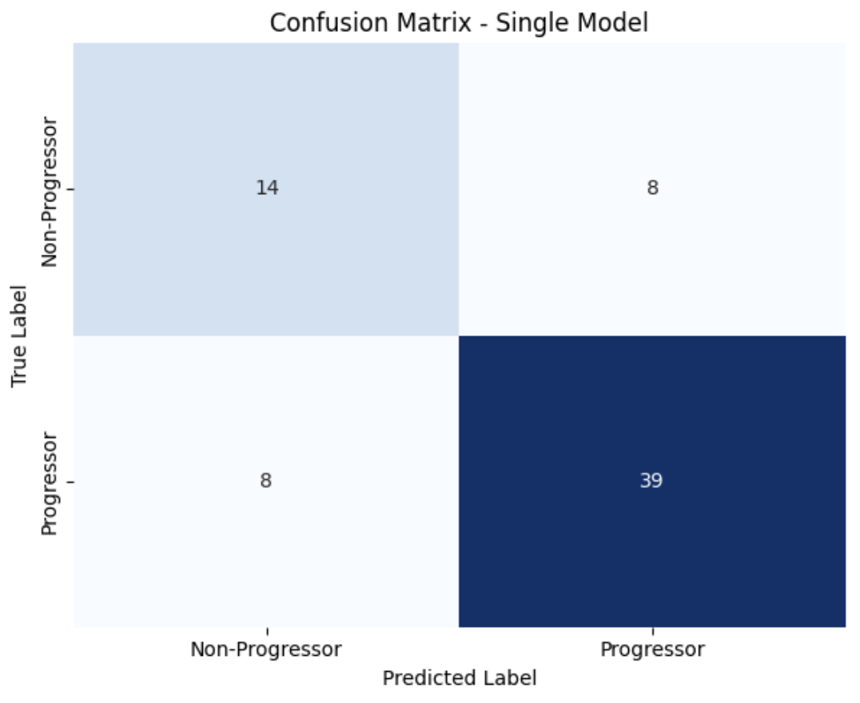
Result
Model Test Accuracy (on Held-Out Test Set): 0.7536

Slide 6
Update on features
From clinical :
V00XRJSM V00XRKL V00XRJSL V01XRJSM V01XRKL V01XRJSL V03XRJSM V03XRKL V03XRJSL V05XRJSM V05XRKL V05XRJSL V00MCMJSW V01MCMJSW V03MCMJSW V05MCMJSW P01BMI V00AGE P02SEX V00WOMKP V01WOMKP V03WOMKP V05WOMKP V00WOMADL V01WOMADL V03WOMADL V05WOMADL
Outcome: Progression: 48 months V06
Best Validation Accuracy: 0.7818
Test Accuracy: 0.6667
Classification Report:
precision recall f1-score support
Non-Progressor (0) 0.48 0.55 0.51 22
Progressor (1) 0.77 0.72 0.75 47
accuracy 0.67 69
Confusion Matrix:
[[12 10]
[13 34]]

Slide 7
Update Binary/ Multi
Binary: Best Validation Accuracy: 0.7818
Test Accuracy: 0.6667
Classification Report:
precision recall f1-score support
Non-Progressor (0) 0.48 0.55 0.51 22
Progressor (1) 0.77 0.72 0.75 47
accuracy 0.67 69
Confusion Matrix:
[[12 10]
[13 34]]
Multiclass:
Best Validation Accuracy: 0.6000
Test Accuracy: 0.4783
Classification Report:
precision recall f1-score support
0: NONPRG 0.52 0.50 0.51 22
1: JSPRG 0.00 0.00 0.00 11
2: PAINONLYPRG 0.43 0.46 0.44 13
3: JSPAINPRG 0.52 0.70 0.59 23
accuracy 0.48 69
macro avg 0.37 0.41 0.39 69
weighted avg 0.42 0.48 0.44 69

Slide 8
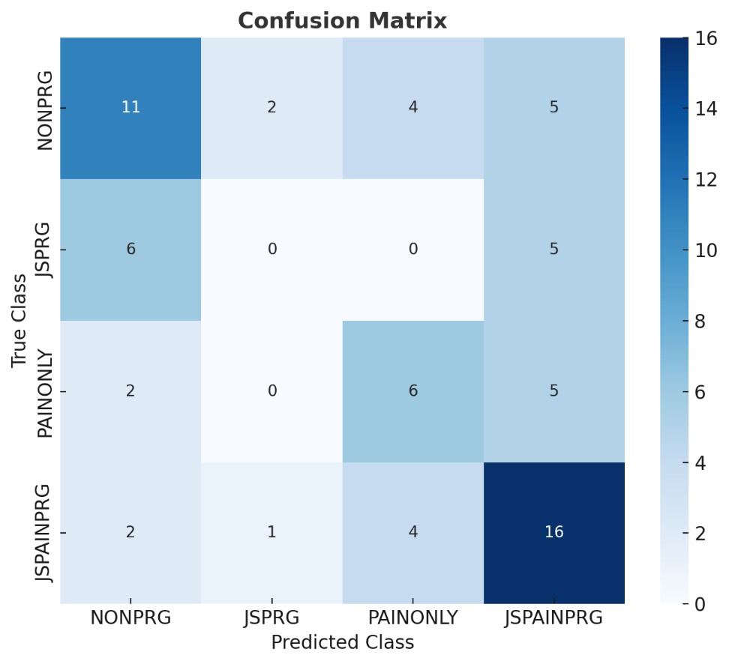
Update 10/09/2025
Multiclass:
Test Accuracy: 0.4783
Classification Report:
precision recall f1-score support
0: NONPRG 0.52 0.50 0.51 22
1: JSPRG 0.00 0.00 0.00 11
2: PAINONLYPRG 0.43 0.46 0.44 13
3: JSPAINPRG 0.52 0.70 0.59 23
accuracy 0.48 69
macro avg 0.37 0.41 0.39 69
weighted avg 0.42 0.48 0.44 69

Slide 9
Separate Class
Results for JSPRG vs NONPRG
Accuracy: 0.536
precision recall f1-score support
NONPRG 0.43 0.55 0.48 22
JSPRG 0.64 0.53 0.58 34
accuracy 0.54 56
macro avg 0.54 0.54 0.53 56
weighted avg 0.56 0.54 0.54 56
Confusion Matrix:
[[12 10]
[16 18]]
JSPRG vs NONPRG: N=279 | Positives=171 | Negatives=108
Results for PAINONLYPRG vs NONPRG
Accuracy: 0.61
precision recall f1-score support
NONPRG 0.74 0.64 0.68 22
PAINONLY 0.47 0.58 0.52 12
accuracy 0.62 34
macro avg 0.60 0.61 0.60 34
weighted avg 0.64 0.62 0.62 34
Confusion Matrix:
[[14 8]
[ 5 7]]
PAINONLYPRG vs NONPRG: N=170 | Positives=62 | Negatives=108
Results for JSPAINPRG vs NONPRG
Accuracy: 0.578
precision recall f1-score support
NONPRG 0.58 0.50 0.54 22
JSPAIN 0.58 0.65 0.61 23
accuracy 0.58 45
macro avg 0.58 0.58 0.57 45
weighted avg 0.58 0.58 0.58 45
Confusion Matrix:
[[11 11]
[ 8 15]]
JSPAINPRG vs NONPRG: N=223 | Positives=115 | Negatives=108

Slide 10
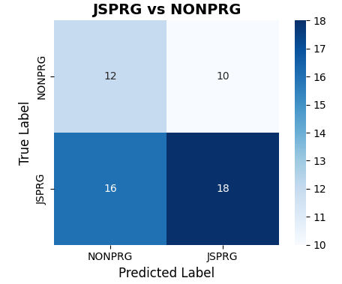
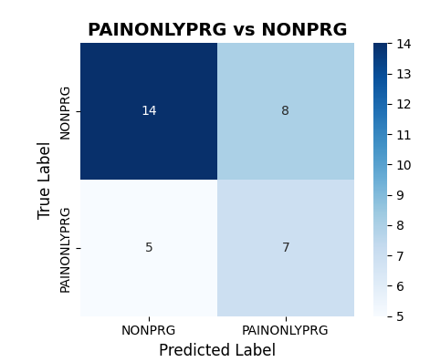
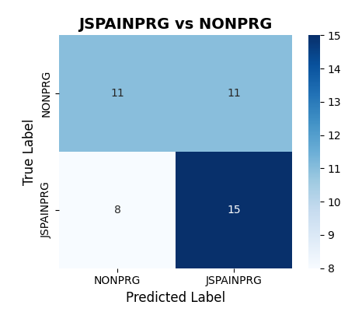
Separate Classes Performance

Slide 11
Binary
Setting | Train_N | Val_N | Test_N | Test_Accuracy | Macro_F1 | Weighted_F1 | Best_Val_Accuracy | Early_Stopping_Epoch
Multimodal (Clinical+Imaging) | 217 | 55 | 69 | 0.6667 | 0.63 | 0.67 | 0.8182 | 41
Clinical-only | 425 | 107 | 133 | 0.8045 | 0.8 | 0.81 | 0.8505 | 100

Slide 12
Multi-Class
Setting | Train_N | Val_N | Test_N | Best_Val_Accuracy | Test_Accuracy | Macro_Precision | Macro_Recall | Macro_F1 | Weighted_Precision | Weighted_Recall | Weighted_F1 | Early_Stopping_Epoch
Multimodal (Clin.+Img.) | 217 | 55 | 69 | 0.6 | 0.4783 | 0.37 | 0.41 | 0.39 | 0.42 | 0.48 | 0.44 | 52
Clinical-only | 425 | 107 | 133 | 0.6916 | 0.5789 | 0.55 | 0.54 | 0.53 | 0.61 | 0.58 | 0.58 | 72

Slide 13
Separate classes
Setting | Task | N | Positives | Negatives | Test_Accuracy | Balanced_Acc | Test_N
Multimodal | JSPRG vs NONPRG | 279 | 171 | 108 | 0.518 | 0.475 | 56
Multimodal | PAINONLYPRG vs NONPRG | 170 | 62 | 108 | 0.529 | 0.428 | 34
Multimodal | JSPAINPRG vs NONPRG | 223 | 115 | 108 | 0.489 | 0.487 | 45
Clinical-only | JSPRG vs NONPRG | 562 | 297 | 265 | 0.478 | 0.482 | 113
Clinical-only | PAINONLYPRG vs NONPRG | 368 | 103 | 265 | 0.351 | 0.49 | 74
Clinical-only | JSPAINPRG vs NONPRG | 459 | 194 | 265 | 0.533 | 0.53 | 92

Slide 14
Update 11/05/2025
OAI Data:
From Clinical: ID, V00WOMKPR, V00WOMKPL, P01BMI, V00AGE
From kxr-qjsw: ID, SIDE, V00MCMJSW,
From kxr-sq: V00XRJSM, V00XRKL, V00XRJSL
From Biospec-LabCorp: V00Serum_CTXI_lc, V00Serum_NTXI_lc (bone resorption), V00Urine_CTXII_lc, V00Urine_CTXII_NUM(cartilage degradation), V00Serum_C2C_lc, V00Serum_C1_2C_lc(collagen), V00Serum_Comp_lc(collagen protein), V00Serum_HA_lc
Next: Extract all other visits V01,V03, V05
Map to images

Slide 15
Update 11/06/2025
Review the FNIH regarding time of progression: 237/600 prg (BMI>26.3 and +45) 206 JSL/JSL+ pain prog → 193 MCMJSW03 <4.7 mm → 188 MCMJSW05 <4.7 mm → 178 MCMJSW01 <4.7 mm → 166 MCMJSW00 <4.7 mm
32 pain only prog → 5 Womac > 9 but all MCMJSW <4.2 mm
223/ 237 in V03(24mo) → MCMJSW <4.6 mm

Slide 16
Time to Event (practice)
covariates (predictors): MCMJSW, age, BMI, sex, pain score
Outcome: 48-month progression event as defined above; censoring at last observed ≤48 months.
event = 1 → The knee progressed (lost ≥0.7 mm of MCMJSW from baseline) by that time.
event = 0 → The knee did NOT progress by the last available follow-up
FNIH → 226 event 1 (43 in 12mo, 102 in 36mo, 81 in 48mo)

Slide 17
ID | SIDE | P01BMI | V00AGE | P02SEX | P02HISP | P02RACE | V00WOMKP | V00WOMADL | V00XRJSM | V00XRKL | V00XRJSL | V00MCMJSW | time | event
9002116 | 2: Left | 36.5 | 61 | 1: Male | 0: No | 2: Black or African American | 12 | 40 | 2 | 3:03 | 0 | 2.886 | 12 | 1
9002430 | 1: Right | 27.4 | 68 | 1: Male | 0: No | 1: White or Caucasian | 2 | 9 | 0 | 2:02 | 0 | 4.42 | 48 | 1
9003380 | 1: Right | 33.1 | 64 | 1: Male | 0: No | 1: White or Caucasian | 3 | 11 | 0 | 1:01 | 0 | 5.917 | 48 | 1
9006723 | 2: Left | 34.7 | 58 | 2: Female | 0: No | 1: White or Caucasian | 0 | 0 | 0 | 2:02 | 0 | 4.964 | 48 | 1
9010370 | 1: Right | 26.9 | 51 | 2: Female | 0: No | 1: White or Caucasian | 2 | 15.86667 | 0 | 2:02 | 0 | 5.064 | 48 | 1
9014209 | 1: Right | 20.8 | 77 | 2: Female | 0: No | 1: White or Caucasian | 0 | 7 | 2 | 3:03 | 0 | 1.896 | 48 | 1
9016403 | 1: Right | 27.3 | 78 | 2: Female | 0: No | 1: White or Caucasian | 2 | 12.46667 | 2 | 3:03 | 0 | 2.335 | 36 | 1
9027422 | 2: Left | 25.6 | 73 | 1: Male | 0: No | 1: White or Caucasian | 1 | 1 | 2 | 3:03 | 0 | 2.102 | 36 | 1
9031141 | 1: Right | 25.8 | 63 | 1: Male | 0: No | 1: White or Caucasian | 0 | 0 | 1 | 2:02 | 0 | 5.594 | 12 | 1
ID | SIDE | t_start | t_stop | event | MCMJSW | V00MCMJSW
9002116 | 2: Left | 0 | 12 | 1 | 1.781 | 2.886
9002430 | 1: Right | 36 | 48 | 1 | 3.627 | 4.42
9003380 | 1: Right | 36 | 48 | 1 | 4.768 | 5.917
9006723 | 2: Left | 36 | 48 | 1 | 4.23 | 4.964
9010370 | 1: Right | 36 | 48 | 1 | 3.8 | 5.064
9014209 | 1: Right | 36 | 48 | 1 | 1.156 | 1.896
9016403 | 1: Right | 12 | 36 | 1 | 1.581 | 2.335
9027422 | 2: Left | 12 | 36 | 1 | 0.6 | 2.102
9031141 | 1: Right | 0 | 12 | 1 | 4.577 | 5.594

Slide 18
12/03/2025
OAI Data:
# XR JSW
xr_jsw_cols = [
"V00MCMJSW","V00XMJSW","V00JSW150","V00JSW175","V00JSW200","V00JSW225",
"V00JSW250","V00JSW275","V00JSW300",
"V00LJSW700","V00LJSW750","V00LJSW800","V00LJSW850","V00LJSW900",
"V00BMANG"]
# KL and XR scoring (from kxr_sq_bu00 subset)
kl_cols = [
"V00XRKL", "V00XROSFM","V00XRSCFM","V00XRCYFM","V00XRJSM",
"V00XROSTM","V00XRSCTM","V00XRCYTM","V00XRATTM",
"V00XROSFL","V00XRSCFL","V00XRCYFL","V00XRJSL",
"V00XROSTL","V00XRSCTL","V00XRCYTL","V00XRATTL"
]
# MRI quantitative mri_cols = [
"V00WMTCTS","V00BMFMTC","V00WMTCAAB",
"V00WLTCTS","V00BLFMTC","V00WLTCAAB",
"V00WLTMTC","V00WMTMTC"]
# Clinical clinical_cols = [
"V00AGE","P01BMI","P01HEIGHT","P01WEIGHT",
"V00SMKNEV","V00SMOKE","V00SMKNOW","V00SMKPKYR",
"V00DIAB","V00KIDFXN","V00ULCER","V00CANCER",
"V00KOOSFX1","V00KOOSFX2","V00KOOSFX3","V00KOOSFX4","V00KOOSFX5",
"V00KOOSKPL","V00KOOSKPR","V00KOOSQOL",
"V00WOMKPL","V00WOMKPR","V00WOMSTFL","V00WOMSTFR","V00WOMTSL","V00WOMTSR",
]

Slide 19
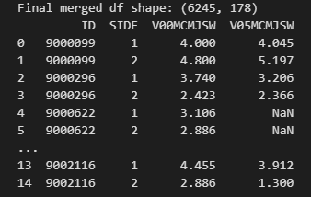
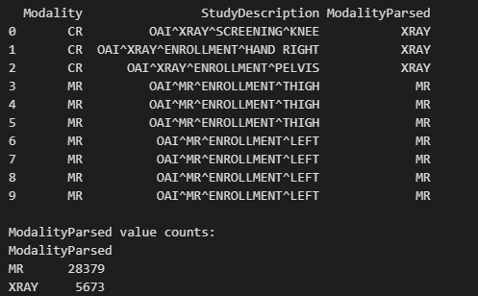
Progression Definition: Joint space loss 0.7mm
Train on baseline
Target: V05MCMJSW (48 mo)
6245 rows, 178 features
Image:
Counts of X-ray vs MRI(DICOM) - baseline: X-ray: 5673 MRI : 28379

Slide 20
Model:
Baseline → XGBoost, LR
☺
Current Status:
Handling imbalance class 0: 5183
1: 1062

Slide 21
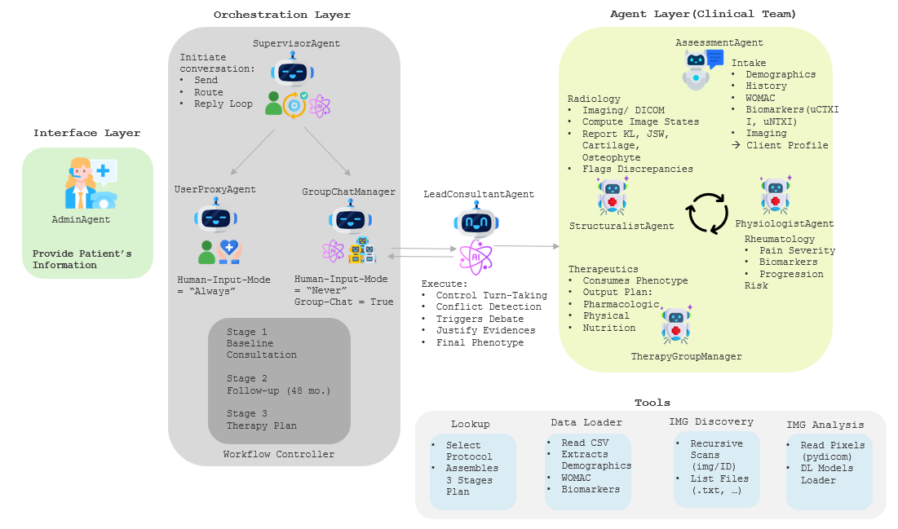
01/15/2026
Multi-Agent System (MAS) OA Assistant
Modalities: clinical, radiographic, MR, biomarker
Outcome: 4 yrs progression
Pain model: wamac & womADL
Agent tasks:
Progression prediction
Compute residual for pain
Debate on discordance
* Will share the manuscript soon.

Slide 22
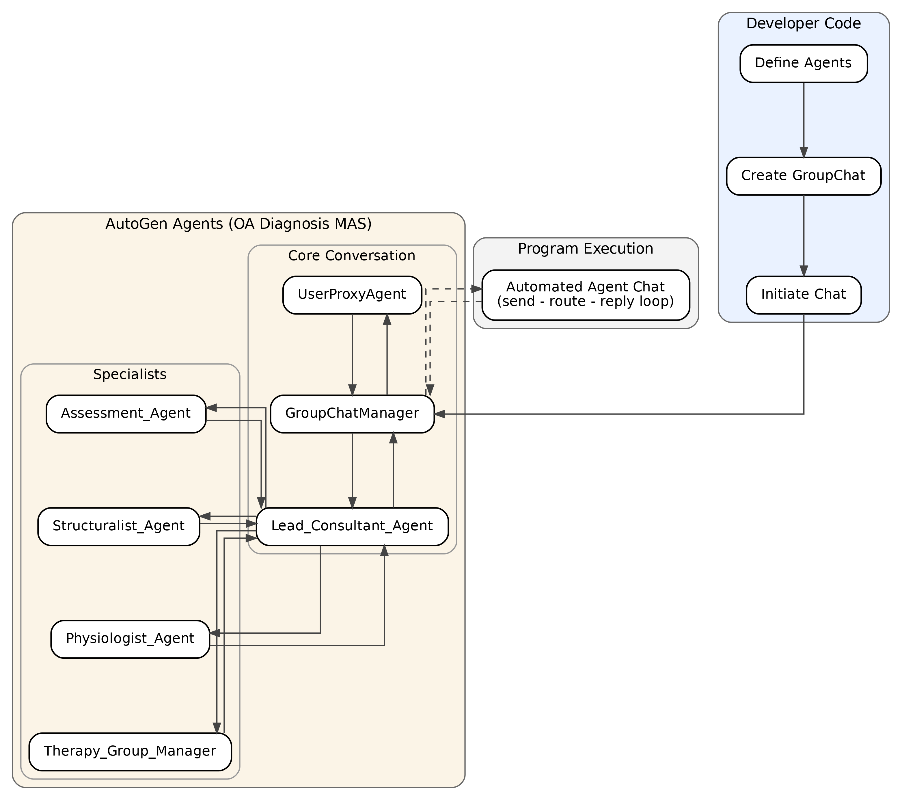
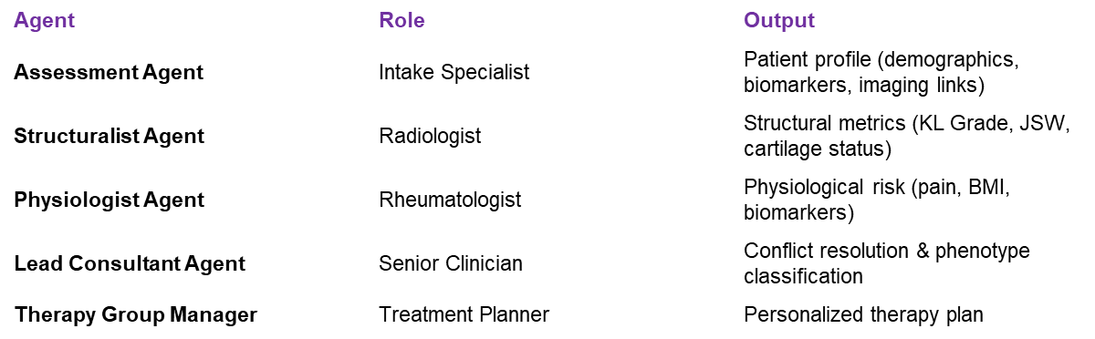
Stage 1 – Primary Consultation
Fetch and analyze baseline patient data.
Stage 2 – Follow-Up Consultation (+4 Years)
Reclassification
Stage 3 – Therapy Recommendation
Generates integrated result

Slide 23
References
Hill, Brandon G., et al. "The Discordance Between Pain and Imaging in Knee Osteoarthritis." JAAOS-Journal of the American Academy of Orthopaedic Surgeons 33.14 (2025): e786-e794.
Pua, Yong-Hao, et al. "Discordance between self-reported and performance-based physical function in patients who have knee osteoarthritis: associations with pain intensity and negative affect." The Journal of arthroplasty 38.9 (2023): 1705-1713.
Finan, Patrick H., et al. "Discordance between pain and radiographic severity in knee osteoarthritis: findings from quantitative sensory testing of central sensitization." Arthritis & Rheumatism 65.2 (2013): 363-372.
Wu, Qingyun, et al. "Autogen: Enabling next-gen LLM applications via multi-agent conversations." First Conference on Language Modeling. 2024.
Chen, X., H. Yi, and M. You. "Enhancing diagnostic capability with multi-agents conversational large language models. NPJ Digit Med 8: 159." 2025,
Liu, Weizhi, et al. "KOM: A Multi-Agent Artificial Intelligence System for Precision Management of Knee Osteoarthritis (KOA)." arXiv preprint arXiv:2511.19798 (2025).

Slide 24
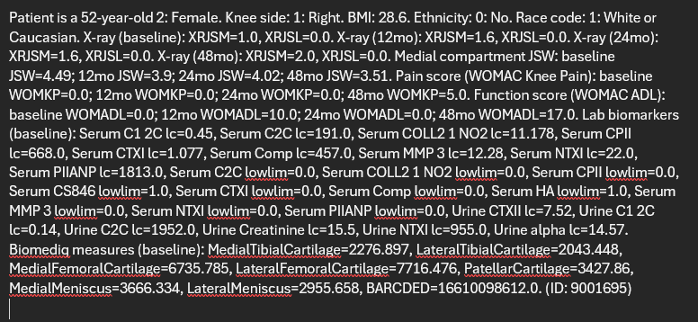
Note Analysis
Abstraction task
Data: FNIH
Convert table to free text
Example →
https://github.com/pegahahadian/Tab2Text
Test: CC radio report data

Slide 25
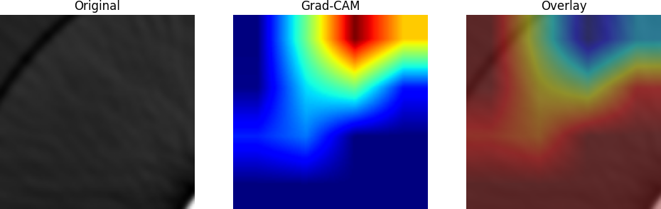
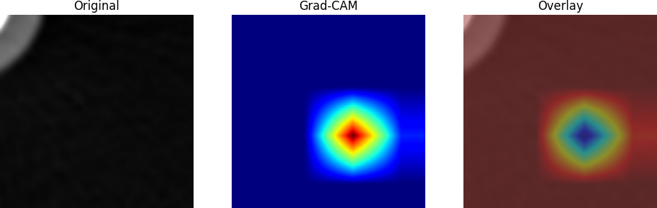
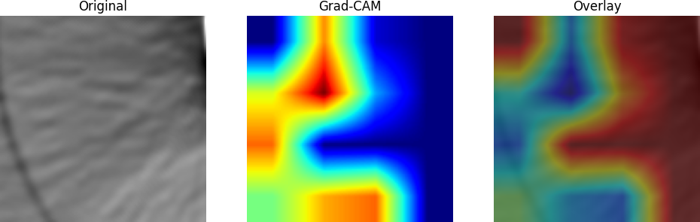
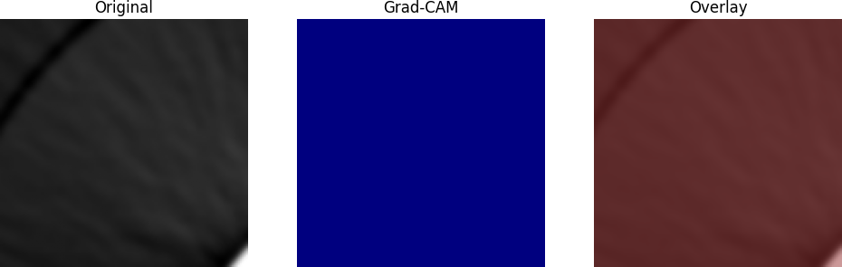
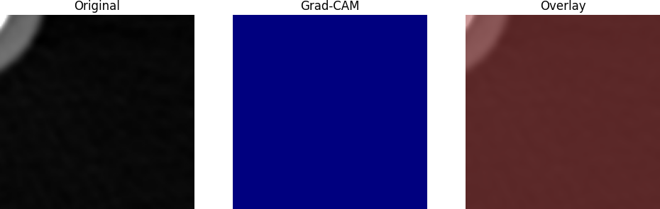
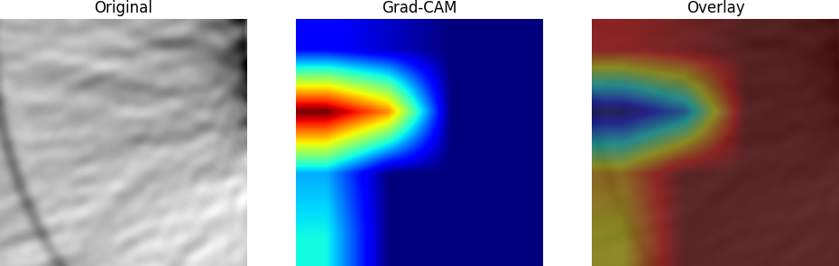
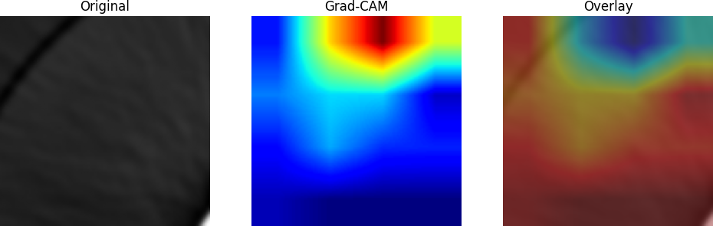
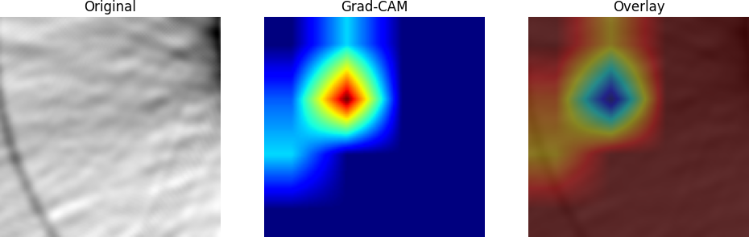
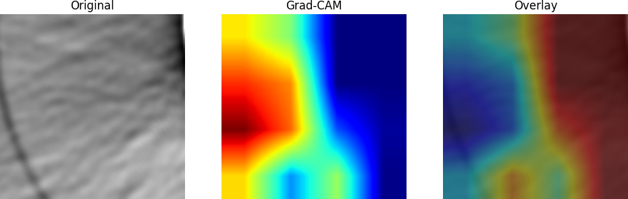
CT - FBP
Lesion 2
Lesion 6
Lesion 9
SP
SA
SP
Lesion | Dose | Method | AUC
Lesion02 | Full | FBP | 0.867677
Lesion02 | Half | FBP | 0.833957
Lesion06 | Full | FBP | 0.968766
Lesion06 | Half | FBP | 0.951483
Lesion09 | Full | FBP | 0.66058
Lesion09 | Half | FBP | 0.611388
Lesion12 | Full | FBP | 0.676053
Lesion12 | Half | FBP | 0.656579

Slide 26
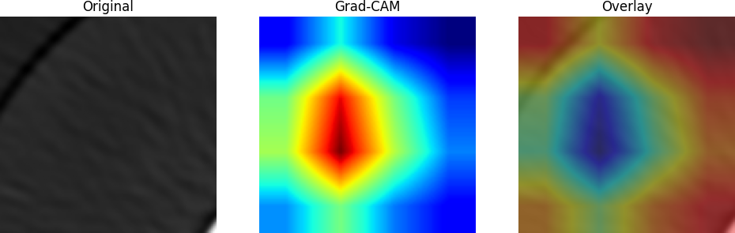
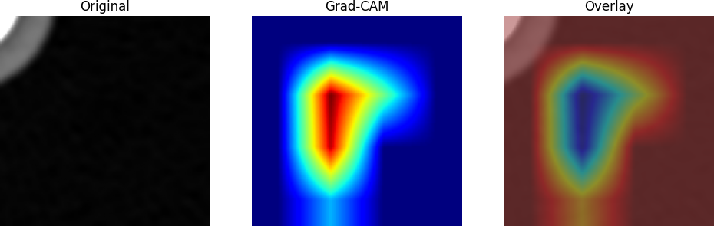
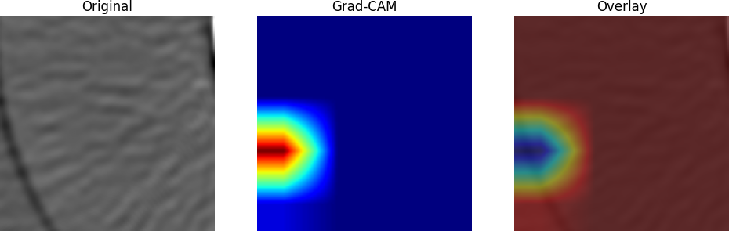
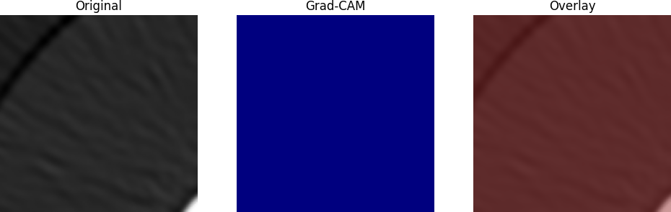
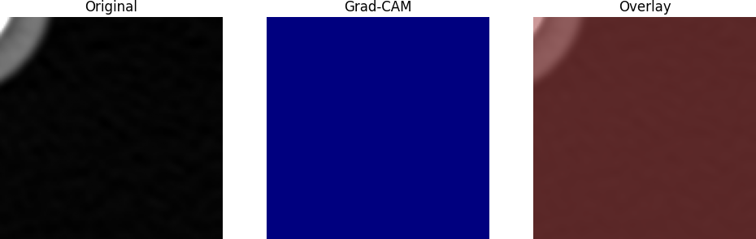
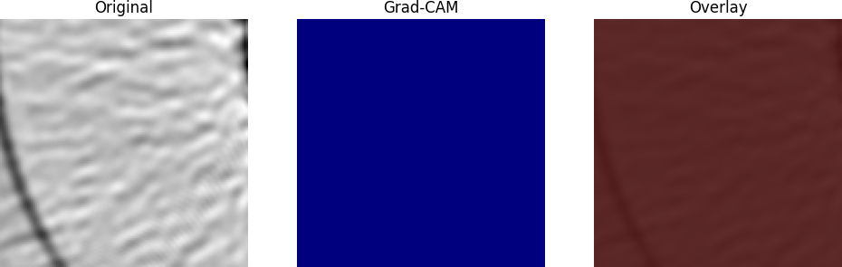
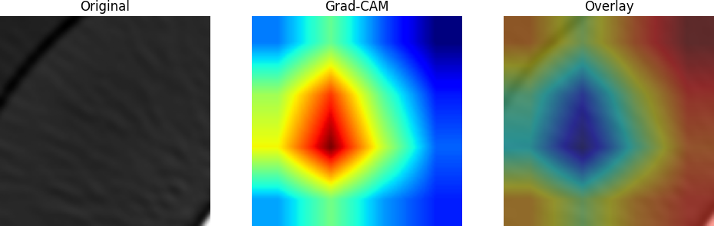
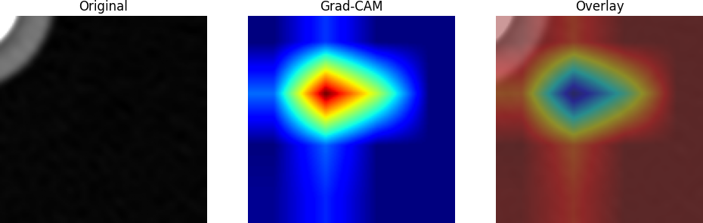
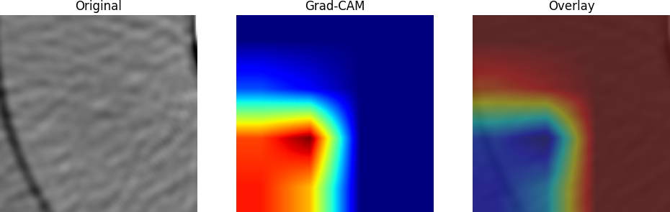
iMAR
Lesion 2
Lesion 6
Lesion 9
SP
SA
SP
Lesion | Dose | Method | AUC
Lesion02 | Full | IMAR | 0.963195
Lesion02 | Half | IMAR | 0.895436
Lesion06 | Full | IMAR | 0.971832
Lesion06 | Half | IMAR | 0.930468
Lesion09 | Full | IMAR | 0.816664
Lesion09 | Half | IMAR | 0.670432
Lesion12 | Full | IMAR | 0.780989
Lesion12 | Half | IMAR | 0.717073

Slide 27
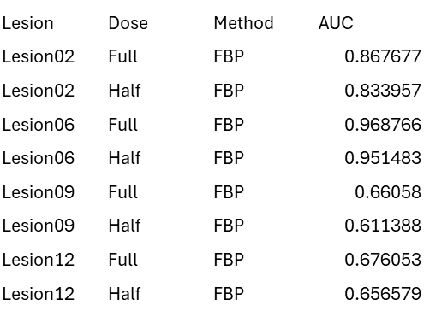
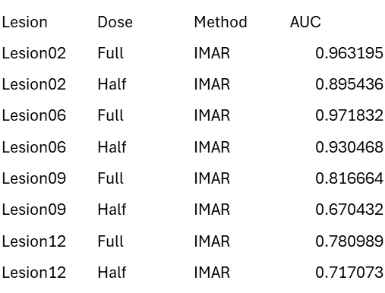
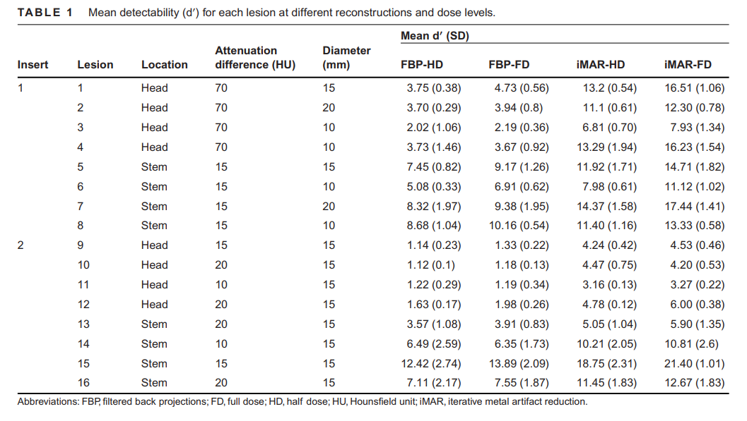

Slide 28
03/09/2026
MRI:
post-processed multiplanar reconstruction images, MPRs → derived from a DESS acquisition.
evidence is in the DICOM metadata:
SeriesDescription: AX_MPR_LEFT, COR_MPR_LEFT, COR_MPR_RIGHT
ProtocolName: SAG 3D DESS WE
They are not directly compatible with segmentation models trained on the original DESS volume.
Solution:
switched to representation learning directly on the available MRI images. - Each MRI volume was converted to NIfTI
- Reoriented to a consistent slice-first format, intensity-normalized, center-cropped, and processed using pretrained DenseNet121 encoder
- Slice-level features were then mean-pooled to generate one patient-level MRI embedding for downstream multimodal fusion.
- On run ~
Notes:
The available MRI data in our FNIH subset are MPR-derived views reconstructed from sagittal 3D DESS acquisitions, rather than the native raw DESS series.

Slide 29
04/20/2026

Slide 30
Literatures
Kraus et al., 2017 - Predictive validity of biochemical biomarkers
baseline, 12 months, and 24 months were used to predict outcomes over 24-48 months.
18 features serum/urine Model used: multivariable regression with hierarchical discriminative analysis, adjusted for age, sex, BMI, race, baseline JSW, KLG, pain, and pain medication use.
Performance: AUC: 0.667
_______________________________________________________________________
2) Deng et al., 2023 - MRI cartilage nomograms
Visits used for prediction: baseline, plus changes from baseline to 12 months and baseline to 24 months. They built nomogram0, nomogramΔ12, and nomogramΔ24.
Features used: quantitative MRI cartilage morphology parameters - cartilage thickness, cartilage volume, subchondral bone exposure area, cartilage thickness uniformity across knee subregions - plus clinical covariates: KL grade, WOMAC pain, WOMAC disability, minimum JSW.
Model used: LASSO for MRI feature selection, then logistic regression to build nomograms.
Performance: nomogram0: AUC 0.69, nomogramΔ12: AUC 0.64, nomogramΔ24: AUC 0.71

Slide 31
3) Hu et al., 2023 – DeepKOA
Visits used for prediction: separate models at baseline, 12 months, and 24 months.
Features used: whole-knee 3D MR images, specifically SAG-IW-TSE-FS, SAG-3D-DESS-WE, axial and coronal reformats; they also tested X-ray and clinical-variable models.
Model used: 3D DenseNet169; clinical variables were modeled with MLP; integrated MRI+clinical models were also tested.
Modality: mainly MRI deep learning; comparison with X-ray and clinical, and an integrated model.
Performance: best sequence was SAG-IW-TSE-FS, with AUCs:
Baseline: 0.664, 12 months: 0.739, 24 months: 0.775
**X-ray model only reached about 0.573-0.613, and adding clinical variables did not improve DeepKOA significantly.

Slide 32
4) Li et al., 2024 - Predictive models for radiographic and pain progression
Visits used for prediction: baseline predictors
Features used: Final radiographic model had 8 variables; pain model had 10 variables. Selected predictors included meniscal extrusion, meniscal volume, osteophytes, denuded cartilage area, BMLs, WOMAC pain, NSAID use, non-target knee X-ray OA findings, and pain-history variables.
Model used: multivariate logistic regression, visualized as nomograms, with 10-fold cross-validation.
Performance: Radiographic model: AUC 0.77
Pain model: AUC 0.76
______________________________________________________________________
5) Hunter et al., 2023 - Skeletal Radiology review on PROGRESS OA
Used baseline and 24-month change predicting 48-month outcomes.
Features used: MRI biomarkers (quantitative cartilage thickness/volume, SQ MRI markers, bone shape, meniscal volume), radiographic TBT, and serum/urine biochemical markers.
Model used: multivariable logistic regression
Modality: review of MRI + radiographic + biochemical biomarkers.
Performance: baseline for pain+radiographic progression: 0.641-0.671
24-month change models: 0.680-0.724

Slide 33
6) Collins et al., 2025 - MRI biomarkers of knee OA progression (PROGRESS OA RCT placebo arms)
baseline MRI biomarkers predicted outcomes over 12-36 months.
Outcome: primary outcome was JSWL ≥0.7 mm; secondary outcomes included pain progression
Features used: baseline quantitative cartilage morphology and MOAKS-type SQ MRI features - cartilage surface area extent, full-thickness loss, osteophytes, BMLs, meniscal morphology/extrusion, Hoffa-synovitis, effusion-synovitis.
Model used: logistic regression
Performance: JSWL ≥0.7 mm: AUC 0.69, Pain progression: AUC 0.77
________________________________________________________________________
7) Collins et al., 2025 - Biochemical biomarkers of knee OA progression (PROGRESS OA)
Visits used for prediction: baseline biochemical biomarkers predicting outcomes over 12-36 months
Outcome: outcome was medial or lateral JSWL ≥0.7 mm
Features used: 9 biochemical biomarkers, including serum HA, sNTX-I, sCTX-I, sPIIBNP, urinary C2C-HUSA, CTXII, NTXI, CTXIα, CTXIβ, modeled with covariates such as BMI and KLG.
Model used: logistic regression
Performance: serum HA + urinary C2C-HUSA + BMI + KLG, with AUC 0.627 Biomarker-only HA+C2C-HUSA reached AUC 0.581.

Slide 34
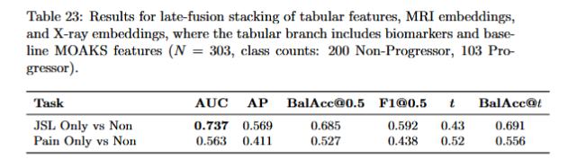
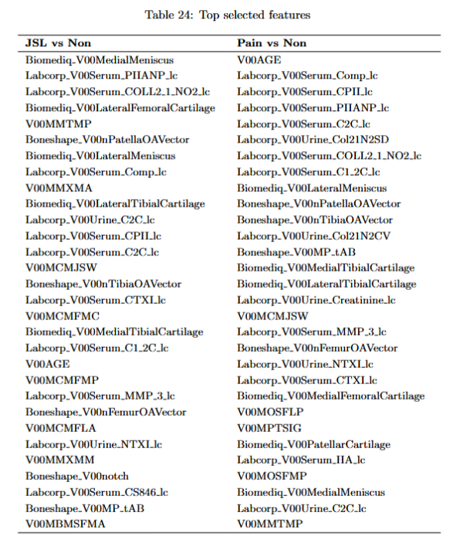
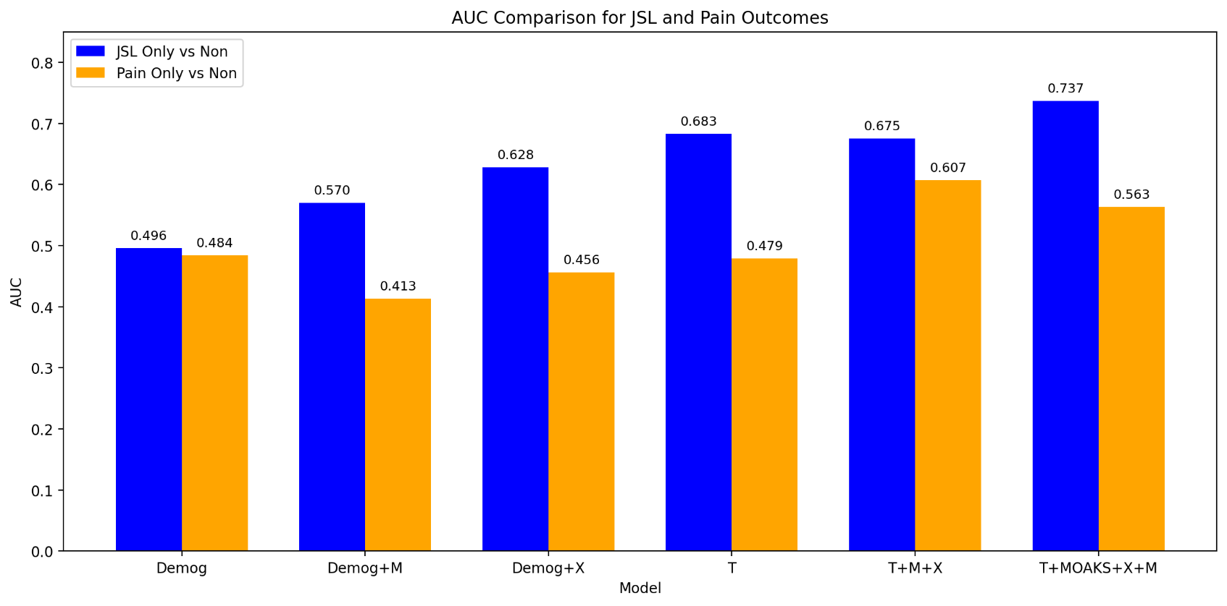
Update Tabular with MOAKS

Slide 35
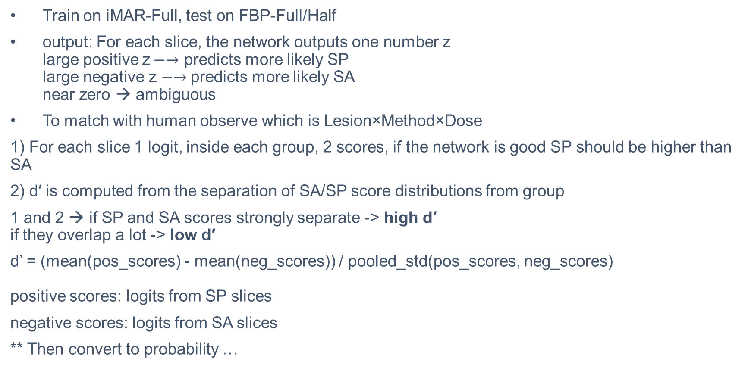
DL- MO CT
Train on iMAR-Full, test on FBP-Full/Half
output: For each slice, the network outputs one number z large positive z$−→$ predicts more likely SP large negative z $−→$predicts more likely SA near zero → ambiguous
To match with human observe which is Lesion×Method×Dose
1) For each slice 1 logit, inside each group, 2 scores, if the network is good SP should be higher than SA
2) d′ is computed from the separation of SA/SP score distributions from group
1 and 2 → if SP and SA scores strongly separate -> high d′ if they overlap a lot -> low d′
d’ = (mean(pos_scores) - mean(neg_scores)) / pooled_std(pos_scores, neg_scores) positive scores: logits from SP slices
negative scores: logits from SA slices
** Then convert to probability …
Notes:
average of standard deviations from two or more independent groups
So the group is all slices belonging to that lesion-method-dose condition, not one set
for one group, we keep all slice logits and split them by truth label: SP and SA then compute d’

Slide 36
EX:
SP logits = [2.0, 2.5, 1.8, 2.2]
SA logits = [-0.5, -0.8, -0.3, -0.6]
mean SP ≈ 2.125
mean SA ≈ -0.55
difference ≈ 2.675
d′= 2.675/ 0.4 ​≈ 6.69 → That is a high d′, meaning strong separation.
LesionNum | Lesion | Method | Dose | ModelDPrime | HumanDPrime
1 | Lesion01 | FBP | Full | 2.45203665 | 4.73
1 | Lesion01 | FBP | Half | 2.716997481 | 3.75
2 | Lesion02 | FBP | Full | 1.750275147 | 3.94
2 | Lesion02 | FBP | Half | 1.936783297 | 3.7
3 | Lesion03 | FBP | Full | 0.998654649 | 2.19
3 | Lesion03 | FBP | Half | 0.929179714 | 2.02
4 | Lesion04 | FBP | Full | 1.558117982 | 3.67
4 | Lesion04 | FBP | Half | 1.372326025 | 3.73
5 | Lesion05 | FBP | Full | 6.612571097 | 9.17
5 | Lesion05 | FBP | Half | 6.392132 | 7.45
6 | Lesion06 | FBP | Full | 3.429561613 | 6.91
6 | Lesion06 | FBP | Half | 3.11980699 | 5.08
7 | Lesion07 | FBP | Full | 3.618302423 | 9.38
7 | Lesion07 | FBP | Half | 2.855662784 | 8.32
8 | Lesion08 | FBP | Full | 5.203749332 | 10.16
8 | Lesion08 | FBP | Half | 4.704779637 | 8.68
9 | Lesion09 | FBP | Full | 0.267946568 | 1.33
9 | Lesion09 | FBP | Half | 0.405505853 | 1.14
10 | Lesion10 | FBP | Full | 0.399367818 | 1.18
10 | Lesion10 | FBP | Half | 0.198987264 | 1.12
11 | Lesion11 | FBP | Full | 0.89195966 | 1.19
11 | Lesion11 | FBP | Half | 0.707855897 | 1.22
12 | Lesion12 | FBP | Full | 1.083586077 | 1.98
12 | Lesion12 | FBP | Half | 1.05902223 | 1.63
13 | Lesion13 | FBP | Full | 3.162922666 | 3.91
13 | Lesion13 | FBP | Half | 2.794668904 | 3.57
14 | Lesion14 | FBP | Full | 3.868552299 | 6.35
14 | Lesion14 | FBP | Half | 4.503146304 | 6.48
15 | Lesion15 | FBP | Full | 9.571176725 | 13.89
15 | Lesion15 | FBP | Half | 7.635545302 | 12.42
16 | Lesion16 | FBP | Full | 5.878150133 | 7.55
16 | Lesion16 | FBP | Half | 5.762517062 | 7.11

