Slide 1
Before Tutorial Starts
Tutorial Page
https://pegasus.isi.edu/tutorial/isi/
Logon to workflow.isi.edu using the training account assigned to you
ssh pegtrainXX@workflow.isi.edu
It will prompt for a password
Notes:
Direct link: http://download.pegasus.isi.edu/wms/download/4.3/PegasusTutorialVM-4.3.0.zip

Slide 2
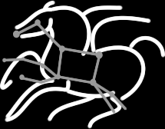
Executing Computing Pipelines using Pegasus WMS
Karan Vahi
Science Automation Technologies Group
USC Information Sciences Institute

Slide 3
Agenda
10:00 – 12:00 Introduction and Tutorial on Pegasus
12:00 – 1:00 Lunch
1:00 – 3:00 Features addressing user problems
2:00 – 3:00 Getting Pegasus to your campus
3:00 Adjourn

Slide 4
Hands on Tutorial Outline
Topics Covered
What are Scientific Workflows
Submission of an already generated example workflow with Pegasus.
How to use the Pegasus Workflow Dashboard for monitoring workflows.
Command line tools for monitoring, debugging and generating statistics.
Recovery from failures
Creation of workflow using system provided API
Information catalogs configuration.

Slide 5
Scientific Workflows
Orchestrate complex, multi-stage scientific computations
Often expressed as directed acyclic graphs (DAGs)
Capture analysis pipelines for sharing and reuse
Can execute in parallel on distributed resources
Setup
Split
Filter & Convert
Map
Merge
Analyze
Epigenomics Workflow
Notes:
Expressed in high-level workflow languages

Slide 6
Pegasus Workflow Management System (est. 2001)
Maps a resource-independent “abstract” workflow onto resources and executes the “executable” workflow
Benefits
Automation
Automates complex, multi-stage processing pipelines
Enables parallel, distributed computations
Automatically executes data transfers
Reusable portable description of workflows that aids reproducibility
Recovery
Automatic job retries
Ability to restart pipelines without repeating steps
Debug
Records how data was produced (provenance)
Simple easy to use command line tools for monitoring and debugging
Web Based Dashboard Available

Slide 7
Scientific Workflows
Orchestrate complex, multi-stage scientific computations
Often expressed as directed acyclic graphs (DAGs)
Capture analysis pipelines for sharing and reuse
Can execute in parallel on distributed resources
Setup
Split
Filter & Convert
Map
Merge
Analyze
Epigenomics Workflow
Notes:
Expressed in high-level workflow languages

Slide 8
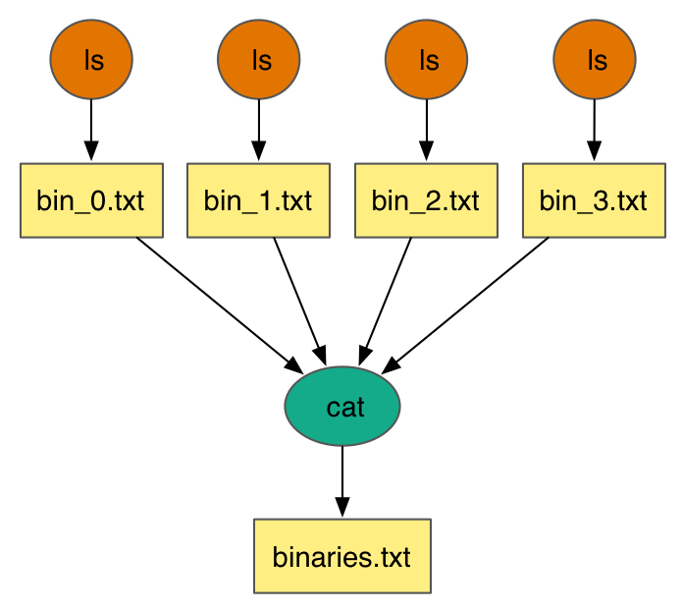
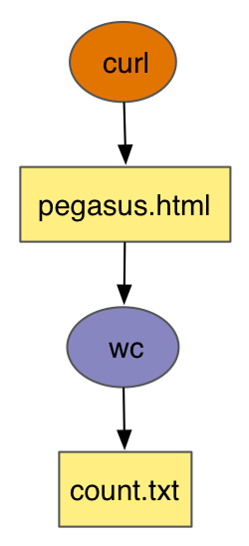
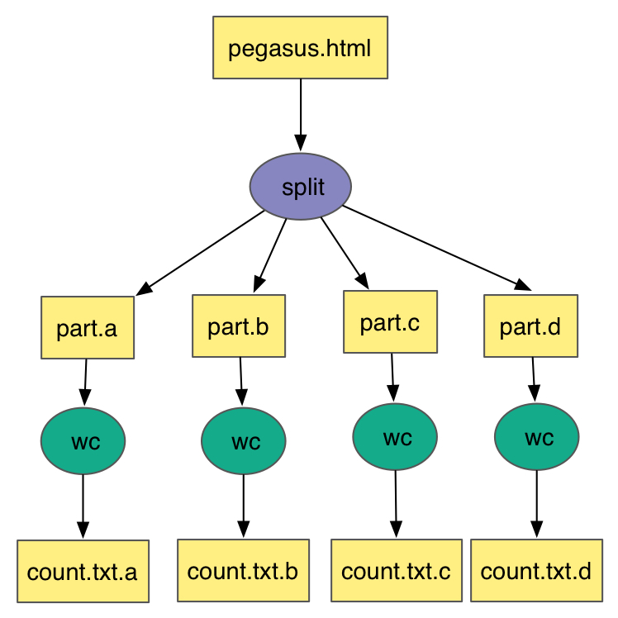
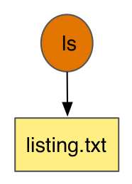
Simple Workflows – Building Blocks
Notes:
Simple Workflow constructs that serve as building workflows for more complex examples

Slide 9
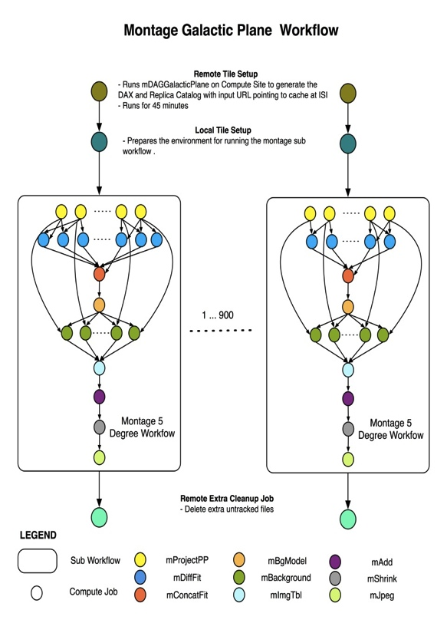

Complex Workflows
John Good (Caltech)
Montage Galactic Plane Workflow
18 million input images (~2.5 TB)
900 output images (2.5 GB each, 2.4 TB total)
10.5 million tasks (34,000 CPU hours)
Need to support hierarchical workflows and scale
× 17
Notes:
Here we have an example of montage galactic plane that leverages hierarchal workflows and is data intensive.
Runs on Amazon EC2.

Slide 10
Simple Steps to Run Pegasus
Specify your computation in terms of DAX
Write a simple DAX generator
Python, Java , Perl based API provided with Pegasus
Set up your catalogs
Replica catalog, transformation catalog and site catalog.
Plan and Submit your workflow
Use pegasus-plan to generate your executable workflow that is mapped onto the target resources and submits it for execution
Monitor and Analyze your workflow
Use pegasus-status | pegasus-analyzer to monitor the execution of your workflow
Workflow Statistics
Run pegasus-statistics to generate statistics about your workflow run.

Slide 11
Move to Hands on Tutorial

Slide 12
Agenda
10:00 – 12:00 Introduction and Tutorial on Pegasus
12:00 – 1:00 Lunch
1:00 – 3:00 Features addressing user problems
2:00 – 3:00 Getting Pegasus to your campus.
3:00 Adjourn

Slide 13
Agenda
10:00 – 12:00 Introduction and Tutorial on Pegasus
12:00 – 1:00 Lunch
1:00 – 2:00 Advanced features addressing user problems
2:00 – 3:00 Getting Pegasus to your campus.
3:00 Adjourn

Slide 14
More Information
Pegasus Website:
http://pegasus.isi.edu
Tutorial:
http://pegasus.isi.edu/wms/docs/latest/tutorial.php
Documentation:
http://pegasus.isi.edu/documentation
Support: pegasus-users@isi.edu pegasus-support@isi.edu
HipChat Support Room

