Slide 1
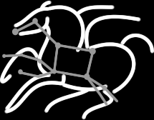
Pegasus on your Campus
Karan Vahi
Science Automation Technologies Group
USC Information Sciences Institute

Slide 2
Agenda
How do you identify if a particular application can use Workflows and Pegasus
Recap of Key Concepts
Setting up Pegasus on Campus
Porting Applications to Pegasus
Tutorials

Slide 3
Why Scientific Workflows?
Automate complex processing pipelines
Support parallel, distributed computations
Use existing codes, no or minimal rewrites
Relatively simple to construct
Reusable, aid reproducibility
Can be shared with others
Capture provenance of data
Notes:
There are a lot of reasons, here are just a few, the most important are probably automation, parallelization, and use of existing codes

Slide 4
Why is Pegasus a good candidate
Portability
How can you run a pipeline on Amazon EC2 one day, and a PBS cluster the next?
Data Management
How do you ship in the small/large amounts data required by your pipeline?
Different protocols for different sites: Can I use SRM? How about GridFTP? HTTP and Squid proxies?
Can I use Cloud based storage like S3 on EC2?
Debug and Monitor Computations.
Users need automated tools to go through the log files
Need to correlate data across lots of log files
Need to know what host a job ran on and how it was invoked
Restructure Pipelines for Improved Performance
Short running tasks?
Data placement?

Slide 5
Pegasus Workflows are Directed Acyclic Graphs
Nodes are tasks
Typically, executables with arguments
Nodes can also be other workflows
Edges are dependencies
Represent data flow
Can also be control dependencies
Pegasus can infer edges from data use
No loops, no branches
Recursion is possible
Can generate workflows in a workflow
Can conditionally skip tasks with wrapper
Notes:
What is DAGMan and what are its benefits? (throttling, retries, rescue DAGs, etc.)

Slide 6
Pegasus WMS Environment

Slide 7
Agenda
How do you identify if a particular application can use Workflows and Pegasus
Recap of Key Concepts
Setting up Pegasus on Campus
Porting Applications to Pegasus
Tutorials

Slide 8
Pegasus Workflow Management System (est. 2001)
Maps a resource-independent “abstract” workflow onto resources and executes the “executable” workflow
Benefits
Automation
Automates complex, multi-stage processing pipelines
Enables parallel, distributed computations
Automatically executes data transfers
Reusable portable description of workflows that aids reproducibility
Recovery
Automatic job retries
Ability to restart pipelines without repeating steps
Debug
Records how data was produced (provenance)
Simple easy to use command line tools for monitoring and debugging
Web Based Dashboard Available

Slide 9
Pegasus Workflow Management System
Abstract Workflows - Pegasus input workflow description
Workflow “high-level language”
Only identifies the computation, devoid of resource descriptions, devoid of data locations
File Aware
Pegasus is a workflow “compiler” (plan/map)
Target is DAGMan DAGs and Condor submit files
Transforms the workflow for performance and reliability
Automatically locates physical locations for both workflow components and data
Collects runtime provenance

Slide 10
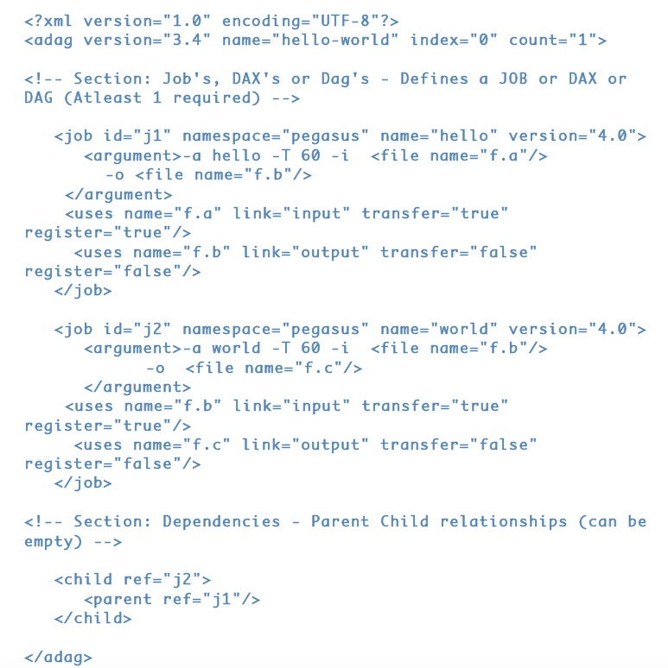
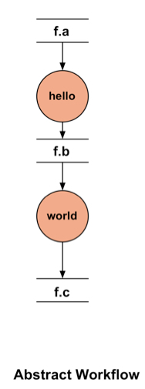
DAX – XML format to describe Abstract Workflows

Slide 11
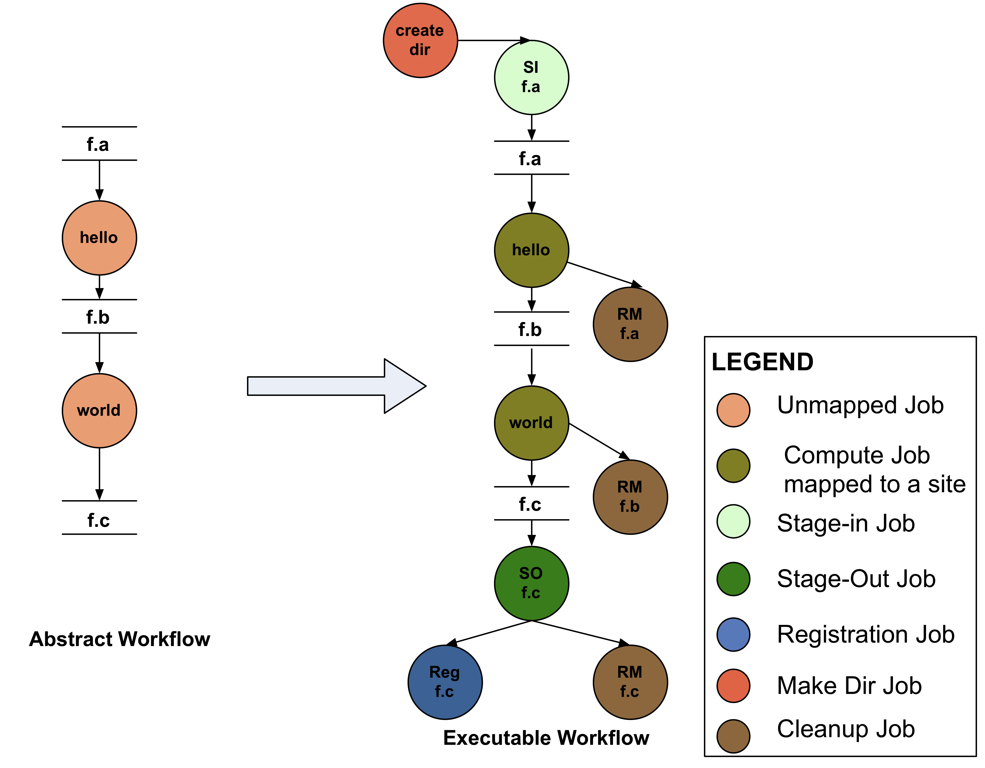
Abstract to Executable Workflow Mapping
Abstraction provides
Ease of Use (do not need to worry about low-level execution details)
Portability (can use the same workflow description to run on a number of resources and/or across them)
Gives opportunities for optimization and fault tolerance
automatically restructure the workflow
automatically provide fault recovery (retry, choose different resource)

Slide 12
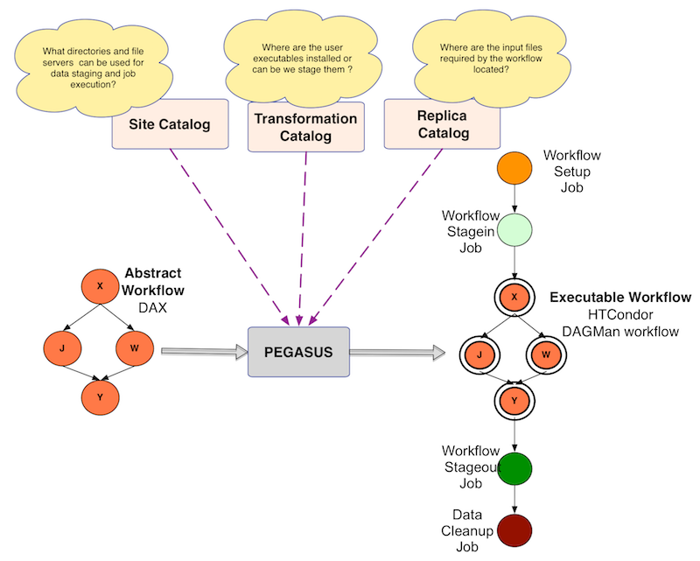
Abstract to Executable Workflow Mapping - Discovery

Slide 13
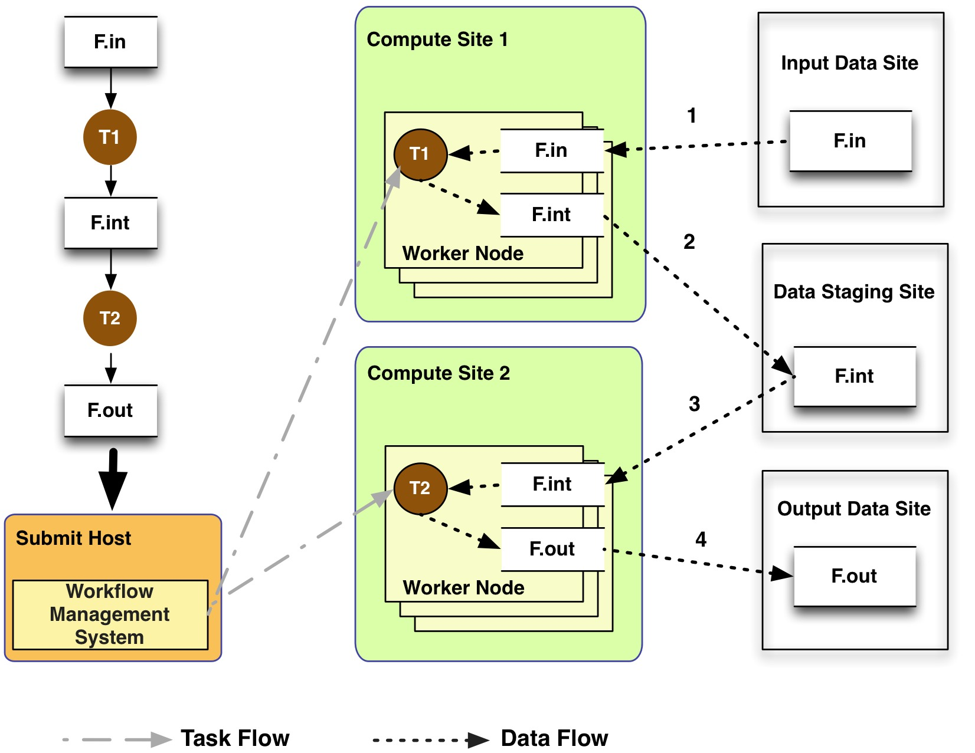
Data Management - General Workflow Execution Model
Most of the tasks in scientific workflow applications require POSIX file semantics
Each task in the workflow opens one or more input files
Read or write a portion of it and then close the file.
Data Staging Site can be the shared filesystem on the compute cluster!
Input Data Site, Compute Site and Output Data Sites can be co-located
Example: Input data is already present on the compute site.
Notes:
Remember to describe each type of site

Slide 14
Different Directories used by Pegasus
Submit Directory
The directory where pegasus-plan generates the executable workflow i.e HTCondor DAGMan and job submit files.
Specified by --dir option to pegasus-plan
Input Directory
Mostly input file locations are catalogued in the Replica Catalog.
However, if inputs are on the submit host, then you can pass –input-dir option to pegasus-plan
Scratch Directory
Workflow specific directory created on the staging site by the create-dir job. This is where all the workflow inputs and outputs are gathered.
The base directory specified in the site catalog entry in sites.xml file.
Output Directory
The output directory where the outputs of the workflow appear.
Specified in the output site entry in the sites.xml file.
Can also be optionally specified by –output-dir option to pegasus-plan

Slide 15
Supported Data Staging Approaches - I
Shared Filesystem setup (typical of XSEDE and HPC sites)
USC HPCC
Cluster
Worker nodes and the head node have a shared filesystem, usually a parallel filesystem with great I/O characteristics
Can leverage symlinking against existing datasets
Staging site is the shared-fs.
Compute Site
WN
Submit
Host
Shared
FS
WN
hpc-pegasus
Non-shared filesystem setup with staging site (typical of OSG and EC 2)
Worker nodes don’t share a filesystem.
Data is pulled from / pushed to the existing storage element.
A separate staging site such as S3.
Compute Site
Submit
Host
WN
Staging
Site
WN
Amazon
EC2 with S3
Jobs
Data
Notes:
Kent changed 080501 – removed periods

Slide 16
Supported Data Staging Approaches - II
Submit
Host
Condor IO ( Typical of large Condor Pools like CHTC)
Worker nodes don’t share a filesystem
Symlink against datasets available locally
Data is pulled from / pushed to the submit host via Condor file transfers
Staging site is the submit host.
Local FS
Jobs
Data
Compute Site
WN
WN
Supported Transfer Protocols
HTTP
SCP
GridFTP
IRODS
S3
Condor File IO
File Copy
Using Pegasus allows you to move from one deployment to another without changing the workflow description!

Slide 17
Agenda
How do you identify if a particular application can use Workflows and Pegasus
Recap of Key Concepts
Setting up Pegasus on your campus.
Porting Applications to Pegasus
Tutorials

Slide 18
Installation
Identify a workflow submit node.
Usually it is the submit node for your local campus cluster i.e PBS/SGE submit node
Usually installed as root
Preferred way is to install from RPM or DEB packages
Binary packages also available for download
https://pegasus.isi.edu/downloads
Installation Guide
https://pegasus.isi.edu/wms/docs/latest/installation.php
Requires HTCondor to be installed
Configured as personal condor if you just want to use the submit functionality

Slide 19
Pegasus Setup - Target execution environment
Identify the target execution environment
Local Campus Cluster (PBS/SGE)
Best way is to install on the PBS/SGE headnode and use the Glite functionality
https://pegasus.isi.edu/wms/docs/latest/glite.php
Remote Campus Cluster
Use BOSCO and SSH submissions
https://pegasus.isi.edu/wms/docs/latest/bosco_submission.php
Open Science Grid using GlideinWMS
https://pegasus.isi.edu/wms/docs/latest/open_science_grid.php
Other Options
https://pegasus.isi.edu/wms/docs/latest/execution_environments.php
Identify data management mode
Boils down to whether you are targeting a particular cluster and it has a shared filesystem
Most HPC systems do, such as those part of XSEDE
For OSG and CHTC condor pools with non shared fileystem, you can use the condorio mode

Slide 20
Pegasus Setup - HTCondor Pool
The easiest mode, no special configuration required
Profiles:
pegasus.style = condor
condor.universe = vanilla
Other condor.* profiles can be used in SC, TC, and DAX to set priority, rank, requirements and other Condor job attributes
<site handle=”condor" arch="x86_64" os="LINUX">
<profile namespace=“pegasus” key=“style”>condor</profile>
<profile namespace=“condor” key=“universe”>vanilla</profile>
</site>

Slide 21
Pegasus Setup - Local PBS/SGE Cluster
Pegasus can submit to local PBS clusters using Condor
Condor must be running on a machine that can call qsub, qstat, etc.
Condor uses glite to interface with PBS
Requires modifications to Condor configuration in /usr/libexec/condor/glite to add a script from /usr/share/pegasus/htcondor/glite
Similar approach for LSF and SGE
Profiles
pegasus.style = glite
condor.grid_resource = pbs
Other profiles can be used in TC and DAX to specify queue, wall time, nodes, cores, etc.
<site handle=”hpcc" arch="x86_64" os="LINUX">
<directory type="shared-scratch" path=”/staging/gmj/juve">
<file-server operation="all" url=”scp://juve@hpc-login2.usc.edu/staging/gmj/juve"/>
</directory>
<profile namespace="env" key="PEGASUS_HOME">/home/rcf-40/juve/pegasus-4.4.1</profile>
<profile namespace=“pegasus” key=“style”>glite</profile>
<profile namespace=“condor” key=“grid_resource”>pbs</profile>
<profile namespace=”pegasus" key=”change.dir">true</profile>
<profile namespace=“pegasus” key=“SSH_PRIVATE_KEY”>/home/gideon/.ssh/id_rsa</profile>
</site>

Slide 22
Pegasus Setup - Remote Cluster / Grid Site
Pegasus can submit jobs to remote sites via Globus GRAM
For example, GRAM is supported at NERSC
Authentication is via X.509, which can be very challenging
GRAM often requires debugging
Profiles
pegasus.style = globus (also the default for historical reasons)
globus.* profiles can be used to set queue, account, max wall time, count, hostcount, etc
<site handle="hopper" arch="x86_64" os="LINUX">
<grid type="gt5" contact="hoppergrid.nersc.gov/jobmanager" scheduler="Fork" jobtype="auxillary"/>
<grid type="gt5" contact="hoppergrid.nersc.gov/jobmanager-pbs" scheduler="PBS" jobtype="compute"/>
<directory type="shared-scratch" path="/scratch/scratchdirs/juve">
<file-server operation="all" url="gsiftp://hoppergrid.nersc.gov/scratch/scratchdirs/juve"/>
</directory>
<profile namespace="env" key="PEGASUS_HOME">/project/projectdirs/m1503/pegasus/pegasus-4.4.0</profile>
<profile namespace="globus" key="project">m1503</profile>
<profile namespace="globus" key="queue">regular</profile>
</site>

Slide 23
Pegasus Setup
All these topics are documented in the user guide
https://pegasus.isi.edu → Documentation → User Guide
Example Site Catalogs
https://pegasus.isi.edu/wms/docs/latest/execution_environments.php
There are many examples in the User Guide and in /usr/share/pegasus/examples

Slide 24
Agenda
How do you identify if a particular application can use Workflows and Pegasus
Recap of Key Concepts
Setting up Pegasus on your campus.
Porting Applications to Pegasus
Tutorials

Slide 25
Simple Steps to Port Applications to Pegasus
Identify the workflow structure template
Sketch or draw the pipeline structure
Identify key components/codes
Specify your computation in terms of DAX
Write a simple DAX generator
Python, Java , Perl based API provided with Pegasus
Set up your catalogs
Replica catalog, transformation catalog and site catalog.
Plan and Submit your workflow
Use pegasus-plan to generate your executable workflow that is mapped onto the target resources and submits it for execution
Monitor and Analyze your workflow
Use pegasus-status | pegasus-analyzer to monitor the execution of your workflow
Workflow Statistics
Run pegasus-statistics to generate statistics about your workflow run.

Slide 26
Things to keep in mind while porting application codes
Often as part of workflow jobs run on remote nodes
However, when users initially code
They assume everything runs on their desktop
Have hardcoded paths, often in the wrapper scripts
Pegasus data management is based on unique filenames
Jobs as part of the same workflow can run in the same directory
Make sure jobs in a workflow generate unique filenames
Other Tips for writing Portable Code
https://pegasus.isi.edu/wms/docs/latest/portable_code.php

Slide 27
Tutorials
If you want to give Pegasus Tutorial on your campus
Pegasus Tutorial available in a Virtual Machine
Each Pegasus Release as VM tutorial that can be executed in Virtual Box
Amazon EC2 image also published
https://pegasus.isi.edu/wms/docs/latest/tutorial.php
Content similar to what we did today
OR
You can setup the tutorial on your submit machine
Fork from GitHub today’s tutorial
https://github.com/pegasus-isi/tutorials/tree/master/ISI
You will need to create training accounts
And do minor changes to configuration files
With Pegasus 4.6 Release will be easier

Slide 28
Pegasus Teaching Materials
General Overview of Pegasus
https://github.com/pegasus-isi/tutorials/blob/master/ISI/training/Pegasus-Introduction.pptx
Advanced Features of Pegasus
https://github.com/pegasus-isi/tutorials/blob/master/ISI/training/Pegasus-Advanced.pptx
This presentation itself
https://github.com/pegasus-isi/tutorials/blob/master/ISI/training/Pegasus-ACI-Refs.pptx

Slide 29
More Information
Pegasus Website:
http://pegasus.isi.edu
Tutorial:
http://pegasus.isi.edu/wms/docs/latest/tutorial.php
Documentation:
http://pegasus.isi.edu/documentation
Support: pegasus-users@isi.edu pegasus-support@isi.edu
HipChat Support Room

