Slide 1
VTI Application Function List
Launch the application
Publish an event
Follow or Unfollow an VTI Twitter Account
Subscribe to a route
Vote received notifications

Slide 2
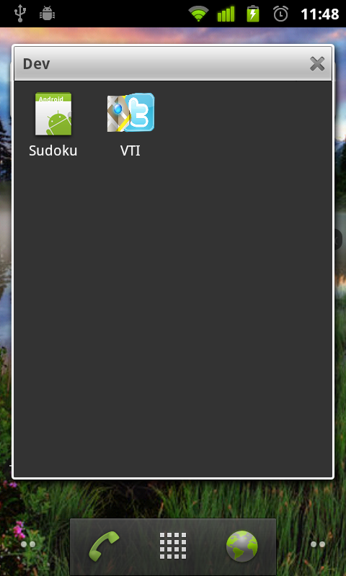
Launch the Application
Click on the “VTI” icon
Notes:
Topic-Based: NNTP

Slide 3
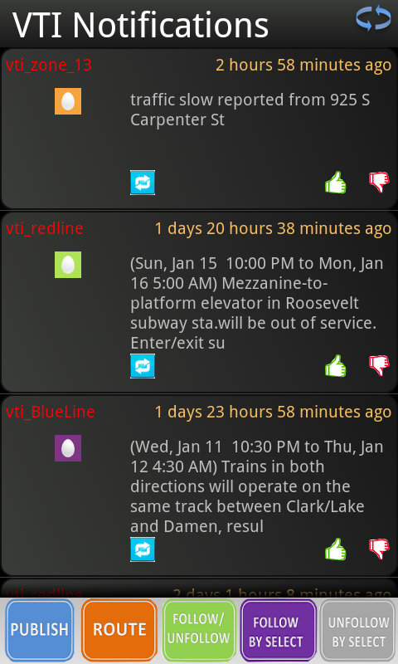
Home View
Notification list
Notes:
Topic-Based: NNTP

Slide 4
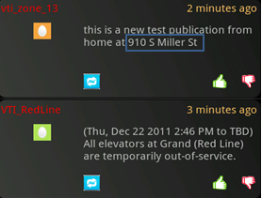
Home View
VTI Zone Accounts
When this publication is created
Where this publication is created (this info. is automatically appended by VTI)
VTI Train Routes Accounts
Notes:
Topic-Based: NNTP

Slide 5
How to Vote
Click “thumb” buttons to vote up or down a particular notification
Notes:
Topic-Based: NNTP

Slide 6
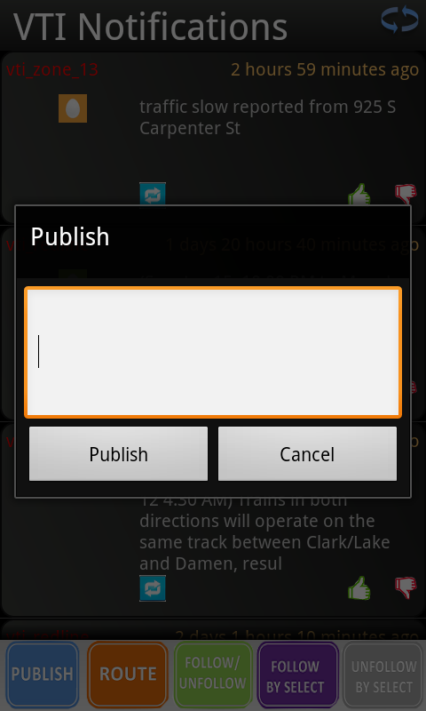
How to Publish
Click the button (or click the row for 1 second) to publish by editing a received notification
Click “publish” button to publish by inputing a new message
Notes:
Topic-Based: NNTP

Slide 7
How to Follow/Unfollow
click “follow/unfollow” button to follow/unfollow specified VTI Twitter accounts
click “follow/unfollow by select” button to select follow/unfollow accounts
Notes:
Topic-Based: NNTP

Slide 8
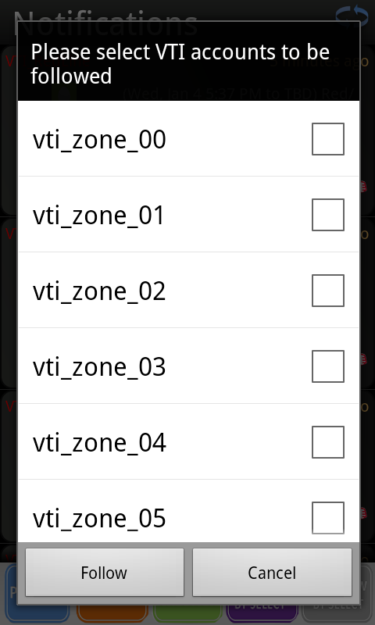
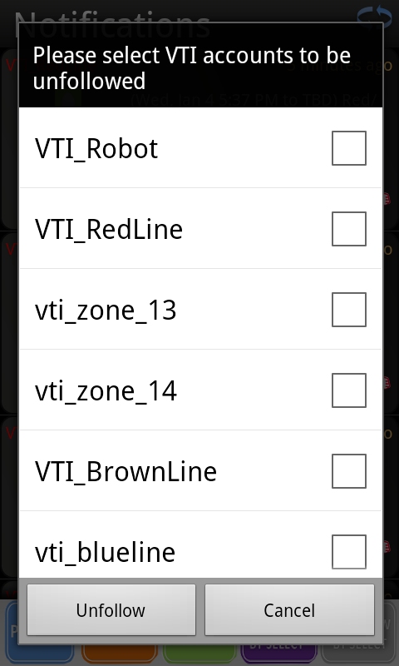
How to Follow/Unfollow
Follow By Select Unfollow By Select
Notes:
Topic-Based: NNTP

Slide 9
How to Subscribe a Route
click “route” button to subscribe route
Notes:
Topic-Based: NNTP

Slide 10
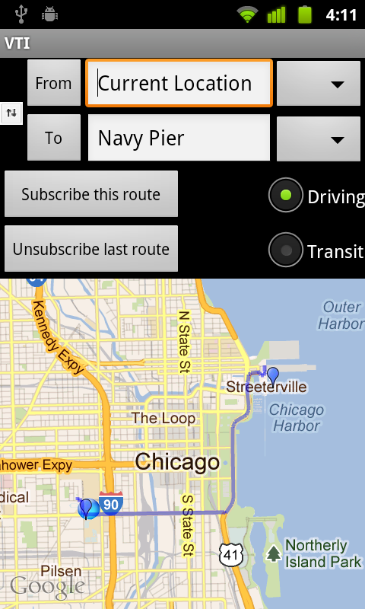
How to Subscribe a Route
Click to select from old inputs
Click to choose transportation mode
Subscribed route shown on the map
Blue glittering dot indicates current location
Notes:
Topic-Based: NNTP

Slide 11
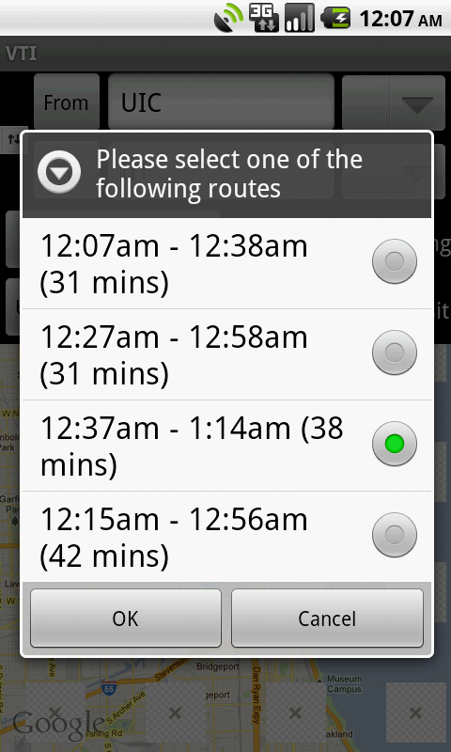
How to Subscribe a Route
Select a transit route
Notes:
Topic-Based: NNTP

Slide 12
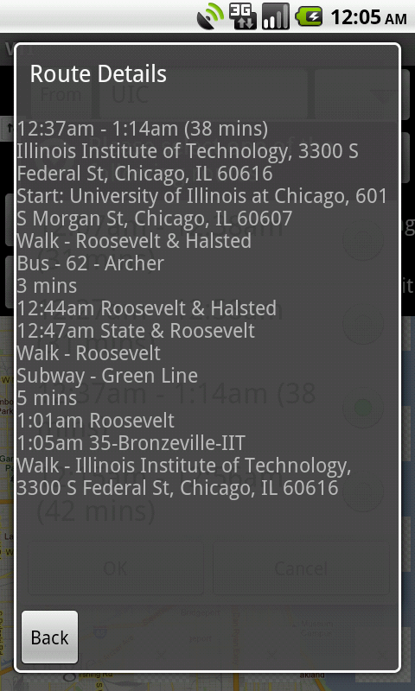
How to Subscribe a Route
Details of selected transit route
Notes:
Topic-Based: NNTP

