Slide 1

Data science laboratory (DSLAB) Feedback on assignment Module #1
Data Science Lab – Spring 2018

Slide 2
Grades were communicated
Grades were posted to your GitLab group
Make sure your name is listed under group members
All group members receive the same group grade
If you don’t see your name or if your grade wasn’t posted to your GitLab, please contact us ASAP

Slide 3
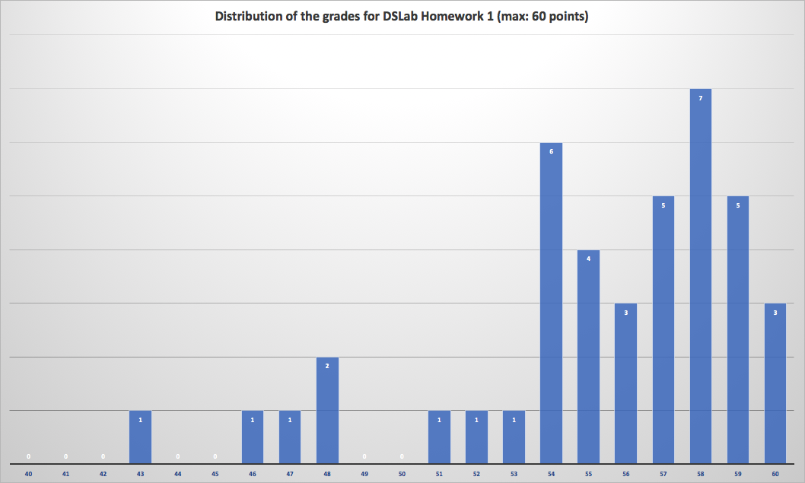
Distribution of the grades

Slide 4
Common issues
Part I: Overall well-done. csv files were sometimes missing
Part II: Some issues with II.A (CO2, altitude plot)
Only one point (median) for site is required
Part III: Common issues:
III.a: The ‘ZSBN’ station was left out of the training phase
III.a: Divided the data into training (before 24.10) and testing (after 24.10)
III.b/c: The `faulty’ station was left out of the training phase
III.b/c: Zone clusters were ignored
III.b/c: The linear model corresponding to one temporal cluster was used to correct the measurements of the entire month

Slide 5
General comments (ignored in the grading… for now)
Clean your code before submitting:
Avoid unnecessary prints
Remove cells that are not required for your response
Add comments
Don’t forget axis labels/legends

