Slide 1

Data science laboratory (DSLAB)
Eric Bouillet
Swiss Data Science Center
EPFL & ETH Zurich
Data Science Lab – Spring 2018

Slide 2
Start your engines!
Head over to the course webpage
https://dslab2018.github.io/
Configure & Run Oracle VirtualBox
Download, configure & start the DSLab VM
Ubuntu linux
Anaconda (Python 3), git, Docker/ pySpark, pyCharm
{username: student, password: student}
If you want to try the big data platform at home
Download, configure & start the HDP (not HDF) Sandbox
https://hortonworks.com/downloads/#sandbox (registration required)
You can choose between the VM for VirtualBox or Docker
Notes:
There are office hours on Fridays for the graded projects
974789e900b5ad11be069b30f7f770b4bb0e1c35 HDP_2.6.4_virtualbox_01_02_2018_1428.ova

Slide 3
Solutions to Week #5
https://raw.githubusercontent.com/dslab2018/dslab2018.github.io/master/notebooks/DSLab_week5_Hive_Exercises.json
Any questions?

Slide 4

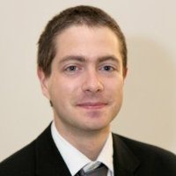


Today’s lab week #6 Graded Homework
Week 3
Week 4
Weeks 1 & 2

Slide 5
This week’s exercises
Get the DSLab Week 6 exercise instructions:
https://github.com/dslab2018/dslab2018.github.io/tree/master/labs/week6
Communications:
https://mattermost-dslab.epfl.ch
Remember we have office hours on Fridays for the graded projects

