Slide 1
Chapter 1: Introduction
Source: CN5E by Tanenbaum & Wetherall, © Pearson Education-Prentice Hall and D. Wetherall, 2011
COSC 439: Computing Network Principles

Slide 2
Chapter 1 Focuses on:
Introduction to Data Communication
Network Classifications
Network Topologies
Standardization Organizations
Forum
OSI Reference Model
COSC 439: Computing Network Principles
Notes:
This chapter covers materials that introduces terminologies as well as the various organizations involved in the development and/or standardization of the different network protocols currently in use.
→ Next slide

Slide 3
Definitions:
Data communication: The exchange of data between two devices via some form of transmission medium.
COSC 439: Computing Network Principles
Notes:
The two devices exchanging data are referred to as nodes and the transmission media used is referred to a transmission links.
→ Next Slide

Slide 4
Five components of a data communication system:
Message
Sender
Receiver
Medium
Protocol
COSC 439: Computing Network Principles
Notes:
The exchange of information between the two nodes includes 5 components:
Message: the information to be exchanged
Sender: the source node
Receiver: the destination node
Medium: transmission link used. This could be in the form of some cables (twisted pair wires, coaxial cable) or wireless media.
Protocol: the process followed by both sender and receiver, in order to allow for correct transmission on the information. This includes the format of the message, how the source and destination nodes are identified, routing, error detection/correction, etc.
In this course, we will be covering the various protocols currently used in computing communications and networking.
→ Next Slide

Slide 5
Definition: Computer networks
Collections of autonomous computers, e.g., the internet.
COSC 439: Computing Network Principles
Notes:
A computer network should have at least 2 nodes and one media link connecting the nodes.
Contrast computer networks with distributed systems, in which a model on top of the network is used to present the independent computers to users as a single coherent system, e.g., the Web.
→ Next Slide

Slide 6
Some Underlying Activities
Generation of digital signal
Conversion from digital to analog
Addressing
Routing
Error detection and correction
Congestion control
Security
Message compatibility
COSC 439: Computing Network Principles
Notes:
Various activities have to be performed in order for a message sent from a source node to correctly arrive at the destination node. For example, if you want to send an email message to someone from your laptop using a WiFi connection, the first thing you would do is to type the message through your keyboard. This process of entering the message through the keyboard creates a corresponding digital form of the message. When you send the message, the computer will then generate the corresponding digital signals which will then be converted to analog signals for transmission through the air. In addition, the address of the email server you are sending your message to, has to be translated and the best route to get there also has to be determined. As the message arrives at its destination, various error detection and/or correction techniques may have been applied along the way. Also, the message may have been encrypted/decrypted for security purposes. As the message arrives at the destination, its format may be checked for compatibility.
We will be covering various examples of protocols associated with digital signal generation, digital to analog conversion techniques and vise versa, addressing protocols, routing protocols, error detection/correction techniques, and congestion control. We will not be covering security (encryption/decryption) techniques in this course since we offer a course specifically on this topic.
→ Next Slide

Slide 7
Network Hardware: Network Classifications based on Scale
PANs (personal area networks)
  Typically over the range of a person
  Example: Bluetooth
LANs (local area networks)
  Typically connect devices in a home or office building
  Usually shares the transmission media
  Examples: Ethernet, WiFi
MANs (metropolitan area networks)
  Typically spans tens of kilometers
  Example: DQDB (distributed queue dual bus)
WANs (wide area networks)
  Could extend worldwide
  Point-to-point, store-and-forward, or packet switched
COSC 439: Computing Network Principles
Notes:
Let’s continue with learning the terminologies:
Local area networks or LANs are the type of network you would normally see in an organization which uses several nodes from the same location. This typically means that the nodes share the transmission media to connect to the rest of the Internet. Otherwise, it becomes very expensive to maintain a dedicated link between each pair of machine within the organization. (More on this in the next slide on Network Topologies.)
Metropolitan area networks or MANs allow for a dedicated network for an organization spanning a city to maintain. It could be used as a second level connectivity, which means that various LANs could be attached as individual nodes to a MAN.
Wide area networks or WANs are typically used as a backbone to connect various types of networks. A network that uses the TCP/IP protocol suite is an example of a WAN.
→ Next Slide

Slide 8
OSI Layers
7. Application: provides email, file transfers, and other user services
6. Presentation: translates data formats, encrypts and decrypts data
5. Session: synchronizes communicating users, recovers from errors, and brackets operations
4. Transport: determines network, may disassemble and reassemble packets
3. Network: determines routes, manages billing information
2. Data link: detects or corrects errotr, defined frames
1. Physical: transmits physical data
COSC 439: Computing Network Principles
Notes:
The Open Systems Interconnect (OSI) model is a set of protocols defined by the International Organization for Standardization (ISO) that would allow any two different systems to communicate regardless of their underlying architecture. Although the model has not been commercially implemented, it is used as a model for understanding the various communication protocols currently in use and how they relate to each other.
The OSI models consists of 7 layers, where each layer performs specific functions and communicates with the layers directly above and below it. The purpose of layering is to make their implementation transparent to other components, thereby allowing for independent design and testing of each component.
→ Next Slide

Slide 9
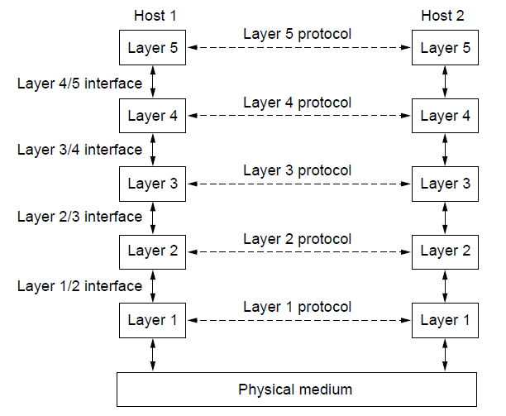
Protocol Layers
Protocol layering is the main structuring method used to divide up network functionality.
Each protocol instance talks virtually to its peer
Each layer communicates only by using the one below
Lower layer services are accessed by an interface
At bottom, messages are carried by the medium
CN5E by Tanenbaum & Wetherall, © Pearson Education-Prentice Hall and D. Wetherall, 2011

Slide 10
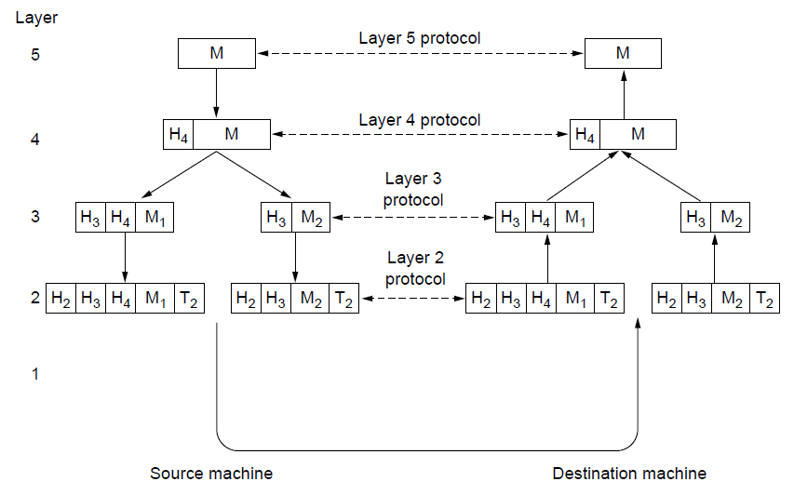
Protocol Layers
Each lower layer adds its own header (with control information) to the message to transmit and removes it on receive
Layers may also split and join messages, etc.
CN5E by Tanenbaum & Wetherall, © Pearson Education-Prentice Hall and D. Wetherall, 2011

Slide 11
Design Issues for the Layers
Each layer solves a particular problem but must include mechanisms to address a set of recurring design issues
Issue | Example mechanisms at different layers
Reliability despite failures | Codes for error detection/correction (§3.2, 3.3) Routing around failures (§5.2)
Network growth and evolution | Addressing (§5.6) and naming (§7.1) Protocol layering (§1.3)
Allocation of resources like bandwidth | Multiple access (§4.2) Congestion control (§5.3, 6.3)
Security against various threats | Confidentiality of messages (§8.2, 8.6) Authentication of communicating parties (§8.7)
CN5E by Tanenbaum & Wetherall, © Pearson Education-Prentice Hall and D. Wetherall, 2011
Notes:
The point is that there are some issues that are not wholly the responsibility of any one layer, and they crop up again and again in the text. For example, reliability is often considered a key function of the transport layer (i.e., making transport reliable) yet reliability mechanisms also appear in other layers (error codes in the link layer, routing around failures in the network layer, and replication at the application layer).

Slide 12
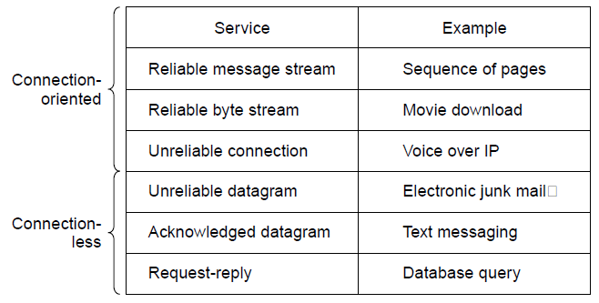
Connection-Oriented vs. Connectionless
Service provided by a layer may be either:
  Connection-oriented, must be set up for ongoing use (and torn down after use), e.g., phone call
  Connectionless, messages are handled separately, e.g., postal delivery
CN5E by Tanenbaum & Wetherall, © Pearson Education-Prentice Hall and D. Wetherall, 2011
Notes:
TCP provides a reliable bytestream service at the Transport layer, IP provides unreliable datagram service at the Network layer.
More examples: RTP (used to carry VoIP data) provides unreliable connection service; 802.11 (WiFi) provides acknowledged datagram service; Ethernet provides unreliable datagram service.

Slide 13
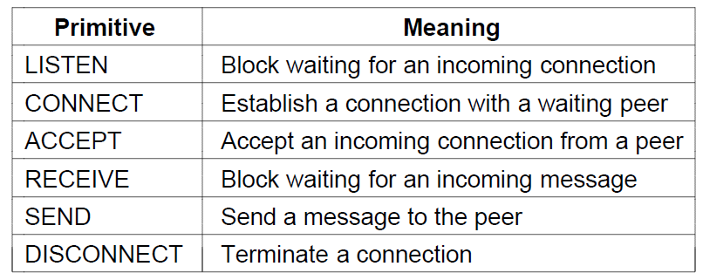
Service Primitives (1)
A service is provided to the layer above as primitives
Hypothetical example of service primitives that may provide a reliable byte stream (connection-oriented) service:
CN5E by Tanenbaum & Wetherall, © Pearson Education-Prentice Hall and D. Wetherall, 2011

Slide 14
Service Primitives (2)
Hypothetical example of how these primitives may be used for a client-server interaction
Client
Server
LISTEN (0)
CONNECT (1)
Connect request
ACCEPT
(2)
Accept response
RECEIVE
SEND
Request for data
(3)
RECEIVE
SEND (4)
Reply
DISCONNECT (5)
Disconnect
DISCONNECT (6)
Disconnect
CN5E by Tanenbaum & Wetherall, © Pearson Education-Prentice Hall and D. Wetherall, 2011
Notes:
The primitives are called at the client and server by the higher layer using the service. The layer implements the primitives by sending messages using the services of the lower layer; these messages are assumed to be reliable for simplicity and the lower layer service is not otherwise described.
This is similar to the way that simple Web browsers and Web servers work today.

Slide 15
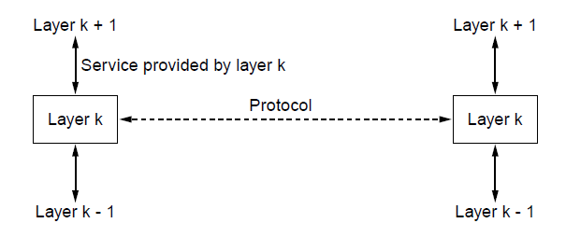
Relationship of Services to Protocols
  A layer provides a service to the one above [vertical]
  A layer talks to its peer using a protocol [horizontal]
CN5E by Tanenbaum & Wetherall, © Pearson Education-Prentice Hall and D. Wetherall, 2011

Slide 16
Reference Models
Reference models describe the layers in a network architecture
  OSI reference model »
  TCP/IP reference model »
CN5E by Tanenbaum & Wetherall, © Pearson Education-Prentice Hall and D. Wetherall, 2011

Slide 17
OSI Reference Model
Layer 1: Physical Layer
  concerned with transmission of unstructured bit stream over physical medium
  deals with the mechanical, electrical, functional, and procedural characteristics to access the physical medium
  twisted pair, coaxial cable, fiber optic cables, microwave, etc.
COSC 439: Computing Network Principles
Notes:
The physical layer is responsible for the representation of a bit over a transmission medium. The bit may take the form of an analog or a digital signal, propagated over a cable or over the air.
→ Next Slide

Slide 18
OSI Reference Model
Layer 2: Data Link Layer
  provides for reliable transfer of information across the physical link
  sends blocks of data (frames) with the necessary synchronization, error control, and flow control
  Contention schemes: collision detection, token passing
  Layer 2 protocols: stop-and-wait, sliding window, go-back-N
  MAC protocols: Ethernet, token bus, token ring, FDDI, DQDB, etc.
COSC 439: Computing Network Principles
Notes:
→ Next Slide

Slide 19
OSI Reference Model
Layer 3: Network Layer
  provides upper layers with independence from the data transmission and switching technologies used to connect systems
  Internet Protocol (IP), IPX
COSC 439: Computing Network Principles
Notes:
→ Next Slide

Slide 20
OSI Reference Model
Layer 4: Transport Layer
  provides reliable, transparent transfer of data between end points
  Multiplexing, buffering, and connection management
  Transport Control Protocol (TCP), User Data Protocol (UDP), SPX
COSC 439: Computing Network Principles
Notes:
→ Next Slide

Slide 21
OSI Reference Model
Layer 5: Session Layer
  provides the control structure for communication between applications
  establishes, manages, and terminates connections (sessions) between cooperating applications
COSC 439: Computing Network Principles
Notes:
→ Next Slide

Slide 22
OSI Reference Model
Layer 6: Presentation Layer
  provides independence to the application processes from differences in data representation (syntax)
COSC 439: Computing Network Principles
Notes:
→ Next Slide

Slide 23
OSI Reference Model
Layer 7: Application Layer
  provides access to the OSI environment for users and also provides distributed information services
  security, FTP, telnet, rsh, etc.
COSC 439: Computing Network Principles
Notes:
→ Next Slide

Slide 24
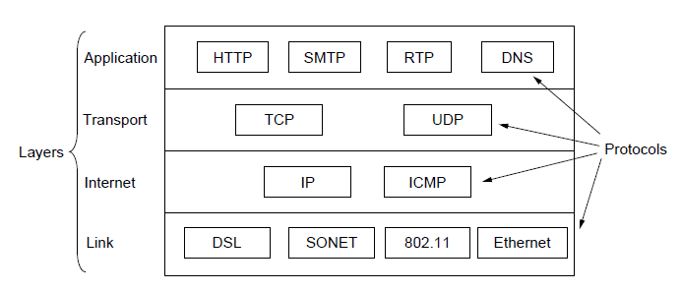
TCP/IP Reference Model
A four layer model derived from experimentation; omits some OSI layers and uses the IP as the network layer.
IP is the “narrow waist” of the Internet
Protocols are shown in their respective layers
CN5E by Tanenbaum & Wetherall, © Pearson Education-Prentice Hall and D. Wetherall, 2011
Notes:
The comment about the narrow waist refers to the fact that the network layer of the Internet is IP (Internet Protocol) such that the network layer is called the “Internet” layer. The significance is that all Internet devices speak IP, which provides a point of interoperability that enables innovation both above (new applications and transports) and below (new link technologies).

Slide 25
Standardization Organizations
International Telecommunication Union Telecommunications Standardization Sector (ITU)
  Examples: X-series, V-series
Institute of Electrical & Electronics Engineers (IEEE)
  largest national professional group involved in developing standards for computing, communication, electrical engineering, and electronics such as the Project 802
Internet Engineering Task Force (IETF)
  Examples: HTTP/1.1, DNS
World Wide Web Consortium (W3C)
  Examples: HTML 5 standard, CSS standard
COSC 439: Computing Network Principles
Notes:
The slide shows various standardization organizations involved in the development of various aspects of computer communications and networking.

Slide 26
Summary
Chapter 1 has focused on
  Introduction to Data Communication
  Network Classifications
  Protocol Layers
  Reference Models
  Connection Strategies
  Standardization Organizations
COSC 439: Computing Network Principles
Notes:
→ Next Slide

Slide 27
Reading Assignment
Chapter 2: The Physical Layer
COSC 439: Computing Network Principles

