Slide 1
Efficient Optimization of Partition Scan Statistics via the Consecutive Partitions Property
Charles A. Pehlivanian, Ph.D.¹
Daniel B. Neill, Ph.D.²
¹New York, NY
²New York University
July 22, 2021
charles.a.pehlivanian@jpmchase.com
pehlivaniancharles@gmail.com

Slide 2
Summary
Partition scan statistics – moving from t = 2 to t>= 2, formulation of problem as combinatorial optimization over size t partitions
Derivation of partition scan statistics objective functions for t >= 2
  Risk partitioning objective
  Multiple clustering objective
Derivation of partition scan statistics objective functions for exponential familes
  Risk partitioning objective as f-divergence
  Multiple clustering objective as Bregman divergence
Solution methods, dynamic programming approach
Simulation results
Future directions

Slide 3
Partition Scan Statistics – Motivation
Existing approaches to pattern and event detection using scan statistics can be thought of as partitioning a dataset into 2 disjoint sets – the detected set and the remainder.
  [Kulldorff, 1997]: Spatial scan statistic, “population-based”, splits data into a detected cluster with risk q_in, and remainder with risk q_out, q_in > q_out. Call this “risk partitioning”.
  [Neill, 2005]: Expectation-based scan statistic, detected cluster has risk q_in > 1, remainder cluster has risk q = 1. Call this “cluster detection”.
Our work expands both of these ideas (risk partitioning and cluster detection) to the case of more that two subsets of interest, while maintaining above results as special cases.
  Multiple risk partitioning
  Multiple cluster detection

Slide 4
Partition Scan Statistics – Motivation
The Kulldorff approach scans exhaustively over circular subregions of the data (O(n^2) in operations), although this does not provide flexibility for detecting irregularly-shaped clusters.
“Fast subset scanning” approaches starting with Neill (2012) allow irregular clusters by solving unconstrained optimization problem in linear time, the “fast subset scanning” approach.
Holds for objective functions satisfying the LTSS (Linear Time Subset Scanning) property. This property can be used as a building block for some constrained optimization problems – spatial cluster detection, pattern detection on graphs, etc.
LTSS approach: After sorting the data by an appropriate priority function, the top-performing subset is the set of top k elements, for some k. Just examine all the k’s between 1 and n.
We show the LTSS property can be generalized to partitions of the data.

Slide 5
Partition Scan Statistics – Motivation
Consecutive Partitions Property (CPP): After sorting the data by an appropriate priority function, the optimal partitioning of the data consists of sets of consecutively-ranked items.
We will provide sufficient conditions for which CPP and similar properties hold.
For n = number of data points, t = number of subsets in partition, the CPP translates to an O(n^(t-1)) algorithm for finding optimal partitions. We will explain a dynamic programming approach which runs in (O((n^2)t)) time, for all n regardless of t, allowing for consideration of large-scaled problems.

Slide 6

Partition Scan Statistics – Motivation
Bell_n_k(50, 8) 3.504173e+40
Bell_n_k(100, 8)
5.052108e+85
.
.
.
NYC census tract data: n=2089, t=8.

Slide 7
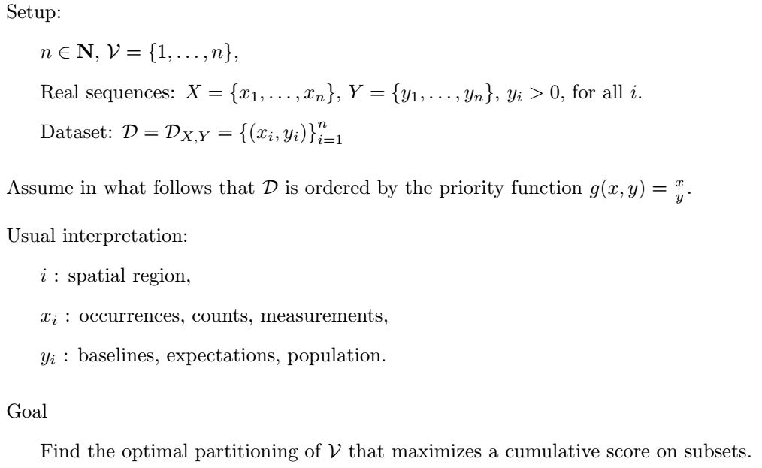
Partition Scan Statistics – Preliminaries

Slide 8
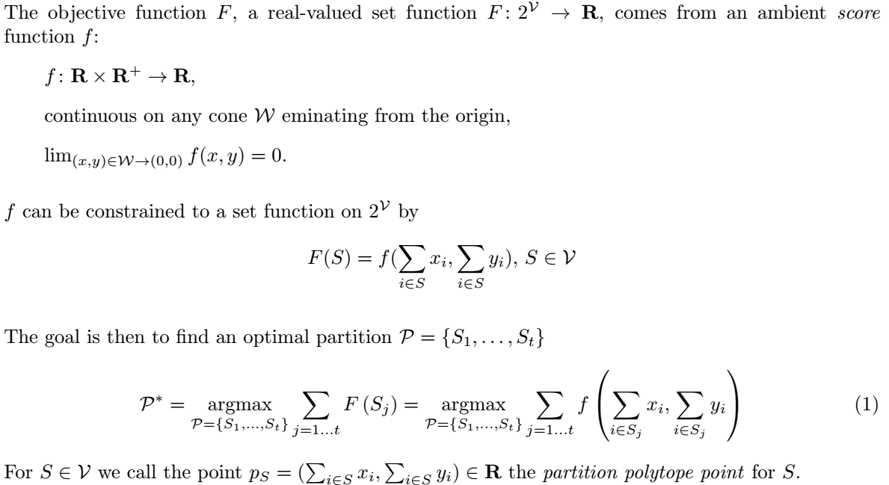
Partition Scan Statistics – Risk Partitioning

Slide 9
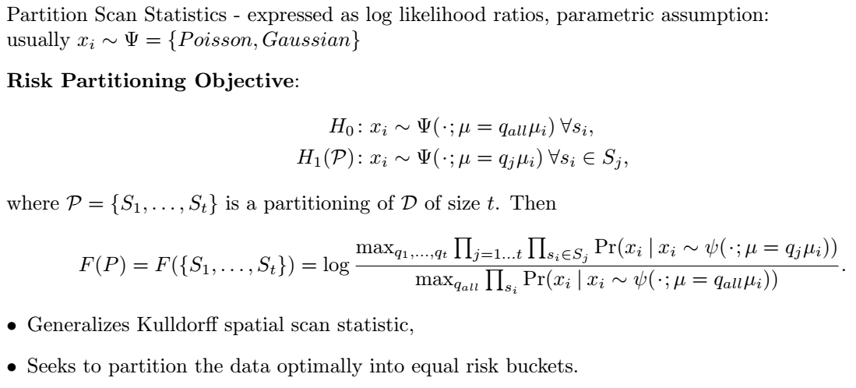
Partition Scan Statistics – Risk Partitioning

Slide 10
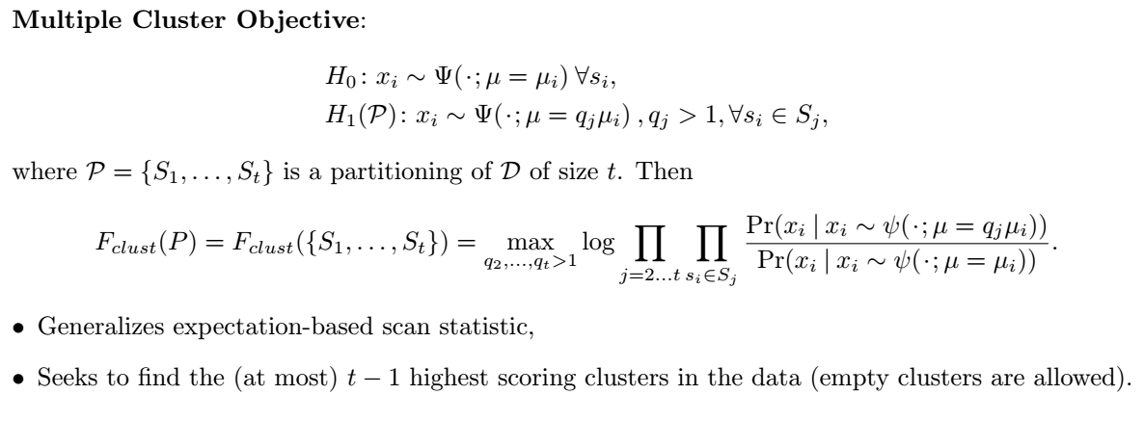
Partition Scan Statistics – Multiple Clustering

Slide 11
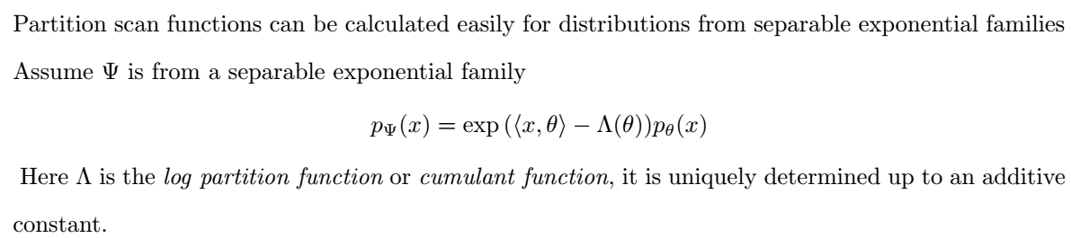
Partition Scan Statistics – Exponential Families

Slide 12
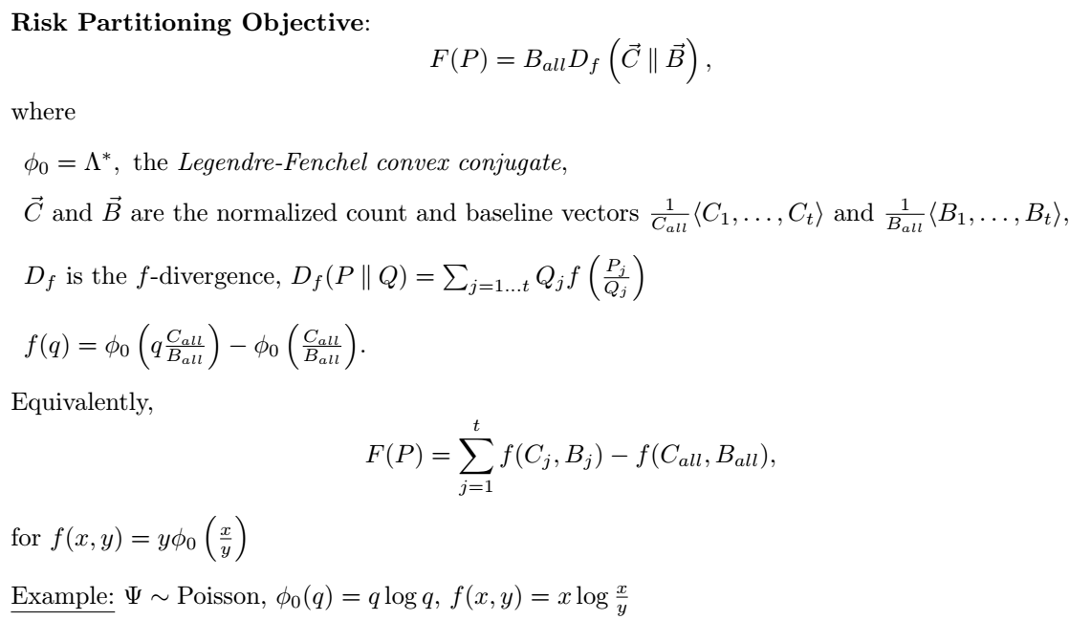
Partition Scan Statistics – Risk Partitioning Score Function for Exponential Families

Slide 13
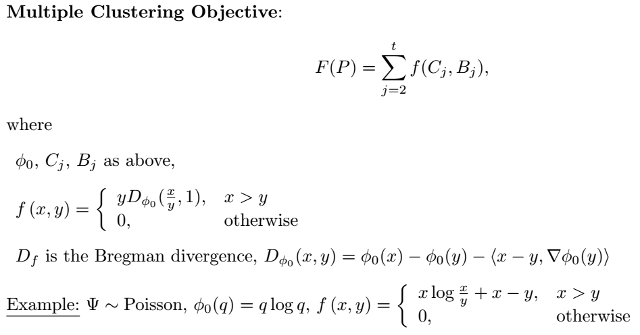
Partition Scan Statistics – Multiple Clustering Score Function for Exponential Families

Slide 14
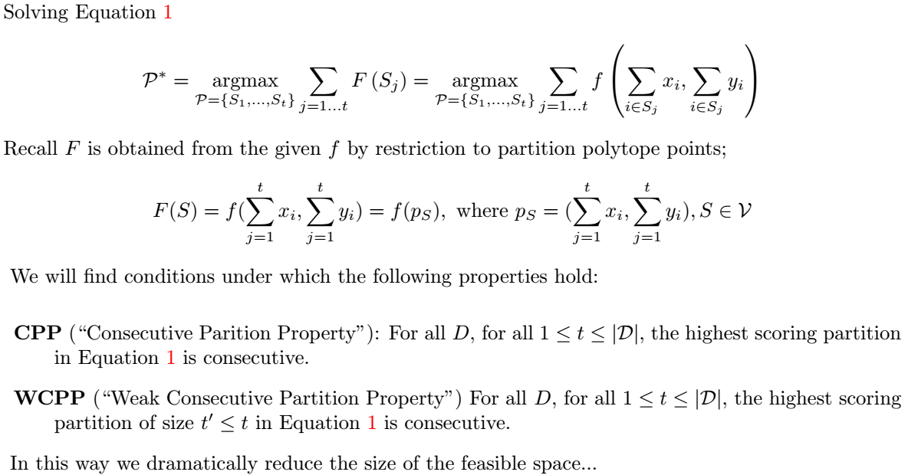
Solving for the Maximal Partition

Slide 15
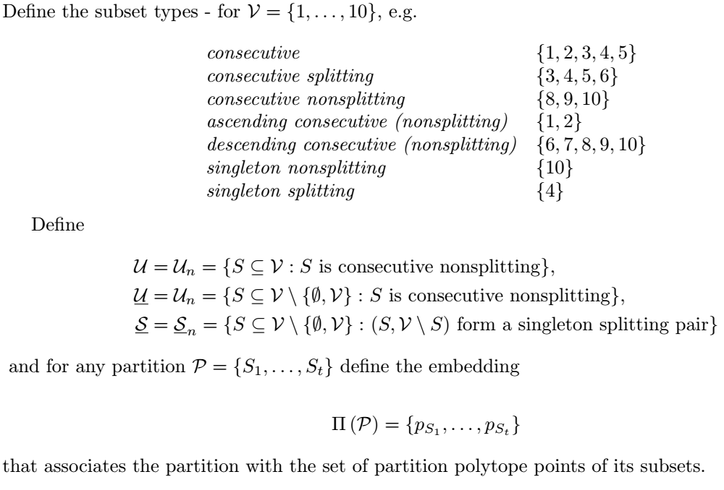
Solving for the Maximal Partition – Notion of Consecutive Partitions

Slide 16
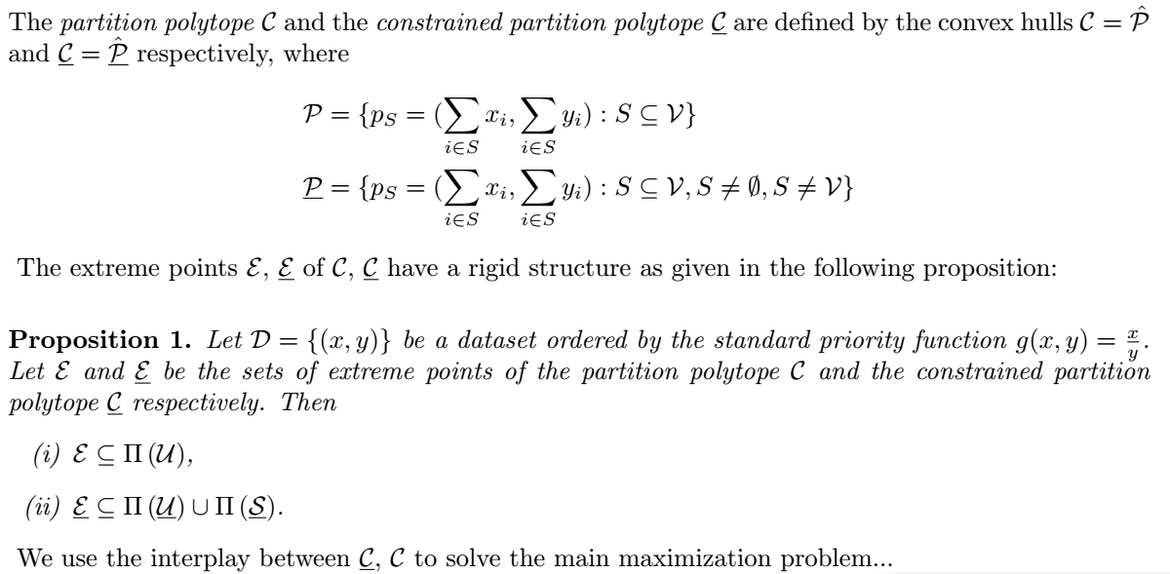
Solving for the Maximal Partition – Description of Partition Polytope

Slide 17
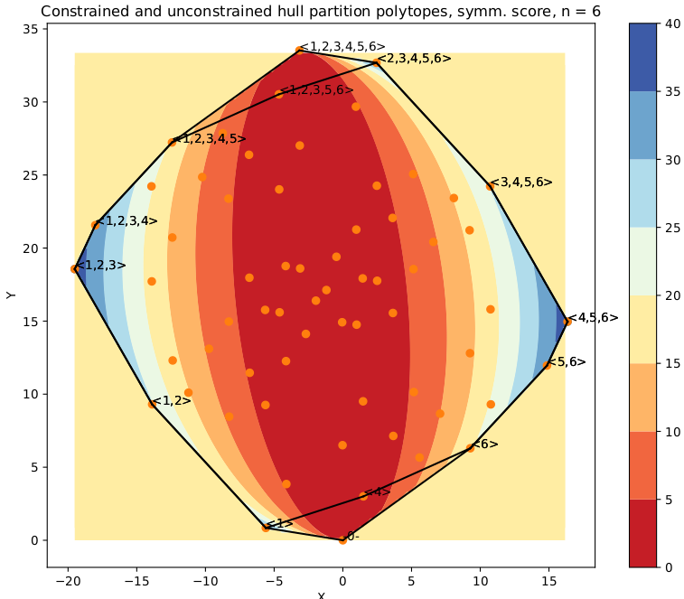
Solving for the Maximal Partition – Description of Partition Polytope

Slide 18
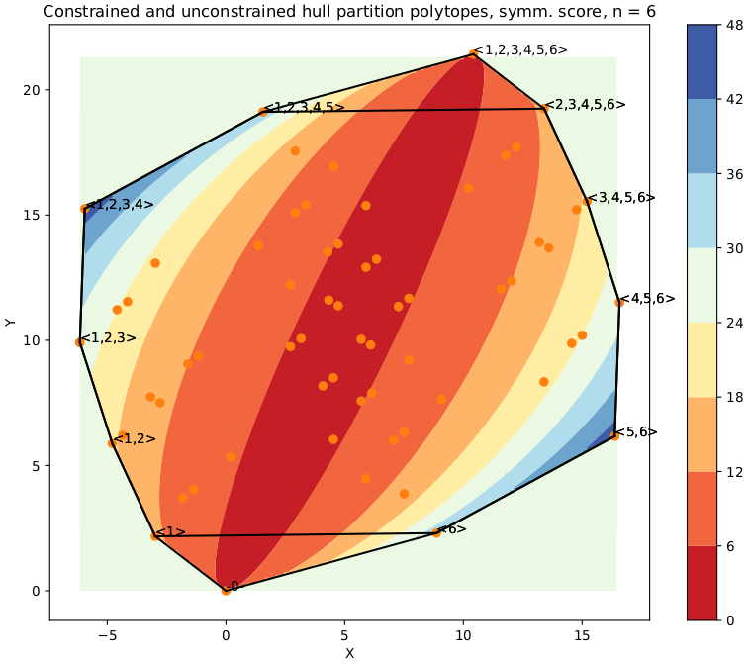
Solving for the Maximal Partition – Description of Partition Polytope

Slide 19
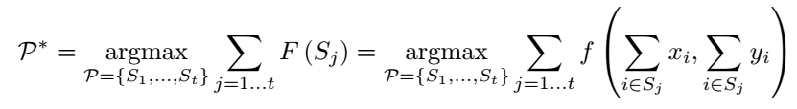
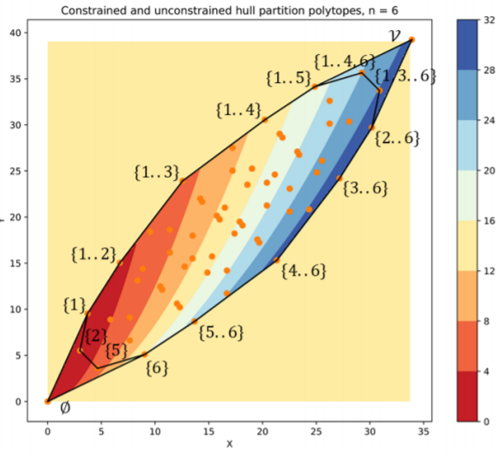
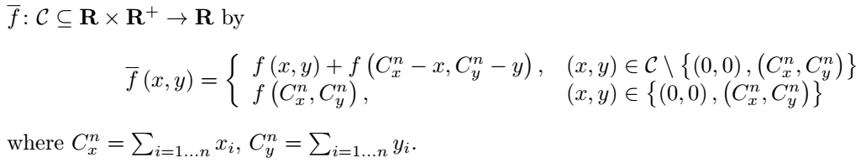
Solving for the Maximal Partition – Description of Partition Polytope

Slide 20
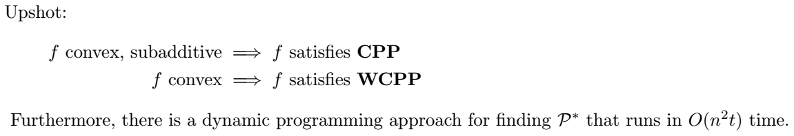
Solving for the Maximal Partition - Solution

Slide 21
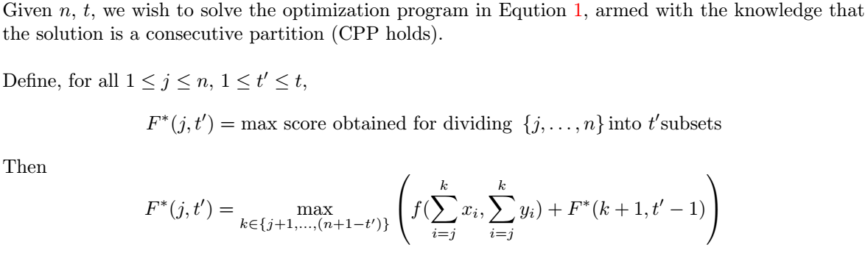
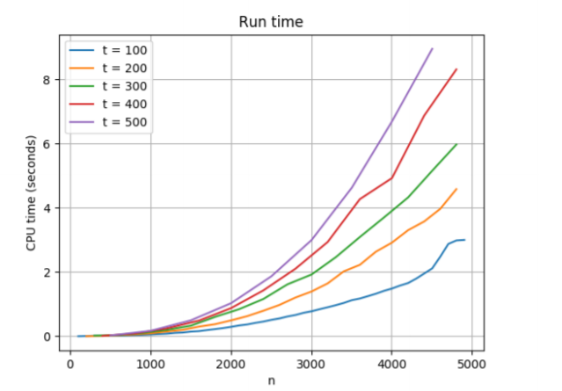
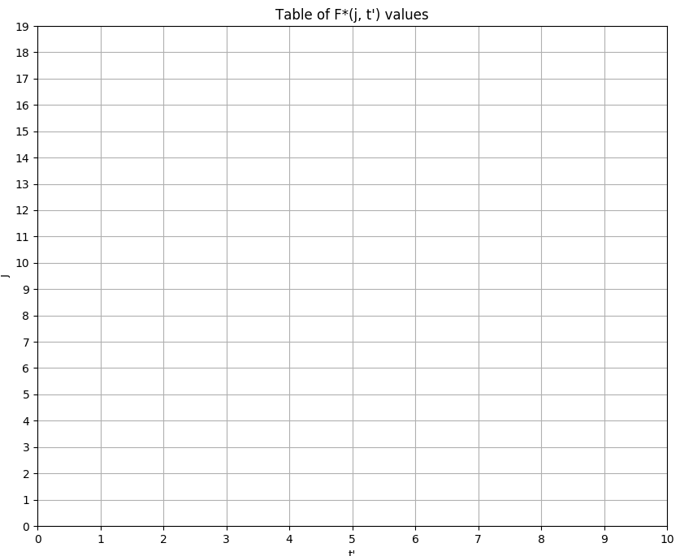

Solving for the Maximal Partition – Dynamic Programming Solution

Slide 22
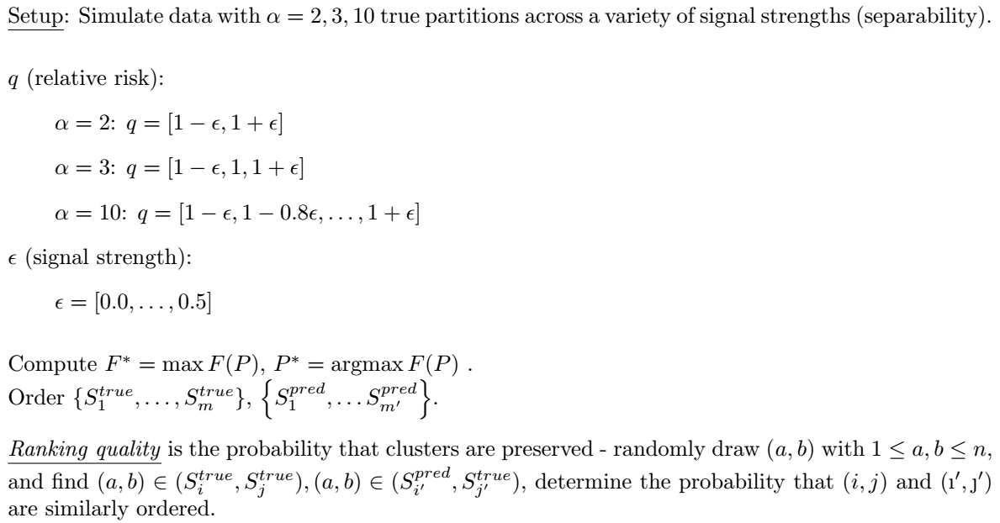
Simulation Results – Risk Partitioning

Slide 23

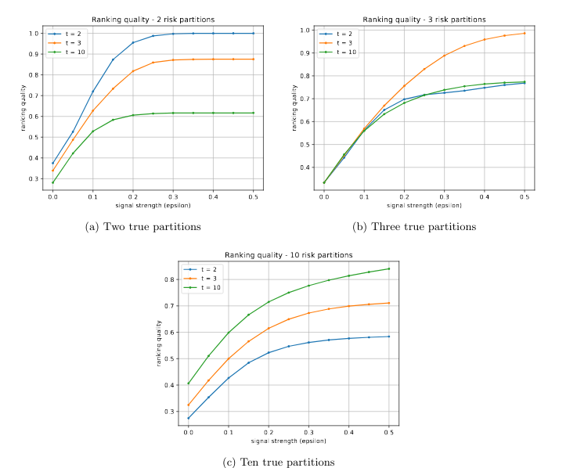
Simulation Results – Risk Partitioning

Slide 24
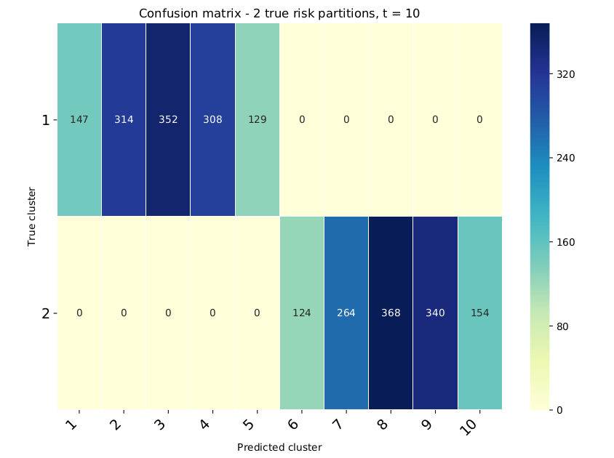
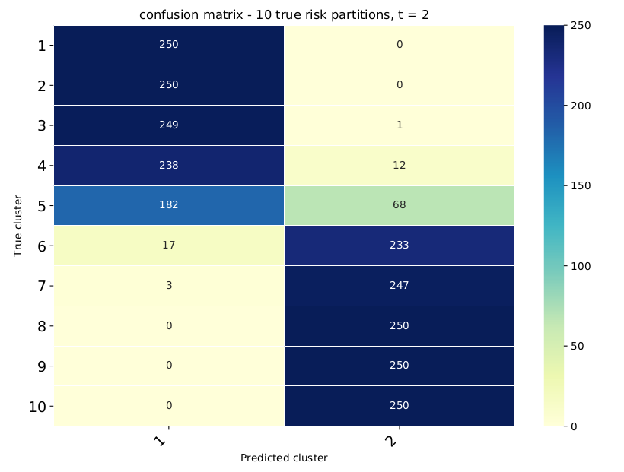
Simulation Results – Risk Partitioning

Slide 25
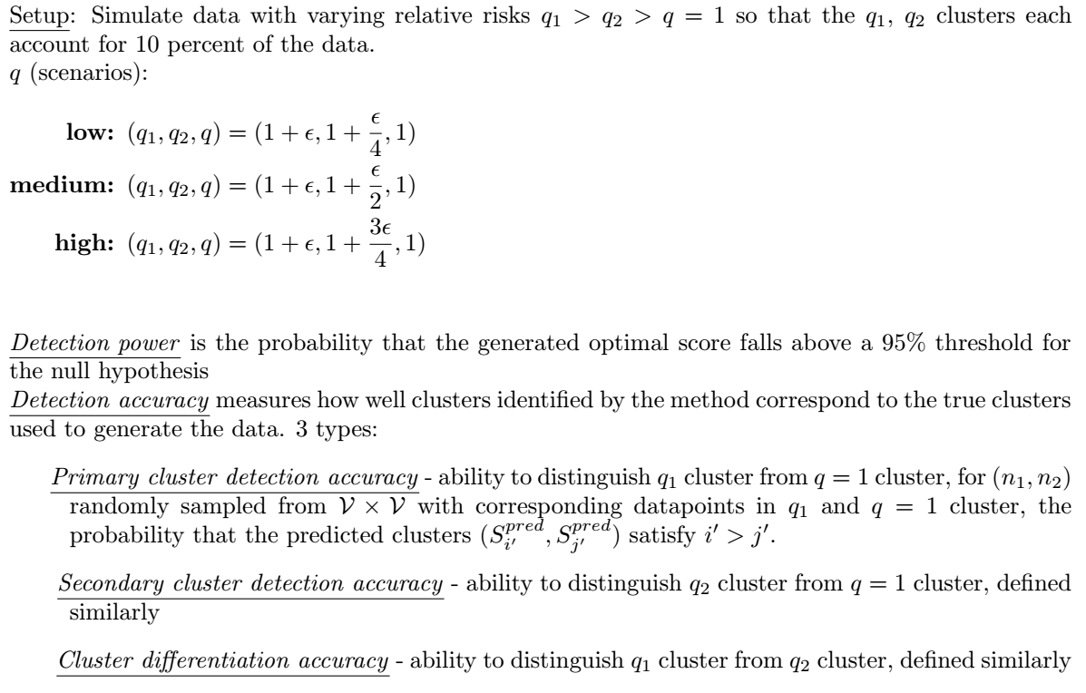
Simulation Results – Multiple Clustering

Slide 26
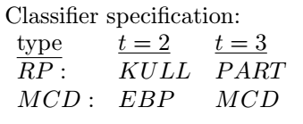
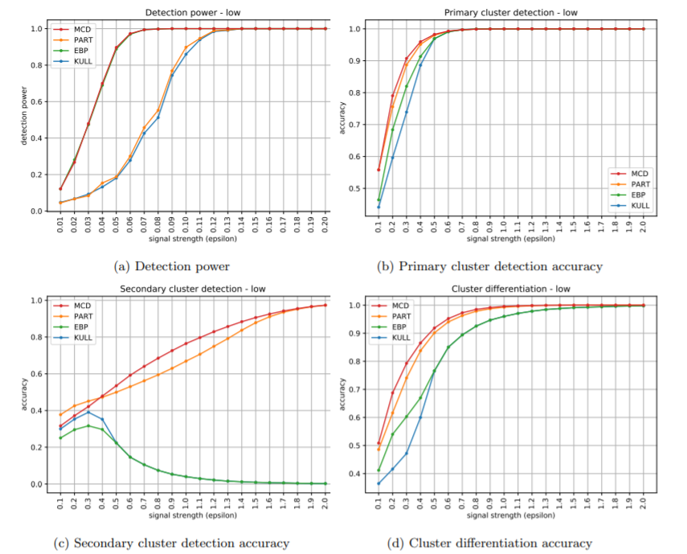
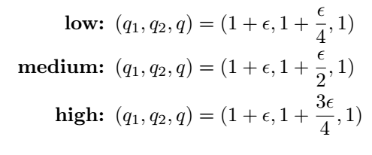
Simulation Results – Multiple Clustering
Low Scenario

Slide 27
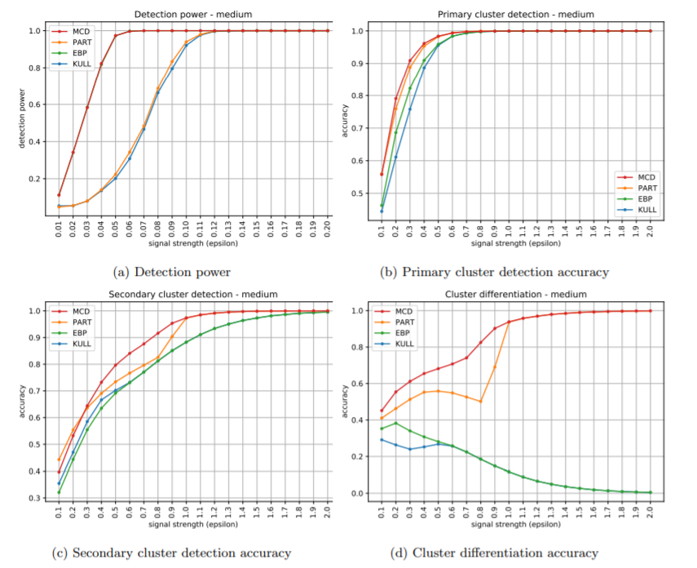
Simulation Results – Multiple Clustering
Medium Scenario

Slide 28
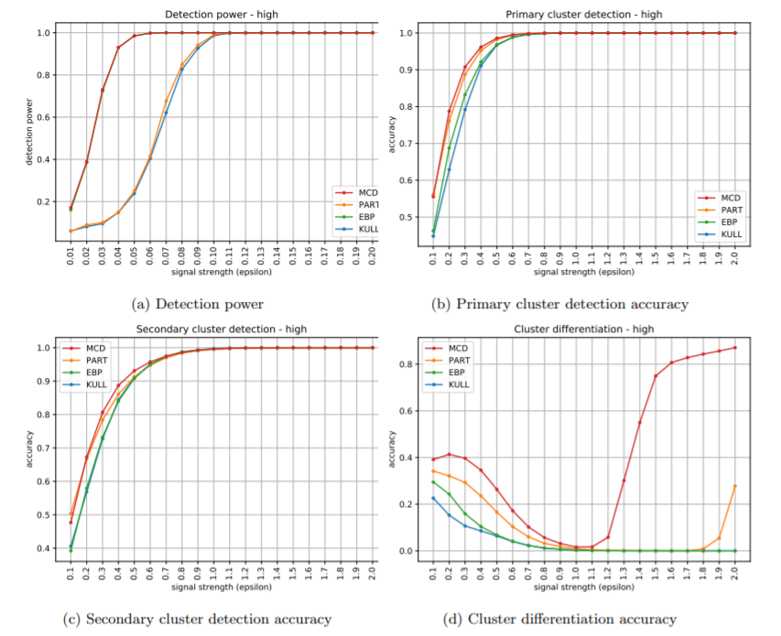
Simulation Results – Multiple Clustering
High Scenario

Slide 29
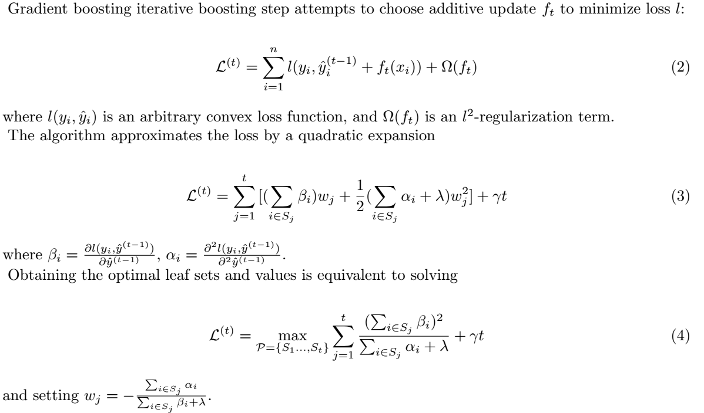
Future Directions?
Gradient Boosting

Slide 30
Future Directions?

Slide 31
Future Directions?
Multidimensional approaches?
Incorporating spatial constraints into the partition scan
Equivalence results; interplay between f, F.

Slide 32
References
Martin Kulldorff, A spatial scan statistic, Communications in Statistics: Theory and Methods, 26(6), 1997: 1481–1496.
Daniel B. Neill, Fast subset scan for spatial pattern detection, Journal. Royal Statist. Soc. B (2012) 74, Part 2, pp. 337–360.
Charles A. Pehlivanian, Daniel B. Neill, Efficient optimization of partition scan statistics via the consecutive partitions property, preprint, 2021.

