Slide 1
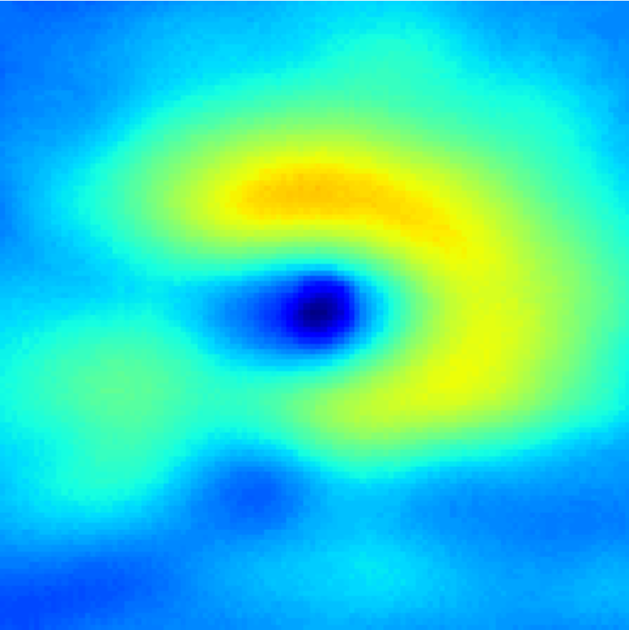
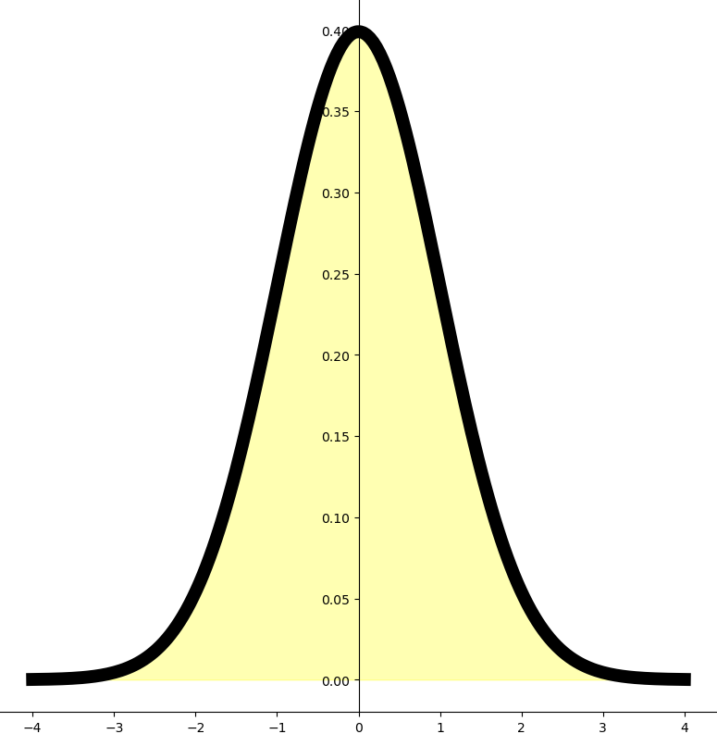
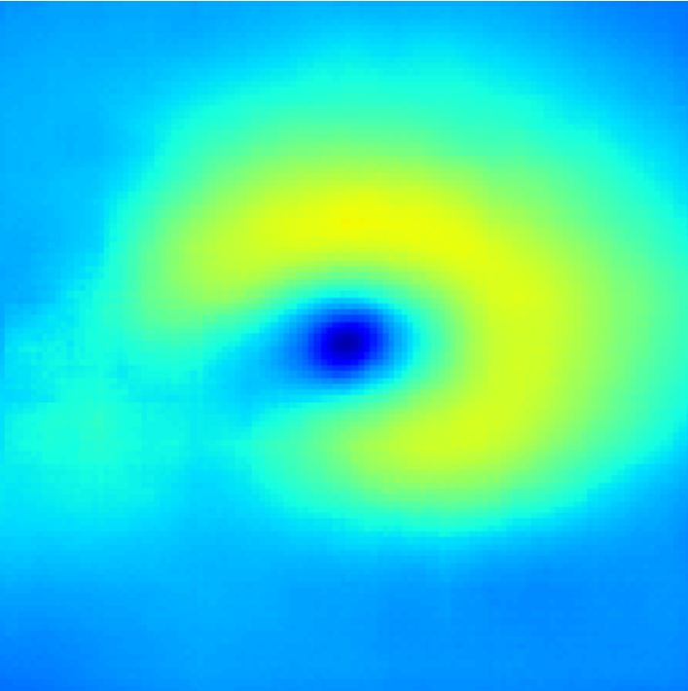
Encoder
Latent Space
Decoder
µ
Latent
Variables
(d1, d2)
7×7×1
7×7×512
σ
Standard Gaussian Distribution
7×7×1
7×7×512
14×14×256
14×14×256
28×28×128
28×28×128
Linear operator
Sampling units
56×56×64
56×56×64
112×112×1
Convolution operator + ReLU
(Kernel Size: 4, Stride: 2)
Transposed Convolution operator + ReLU
(Kernel Size: 4, Stride: 2)
112×112×1
Notes:
D:\DL\20_VAE_G_N_Modified_Loss\outputs\Glaucoma\PVIP2-4145\06-15-2011\OS\sn28405

